Slide 1
KEES Overview
KEES
Notes:
Welcome participants to the training session.
Cover any housekeeping items such as:
The location of restrooms and break rooms.
Ground rules for the training.
Instructor introductions.
Participant introductions.
Transition: Let’s talk about why we’re all here.

Slide 2
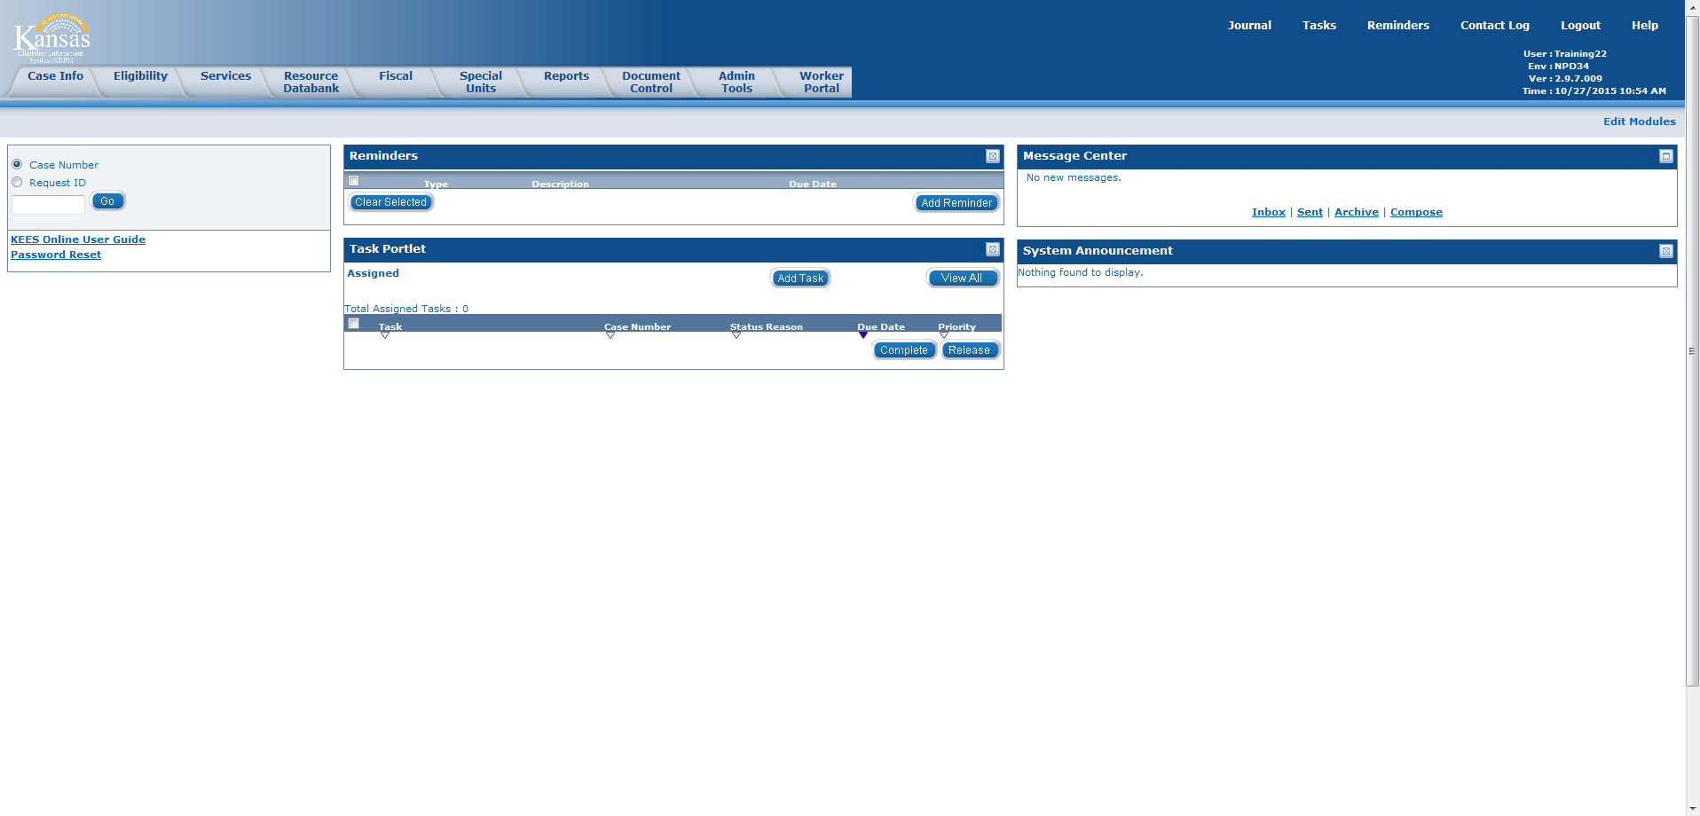
KEES Overview
KEES Homepage
This is the KEES Homepage.
After the user logs in, this is the page from which the user begins to work in KEES.

Slide 3
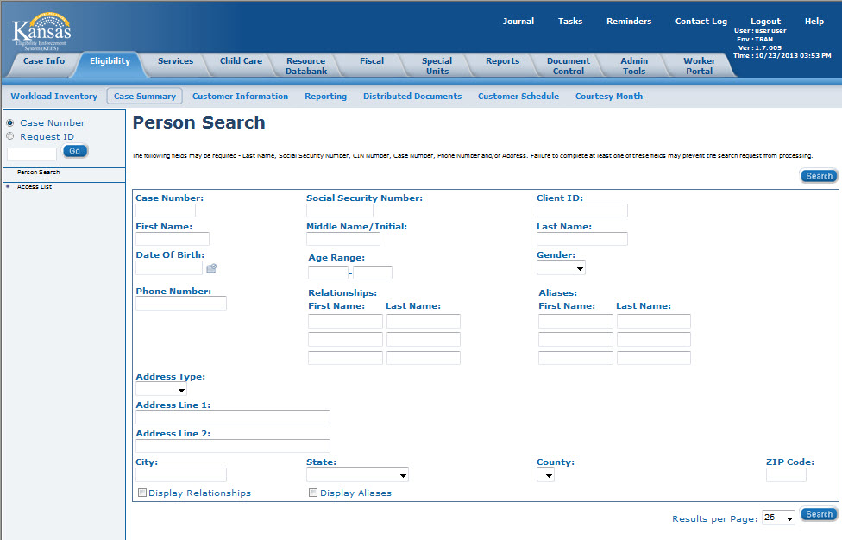
KEES Overview
KEES Overview > Global Navigation
Global Navigation
Notes:
Global, Local, Task Navigation—The Navigation Bars replace the CAMM, SUAM, and INME (all Menu) screens in KAECSES.

Slide 4
KEES Overview
KEES Overview > Local Navigation
Local Navigation
Notes:
Global, Local, Task Navigation—The Navigation Bars replace the CAMM, SUAM, and INME (all Menu) screens in KAECSES.

Slide 5
KEES Overview
KEES Overview > Task Navigation
Task Navigation
Notes:
Global, Local, Task Navigation—The Navigation Bars replace the CAMM, SUAM, and INME (all Menu) screens in KAECSES.
NOTE: Task Navigation values are dependent/dynamic based on the Global and Local Navigation selections made.

Slide 6
KEES Overview
Introduction
After completing this course, you will be able to complete the following actions in KEES:
Perform a Person Search
View Non-Financial pages
View Financial pages
Perform a Distributed Documents Search
Notes:
Slide Title: Introduction
Explain:
Instructor Note:
Transition: Let’s take a closer look at what we will be covering in this course.

Slide 7
KEES Overview
Agenda
Lesson 1: Performing a Person Search
Lesson 2: Viewing Non-Financial Data
Lesson 3: Viewing Financial Data
Lesson 4: Viewing Distributed Documents
Notes:
Slide Title: Agenda
Explain:
Instructor Note:
Transition:

Slide 8
KEES Overview
Lesson 1: Performing a Person Search > Introduction
Person Search is used to determine whether a person currently exists in KEES and whether they already have a case number.
Notes:
Slide Title: Lesson 1: Performing a Person Search > Introduction
Explain:
Instructor Note:
Transition: Let’s take a look at the Person Search page.

Slide 9
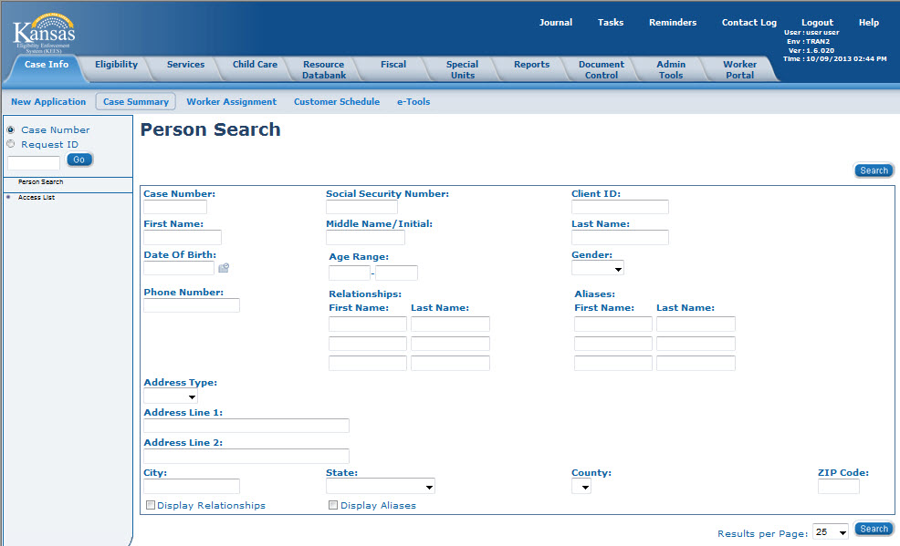
KEES Overview
Lesson 1: Performing a Person Search > Person Search
The Person Search page is similar to completing a CLIN search in KAECSES.
The Person Search page is located on the Task Navigation portion of the page.
The user is able to search by Name, SSN, and DOB.
Notes:
Slide Title: Lesson 1: Performing a Person Search > Person Search
Explain: Any number of things on the screen can be searched.
Instructor Note: CLIN stands for “Client Inquiry”; KAECSES stands for “Kansas Automated Eligibility Child Support Enforcement System” and is the legacy system that KEES is replacing.
Transition: Let’s look at how the wild card search works.

Slide 10
KEES Overview
Lesson 1: Performing a Person Search > Wild Card
Wild card searches can be performed on both the First Name and Last Name of the consumer.
This means that the user can enter only partial first and last names followed by an asterisk (*) to get a larger return on their search.
For example, if the user was looking for James Robertson, they could enter Jam* Robe*. This would return any persons in KEES whose first three letters of their first name were ‘Jam’ and the first four letters of their last name were ‘Robe’.
NOTE: For Phase 3 the asterisk is not required to do a wild card search. KEES will automatically do a wild card search regardless of how much information is entered. For Phase 3 the user should enter as much information as known when conducting the Person Search.
Notes:
Slide Title: Lesson 1: Performing a Person Search > Wild card
Explain:
Instructor Note:
Transition: In addition to the wild card search, KEES has some other behind-the-scenes logic that it applies when searching for someone.

Slide 11
KEES Overview
Lesson 1: Performing a Person Search > Comprehensive
Beginning Phase 3 a user is able to complete a comprehensive person search. This is recommended. The more information KEES has to use in the person search, the more accurate the returned match will be.
This means that the user can enter the entire first and last name, SSN, and DOB for the consumer to get a match on as much information as possible.
For example, if the user was looking for James Robertson, they could enter James Robertson. SSN, and DOB. This would return any persons in KEES whose information matches with the information provided.
Notes:
Slide Title: Lesson 1: Performing a Person Search > Comprehensive (P3)
Explain:
Instructor Note:
Transition: KEES has some behind-the-scenes logic that it applies when searching for someone. This logic compares name, SSN, and DOB information.

Slide 12
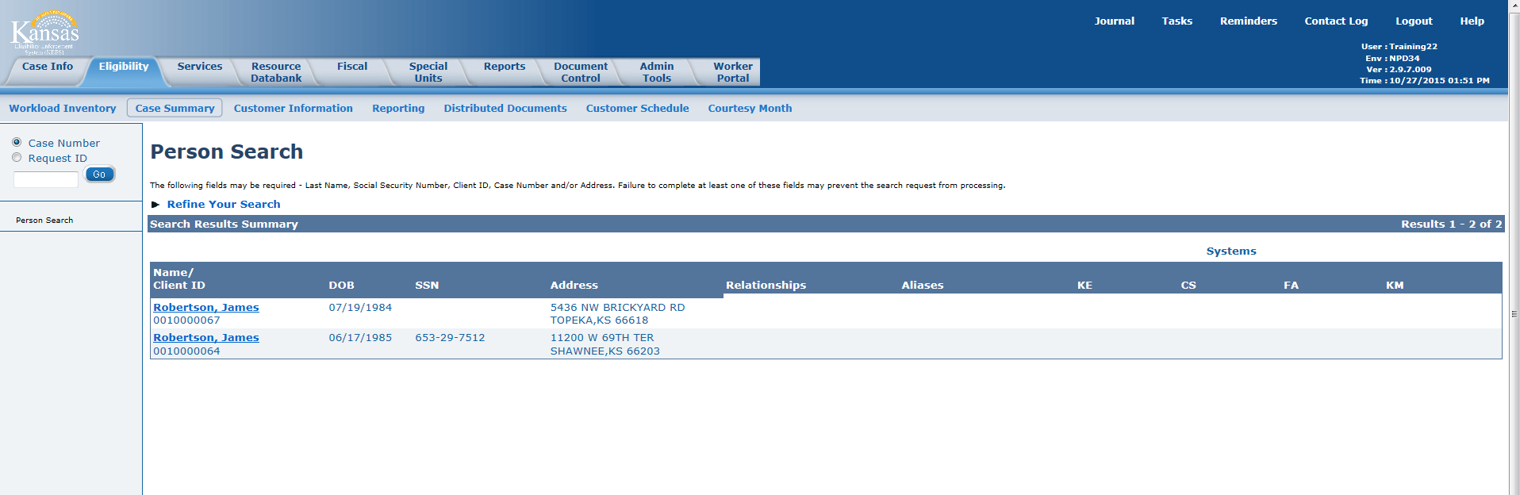
KEES Overview
Lesson 1: Performing a Person Search > Person Search Results
KEES performs a comprehensive search and returns any potential matches to the user for review. If a user is uncertain whether one of the potential matches returned is the correct person, clicking the person name hyperlink accesses additional case specific information which can be used to aid in the decision.
Notes:
Slide Title: Performing a Person Search > Person Search results
Explain: Notice one consumer returned has an SSN and the other does not. The SSN matches the one on the application, but we still need to take a closer look at the persons as we need to verify that this is not a duplicate of the same person.
Instructor Note: If too many consumer names are returned, the user can click on Refine Your Search to go back to the Person Search page (maintaining previously entered info) and add additional info.
Transition: Clicking on the Name link will take us to the Person View page.

Slide 13
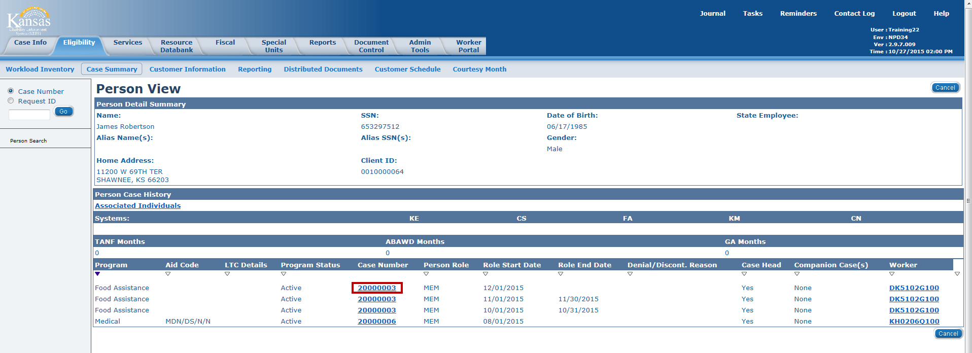
KEES Overview
Lesson 1: Performing a Person Search > Person Search results
Once the person name hyperlink is selected, the Person View page appears. The Person View displays a holistic view of the individual and case related details. All of the programs and case numbers the person has been associated with are listed.
Clicking the Case Number hyperlink takes the user to the Case Summary page.
Notes:
Slide Title: Lesson 1: Performing a Person Search > Person View
Explain: For now however, we just need to determine if this is the James Robertson we are looking for. You’ll notice the Case Number is a hyperlink. Any case numbers listed here will link the user to the Case Summary page for that particular case. The Case Summary page will provide the user with an overview of the case and all of the programs and persons associated with it.
Instructor Note: Under the section labeled “Systems” – [KE=known to KEES, CS=known to CSE, FA=known to FACTS, KM=known to KMIS].
Transition: Let’s take a look at the Case Summary page.

Slide 14
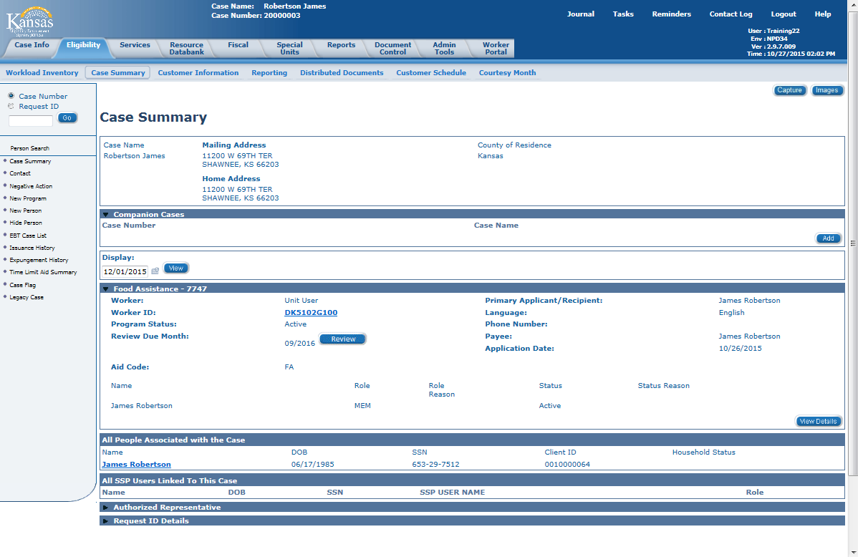
KEES Overview
Lesson 1: Performing a Person Search > Case Summary
Notes:
Slide Title: Lesson 1: Performing a Person Search > Case Summary
Explain: The Case Summary page is one of the most useful pages in KEES and is similar to CAP2 in KAECSES. At the bottom of the Case Summary, is a block called ‘All People Associated with the Case’. This is where all of the Case Persons are listed.
Instructor Note: CAP2 stands for “Case Profile – page 2”
Transition: What is a Case Person you say? Excellent question! A Case Person is someone associated to the case. A Program Person is in a Program Block and is either receiving benefits, or financially responsible for someone receiving benefits.

Slide 15
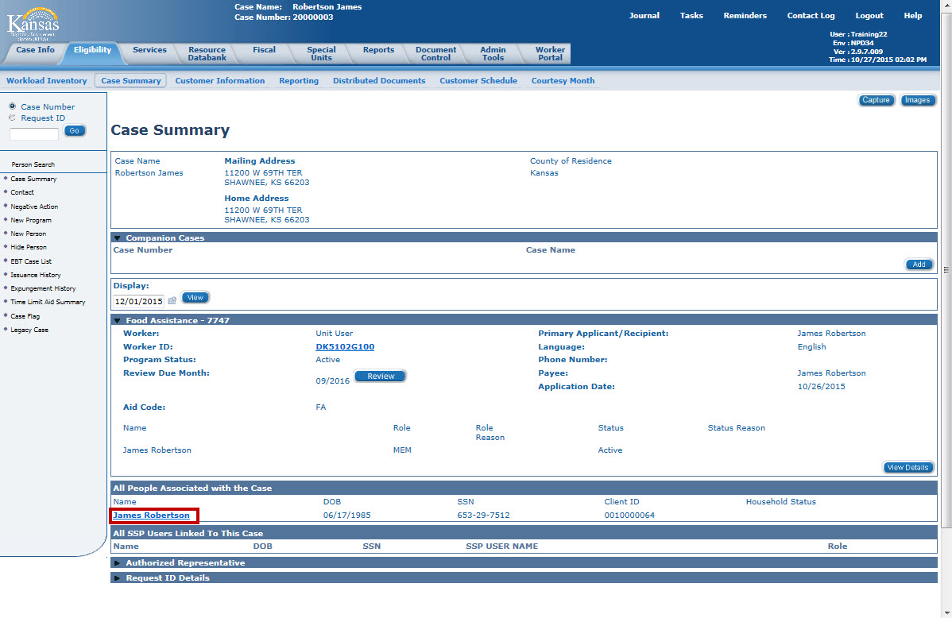
KEES Overview
Lesson 1: Performing a Person Search > Case Summary
Clicking on the person name hyperlink from the Case Summary page returns the user to the Person View page.
Notes:
Slide Title: Lesson 1: Performing a Person Search > Case Summary
Explain:
Instructor Note:
Transition: So let’s look at that Person View page again.

Slide 16

KEES Overview
Lesson 1: Performing a Person Search > Program Assignment
On the Person View page the user can determine which agency owns the case number. This is important since Medical and Non-Medical programs should not be on the same case number.
Under the Worker column, the first letter of the worker ID is a “D” for DCF or “K” for KDHE.

Slide 17

KEES Overview
Lesson 1: Performing a Person Search > Program History
The Person View page can also be used to determine the Benefit History.

Slide 18
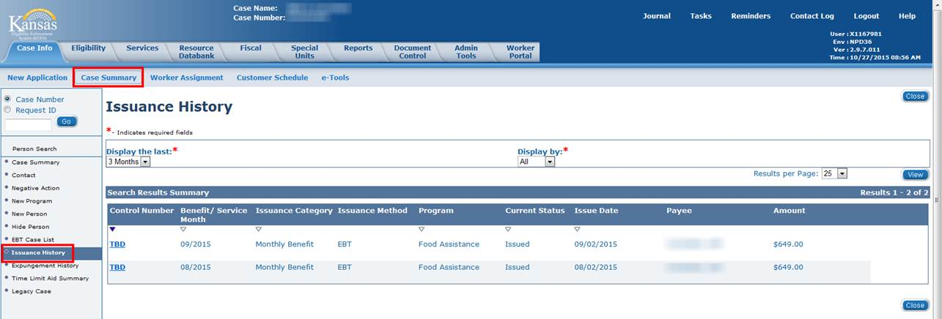
KEES Overview
Lesson 1: Performing a Person Search > Issuance History
To view the Issuance History the user must be in the context of a case.
Once in the context of a KEES case, the user can navigate from the Case Summary Local Navigation to the Issuance History tab in the Task Navigation.
The Case Summary page can be accessed from either the Case Info or Eligibility Global Navigation tab.

Slide 19
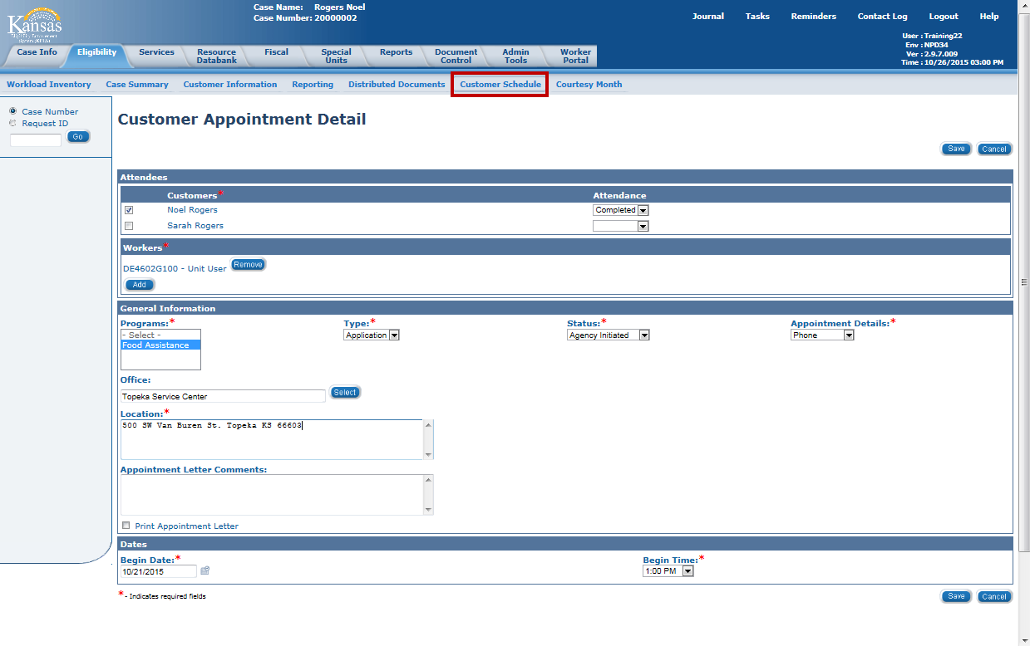
KEES Overview
Lesson 1: Customer Schedule > Recording an Interview
The Customer Schedule page is where the user records a scheduled and/or completed interview record.
This page can be accessed using the Local Navigation from the Case Info or the Eligibility tab in the Global Navigation bar.
Notes:
This page replaces INDA in KAECSES.

Slide 20
KEES Overview
Lesson 1: Performing a Person Search > Summary
The Person Search in KEES is similar to a Client Inquiry (CLIN) in KAECSES. A user can search using SSN, DOB, and First and Last Name.
The results show in a Search Results Summary similar to the Client Inquiry Short List (CLIS).
Next, let’s take a look at some KEES pages.
Notes:
Slide Title: Lesson 1: Performing a Person Search > Summary
Explain:
Instructor Note:
Transition:

Slide 21
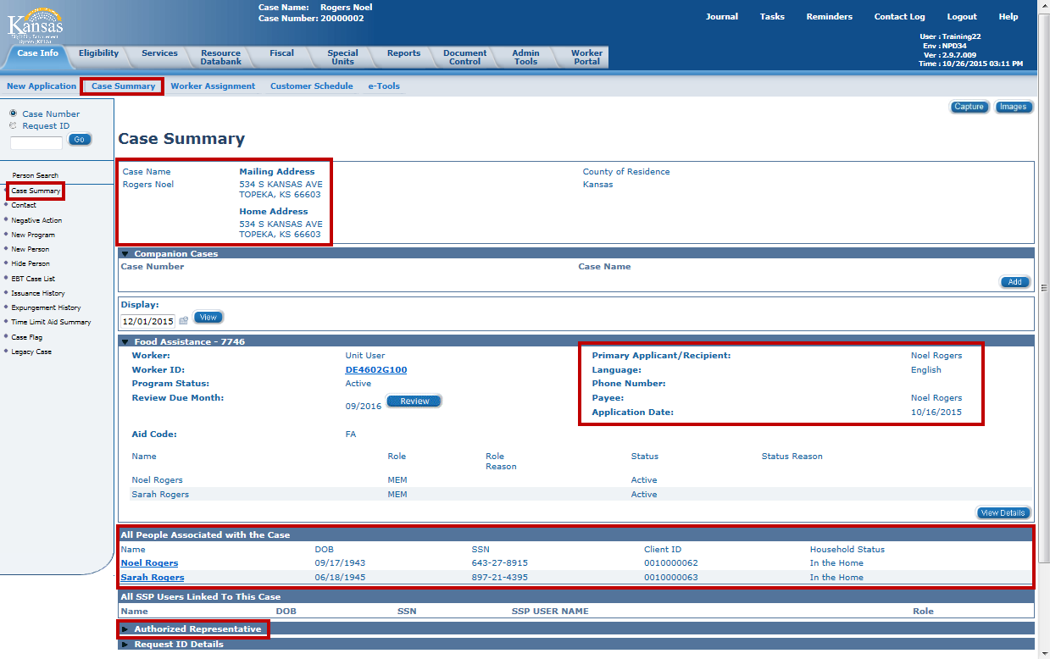
KEES Overview
Lesson 2: Non-Financial Data > Case Summary
Notes:
The Case Summary page replaces CAP1 and CAP2 in KAECSES.
The Case Summary shows:
Case Head/Primary Applicant
Consumer’s home and mailing addresses
Program block—which contains the details of the consumer’s eligibility and any Authorized Representatives.
All People Associated with the Case
A Case Person is a person who is part of the case, but may or may not have received benefits for themselves.
The Case Persons are the people you would have been used to seeing on CAP2 in KAECSES – this list includes everyone on the case (the people who would have been coded “IN”, “DI”, “OU”)
A difference between KEES and KAECSES is that Case Persons are NEVER removed from the case. They can have a Household Status of “Permanently Out of the Home” and can even be “hidden” so as not to appear on other pages throughout the system but they are never removed.

Slide 22
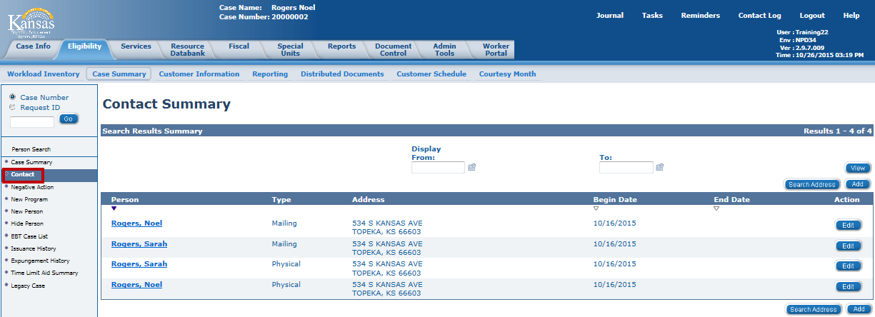
KEES Overview
Lesson 2: Non-Financial Data > Contact Summary
The Contact Summary displays the Mailing and Physical address for all Case Persons and the Begin Date for the addresses. This is similar to the ADDR screen in KAECSES.
The Contact Summary page can be accessed from both the Case Summary and the Customer Information in the Local Navigation bar.

Slide 23
KEES Overview
Lesson 2: Non-Financial Data > Individual Demographics
Individual Demographics information is collected on all members.
Information captured on this page includes:
Name
SSN
Marital Status
Gender
U.S. Citizenship (Non-Medical programs)
Date of Birth
Race/Ethnic Origin
Language (Spoken, Written, and Correspondence)
This page contains information similar to SSDO in KAECSES.
Notes:
Unit 19: KanCare Non-Financial Information/Summary
Questions?
Transition: Great job. This completes Lesson 2.

Slide 24
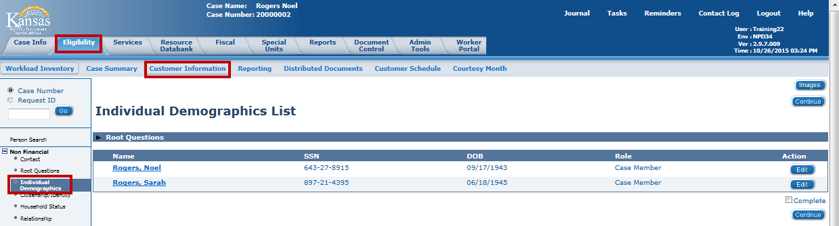
KEES Overview
Lesson 2: Non-Financial Data > Individual Demographics
An Individual Demographic record is automatically created for each member associated with the case during the registration process. Clicking on the Person Name hyperlink or the Edit button takes the user to the Individual Demographic Detail page.

Slide 25
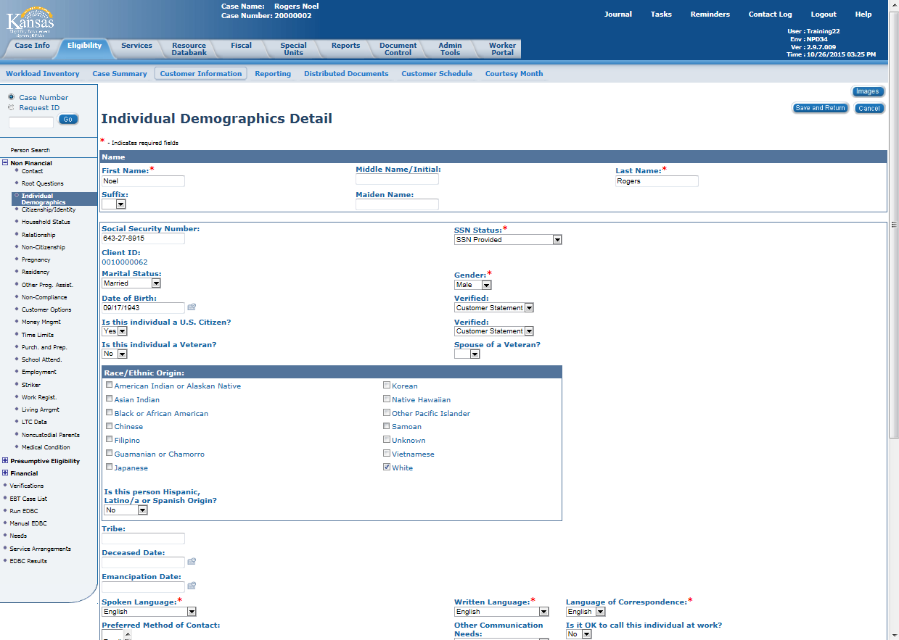
KEES Overview
Lesson 2: Non-Financial Data > Individual Demographics
The Individual Demographics Detail page has:
Consumer’s Name
SSN
Client ID #
Marital Status
Gender
Citizenship (for Non-Medical programs)
DOB
Race/Ethnic Origin
Decease Date
Language Preferences
Phone Numbers
Aliases
Last Grade Completed
Notes:
The Individual Demographics detail captures information formerly captured on SSDO, ETRC, MAST, and other screens in KAECSES.

Slide 26
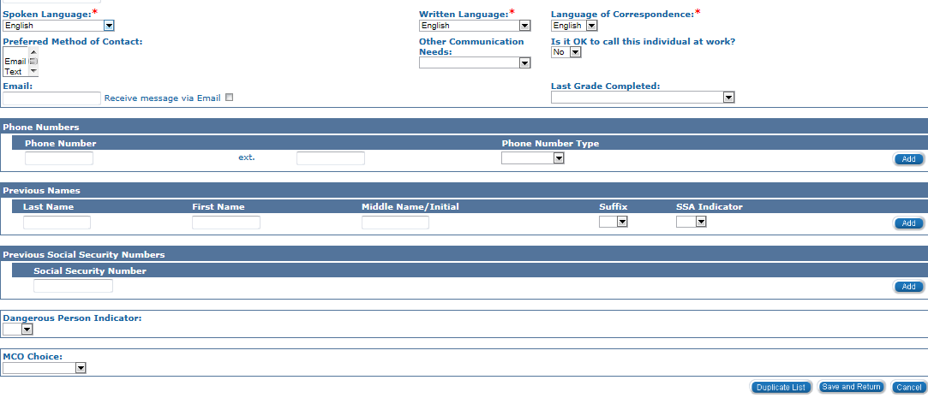
KEES Overview
Lesson 2: Non-Financial Data > Individual Demographics
Last Grade Completed for TANF is also captured on the Individual Demographics page. Phone Numbers and Aliases display at the bottom of the page.
Notes:
The Last Grade Completed used to be displayed on MAST in KAECSES.

Slide 27
KEES Overview
Lesson 2: Non-Financial Data > Household Status
Household Status information in KEES is used by the EDBC Rules to determine who lives in the home and who is permanently or temporarily out of the home. This is comparable to SEPA codes used in KAECSES, but with limited selections.
If no Household Status exists for a consumer, KEES rules assume the consumer is “In the Home”.
Once a Household Status is added for a person, the person will be required to have a household status record. Similar to case address records, household status records are continuous records. This means that, while the status may change, there must always be a status record in KEES.
Notes:
Household status information is used to determine who lives in the home and who is permanently or temporarily out of the home.
Every person associated with the case is required to have a household status. If no Household Status exists for a consumer, KEES rules assume the consumer is “In the Home”.
Similar to case address records, household status records are continuous. This means that, while the status may change, there must always be a status in KEES. Let’s define our statuses.

Slide 28
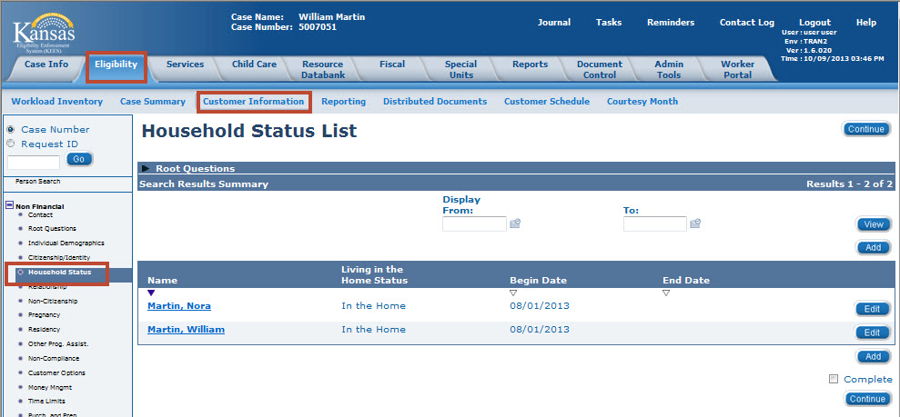
KEES Overview
Lesson 2: Non-Financial Data > Household Status
Notes:
The Household Status List page appears with four headers:
Name: Names will appear here as hyperlinks you can choose to use the hyperlink that will take you to the view mode or the Edit button at the end of each entry to add information.
Living in the Home Status: This field will show you which of the statuses the Consumer currently has in this case.
Begin Date: The Date in which the Living in the Home Status begun.
End Date: The Date in which the Living in the Home Status ended. No End Date means the consumer currently has that Household Status.
Edit button: This is used to correct any incorrect information that has been previously entered.
Add Button: This is used to Add any new information to the Case.
NOTE: If you are updating information use the Add Button as this will save all previously entered information as history.
It is important to remember that when the Edit Button is used, the existing information is overwritten. This changes the information and does not retain the existing values. This prevents the user from being able to view historical records.

Slide 29
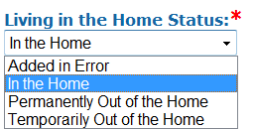
KEES Overview
Lesson 2: Non-Financial Data > Household Status
Status choices are:
In the Home – A person who lives in the home and may or may not be receiving assistance.
Permanently Out of the Home – A person who was previously in the home but is no longer living there.
Temporarily Out of the Home – A person who is not living in the home at this time, but is expected to return. This could be a person who is placed in the hospital due to an accident or illness or a child that is placed in foster care.
Added in Error – This status is used when the wrong person is added to a case. Since consumers cannot be removed from a case, this person is given the Household Status of Added in Error.
Notes:
Options to choose from in the Living in the Home Status drop-down box
Added in error?

Slide 30
KEES Overview
Lesson 2: Non-Financial Data > Household Status
Household status is used to determine who lives in the home and who is permanently or temporarily out of the home.
If no Household Status exists, KEES assumes the person is “In the Home”.

Slide 31
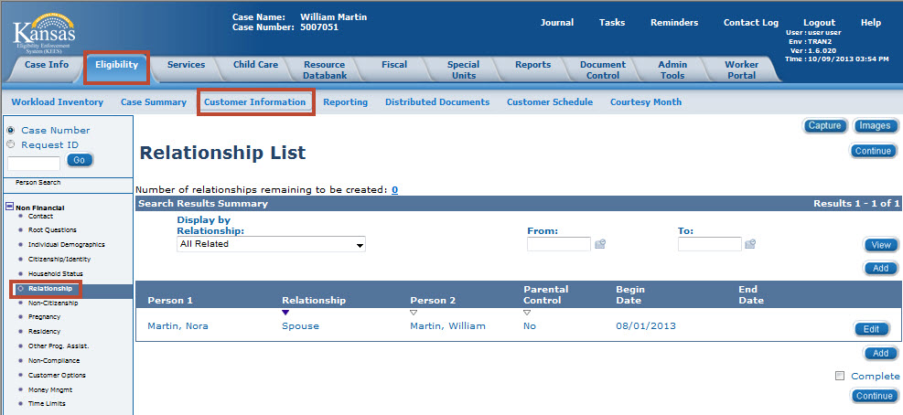
KEES Overview
Lesson 2: Non-Financial Data > Relationship
Relationships are established between two persons in the household.
Relationship information must exist for all persons associated to the case regardless if the person is requesting or receiving assistance.
Notes:
This page is similar to LERP in KAECSES.

Slide 32
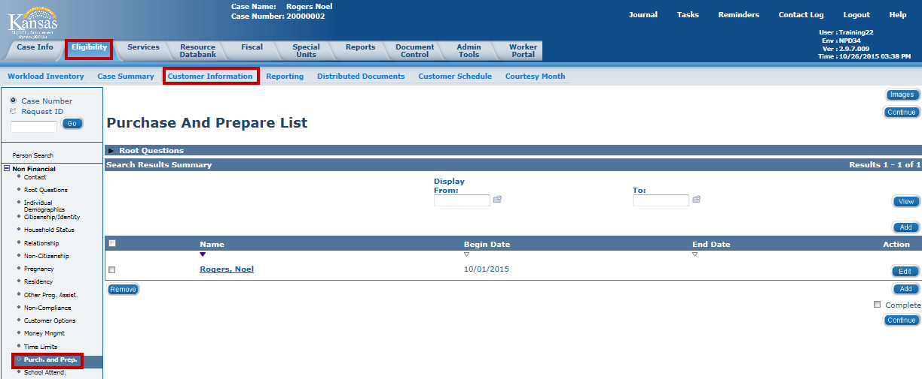
KEES Overview
Lesson 4: Non-Financial Data > Purchase and Prepare
A purchase and prepare record is required for the Primary Applicant and any individuals that purchase and prepare with the Primary Applicant that are not already required to be part of the FA household. This includes unrelated individuals and adult siblings or children that are not required to be part of an FA household unless the individuals purchase and prepare meals together.
Notes:
A purchase and prepare record is required for the Primary Applicant and any individuals that purchase and prepare with the Primary Applicant that are not already required to be part of the FA household. This includes Unrelated individuals and adult siblings or children that are not required to be part of an FA household unless the purchase and prepare meals together.

Slide 33
KEES Overview
Lesson 2: Non-Financial Data > Summary
Case Summary: This page displays Case Name, Address, Responsible Persons, and All People Associated with the Case.
Contact Summary: This page displays the address for all persons associated to the case.
Individual Demographics: This page is used to view the demographic information, such as DOB, SSN, and Marital Status.
Household Status: The user can view the household status for all persons on the case.
Relationship: The user can view the relationships of all persons in the home. All Case Persons need to have relationship whether or not they receive benefits.
Purchase and Prepare: The information on this page relates individuals that purchase and prepare meals together for the FA program.

Slide 34
KEES Overview
Lesson 3: Financial Pages > Introduction
The Financial Data collection pages are designed to capture specific information such as income sources, resources, Medicare, other health insurance information and expenses.
This lesson will cover:
  Viewing Income Information
  Viewing Resource Information
  Viewing Expense Information
Notes:
Medical Eligibility: Data Gathering-Financial Pages
Explain:
This unit will provide you with an overview of the Financial pages in KEES.
Transition: Let’s look at the overall process.

Slide 35
KEES Overview
Lesson 3: Financial Pages > Income
The Income pages capture the following information which is used for determining eligibility and benefits:
Earned Income amounts
Unearned Income amounts
Self-Employment Income amounts
Notes:
The income page captures all income—this includes earned income, like wages, unearned income, such as Social Security or Unemployment benefits, and self employment. On KAECSES these incomes were captured on multiple screens. KEES will house all the income information in one place.

Slide 36
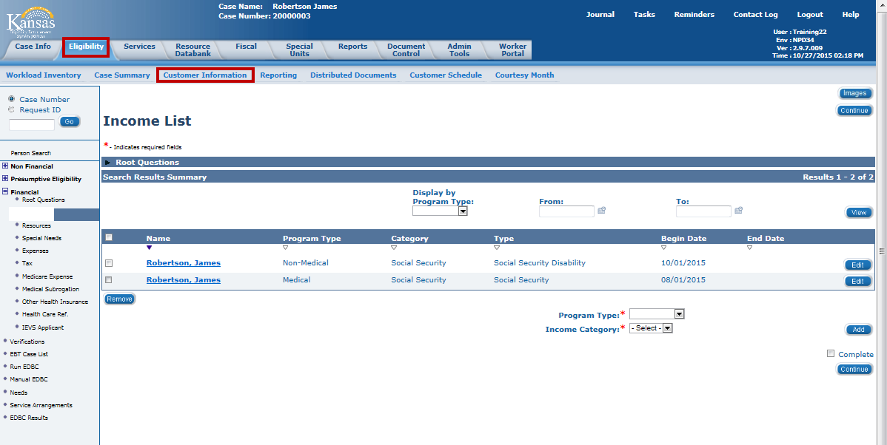
KEES Overview
Lesson 3: Financial Pages > Income List Page
Once Income is selected on the Task Navigation, the Income List page appears.
Notes:
Again, remember Income information is stored at a consumer level, not a case level. This means if a consumer is on multiple cases, changing income on one will update the information for other cases (based on Program Type).
The Income List page shows summary information and has Add and Edit buttons to access the detail pages
Information is entered per program type (Medical or Non-Medical)
Income Types are added on the Income Detail after selecting a Program Type and an Income Category
To add a new income, on the Income List page select the Program Type from the Program Type drop-down menu. The options are Medical and Non-Medical (beginning Phase 3). Some Income Category Values are different for Medical and Non-Medical Program Types.
After Medical has been selected for the Program Type, select the Income Category from the drop-down menu.

Slide 37
KEES Overview
Lesson 3: Financial Pages > Resource List Page
The Resource List page allows the worker to view the type of resources each consumer owns. The types of resources are captured on the detail pages:
  Liquid Resources Detail – includes: checking, savings, stocks, etc.
  Motor Vehicle Detail – includes: cars, motorcycles, RVs, etc.
  Real Property Detail – includes: houses, land, buildings, etc.
Notes:
The Resource List page allows the worker to view the type of resources each consumer owns. The types of resources are captured on the detail pages:
Liquid Resources Detail
Motor Vehicle Detail
Real Property Detail
Transferred Property is calculated off system and recorded as a Non-Compliance record.

Slide 38
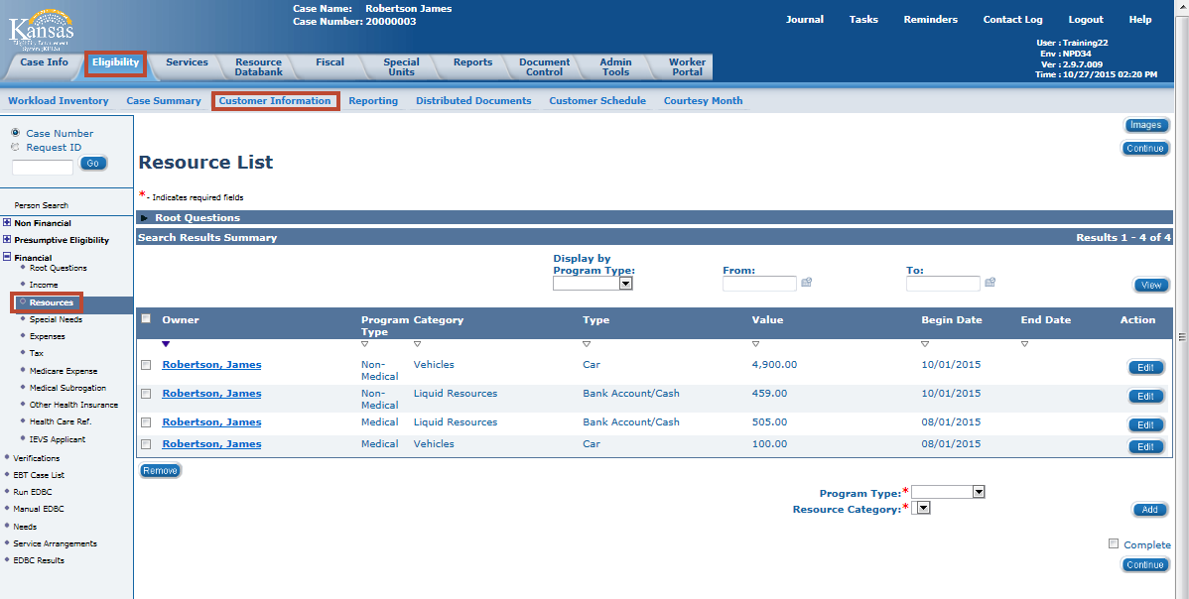
KEES Overview
Lesson 3: Financial Pages > Resource List Page
The Resource List displays resource records and allows selective viewing and addition of resources by Program Type (Medical and Non-Medical).
Notes:
The Resource List Page shows:
Owner: the owner of the resource
Program Type: Medical or Non-Medical
Category: Liquid, Motor Vehicle, or Real Property
Type: Type of Liquid or Real Property
Begin Date: The first day of the first month medical assistance is requested; this can be the first day of the application month or a prior medical month.
End Date: The date the consumer no longer owned the resource
This page has the ability to sort resources by Program Type (Medical or Non-Medical) and display by date.

Slide 39
KEES Overview
Lesson 3: Financial Pages > Resource List Page
Clicking the Person Name hyperlink on the Resource List page allows the user to view the Resource Detail information.
Notes:
The Resource List Page shows:
Owner: the owner of the resource
Program Type: Medical or Non-Medical
Category: Liquid, Motor Vehicle, or Real Property
Type: Type of Liquid or Real Property
Begin Date: The first day of the first month medical assistance is requested; this can be the first day of the application month or a prior medical month.
End Date: The date the consumer no longer owned the resource
This page has the ability to sort resources by Program Type (Medical or Non-Medical) and display by date.

Slide 40
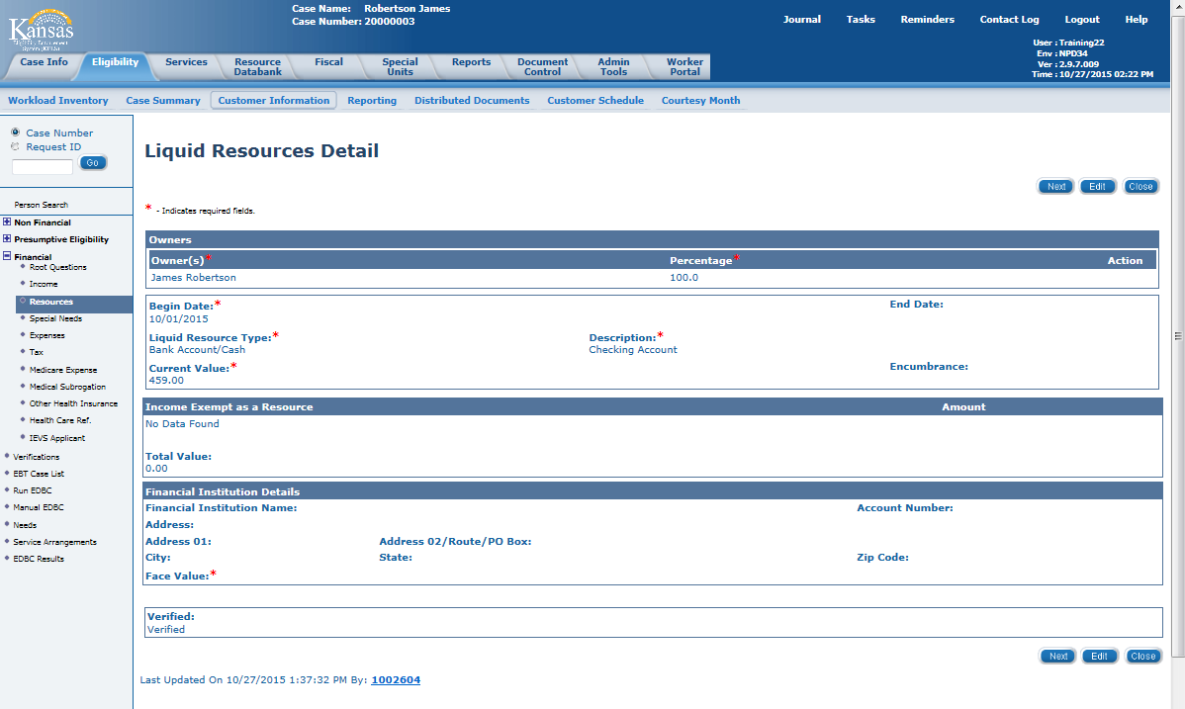
KEES Overview
Lesson 3: Financial Pages > Liquid Resources Detail Page
Clicking the James’ name for the Bank Account/Cash record on the Resource List page allows the user to view the Liquid Resource information.
Notes:
On the Liquid Resource Detail page:
Select the Owner of the resource from the Owner drop-down menu. This menu is populated by the members on the case.
The Percentage of ownership is 100% for most resources.
The Begin Date should be the first day of the first month eligibility determination is requested for the application.
The Liquid Resource Type varies and will change the Description.
The Description field determines if the liquid resource is countable or exempt.
The Current Value is the amount the user wants counted in the eligibility determination.
The Verification field determines if the resource has been verified.

Slide 41
KEES Overview
Lesson 3: Financial Pages > Resource List Page
Clicking the James’ name next to the Vehicle allows the user to view the Motor Vehicle Detail information.
Notes:
The Resource List Page shows:
Owner: the owner of the resource
Program Type: Medical or Non-Medical
Category: Liquid, Motor Vehicle, or Real Property
Type: Type of Liquid or Real Property
Begin Date: The first day of the first month medical assistance is requested; this can be the first day of the application month or a prior medical month.
End Date: The date the consumer no longer owned the resource
This page has the ability to sort resources by Program Type (Medical or Non-Medical) and display by date.

Slide 42
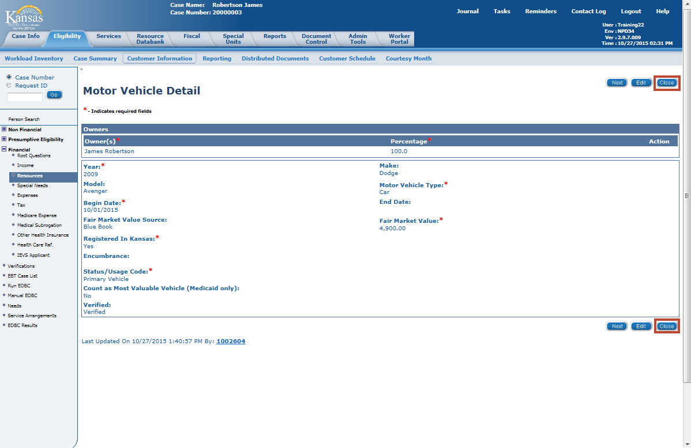
KEES Overview
Lesson 3: Financial Pages > Motor Vehicle Detail
Click the Close button to return to the Resource List page.
Notes:
On the Motor Vehicle Detail page:
Select the Owner of the vehicle from the Owner drop-down menu. This menu is populated by the members on the case.
The Percentage of ownership is 100% for most resources.
Enter the detail information regarding the Year, Make, Model, and Motor Vehicle Type.
The Begin Date should be the first day of the first month eligibility determination is requested for the application.
Select the Fair Market Value Source (optional):
Blue Book
County Appraisal
Dealer Estimates
Other
Private Appraisal

Slide 43
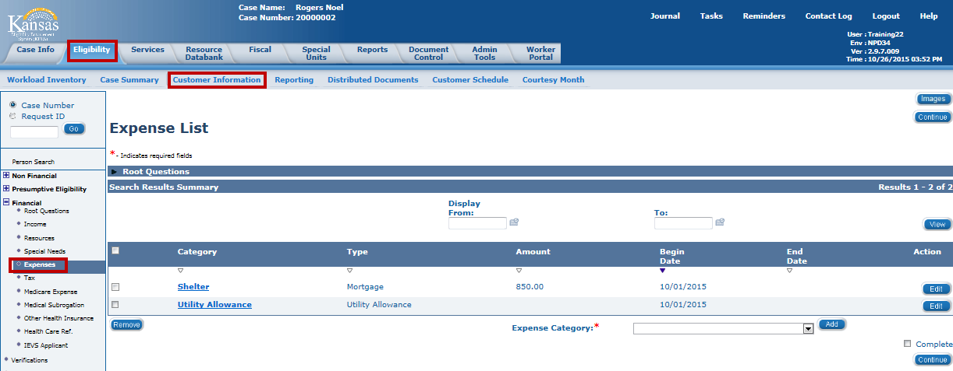
KEES Overview
Lesson 3: Financial Pages > Expenses
The Expense List page lists the expenses associated to case members.
Notes:
The Expense List page lists the expenses associated to case members.
The fields on this page include:
Category: the category of expense
Type: the type of expense within the category
Amount: the amount of the expense
Begin Date: the first day of the first month for which eligibility is being processed
End Date: the date the consumer no longer has the expense

Slide 44
KEES Overview
Lesson 3: Financial Pages > Expenses
Clicking the Expense hyperlink takes the user to the Expense Detail page to view additional information.
Notes:
The Expense List page lists the expenses associated to case members.
The fields on this page include:
Category: the category of expense
Type: the type of expense within the category
Amount: the amount of the expense
Begin Date: the first day of the first month for which eligibility is being processed
End Date: the date the consumer no longer has the expense

Slide 45
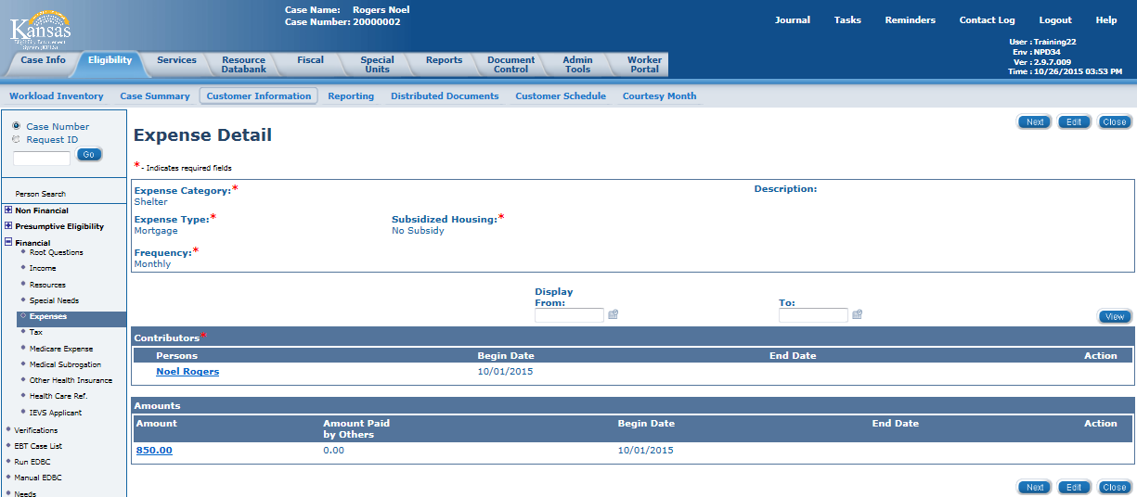
KEES Overview
Lesson 3: Financial Pages > Expenses
Clicking the Expense hyperlink takes the user to the Expense Detail page to view additional information.
Notes:
The Expense List page lists the expenses associated to case members.
The fields on this page include:
Category: the category of expense
Type: the type of expense within the category
Amount: the amount of the expense
Begin Date: the first day of the first month for which eligibility is being processed
End Date: the date the consumer no longer has the expense

Slide 46
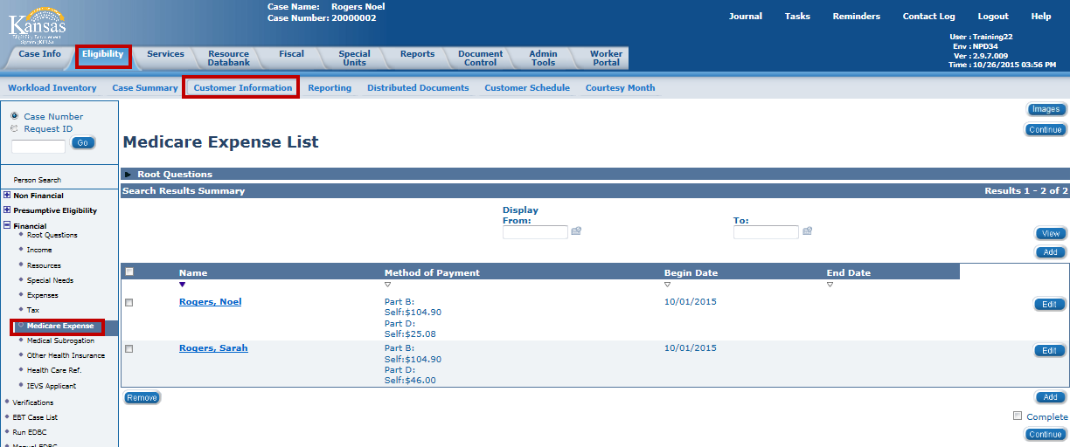
KEES Overview
Lesson 3: Financial Pages > Medicare Expenses
Clicking the Medicare Expense hyperlink takes the user to the Medicare Expense Detail page to view additional information.
Notes:
The Medicare Expense List page lists the Medicare Expenses associated to case members.
The fields on this page include:
Payment Type: This can be Self, State (if the person is on Buy-In or Medicare Savings Program), or Other Entity if another entity is paying the Medicare Premium.
Payment Amount: the amount of the expense
Begin Date: the first day of the first month for which the Medicare expenses should be counted.
End Date: the date the consumer no longer has the Medicare expense

Slide 47
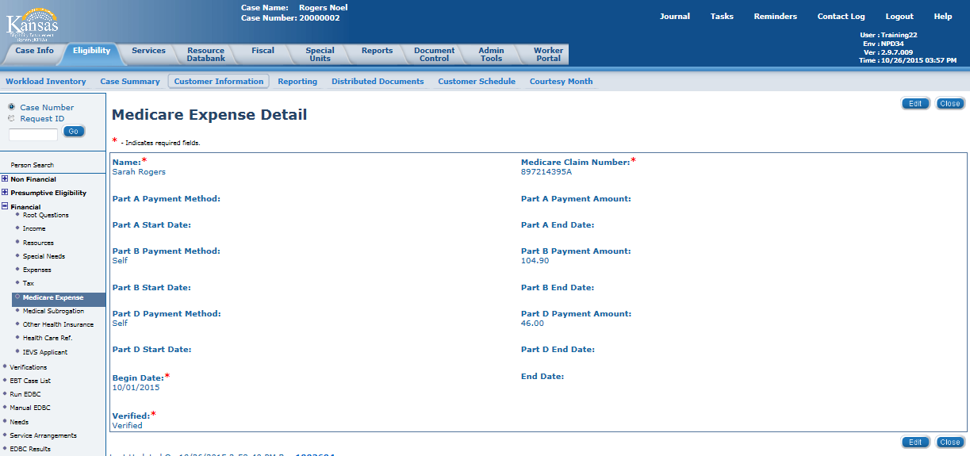
KEES Overview
Lesson 3: Financial Pages > Medicare Expenses
Clicking the Medicare Expense hyperlink takes the user to the Medicare Expense Detail page to view additional information.
Notes:
The Medicare Expense Detail page lists the Medicare expenses associated to case members.
The fields on this page include:
Payment Type: This can be Self, State (if the person is on Buy-In or Medicare Savings Program), or Other Entity if another entity is paying the Medicare Premium.
Payment Amount: the amount of the expense
Begin Date: the first day of the first month for which the Medicare expenses should be counted.
End Date: the date the consumer no longer has the Medicare expense

Slide 48
KEES Overview
Lesson 3: Financial Pages > Summary
Income: This page displays the income for all case persons.
Resources: This page displays the resources for all persons associated to the case.
Expenses: This page is used to view the expense information for the individuals on the case.
Medicare Expense: The user can view Medicare Expenses for persons on the case.
Next we’ll talk about viewing Distributed Documents (or Notices).
Notes:
Financial Pages Summary

Slide 49
KEES Overview
Lesson 4: Viewing Distributed Documents > Introduction
Viewing Forms and NOAs
KEES contains a record of all NOAs and Forms that have been generated within the context of a case
History is in the Distributed Documents page under the Eligibility Global Tab
Note: Blank Template Forms without case or office information and printed locally are not kept on record. When a Form is generated outside the context of a case, it has no specific consumer or case to be associated with in KEES.
Notes:
Viewing Forms and NOAS
KEES contains a record of all NOAs (notices) as well as Forms that have been generated within the context of a case. The record is in the Distributed Documents page that we have been looking at in other examples.
Note: Blank Template Forms without case or office information that are printed locally as mentioned earlier, are not kept on record. That’s because when a Form is generated outside the context of a case, it has no specific consumer or case to be associated with in KEES.

Slide 50
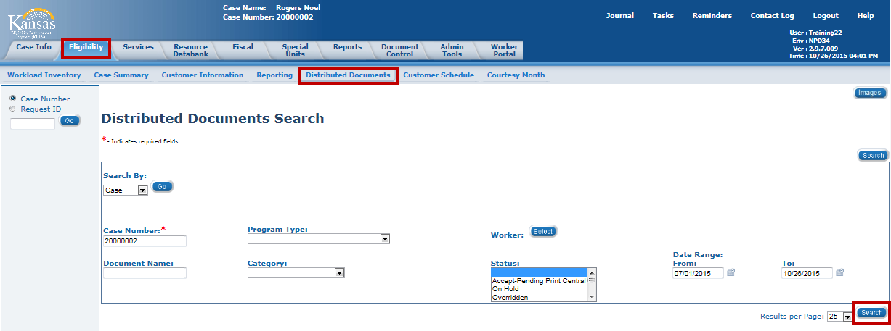
KEES Overview
Lesson 4: Viewing Distributed Documents > Process Steps
Once in the context of a case, click the Eligibility Global Tab, then the Distributed Documents Local tab. The Search By: field defaults to Case and the Case Number is already populated. Click the Search button to view the notice history.
To restrict the amount of information returned in the search, the user can select a date range.
Notes:
Process Steps
To access the history:
Click on the Distributed Documents Local Navigation tab. The Distributed Document Search page appears.
The Case Number populates if the user is in the context of a case, otherwise it must be entered.
There are several ways to search for past documents.
The search can be narrowed down to a specific document Name or Type, Status, or even Program Type or Category.
Date range of the Form or NOA being sought can be further refined.
The number of results per page can also be specified.

Slide 51
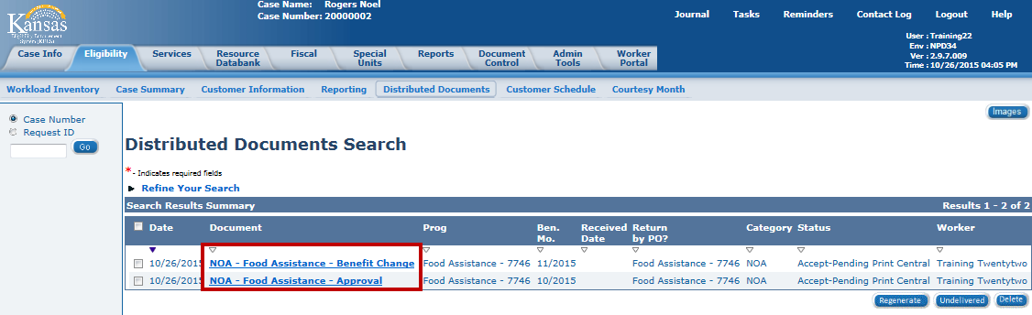
KEES Overview
Lesson 4: Viewing Distributed Documents > Process Steps
The Distributed Documents Search results replaces the NOHS screen in KAECSES.
To view the notice, click the Document name hyperlink.
Notes:
This page contains the notice history.

Slide 52
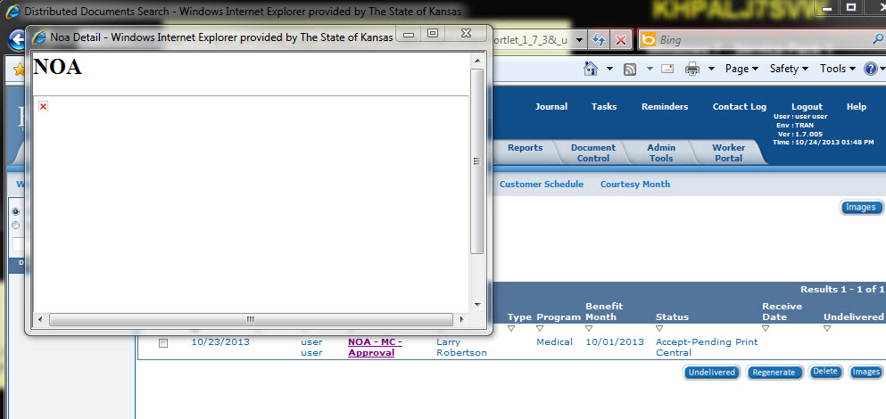
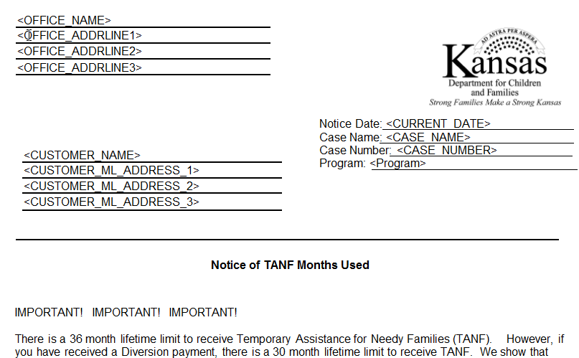
KEES Overview
Lesson 4: Viewing Distributed Documents > Process Steps
Once the user has selected the Document name hyperlink a pop-up window displays the notice. The notice is viewable as a PDF document.
Notes:
The document displays in a PDF format.

Slide 53
KEES Overview
Lesson 4: Viewing Distributed Documents > Summary
In Summary:
Sent Forms and NOAs are stored in KEES.
Stored Forms and NOAs can be accessed on the Distributed Documents tab.
Users can sort the history by Program Type, Document Name, Category, Status, and by a Date Range. Users may also limit the number of results on the page.

Slide 54
KEES Overview
KEES Overview > Wrap Up
In this course you learned about KEES.
Today we have talked about how to:
  Perform a Person Search
  View the Case Summary page
  View the Person View page
  View the Customer Appointment record
  View the Contact Summary
  View Individual Demographics
  View Relationships
  View Purchase and Prepare
  View Resource, Income, Expense, and Medicare Expense screens
  Perform a Distributed Documents Search

