Slide 1
Medical Eligibility
Eligibility Determination and Benefit Calculation (EDBC)
Notes:
Welcome to Medical Eligibility - Eligibility Determination and Benefit Calculation or EDBC
Cover any housekeeping items such as:
The location of restrooms and break rooms.
Ground rules for the training.
Instructor introductions.
Participant introductions.
Transition: Let’s talk about why we’re all here.

Slide 2
Medical Eligibility: EDBC
Introduction
In this course, you will learn how to run Eligibility Determination and Benefit Calculation (EDBC) for medical programs.
After completing this course, you will be able to:
Explain EDBC
Understand how a “Rules Engine” relates to EDBC
Run EDBC
Review and Verify EDBC
Override a program configuration
Create a manual EDBC
Describe batch eligibility processes
Notes:
This course explains how to run and verify EDBC and troubleshoot EDBC. You will also learn how to override EDBC, complete a manual EDBC and describe the batch eligibility process.
Let’s look at the lessons in this course.

Slide 3
Medical Eligibility: EDBC
Agenda
Lesson 1: What is EDBC
Lesson 2: Run EDBC
Lesson 3: Review and Verify EDBC
Lesson 4: Troubleshooting EDBC
Lesson 5: Overriding EDBC
Lesson 6: Manual EDBC
Lesson 7: Batch Eligibility Processes
Notes:
The course is broken down into seven (7) lessons.
Let’s start by taking a closer look at the first lesson: What is EDBC

Slide 4
Medical Eligibility: EDBC
Lesson 1: What is EDBC
What is EDBC?
EDBC = Eligibility Determination and Benefit Calculation
EDBC is how KEES executes rules to determine eligibility and budget for programs based on regulations
The EDBC rules engine applies policy
EDBC Summary can be thought of as a snap shot of eligibility based on what the system knows at a point in time
Notes:
Once data collection information is entered, you can run EDBC to execute the system’s programmed rules to determine eligibility and budget. EDBC is everything that happens in the background (rules engine) after you hit the Run EDBC button.

Slide 5
Medical Eligibility: EDBC
Lesson 1: What is EDBC > Online EDBC
There are five (5) Medical programs available in KEES:
Medical
Presumptive Eligibility (PE)
Presumptive Eligibility Pregnant Women (PE PW)
State Supplemental Payment Program (SSPP)
AIDS Drug Assistance Program (ADAP)
Only Medical utilizes online rules.
Online EDBC means that the eligibility determination is run in KEES using the defined rules engine.
Notes:
Question: What is the difference between ‘Medical’ and the other Requested Medical types?
Answer: If Medical is chosen, EDBC will run through the rules to test and determine consumer eligibility from the Medical hierarchy.

Slide 6
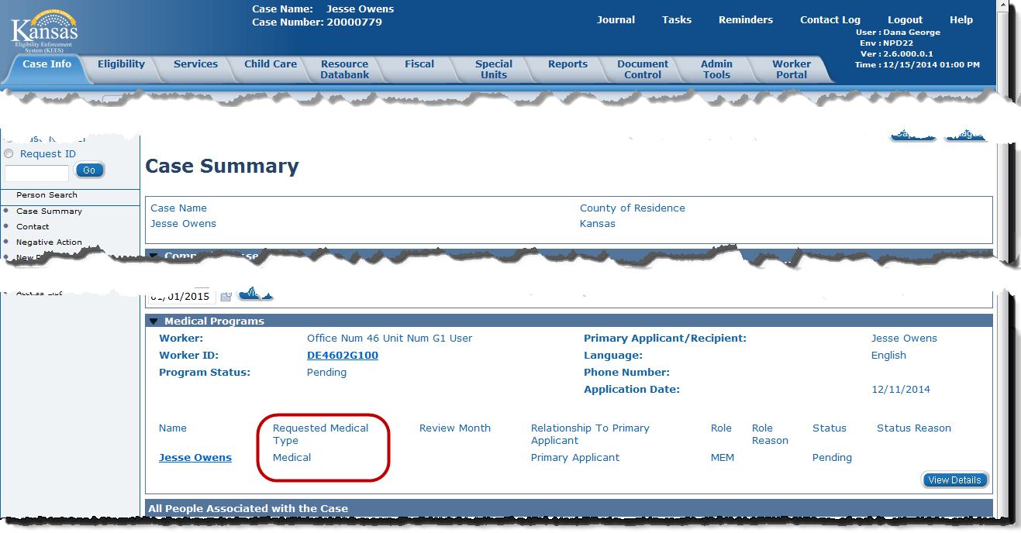
Medical Eligibility: EDBC
Lesson 1: What is EDBC > Online EDBC
Notes:
If the Requested Medical Type is Medical on the Case Summary Page, KEES will apply the ‘rules engine’ to the data collected, running the data through all budgets under a hierarchy.
Let’s look at programs in this hierarchy.

Slide 7
Medical Eligibility: EDBC
Lesson 1: What is EDBC > Hierarchy
Refugee Medical
Aged Out Foster Care
Foster Care
Adoption Support Medical
SSI Recipients
Breast Cancer Cervical
Protected Medical Groups
Working Healthy
Caretaker Medical
Transitional Medical
Extended Medical
Title 19
CHIP
Medically Needy
MediKan
Tuberculosis
ADAP
MSP
Notes:
There are several medical coverages that are being looked at in KEES.
If Medical is the RMT indicated, KEES will run the rules and budgets under this hierarchy, starting with Refugee Medical and ending with ADAP.

Slide 8
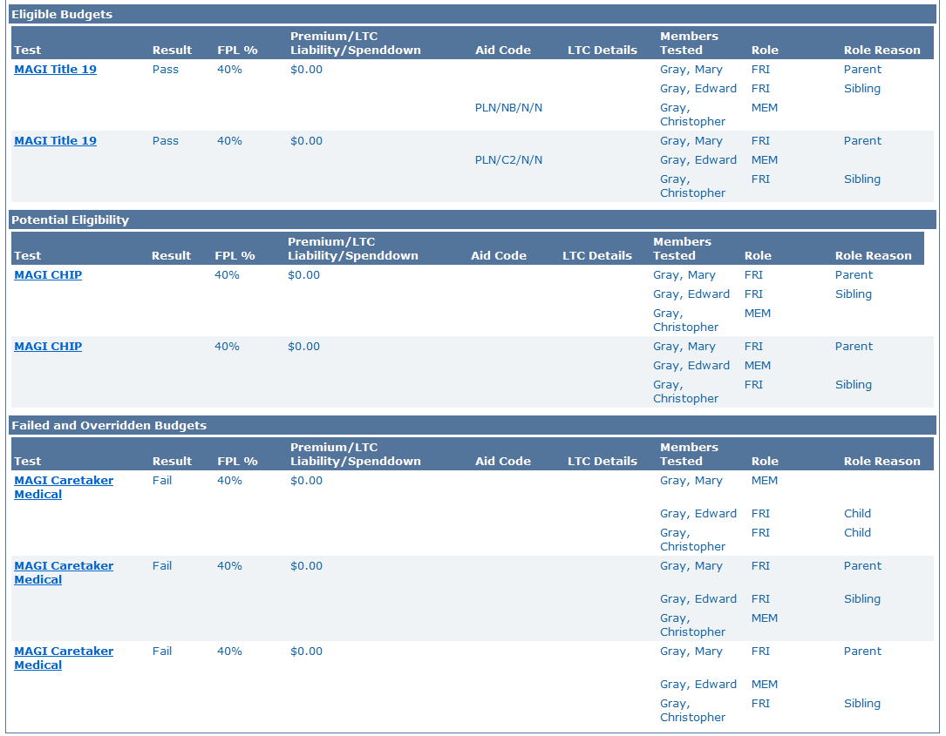



Medical Eligibility: EDBC
Lesson 1: What is EDBC > Hierarchy
Notes:
When EDBC is run, KEES could return several results which is based on a hierarchy of medical programs. Users will be able to see the budget for each individual screened for the case.
In this example: MAGI Caretaker was the first medical coverage being tested, but due to excess income they were not eligible. The system then looked at MAGI Title 19 as the next available coverage. This family was potentially eligible for MAGI CHIP but based on the medical hierarchy, Title 19 was the best plan for them.

Slide 9
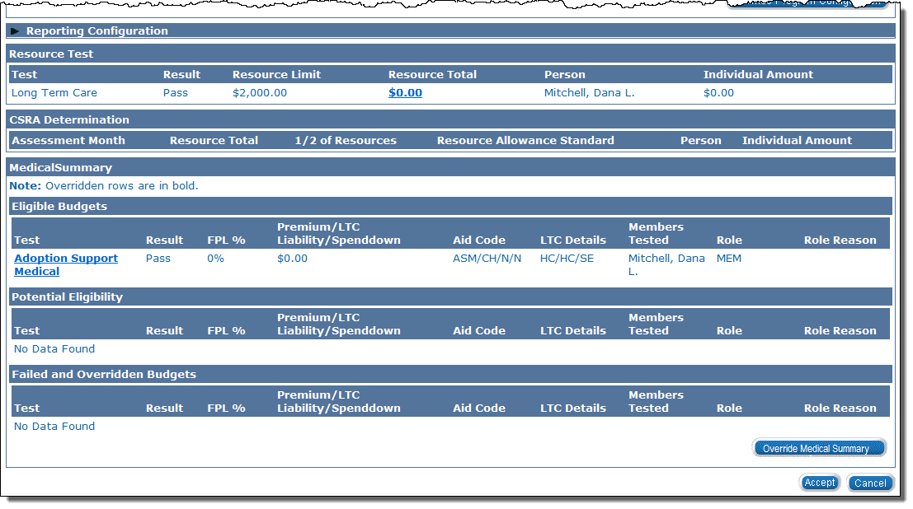
Medical Eligibility: EDBC
Lesson 1: What is EDBC > Hierarchy
Notes:
PPS Only – Foster Care screen show.

Slide 10
Medical Eligibility: EDBC
Lesson 1: What is EDBC > Hierarchy
In situations where the consumer could be eligible for more than one program and has the option to choose which program they agree to the terms and conditions of (e.g. premium vs. spenddown), there are two solutions for handling this:
Requested Medical Type (RMT)
Customer Options
Notes:
Let’s look at Requested Medical Type and what it means.
PPS only: PPS will never use Customer Options.

Slide 11
Medical Eligibility: EDBC
Lesson 1: What is EDBC > Requested Medical Types
Requested Medical Types
Inmate
Working Healthy
Qualified Disabled Working Individual
PPS
Medical
MSP
MAGI
LTC (Long Term Care)
Resource Assessment Only
You can add the ‘Requested Medical Type’ to be more specific to the type of medical coverage on the Requested Medicaid Type Detail page.
EDBC will run apply rules for the requested medical type (i.e. Working Healthy) versus a hierarchy of test categories.
Notes:
The first solution, is adding the Requested Medical Type.
Foster Care and Adoption Assistance medical programs will select PPS as the ‘Requested Medical Type’.

Slide 12
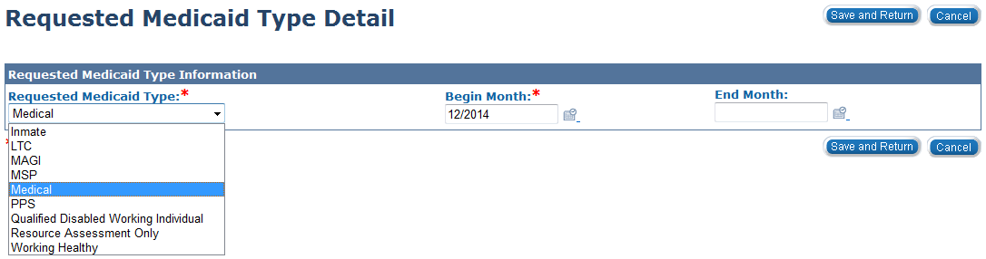
Medical Eligibility: EDBC
Lesson 1: What is EDBC > Requested Medical Types
Requested Medical Type
On the person’s Program Detail page a user will select the consumer’s Requested Medical Type.
The Requested Medical Type can be added or edited after the case has been registered on the Program Person Detail page.
Notes:
Reference the E&D application where we ask the applicant if they are requesting any of the special medical types, such as working healthy, LTC, MSP, etc.
Remove this sentence if you are PPS. - Let’s look at Customer Options which is the opposite of this page.

Slide 13
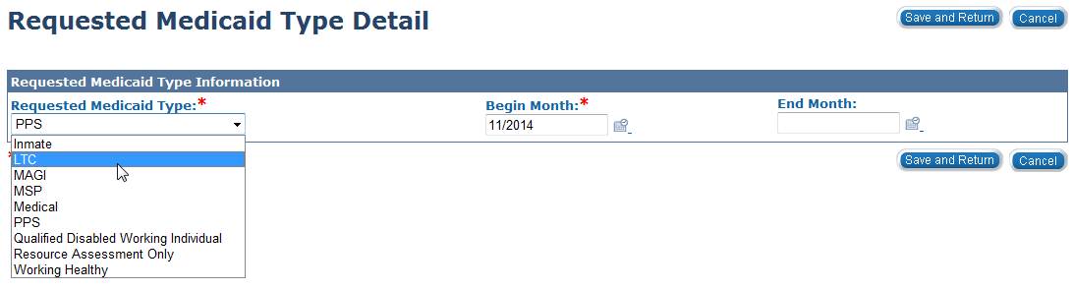
Medical Eligibility: EDBC
Lesson 1: What is EDBC > Requested Medical Types
In the event a child enters a Psychiatric Residential Treatment Facility (PRTF) or requires HCBS services, the Requested Medical Type will need to add a LTC RMT.
The LTC ‘Requested Medical Type’ must be set for the entire month in which services are provided.
Notes:
PPS only slide.

Slide 14
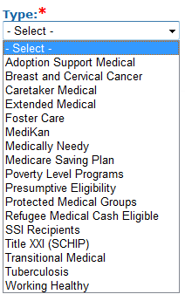
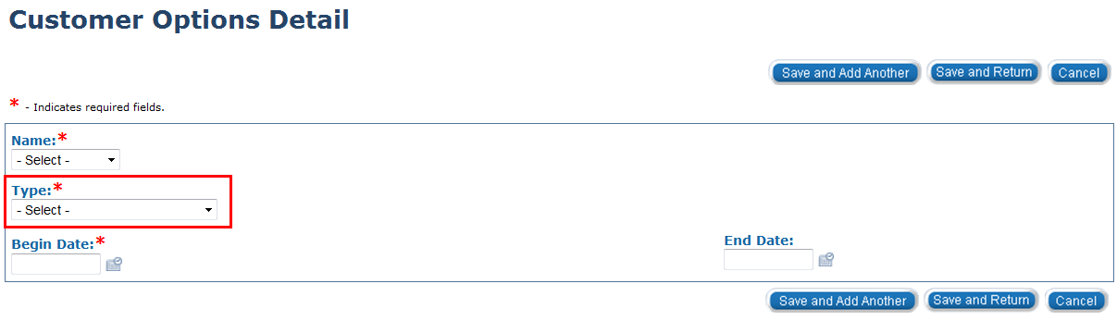
Medical Eligibility: EDBC
Lesson 1: What is EDBC > Customer Options
Customer Options
This page allows the worker to exclude the consumer from selected programs. Therefore, once EDBC is run, the results would not return those programs in the determination.
Notes:
This slide must be hidden from PPS.
For example, if a refugee consumer is categorically eligible for a medical program, the user would enter Refugee Medical as a customer option. When EDBC is run again, the rules will point to this record and identify eligibility for the next program in the hierarchy.
This slide contains builds:
Click 1: Reveals the options from the Type drop-down menu

Slide 15
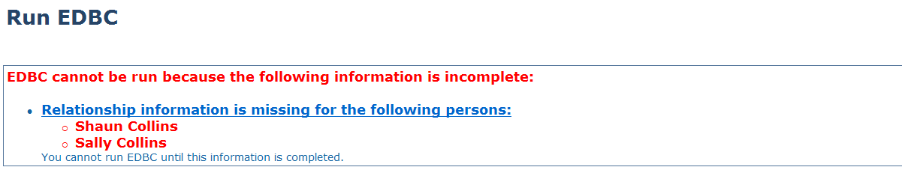
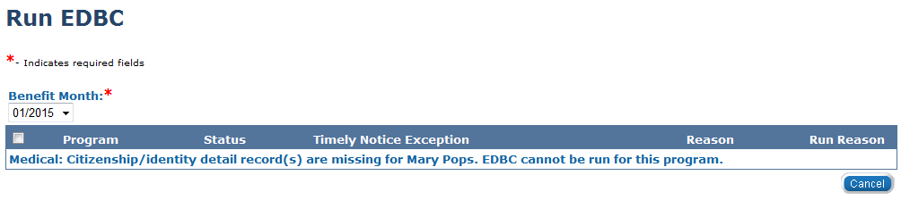
Medical Eligibility: EDBC
Lesson 1: What is EDBC > Missing Information
If information is incomplete KEES gives a hard warning that EDBC cannot be run.
Based on data collection pages
Must enter any and all information
When one of the above hard warning appears on your screen, you will not be able to run EDBC until this information is complete.
Notes:
KEES can give you two type of warnings that indicates that EDBC cannot be run.
In KEES, EDBC rules will consider all factors of eligibility based on the information entered on all the data collection pages. EDBC uses this information to complete various eligibility tests for the Consumer.
Therefore, it is very important that you enter any and all information you have in the appropriate data collection pages even if you feel that it may not be relevant.
A “hard warning” will display a message to the user and restrict them from continuing to process until a defined action is taken.

Slide 16
Medical Eligibility: EDBC
Lesson 1: What is EDBC > Missing Information
Some examples of hard warnings if one or more of the following is missing:
Missing relationships for all or some household members
Missing birth dates for program persons
No active or pending program in the case for the selected benefit month
No designated primary applicant/recipient
No worker assigned

Slide 17
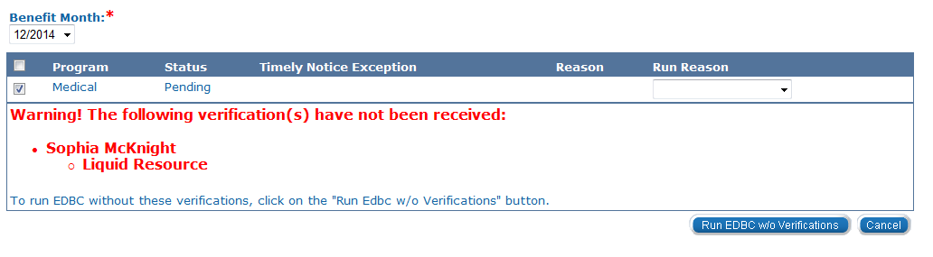
Medical Eligibility: EDBC
Lesson 1: What is EDBC > Missing or Pending Verifications
Verifications are not required to run EDBC. KEES will display a soft warning if verifications are missing/pending.
Notes:
A ‘soft warning’ will display a message to the user, but allow them to continue processing.
After clicking Run EDBC, a pending verification warning will appear, you still have the option of running EDBC.
If you are wanting to deny the case due to lack of verification, then the user must update the verification status to “Refused”, create a non-compliance record, and then run EDBC.
There are times when you can still “Run EDBC without Verifications” when you have an associated person to the case.
Now that we’ve reviewed the types of EDBC and associated information let’s navigate to the Run EDBC for our consumer.

Slide 18
Medical Eligibility: EDBC
Lesson 1: What is EDBC > Summary
In Lesson 1: we have learned:
EDBC stands for Eligibility Determination and Benefit Calculation
There are five medical programs in KEES
KEES has a medical hierarchy that determines the best plan
Adding a RMT will only apply the rules for that RMT
The difference between a ‘hard’ warning to a ‘soft’ warning
Notes:
We will review the steps how to review and verify the Medical EDBC Summary in Lesson 2.

Slide 19
Medical Eligibility: EDBC
Agenda
Lesson 1: What is EDBC
Lesson 2: Run EDBC
Lesson 3: Review and Verify EDBC
Lesson 4: Troubleshooting EDBC
Lesson 4: Overriding EDBC
Lesson 5: Manual EDBC
Lesson 6: Batch eligibility processes
Notes:
We’ve walked talked through what EDBC is, data collection and rules engine.
Let’s take a moment and discuss how to Run EDBC.

Slide 20
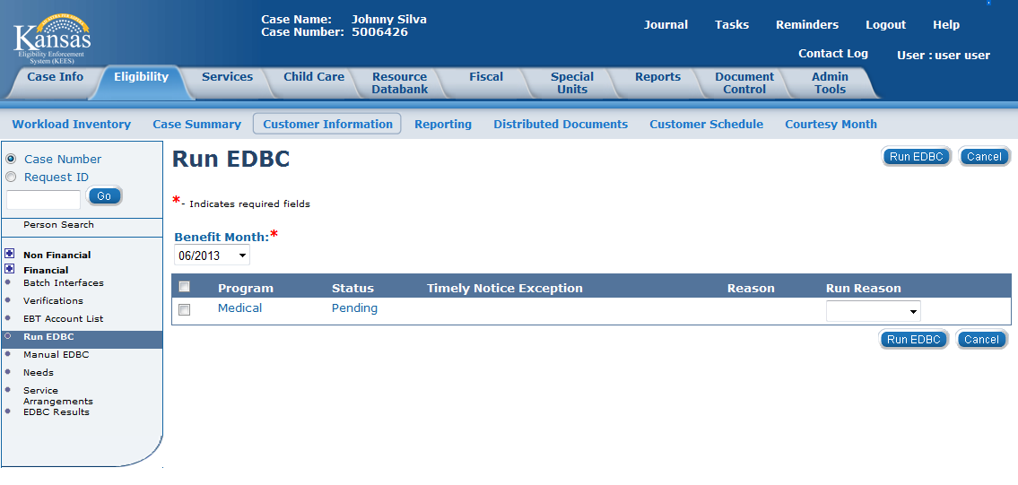
Medical Eligibility: EDBC
Lesson 2: How to Run EDBC > Running EDBC
The Run EDBC page allows you to run eligibility determination and benefit calculation for programs in which a consumer is applying or participating.
Notes:
How do we know the program and in which benefit month we are running EDBC? Let’s look at some of the features on this page.

Slide 21
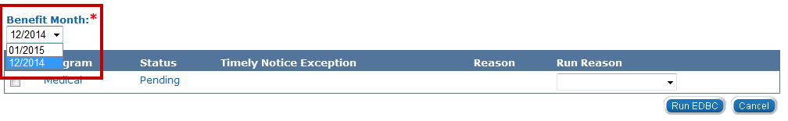
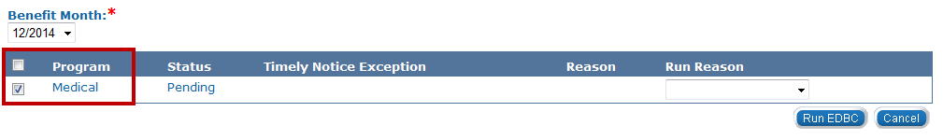
Medical Eligibility: EDBC
Lesson 2: How to Run EDBC > Running EDBC
The Benefit Month drop-down box will default to the application month. However, you can change the benefit month by selecting the month from the Benefit Month drop-down box. If you change the benefit month, the Run EDBC page will then be refreshed with programs pending or active for that month.
Select the Program(s) by clicking the check box next to the program. You can select ALL programs to run at the same time by clicking the check box next to the program title, if applicable.
Notes:
Best Practice:
At initial application, you must run EDCB through the come-up month (current system month).
It is encouraged you run EDBC in chronological order according to benefit month.
The last selection available on this page (at initial application) is the Run Reason. Let’s look at what those are.

Slide 22
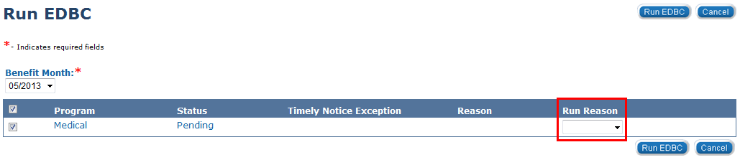
Medical Eligibility: EDBC
Lesson 2: Run EDBC > Running EDBC
By selecting a run reason from the Run Reason drop-down box, a user may indicate why EDBC is being run. It is not necessary to indicate a run reason at initial application.
Run Reasons are available
CE Reset | Review – No Touch
CSRA Reassessment | Review Processing
No Touch | Spenddown
Notes:
PPS will not use these run reasons.
Let’s define these Run Reasons

Slide 23
Medical Eligibility: EDBC
Lesson 2: Run EDBC > Run Reasons
What do these Run Reasons mean/do?
CE (Continuous Eligibility) Reset
This run reason is used to allow negative changes to a case and changes the CE period or review and the type of medical coverage provided.
CSRA Reassessment
If you need to re-determine the Community Spouse Resource Allowance (CSRA) calculation after you have already run EDBC which was Saved and Accepted. Or when you want a new “Assessment Only” and a recalculation, the user will need to change the RMT to “Assessment Only” and run EDBC with this Run Reason.
No Touch
This run reason is used when a MAGI/ Non-MAGI determination was attempted through the original EDBC run and wasn’t successful.
Notes:
PPS will not use these run reasons.
No Touch: Instructions on when a worker needs to run EDBC with the 'no touch' run reason because the Magi/Non-Magi determination was not done based on the original run (or attempt to run) EDBC.

Slide 24
Medical Eligibility: EDBC
Lesson 2: Run EDBC > Run Reasons
Review – No Touch
It’s a combined functions of the Review Processing and No Touch service run reasons. It will create a “Read Only” EDBC, establishes a type of review and only Passive and Super Passive reviews will be authorized.
Review Processing
This will update the status of RE documents (if sent through KEES) and establish a new review period for the medical program on the Case Summary page. This run reason is used when running EDBC in response to returned review in order to extend the review period and mark the Review & IR status to ‘Complete’.
Spenddown
This run reason is used when a consumer already has a spenddown and you need to establish a new base period prior to the review.
Notes:
PPS will not use these run reasons.
Review – It is critical the worker uses this run reason when processing a review in order to establish the new correct review date.
Again, at initial application, users do not need to select a Run Reason.

Slide 25
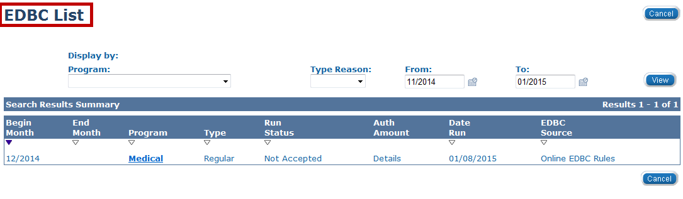
Medical Eligibility: EDBC
Lesson 2: Run EDBC > EDBC List
Once EDBC is run, the page refreshes with the EDBC List page.
Let’s take a look at the column headings on this page.

Slide 26
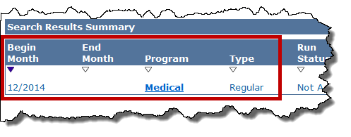
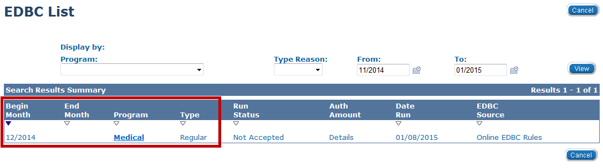
Medical Eligibility: EDBC
Lesson 2: Run EDBC > EDBC List
Begin Month: Benefit month
End Month: Will display if budgeted for one month
Program Name: Medical (specific program information will be provided on the Summary page)
EDBC Type: Read Only or Regular
Notes:
This slide contains builds:
Click 1 reveals the highlighted portion of the EDBC List page.
Begin and End Months: The EDBC begin and end dates are important to note. On all new medical programs, you must run EDBC for the current AND come-up month (current system month). This will produce a ‘High-Dated’ EDBC record, which will ensure those benefits continue to roll moving forward until further action is taken on the program. High-dated means that the record has no end date, only a begin date.
The “Read Only” type means that EDBC was previously ran and accepted.
The “Regular” type means that the user is running the rules for the first time.

Slide 27
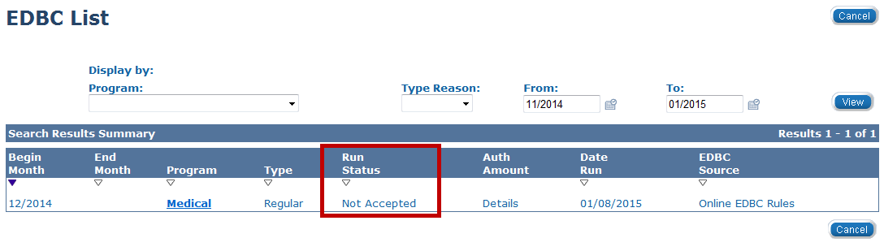
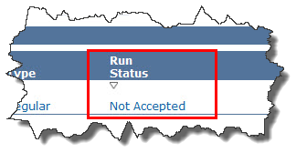
Medical Eligibility: EDBC
Lesson 2: Run EDBC > EDBC List
The Run Status column provides you with the status of the EDBC. When you initially run EDBC and the EDBC List page is displayed, the run status will display as “Not Accepted”.
Other EDBC statuses include:
Accepted - Not Saved
Accepted – Saved
Notes:
This slide contains builds:
Click 1 reveals the highlighted portion of the EDBC List page
Accepted – Not Saved is when you have Accepted the results on the EDBC Summary Page.
Accepted – Saved is when you have selected the “Save and Continue” button on the EDBC List page after reviewing the EDBC Summary page. The user is accepting the outcome of EDBC run.
You will learn how to review, accept or reject and save EDBC results in the next lesson.

Slide 28
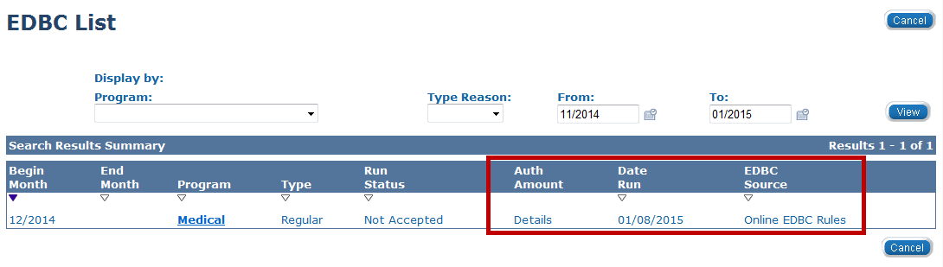
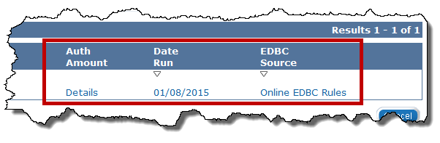
Medical Eligibility: EDBC
Lesson 2: Run EDBC > EDBC List
Auth Amount: Medical will read ‘Details’ or ‘Fail’ when a determination has been completed.
Date Run: Date EDBC is run
EDBC Source: Conversion, Batch EDBC Rules, Manual, Online EDBC Rules, Overridden, or Special Program Pages
Notes:
This slide contains builds:
Click 1 reveals the Auth Amount, Date Run, EDBC Source
If the Authorized Amount indicates Fail, it was determined that the consumer wasn’t eligible for medical coverage.
Conversion
Batch EDBC Rules is the process of running the Eligibility Determination/Benefit Calculation (EDBC) component of the system at night. This is done for changes that affect many cases at once as well as for individual case changes (e.g., age changes). It is set to run on a designated schedule.
Manual indicates that the determination was determined off the system and the outcome is recorded in the system.
Online EDBC Rules indicates that Rules in the background determined the results.
Overridden
Special Program Pages
When you click on the Medical program hyperlink this will access the Medical Summary page.
Let’s review and verify our EDBC results in the next lesson.

Slide 29
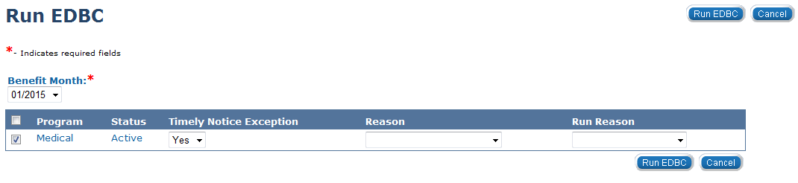
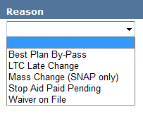
Medical Eligibility: EDBC
Lesson 2: Run EDBC > Timely Notice Exception
There will be times when a worker will need to use the Timely Notice Exception.
This will most often occur when the user will need to re-run EDBC for a paid month where Long Term Care either starts or stops.
Notes:
PPS will use LTC Late Change and Waiver on File for timely notice exception.
Best Plan By-Pass should only be used by KDHE Central Office.
LTC Late Change is to be used when the user needs to re-run EDBC for a paid month where LTC either starts or stops. PPS will also use this timely notice exception.
Example: Moving from Independent Living to Long Term Care living arrangement or back.
Mass Change (Snap only)
Stop Aid Paid Pending this is part of baseline value that is not being used for P2.6
Waiver on File: will be used for PPS.

Slide 30
Medical Eligibility: EDBC
Lesson 2: Run EDBC > Summary
In Lesson 2: we have learned:
Steps in running EDBC
How to read the EDBC List page
Run Reasons available to use on the Run EDBC page
Timely Notice Exception Reasons

Slide 31
Medical Eligibility: EDBC
Agenda
Lesson 1: What is EDBC
Lesson 2: Run EDBC
Lesson 3: Review and Verify EDBC
Lesson 4: Troubleshooting EDBC
Lesson 4: Overriding EDBC
Lesson 5: Manual EDBC
Lesson 6: Batch eligibility processes
Notes:
We’ve talked through what EDBC is and how data collection is used for rules when running EDBC.
Let’s take a moment and discuss how to review and verify EDBC results.

Slide 32
Medical Eligibility: EDBC
Lesson 3: Review and Verify EDBC Results
In this lesson, we will access, review and verify the EDBC results for our consumer. The following components of our Medical EDBC Summary will be reviewed:
Program Configuration
Reporting Configuration
Resource Determination
Income
Household Size
Deductions
Aid Codes
Notes:
We will review what each of these mean and the information provided within each section in more detail later in this lesson.

Slide 33
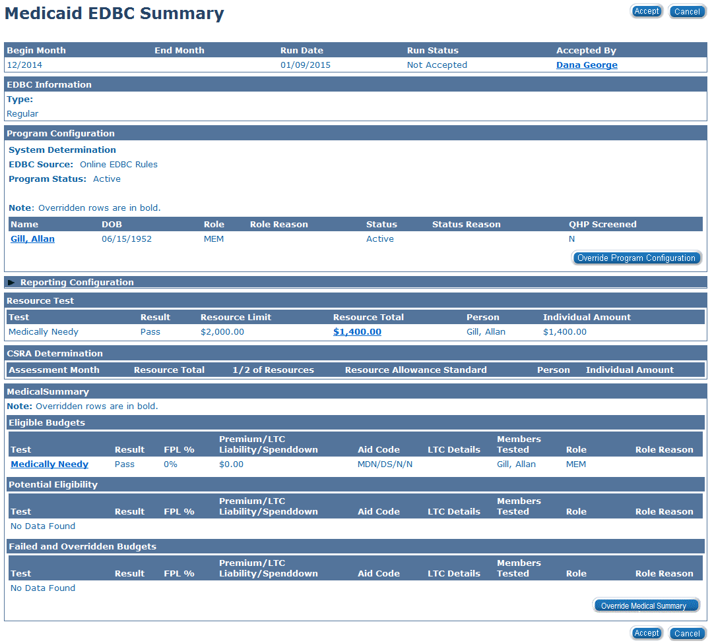
Medical Eligibility: EDBC
Lesson 3: Review and Verify EDBC Results
Notes:
For EES DCF only.
PPS must hide this slide.
After running EDBC, click on the Medical hyperlink from the List page to get to the Medical EDBC Summary page.
The Medicaid EDBC Summary page allows you to review the budget for the benefit month , the program status and the medical programs that were tested.
Before we Accept the results or Cancel the results, we first need to review and verify our EDBC results.
After reviewing:
If your results are correct on the EDBC Summary: Click Accept
If your results are not correct on the EDBC Summary: Click Cancel
Let’s look at the top portion of the Medical EDBC Summary before the Program Configuration and Medical Summary sections.

Slide 34
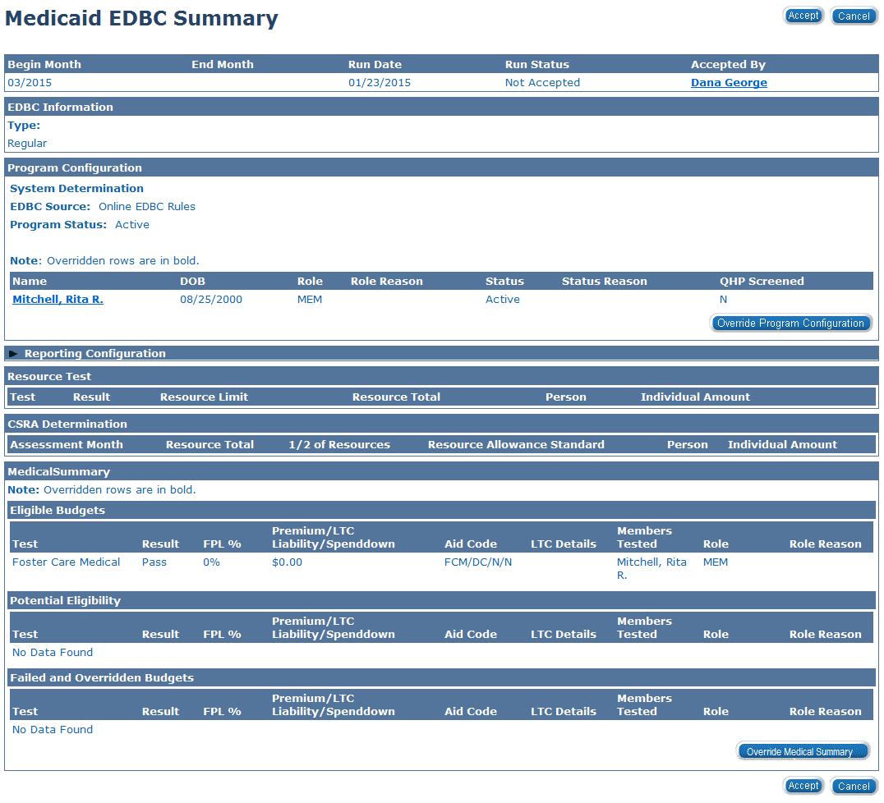
Medical Eligibility: EDBC
Lesson 3: Review and Verify EDBC Results
Notes:
For PPS Only slide
After running EDBC, click on the Medical hyperlink from the List page to get to the Medical EDBC Summary page.
The Medicaid EDBC Summary page allows you to review the budget for the benefit month , the program status and the medical programs that were tested.
Before we Accept the results or Cancel the results, we first need to review and verify our EDBC results.
After reviewing:
If your results are correct on the EDBC Summary: Click Accept
If your results are not correct on the EDBC Summary: Click Cancel
Let’s look at the top portion of the Medical EDBC Summary before the Program Configuration and Medical Summary sections.

Slide 35
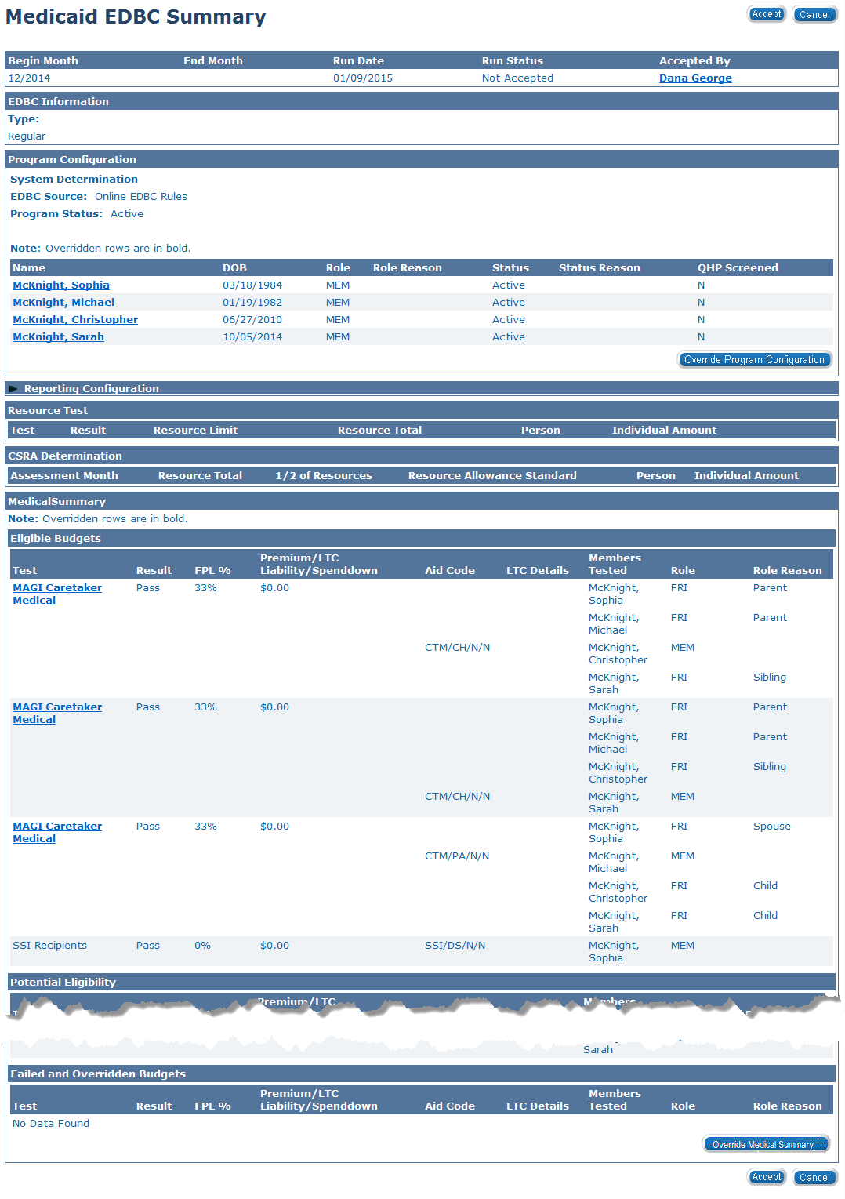
Medical Eligibility: EDBC
Lesson 3: Review and Verify EDBC Results
Notes:
For: CH
After running EDBC, the Medical EDBC Summary page appears.
The Medicaid EDBC Summary page allows you to review the budget for the benefit month , the program status and the medical programs that were tested.
Before we Accept the results or Cancel the results, we first need to review and verify our EDBC results.
After reviewing:
If you are satisfied with EDBC Summary: Click Accept
If you are not satisfied with EDBC Summary: Click Cancel
Let’s look at the top portion of the Medical EDBC Summary before the Program Configuration and Medical Summary sections.

Slide 36
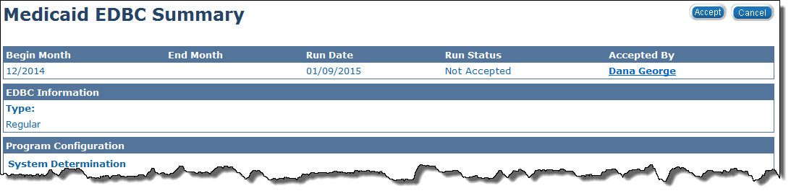
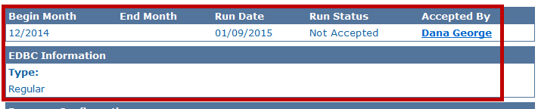
Medical Eligibility: EDBC
Lesson 3: Review and Verify EDBC Results
The top section of the Medicaid EDBC Summary displays:
The range of benefit months that the EDBC encompasses
The date EDBC was run
The run status
The Worker who ran and accepted the EDBC
The EDBC type will be either ‘Read Only’ or ‘Regular’
Notes:
In our scenario, we have run EDBC for the consumer for the first time (initial application). The Run Status is Not Accepted. Accepted By shows the worker’s name who took the action.
You can view The Worker Detail page by clicking the Accepted by hyperlink. (if you need information for the worker who ran and accepted this EDBC)
Remember:
The “Read Only” type means that EDBC was previously ran and accepted.
The “Regular” type means that the user is running the rules for the first time.

Slide 37
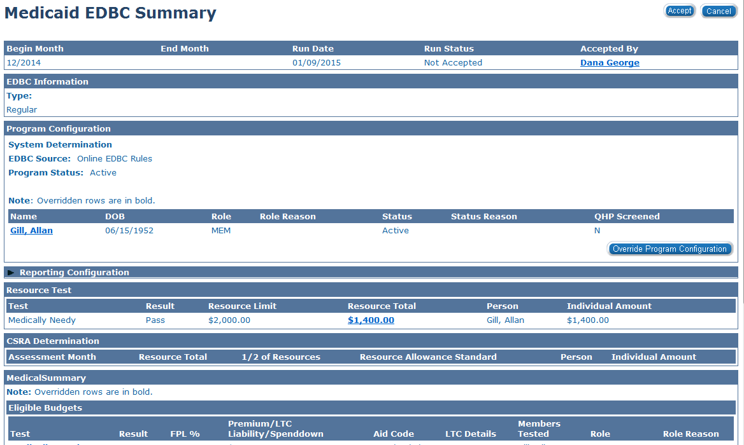
Medical Eligibility: EDBC
Lesson 3: Review and Verify EDBC Results
Program configuration
Medical Summary
Reporting configuration
Overpayments / Underpayments
Resource Test
CSRA Determination
Notes:
These are the sections of the EDBC Summary that require review after ensuring you’ve run the correct benefit month.
Transition: Let’s take a look at the Program Configuration section.

Slide 38
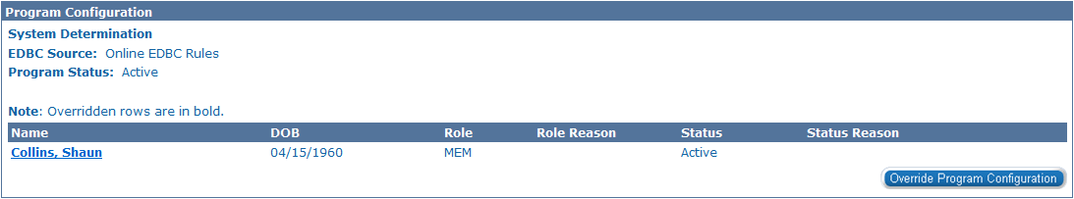
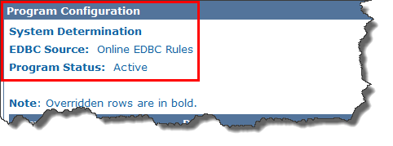
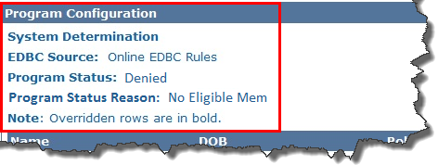
Medical Eligibility: EDBC
Lesson 3: Review and Verify EDBC Results
In the Program Configuration section, you can view the EDBC Source, Program Status, and, if applicable, the Program Status Reason.
Notes:
This slide contains builds:
Click 1 reveals an eligible program
Click 2 reveals a denied program
The Program Configuration may appear either way on the Medicaid EDBC Summary page. Let’s go into further detail regarding this section.

Slide 39
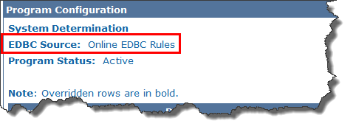
Medical Eligibility: EDBC
Lesson 3: Review and Verify EDBC Results
EDBC Source: This is the source from which eligibility was determined.
EDBC Sources include:
Online EDBC Rules
Batch EDBC Rules
Manual
Notes:
Remember:
Online EDBC Rules indicates that Rules in the background determined the results.
Manual indicates that the determination was determined off the system and the outcome is recorded in the system.
Batch EDBC Rules is the process of running the Eligibility Determination/Benefit Calculation (EDBC) component of the system at night. This is done for changes that affect many cases at once as well as for individual case changes (e.g., age changes). It is set to run on a designated schedule.

Slide 40
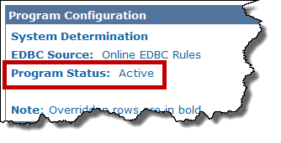
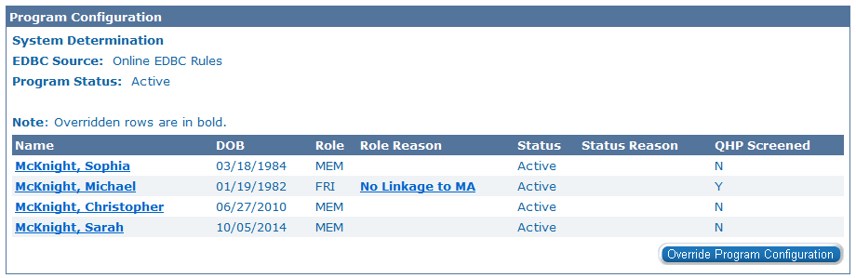
Medical Eligibility: EDBC
Lesson 3: Review and Verify EDBC Results
Program Status: The overall status of the program can include:
  Active
  Denied
  Discontinued
Program Person
This section will also list the program members.
Notes:
Active – for at least one eligible program person
Denied – at initial application and all program persons are deemed ineligible
Discontinued – after program is ‘Active’ and EDBC is recalculated determining all program persons no longer eligible due to changes in the case
When the program status is Active a list of Program Persons will display with their Date of Birth, Role, Role Reason, Status and Status Reason.
For medical, there are two roles: MEM for Member and FRI for Financially Responsible Individual. A Member will have no Role Reason. An FRI will have a role reason such as ‘Parent’, ‘Spouse’, etc. Each individual’s role determines how this person’s income, resources, expenses, and any miscellaneous income/expenses were used in EDBC.

Slide 41
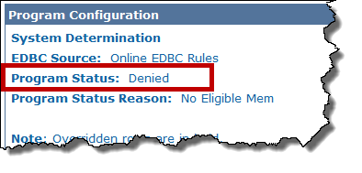
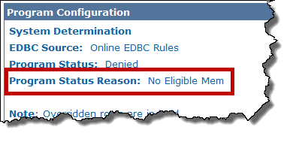
Medical Eligibility: EDBC
Lesson 3: Review and Verify EDBC Results
Program Status: The overall status of the program can include:
  Active
  Denied
  Discontinued
Program Status Reason will display if there is a determination of ‘Denied’ or ‘Discontinued’ EDBC. Some examples include:
No Eligible Member
Over Resources
Whereabouts Unknown
No Linkage to MC
Notes:
Active – for at least one eligible program person
Denied – at initial application and all program persons are deemed ineligible
Discontinued – after program is ‘Active’ and EDBC is recalculated determining all program persons no longer eligible due to changes in the case
If there was a negative outcome to EDBC the program status reasons could appear.

Slide 42
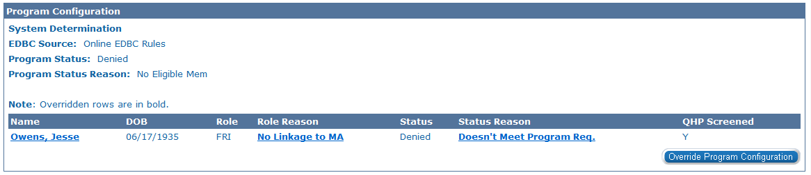
Medical Eligibility: EDBC
Lesson 3: Review and Verify EDBC Results
Program Person
This section will list the program members and their vital information.
Date of birth
Role
Role Reason
Status
Status Reason
Notes:
For medical, there are two roles: MEM for Member and FRI for Financially Responsible Individual. An FRI will have a role reason such as ‘Parent’, ‘Spouse’, etc. Each individual’s role determines how this person’s income, resources, expenses, and any miscellaneous income/expenses were used in EDBC.

Slide 43
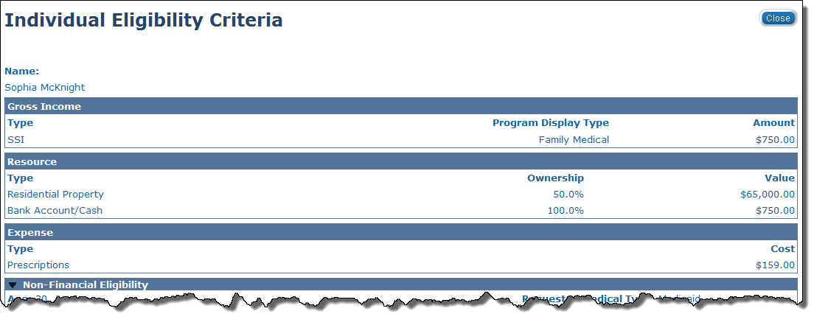
Medical Eligibility: EDBC
Lesson 3: Review and Verify EDBC Results
The user can select the member’s name hyperlink in the program configuration block to access the Individual Eligibility Criteria page. This page displays every income, expense, and resource, regardless of type and possible exemptions. Selecting the Close button will return the user to the Medicaid EDBC Summary page.
Notes:
Next we will discuss the Reporting Configuration section.

Slide 44
Medical Eligibility: EDBC
Lesson 3: Review and Verify EDBC Results
Program configuration
Medical Summary
Reporting configuration
Overpayments / Underpayments
Resource Test
CSRA Determination

Slide 45
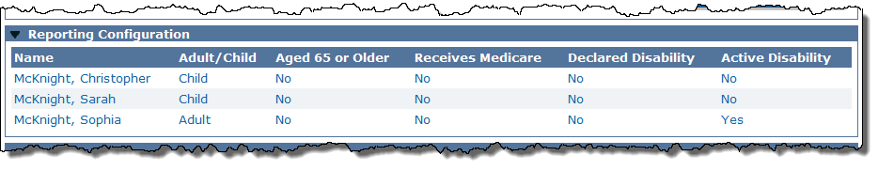
Medical Eligibility: EDBC
Lesson 3: Review and Verify EDBC Results
Reporting Configuration
The program persons and their Adult/Child code will be listed in this section.
Notes:
Member roles will only appear here.

Slide 46
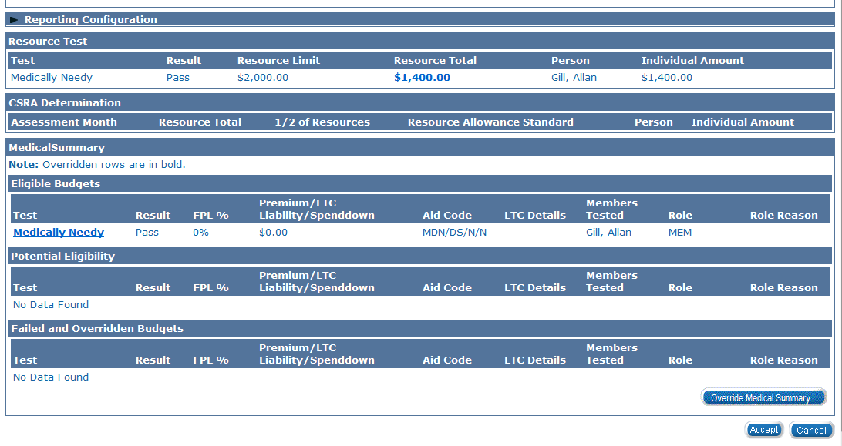
Medical Eligibility: EDBC
Lesson 3: Review and Verify EDBC Results
Program configuration
Medical Summary
Reporting configuration
Overpayments / Underpayments
Resource Test
CSRA Determination

Slide 47
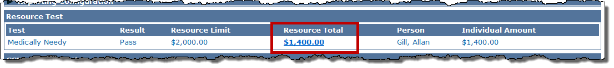
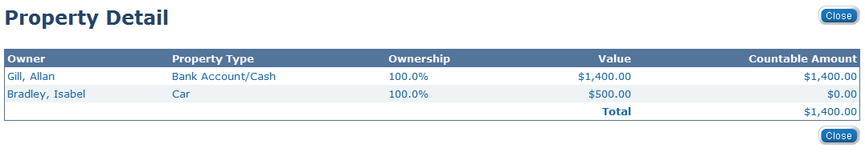
Medical Eligibility: EDBC
Lesson 3: Review and Verify EDBC Results
After selecting the Resource Total hyperlink on the Medicaid EDBC Summary page, the user will access the Property Detail page. Selecting Close will return the user to the Medicaid EDBC Summary page.

Slide 48
Medical Eligibility: EDBC
Lesson 3: Review and Verify EDBC Results
Program configuration
Medical Summary
Reporting configuration
Overpayments / Underpayments
Resource Test
CSRA Determination

Slide 49
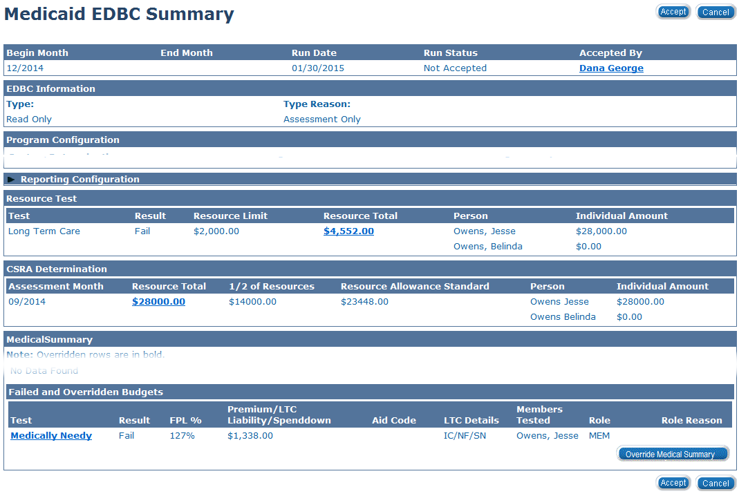
Medical Eligibility: EDBC
Lesson 3: Review and Verify EDBC Results
Notes:
This block only appears when there is a Requested Medical Type of Resource Assessment Only or when processing a LTC eligibility after a resource assessment has been completed. The CSRA Determination block shows the Community Spouse Resource Assessment amount for LTC programs. It only looks at the resources of the individuals.

Slide 50
Medical Eligibility: EDBC
Lesson 3: Review and Verify EDBC Results
Program configuration
Medical Summary
Reporting configuration
Overpayments / Underpayments
Resource Test
CSRA Determination

Slide 51
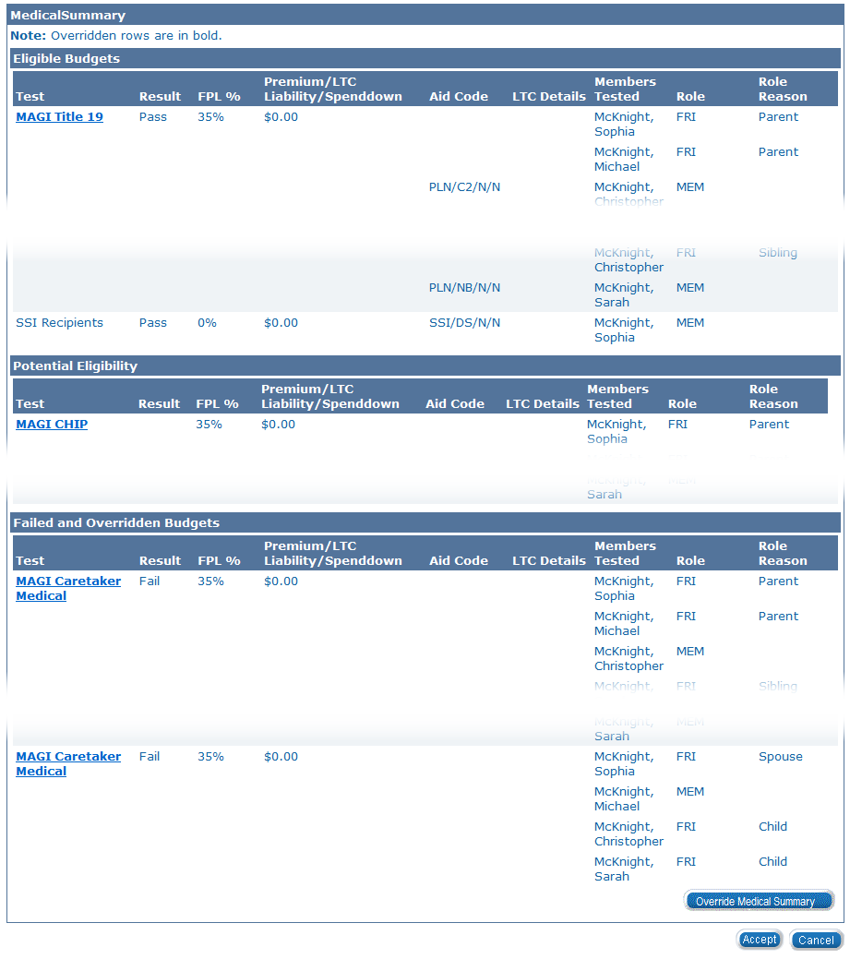
Medical Eligibility: EDBC
Lesson 3: Review and Verify EDBC Results
Notes:
In the Medical Summary section, you will find the Eligible Budgets, Potential Eligibility and the Failed and Overridden Budgets. The system is able to calculate separate budgets based on rules and determine potential eligibility for multiply medical programs.

Slide 52
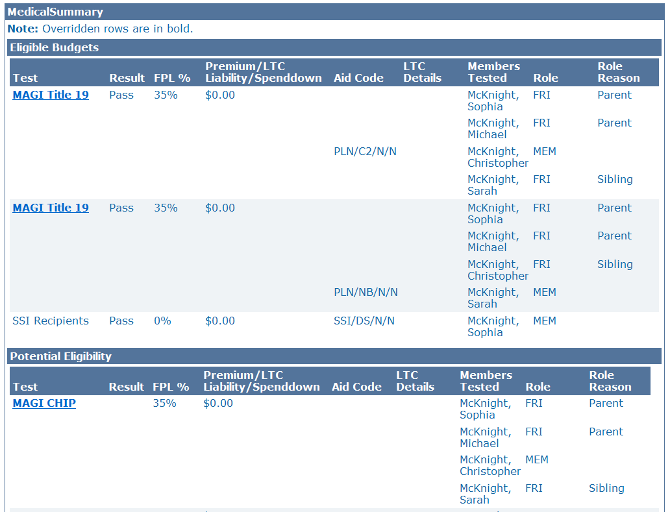
Medical Eligibility: EDBC
Lesson 3: Review and Verify EDBC Results
Notes:
The Eligible Budgets section indicates the eligible medical program for each program person.
The Test section indicates the programs or budgets tested from the Medical hierarchy
Result –will show either ‘Pass’ or ‘Fail’
FPL% - shows the percentage of income related to the Federal Poverty Level
Premium / LTC Liability / Spenddown – will display the specific amount budgeted per program
Aid Code - The State assigned classification determined by the program applied for and on the Consumer’s eligibility determination
LTC Details-shows the Long Term Care specific criteria.
Members Tested – the program members tested and passed
Role – will include MEM for Member, FRI for Financial Responsible Included or UP for Unaided persons from converted cases only
Role Reason – will show the relationship between the members of the Individual Budgeting Unit

Slide 53
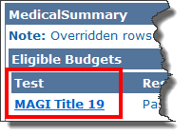
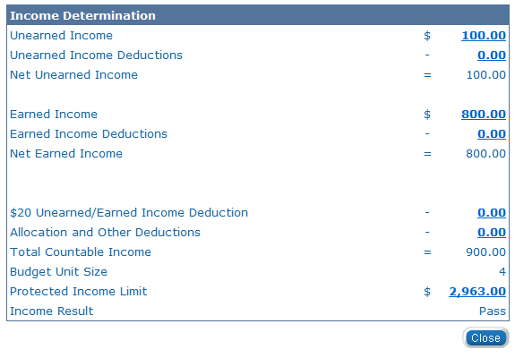
Medical Eligibility: EDBC
Lesson 3: Review and Verify EDBC Results
Click the Test category hyperlink to access the Income Determination page. This page shows how much income was counted for that person.
The Income Determination page shows:
Income used
Deductions allowed
Income Allocations
Protected Income Limit
Notes:
In KEES, all program EDBC pages will provide you with hyperlinks to access related detail pages. These pages are available only for you to review and verify the information used to run EDBC. These pages are not editable.
If information is incorrect, you will need to cancel EDBC, and update the appropriate data collection pages.

Slide 54
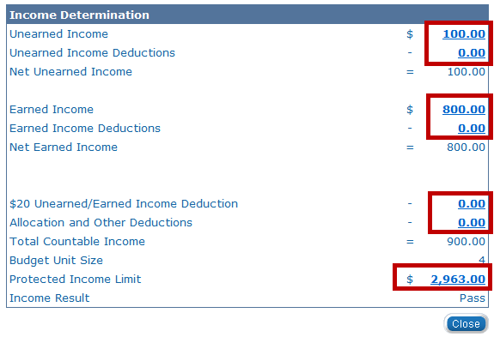
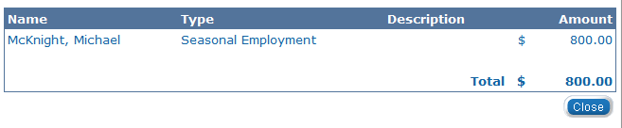
Medical Eligibility: EDBC
Lesson 3: Review and Verify EDBC Results
Selecting the hyperlinks in the Income Determination page will navigate the user to the detail page for that line item.
Notes:
For example, if the user clicked on the Earned Income link, they will be navigated to the EDBC Person Line Item Detail page. To navigate back to the Medicaid EDBC Summary page, select the Close button.

Slide 55

Medical Eligibility: EDBC
Lesson 3: Review and Verify EDBC Results
Notes:
The Potential Eligibility section indicates the potential eligible medical program for each program person.
The Test section indicates the programs or budgets tested from the Medical hierarchy
FPL% - shows the percentage of income related to the Federal Poverty Level
Premium / LTC Liability / Spenddown – will display the specific amount budgeted per program
Members Tested – the program members tested and passed
Role – will include MEM for Member, FRI for Financial Responsible Included) or UP for Unaided persons from converted cases only
Role Reason – will show the relationship between the members of the Individual Budgeting Unit

Slide 56

Medical Eligibility: EDBC
Lesson 3: Review and Verify EDBC Results
Notes:
The Failed and Overridden Budgets section shows which medical eligibility budgets/programs were tested and failed.
If Failed Budgets are overridden through the Override Medical Summary budget, they will also be listed here in bold.

Slide 57


Medical Eligibility: EDBC
Lesson 3: Review and Verify EDBC Results
Click the Test category hyperlink to access the Income Determination page. This page shows how much income was counted for that person.
Notes:
KEES has provided you with hyperlinks to access the related detail pages which will tell you specifically why the family member(s) did not pass the test.
Selecting the hyperlinks in the Budget Detail page will navigate the user to the detail page for that line item.

Slide 58
Medical Eligibility: EDBC
Lesson 3: Review and Verify EDBC Results
Program configuration
Medical Summary
Reporting configuration
Overpayments / Underpayments
Resource Test
CSRA Determination

Slide 59
Medical Eligibility: EDBC
Lesson 3: Review and Verify EDBC Results
At the bottom of the Medical EDBC Summary page is the Overpayments/Underpayments section.
This section will not display results at initial application.
An overpayment is a result of a shift in eligibility or a change in spenddown amount when EDBC is recalculated for a paid month.

Slide 60
Medical Eligibility: EDBC
Lesson 3: Review and Verify EDBC Results
Reviewing EDBC is a simple but a very important function in KEES.
EDBC can be:
Accepted
Overridden
for specific situations when rules are not used
Cancelled
if the eligibility determination or the benefit calculation is not correct
if the eligibility determinations are correct
Notes:
Remember, you can run EDBC, but you don’t have to Accept and Save EDBC.

Slide 61

Medical Eligibility: EDBC
Lesson 3: Review and Verify EDBC Results
Once you have reviewed EDBC, you can either:
Accept the EDBC by clicking the Accept button
OR
By clicking the Cancel button the user returns to the EDBC List page.
These buttons are made available to you at the top and bottom of every Medicaid EDBC Summary page.
Notes:
If you click the Accept button, the EDBC List page appears and the Run Status for the EDBC result is Accepted – Not Saved.
Tip: If you navigate away from this page without hitting cancel the case becomes locked.

Slide 62


Medical Eligibility: EDBC
Lesson 3: Review and Verify EDBC Results
Once EDBC results are accepted, the status is updated to Accepted – Not Saved and a Save and Continue button appears.

Slide 63
Medical Eligibility: EDBC
Lesson 3: Review and Verify EDBC Results
Clicking the Save and Continue button generates a Notice of Action (NOA). You can locate this NOA on the Distributed Documents Search page. If a notice is not generated a user will need to create a form.
A NOA will generate after saving an EDBC at initial application or when there is change in benefits.

Slide 64
Medical Eligibility: EDBC
Lesson 3: Review and Verify EDBC Results > Summary
In this lesson, we learned:
EDBC List page
Medical EDBC Summary
  Program Configuration
  Passed Budgets
  Failed and Overridden Budgets
  Accept or Cancel Results
  Notifications
Notes:
We will review and verify the Medical EDBC Summary in Lesson 2.

Slide 65
Medical Eligibility: EDBC
Agenda
Lesson 1: What is EDBC
Lesson 2: Run EDBC
Lesson 3: Review and Verify EDBC
Lesson 4: Troubleshooting EDBC
Lesson 5: Overriding EDBC
Lesson 6: Manual EDBC
Lesson 7: Batch eligibility processes
Notes:
We’ve just reviewed and verified our EDBC results.

Slide 66
Medical Eligibility: EDBC
Lesson 4: Troubleshooting EDBC
Verify & Accept
If results are incorrect, you must determine why.
Troubleshoot
Check all information has been entered accurately on data collection pages.
Notes:
This will create concern since an override does not produce a NOA when eligibility is determined. A form would have to be used to notify clients and that is error prone.

Slide 67

Medical Eligibility: EDBC
Lesson 4: Troubleshooting EDBC
Notes:
You do not have to Accept an EDBC result if it is determined that an error was made on one of the data collection pages.

Slide 68

Medical Eligibility: EDBC
Lesson 4: Troubleshooting EDBC
Notes:
We should first view the Individual Eligibility Criteria page to determine if we missed anything. To Access this page we will select the consumer’s name hyperlink from the Program Configuration block on the Medical EDBC Summary page.

Slide 69

Medical Eligibility: EDBC
Lesson 4: Troubleshooting EDBC
Notes:
In this example the individual is applying for Long Term Care. We noticed that EDBC doesn’t see that this consumer is in a Long Term Care Living Arrangement. Therefore we will need to update the appropriate LTC data collection page.
It is important to note that you can run and re-run EDBC until close of business. After COB, you can not change the EDBC results if you have accepted the results. The accepted EDBC results will be sent to MMIS.

Slide 70

Medical Eligibility: EDBC
Lesson 4: Troubleshooting EDBC
Role Reason | Solution
State Residence | Check Contact Summary page which includes the Address Detail page. Make sure the begin date reflects the first day of the month benefits begin. Check Residency List page and the Residency Detail page
Pending SSN Verif | Check the Individual Demographics page.
Applicant is a citizen or non-citizen | Information is not entered correctly on the Individual Demographics Detail page and/or Citizenship/Identity or Non-Citizenship Detail page.
Notes:
Here are some role reason errors that you can receive when running EDBC.

Slide 71
Medical Eligibility: EDBC
Lesson 4: Troubleshooting EDBC
Important items to look for when Income or Resources affect benefit determinations.
A budget wasn’t created at the time EDBC was run.
Begin dates must be entered as the 1st day of the Month regardless of when the application was received.

Slide 72
Medical Eligibility: EDBC
Lesson 4: Troubleshooting EDBC > Summary
It is important to verify all information on the data collection pages is accurate.
Ensure the begin dates are correct.
If KEES has not been updated with new regulations, override the EDBC results.

Slide 73
Medical Eligibility: EDBC
Agenda
Lesson 1: What is EDBC
Lesson 2: Run EDBC
Lesson 3: Review and Verify EDBC
Lesson 4: Troubleshooting EDBC
Lesson 5: Overriding EDBC
Lesson 6: Manual EDBC
Lesson 7: Batch eligibility processes
Notes:
Lesson 5 will need to be skipped for PPS.

Slide 74

Medical Eligibility: EDBC
Lesson 5: Overriding EDBC > Program Configuration
Determination based on regulations in KEES rules.
Override if determination was incorrect, for reasons other than data entry errors.
Overriding
Changing the eligibility determination.
Program Configuration
Determining eligibility outside of KEES rules.

Slide 75

Medical Eligibility: EDBC
Lesson 5: Overriding EDBC > Program Configuration
EDBC Override Reasons includes:

Slide 76

Medical Eligibility: EDBC
Lesson 5: Overriding EDBC > Program Configuration
Notes:
This is an example of a fail budget that needs to be overridden.

Slide 77
Medical Eligibility: EDBC
Lesson 5: Overriding EDBC > Medical Summary Page
Determination based on regulations.
Override if determination was incorrect, for reasons other than data entry errors.
Medical Summary
Regulation Change
Override Medical Summary
New Policy
Manual EDBC Program
Notes:
KEES determines eligibility based on the information you enter. However, it may be necessary to override the Medical determination. These are examples.

Slide 78
Medical Eligibility: EDBC
Lesson 5: Overriding EDBC > Summary
Overriding is used to change the eligibility determination made by KEES.
You would override program configuration if KEES determination
was not correct for a reason other than incorrect data entry.

Slide 79
Medical Eligibility: EDBC
Agenda
Lesson 1: What is EDBC
Lesson 2: Run EDBC
Lesson 3: Review and Verify EDBC
Lesson 4: Troubleshooting EDBC
Lesson 5: Overriding EDBC
Lesson 6: Manual EDBC
Lesson 7: Batch Eligibility Processes

Slide 80

Medical Eligibility: EDBC
Lesson 6: Manual EDBC > Manual EDBC
A manual EDBC is used for a few programs that do not have rules built into EDBC such as:
Presumptive Eligibility (PE)
Presumptive Eligibility Pregnant Women (PE PW)
Notes:
KDHE only.

Slide 81



Medical Eligibility: EDBC
Lesson 6: Manual EDBC
Select the correct benefit month from the Benefit Month drop-down box and click the Go button.
A reason for the manual EDBC is selected from the Manual EDBC Reason drop-down box.
Click the Run EDBC Program:
Notes:
KDHE only.
This slide contains builds:
Click 1 reveals the Manual EDBC Reason

Slide 82

Medical Eligibility: EDBC
Lesson 6: Manual EDBC
On the EDBC List page after the manual EDBC has been created the EDBC Source will show Manual.
Notes:
KDHE only.

Slide 83

Medical Eligibility: EDBC
Lesson 6: Manual EDBC
1. Click Set Program Configuration.
Update the status to ‘Active’.
Edit the Program Configuration for the applicant.
Save and Return.
Notes:
KDHE only.
After running a Manual EDBC click the program hyperlink on the EDBC List page to access the medical EDBC Summary (Manual) page.

Slide 84

Medical Eligibility: EDBC
Lesson 6: Manual EDBC
Next the user will need to set the medical summary by clicking Set Medical Summary.
Notes:
KDHE only.
6. Clicking the Set Medical Summary button
7. Select <insert test budget> from the Test drop-down
8. Select Pass from the Test Result
9. Select Applicant from Person drop-down
10. Select Role
11. Select Aid Code
12. Save and Return
To complete and save the actions taken for the Manual EDBC:
Click Save and Return on the Medical EDBC List page
Click Accept On Medical EDBC Summary page, and
Click Save and Return EDBC List page

Slide 85
Medical Eligibility: EDBC
Lesson 6: Manual EDBC > Summary
A manual EDBC is a determination of eligibility made outside of KEES.
A Notice of Action is not created when a Manual EDBC is run.
Notes:
KDHE only.
It also changes a pending status to an active status.

Slide 86
Medical Eligibility: EDBC
Agenda
Lesson 1: What is EDBC
Lesson 2: Run EDBC
Lesson 3: Review and Verify EDBC
Lesson 4: Troubleshooting EDBC
Lesson 5: Overriding EDBC
Lesson 6: Manual EDBC
Lesson 7: Batch Eligibility Processes

Slide 87
Medical Eligibility: EDBC
Lesson 7: Batch Eligibility Processes
What is Batch Eligibility?
The process of running EDBC systematically on a scheduled basis.
This is done for changes that affect many cases at once as well as for individual case changes (i.e. age changes).
Identify Cases/Programs that can be Processed in Batch
Determine Authorized Benefits
Approve Each Batch EDBC Result
Create and Approve a NOA for Each EDBC Result
Generate the Batch Eligibility Report
Execute EDBC for Each Case/Program
Notes:
The batch eligibility process runs at night.
Batch eligibility will run on all programs with rules built into KEES.

Slide 88
Medical Eligibility: EDBC
Lesson 7: Batch Eligibility Processes
Other Things to Know:
KEES automatically approves and generates a Notice of Action (NOA), if appropriate, for each Batch EDBC result.
A task will be created for program that do not process automatically. Worker action will be necessary.
The system produces tasks for action when validations, such as identification of overpayments, require worker action.
Notes:
Explain: Users will be notified if action is required on a case.

Slide 89

Medical Eligibility: EDBC
Lesson 7: Batch Eligibility Processes
EDBC results will appear on the EDBC List and EDBC Results List page for EDBCs completed through Batch Eligibility similar to EDBCs that you run, accept and save yourself.
The EDBC Source for EDBCs processed through Batch Eligibility will display as ”Batch EDBC Rules”.
Notes:
The Batch Eligibility Report is an on request report that provides a detailed list of cases/programs that have been run through the nightly EDBC batch process.
The EDBC Source will display “Batch EDBC Rules” for EDBCs processed through batch eligibility.
Users will be notified which cases EDBC batch did not run because of an exclusion reason such as a missing date of birth.
Users will also be notified which cases you need to run EDBC on through an automated task. This task will tell a user which program was not processed through batch eligibility and for which benefit month a user must run EDBC.

Slide 90
Medical Eligibility: EDBC
Lesson 7: Batch Eligibility Processes
An automated task will tell you which programs were not processed through batch eligibility and for which benefit month EDBC needs to be run.
Notes:
Note: Batch EDBC Report can also be used to determine which cases/programs processed by
Batch EDBC require worker action.

Slide 91
Medical Eligibility: EDBC
Lesson 7: Batch Eligibility Processes > Summary
In Lesson 7: we have learned:
The Batch Eligibility process runs at night and will run with the rules
Users will be notified which cases did not run during the Batch Eligibility
EDBC results will appear on the EDBC List and EDBC Results List page for EDBCs completed through Batch Eligibility similar to EDBCs that you run, accept and save yourself.

Slide 92
Medical Eligibility: EDBC
Course Summary
In this course, you learned how to:
Explain EDBC
Understand how a “Rules Engine” relates to EDBC
Run EDBC
Review and Verify EDBC
Override a program configuration
Create a manual EDBC
Describe batch eligibility processes

Slide 93
Medical Eligibility: EDBC
Questions
QUESTIONS?

