Slide 1
Medical Eligibility:
Forms & Notices of Action (NOAs)
Notes:
Welcome participants to the training session.
Cover any housekeeping items such as:
The location of restrooms and break rooms.
Ground rules for the training.
Instructor introductions.
Participant introductions.

Slide 2
Medical Eligibility:
Forms & Notices of Action (NOAs)
Introduction
Overview
Documents distributed to KDHE and DCF consumers
These documents are referred to as Distributed Documents
  Click Eligibility on the Global Navigation tab
  Click Distributed Documents on the Local Navigation tab
Notifications fall under two categories and are discussed at length in this course:
  Forms
  NOAs (Notices of Action)
Notes:
This unit is about the various documents which are distributed to KDHE and DCF consumers through KEES.
Users should learn the difference of forms and NOAs, and when to use which type of document.
In KEES, these documents are referred to as Distributed Documents, which is also the name of the Local navigation tab under the Eligibility Global navigation tab.
KEES distributed documents fall under two categories and are discussed at length in this course:
Category #1: Forms
Category #2 :Notices of Action (NOAs)

Slide 3
Medical Eligibility:
Forms & Notices of Action (NOAs)
Unit Objectives
After completing this unit you will be able to:
Differentiate between Forms and NOAs
Generate Forms and NOAs
Understand the content arrangement including barcodes
Understand how NOAs are assembled
Access and use the Forms and NOAs history
Understand the use of foreign language in Forms and NOAs

Slide 4
Medical Eligibility:
Forms & Notices of Action (NOAs)
Agenda
Lesson 1: Understanding the Terms
Lesson 2: Contents
Lesson 3: Generating and Deleting
Lesson 4: History and Regenerating Forms & NOAs
Lesson 5: Foreign Language in Forms & NOAs

Slide 5
Medical Eligibility:
Forms & Notices of Action (NOAs)
Lesson 1: Understanding the Terms > Forms
Form:
Any distributed document with primarily fixed text.
Some Forms may be populated with information from KEES.
Certain Forms have enterable fields
The primary content of a form is specific to its function and has static text.
Notes:
In KEES:
Form refers to any distributed document with a primarily fixed text.
Some Forms may be populated with information from KEES, for example a consumer’s name and address.
Also certain Forms such as those in which information is requested have enterable fields in which the user may add text to clarify the specific information requested.
But the primary content of a Form is specific to its function and has static text

Slide 6
Medical Eligibility:
Forms & Notices of Action (NOAs)
Lesson 1: Understanding the Terms > Forms
Examples of Forms:
  Income or resource verification letters
  HCBS case manager change letter
Blank Template Forms are also able to be generated without case populated information.
Notes:
Forms cannot be edited once they have been saved.
Some examples of Forms are:
Applications
Income or resource verification letters
HCBS case manager change letter.
Facility Notices for Approval, Denial, Closure. These say notice, but they are forms.
The next slide is an example of a General Correspondance form.

Slide 7
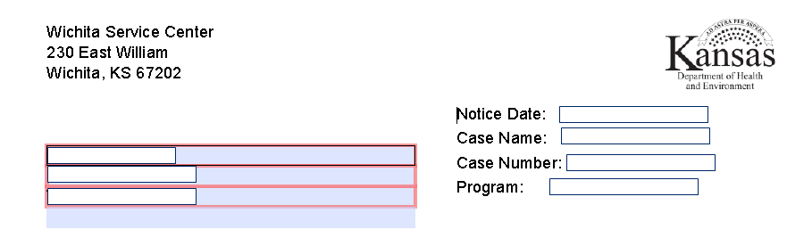
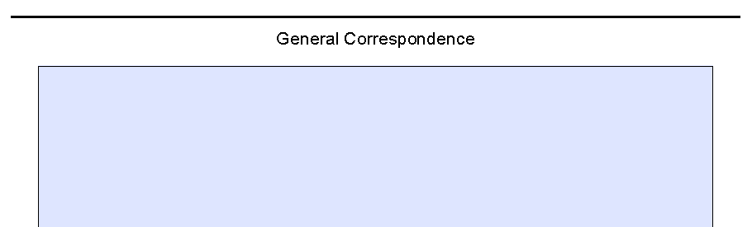
Medical Eligibility:
Forms & Notices of Action (NOAs)
Lesson 1: Understanding the Terms > Forms

Slide 8
Medical Eligibility:
Forms & Notices of Action (NOAs)
Lesson 1: Understanding the Terms > Notices of Action (NOA)
Notices of Action (NOAs)
NOAs are distributed documents that are assembled from a wide variety of statements, or fragments, that are pre-written and stored in KEES.
Specific fragments and manual references pertaining to the case actions are brought forward to make up the NOA.
A NOA can only be generated by running EDBC and there has to be a change in benefits from the previous month. If the system does not recognize a change, a NOA will not be generated.
KEES writes the NOA based on the specific action taking place with the case.
Notes:
Notices of Action, or NOAs, on the other hand, are distributed documents that are “assembled” from a wide variety of statements, or fragments, that are prewritten and stored in KEES and can cover hundreds of different scenarios. Out of these many prewritten statements, the specific fragments and manual references pertaining to the case action at hand are brought forward to make up the NOA. In essence, KEES itself writes the NOA based on the specific action taking place with the case.
A NOA can only be generated by running EDBC and there has to be a change in benefits from the previous month. If the system does not recognize a change, a NOA will not be generated.

Slide 9
Medical Eligibility:
Forms & Notices of Action (NOAs)
Lesson 1: Understanding the Terms > Notices of Action (NOA)
The NOA cannot be produced until all the information of the case has been input and EDBC (Eligibility Determination Benefit Calculation) has been run to determine eligibility and saved.
A NOA always states an action to:
  Approve
  Reinstate
  Deny
  Discontinue
  Change
A Form is a letter sent to a consumer that requests information that was not initially provided at the time of application, with the intent to take action.
Notes:
Of course the NOA cannot be produced until the system has all the information to pull facts together. The point information is available is when Eligibility Determination Benefit Calculation, or EDBC, runs and is saved.
Another distinguishing factor of a NOA in KEES is that it always states an action to approve, reinstate, deny, discontinue or change a case. A letter that requests information with the intent to take action if not provided, would not be a NOA, but would be a Form in KEES

Slide 10
Medical Eligibility:
Forms & Notices of Action (NOAs)
Lesson 1: Understanding the Terms > Methods of Distribution
Methods of Distribution
  Forms and NOAs may be generated 3 ways:
    Printed locally (by the worker) and given to the consumer
    Printed locally (by the worker) and mailed to the consumer
    Printed and mailed from a central location without worker intervention
Notes:
Print Centrally means the document will be automatically generated and mailed without worker intervention.

Slide 11
Medical Eligibility:
Forms & Notices of Action (NOAs)
Lesson 1: Methods of Distribution > Central Print
Centrally Printed
Centrally printed Forms and NOAs are combined in a single envelope with all other NOAs and Forms for that day’s batch for each consumer. A single envelope will hold up to 7 pages.
Forms and NOAs may also be provided electronically through the consumer Self-Service Portal (SSP) when the consumer has signed up for an SSP account and has provided their email address.
The consumer may elect to receive a message via email to alert them that correspondence is in the SSP Message Center for them to view. This process is discussed in more detail in another unit.

Slide 12
Medical Eligibility:
Forms & Notices of Action (NOAs)
Lesson 1: Understanding the Terms > Summary
Summary
NOAs are distributed documents that indicate an action on the case has been made. NOAs are created from statements within the system that fit the case action
Forms have a static content for a specific purpose such as informational forms or letters that request additional information
Forms do not take specific action
Notes:
NOTE: When we override EDBC on cases a form is the resulting notice of the action. There are other programs like Medikan that the only notification is by form. Also the notifications to Nursing Facilities are all on forms.

Slide 13
Medical Eligibility:
Forms & Notices of Action (NOAs)
Lesson 1: Methods of Distribution > Summary
Summary (Continued):
All NOAs and most Forms may be printed locally or centrally
All centrally printed documents are put in one envelope per consumer up to 7 pages
Forms have a primarily fixed or static content
NOAs are assembled from written fragments and case information after EDBC has been run, accepted, and saved
Notes:
Forms and NOAs may be viewed in the SSP - Currently forms are not viewable in the SSP - this is supposed to be fixed but has not happened yet.

Slide 14
Medical Eligibility:
Forms & Notices of Action (NOAs)
Agenda
Lesson 1: Understanding the Terms
Lesson 2: Contents
Lesson 3: Generating and Deleting
Lesson 4: History and Regenerating Forms & NOAs
Lesson 5: Foreign Language in Forms & NOAs

Slide 15
Medical Eligibility:
Forms & Notices of Action (NOAs)
Lesson 2: Contents > Introduction
Contents
Forms have a fixed content for a specific purpose
Additions to Forms are allowable in some instances
Forms can be viewed any time as they contain fixed text
Various statements stored in KEES are brought together based on factors in the determination to produce the contents of forms & NOAs
NOAs are generated and available to be viewed only after EDBC has been run and the result has been saved
There are no fixed text NOAs. NOAs are dynamically produced based on the case information and EDBC result
Notes:
Within the system, the user will have 2 options to determine a consumer’s benefits. Those options are (1) manual EDBC or (2) run EDBC.
Manual EDBC will not generate a NOA. It will require the user to enter the information determined by the manual EDBC into a form.
When a worker runs EDBC the NOA will be generated when the user accepts the EDBC and selects the “Save & Continue” button.

Slide 16
Medical Eligibility:
Forms & Notices of Action (NOAs)
Lesson 2: Contents > NOAs and Forms
Contents
The front and back of each page will be utilized for printing
A document may be multiple pages in length dependent upon the required content
Rights and Responsibilities information appear at the end of the document as necessary
Case information will identify & determine which agency is sending the document, thus providing the appropriate return contact information to the consumer
Notes:
Forms and NOAs will be printed on the front and back of a page, and can be multiple pages depending on the length of the content. When Rights and Responsibilities information appears it will be at the end of the document.
The NOA and appropriate Forms that are populated with case information will identify who is sending the document and will provide appropriate return contact information

Slide 17
Medical Eligibility:
Forms & Notices of Action (NOAs)
Lesson 2: Contents > NOA Limitations
NOA Parameters
If there are multiple persons included in a program individual information will be dealt with separately and consecutively when the NOA is printed
An individual NOA can only deal with a single program or month
As mentioned earlier, all Forms and NOAs produced centrally on the same day would be included in a single mailing
Notes:
NOA Limitations: Despite some unique and positive features of NOAs in KEES, there are some limitations.
For one thing, if there are multiple persons included in a program on a NOA, the individual information will be dealt with separately and consecutively. For example if there are three children being approved, instead of one paragraph referencing all three children and other mutual information explained, each child will have eligibility described in separate sections in the same NOA.
Another limitation is that an individual NOA can only deal with a single program or month. For example if eligibility for separate months must be explained, then a separate NOAs will be produced. Likewise, if more than one program is involved, separate NOAs must be produced.
As mentioned earlier, all Forms and NOAs produced centrally on the same day would be included in a single mailing.

Slide 18
Medical Eligibility:
Forms & Notices of Action (NOAs)
Lesson 2: Contents > Barcodes
Barcodes
Stuffer:
    Located on the upper left hand corner of the front facing page
    When centrally mailed, appropriate stuffers are included
    Assists in bundling all correspondence to the consumer for that day into the same envelope, up to 7 pages
Document:
    Located on the lower right hand corner
    Associates that document with the corresponding case
    Assists in tracking timely return of a document
More information will be included on working with returned documents and needed information in another course.
Notes:
Barcodes. A special feature of KEES Forms and NOAs is barcodes which are included on the documents. There are two types:
Stuffer barcodes
Document barcodes
Stuffer barcodes are included with a Form or NOA so that when centrally mailed, any appropriate stuffer is included with the mailing. This barcode also assists in bundling all correspondence to the consumer for that day into the same envelope. The stuffer barcode will be located in the upper left corner along the side of the addressed to data.
Document barcodes are located on the lower right hand corner of the Form or NOA.
For example, when a review form with this barcode is timely returned by the consumer, the barcode associates the form to the appropriate case and identifies that it was timely returned. More information will be included on working with returned documents and needed information in another venue.
Re: Return Mail – Mail that has been returned as undelivered will have to be manually entered in to the system on the Distributed Documents screen. This will allow the system to generate a warning message if the user attempts to distribute a document to an address where the last correspondence was returned as “undelivered”.
The message will generate as a warning when the user selects Run EDBC on a NOA or Save & Print Central or Local on a form.

Slide 19
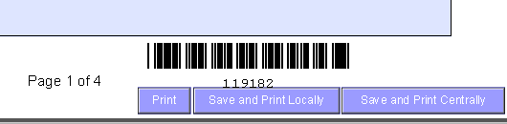
Medical Eligibility:
Forms & Notices of Action (NOAs)
Lesson 2: Contents > Summary
Summary
  Forms and NOAs are printed front and back
  NOAs are specific to one program and month
  Barcodes help with central mailing processes
  Barcodes associate a document to a case
Notes:
Imaging staff should be aware that any extra documents received with a barcoded document would be indexed to the same indexing values if scanned together.

Slide 20
Medical Eligibility:
Forms & Notices of Action (NOAs)
Agenda
Lesson 1: Understanding the Terms
Lesson 2: Contents
Lesson 3: Generating and Deleting
Lesson 4: History and Regenerating Forms & NOAs
Lesson 5: Foreign Language in Forms & NOAs

Slide 21
Medical Eligibility:
Forms & Notices of Action (NOAs)
Lesson 3: Generating and Deleting > Forms
Forms Generation
  Click Documents Control on the Global Navigation tab
  Click the appropriate selection on the Local Navigation tab
  Complete the search and select steps for the desired Form
  Complete the Document Parameters search criteria
  Add content if needed
  Review the Form
  Choose the appropriate print option
Notes:
For most Form situations, start at the Documents Control Global Navigation tab, complete the search and select steps, complete a window to bring in case information add content if needed, review the Form, choose the print option and finish.

Slide 22
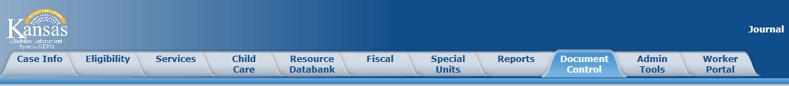
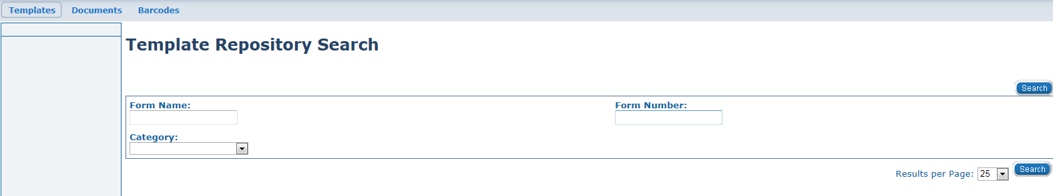
Medical Eligibility:
Forms & Notices of Action (NOAs)
Lesson 3: Generating and Deleting > Forms
  Click Document Control on the Global Navigation tab
  Complete the Template Repository Search

Slide 23
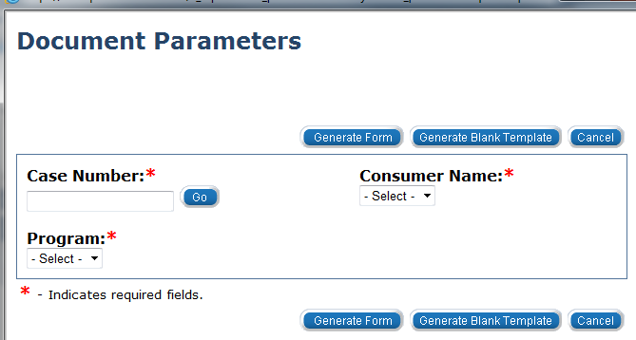
Medical Eligibility:
Forms & Notices of Action (NOAs)
Lesson 3: Generating and Deleting > Forms
  Click the appropriate link of the desired document returned in the Search Results Summary
  Input case information into the Document Parameters pop-up window
  Then generate form or blank template
Notes:
If a user selects a blank template, add verbal (writes a message) and prints it locally it needs be saved to the case by the worker. (See Imaging.)
Once a form is viewable in SSP, it cannot be edited or deleted in either ABMS or SSP. This only applies once posting a form to SSP. Although, this may change in the future.
If copies of a form are generated for additional correspondents, and the primary copy is deleted, the copies for additional correspondents are NOT automatically deleted. The user has to delete them separately.

Slide 24
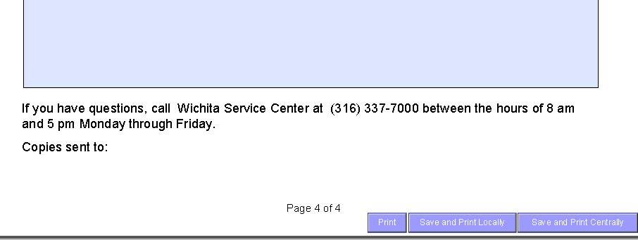
Medical Eligibility:
Forms & Notices of Action (NOAs)
Lesson 3: Generating and Deleting > Forms
  Add content if needed
  Review the form
  Choose the Print option and finish
Notes:
When a specific Form is brought up inside the context of a case different actions are taken. Detailed steps for completing these processes are illustrated in later examples.
There are a couple of exceptions when a specific Form is brought up inside the context of a case. Detailed steps for completing these processes are illustrated in later examples.

Slide 25
Medical Eligibility:
Forms & Notices of Action (NOAs)
Lesson 3: Generating and Deleting
NOA
Reviewing each NOA produced after running EDBC is essential.
The standard process is to run EDBC, review the NOA it generates, then finalize for printing and mailing.

Slide 26
Medical Eligibility:
Forms & Notices of Action (NOAs)
Lesson 3: Generating and Deleting > Corrections
An Incorrect NOA Was Generated
  Do not save after running EDBC
  Correct the information that caused the error
  Rerun EDBC
  Review the newly generated NOA for accuracy
  Generate an accompanying form
    V-008 General Correspondence with information to clarify the NOA
  Generate a Backup Form
    Backup Forms in the NOA format are available to replace the NOA.
    These allow more unscripted text entry by the worker so that the correct message is sent to the consumer
Notes:
Note: Reviewing each NOA produced after running EDBC is essential.
If the NOA produced isn’t correct other steps are necessary. If a NOA is incorrect based on entered data, do not save it after running EDBC. Instead, correct the information in the data collection pages that caused the error, rerun EDBC, and re-review the newly produced NOA for correctness.
If a clarifying statement would suffice, generate Form V-008 General Correspondence with information to accompany the NOA
An option if necessary is to again not save the NOA after running EDBC, and instead generate a backup Form. As a substitute for some NOAs, back up Forms in a NOA format are available to allow more text entry by the user so that the correct message can be sent to the consumer.
These back up Forms are:
V-115 General Notice of Approval
V-200 General Notice of Denial
V-400 General Notice of Discontinuance (Closure)
V-600 General Notice of Reinstatement
V-700 General Notice of Change

Slide 27
Medical Eligibility:
Forms & Notices of Action (NOAs)
Lesson 3: Generating and Deleting > Corrections
Backup Forms
  V-008 General Correspondence
  V-115 General Notice of Approval
  V-200 General Notice of Denial
  V-400 General Notice of Discontinuance (Closure)
  V-600 General Notice of Reinstatement
  V-700 General Notice of Change

Slide 28
Medical Eligibility:
Forms & Notices of Action (NOAs)
Lesson 3: Generating and Deleting > Corrections
Deletion
A Form or NOA may be deleted from KEES in the Distributed Document Search Results page.
The next lesson will show you how to access the Distributed Document Search Results page.
Notes:
Documents that have been distributed to the consumer should not be deleted.

Slide 29
Medical Eligibility:
Forms & Notices of Action (NOAs)
Lesson 3: Generating and Deleting > Summary
Summary
Forms and NOAs are to be reviewed before printing
Forms: the Document Parameters window varies by Form type and controls the populated information
Blank Template Forms do not contain case information and are always printed locally
Forms and NOAs cannot be changed once saved
Forms and NOAs printed centrally can be deleted and re-created before the end of the business day
Remember: Blank templates printed locally will require the worker to image the document to which case it belongs.

Slide 30
Medical Eligibility:
Forms & Notices of Action (NOAs)
Agenda
Lesson 1: Understanding the Terms
Lesson 2: Contents
Lesson 3: Generating and Deleting
Lesson 4: History and Regenerating Forms & NOAs
Lesson 5: Foreign Language in Forms & NOAs
Notes:
Facility notices may have a user entered “Copies Sent To” field. These need to be printed locally and mailed by the worker. These will not automatically generate.
Copies of NOAs will automatically be sent to additional correspondents as long as the roles are selected prior to running EDBC.

Slide 31
Medical Eligibility:
Forms & Notices of Action (NOAs)
Lesson 4: History and Regenerating Forms and NOAs
History and Regenerating Forms and NOAs
KEES retains a record of all Forms and NOAs that have been generated within the context of a case
History is kept in the Distributed Documents page
Locally printed Blank Template Forms without case or office information are not saved
When a Form is generated outside the context of a case, it has no specific consumer or case to be associated with in KEES
Notes:
Note: Blank Template Forms without case or office information and always printed locally as mentioned earlier, are not kept on record. That’s because when a Form is generated outside the context of a case, it has no specific consumer or case to be associated with in KEES.

Slide 32
Medical Eligibility:
Forms & Notices of Action (NOAs)
Lesson 4: History and Regenerating Forms and NOAs
Access The History Or Documents
Click Eligibility on the Global Navigation bar
Click Distributed Documents on the Local Navigation tab
Notes:
To access the history or documents, click on the Distributed Documents, Local Navigation tab. The Distributed Document Search page will appear. There are several ways to search for past documents.
The Case Number will populate if in the context of a case, otherwise it must be entered. In addition to the Case Number, the search can be narrowed down to a specific document Name or Type, Status, or even Program Type or Category. It can be further refined by date range of the Form or NOA being sought. One can also specify the number of results per page.
Let’s do an example of bringing up a past Form to view, and regenerating it to illustrate the search process and how to use it.

Slide 33
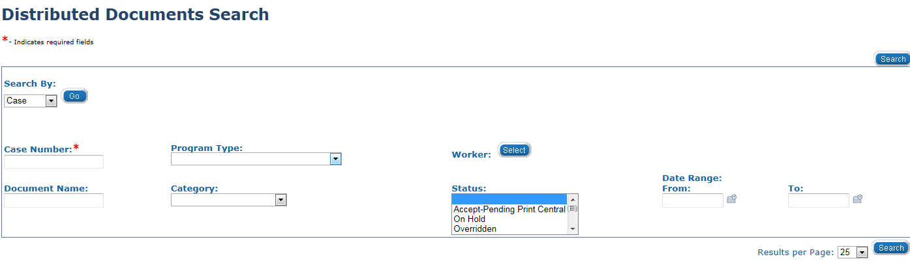
Medical Eligibility:
Forms & Notices of Action (NOAs)
Lesson 4: History and Regenerating Forms and NOAs
The Distributed Document Search page will appear
  The Case Number will populate if in the context of a case, otherwise it must be entered

Slide 34
Medical Eligibility:
Forms & Notices of Action (NOAs)
Lesson 4: History and Regenerating Forms and NOAs
Search For Past Documents
  The search can be narrowed down to
    Case or Resource
    Case Number
    Document Name
    Worker
    Status
    Program Type
    Category
    Date Range
  The number of results listed per page may also be adjusted.

Slide 35
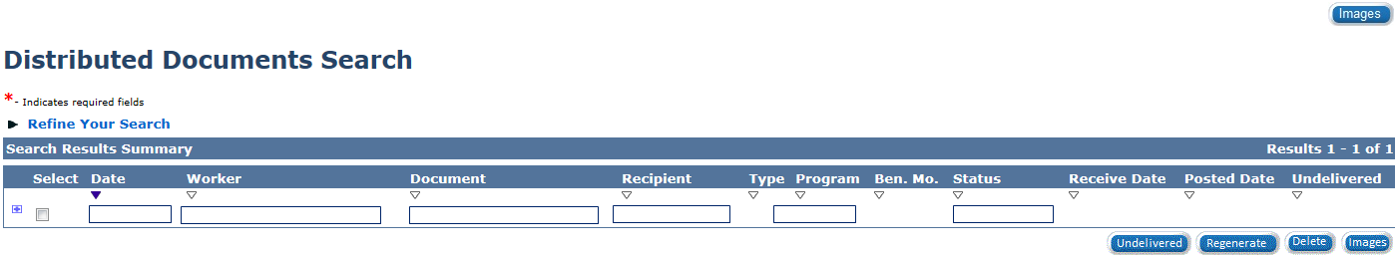
Medical Eligibility:
Forms & Notices of Action (NOAs)
Lesson 4: History and Regenerating Forms and NOAs
Regenerate A Previously Generated NOA or Form
A worker may choose to:
Regenerate
Delete
Mark Undelivered

Slide 36
Medical Eligibility:
Forms & Notices of Action (NOAs)
Lesson 4: History and Regenerating Forms and NOAs
Process Steps Review
Start with the Distributed Documents on the Local Navigation tab under the Eligibility on the Global Navigation tab
The Distributed Documents Search page appears. A search for the needed Form or NOA can be done in a number of ways
  Enter the required Case Number
  Click the Search button
If necessary refine the search by type or date range

Slide 37
Medical Eligibility:
Forms & Notices of Action (NOAs)
Lesson 4: History and Regenerating Forms and NOAs
Process Steps Continued
The Distributed Documents Search (Search Results Summary) appears
Check the box at the left of the appropriate Form
Click Regenerate
Click Save and Print Centrally. The regenerated form will be mailed centrally the next business day
On the Distributed Documents Search (Search Results Summary) page, the Status of the regenerated form will change to “Pending Reprint Central” until it is reprinted that evening
If desired, the reprinting of the document could still be deleted. After the document is reprinted, the Status will change to “Reprinted Centrally”

Slide 38
Medical Eligibility:
Forms & Notices of Action (NOAs)
Lesson 4: History and Regenerating Forms and NOAs
NOTE: Verify consumer contact information prior to regenerating a Form or NOA. A regenerated Form or NOA is an exact duplicate of the original.
If the consumer has had an address change since the original document was mailed, the regeneration will print with the same old address.
Printing a regenerated form or NOA locally and mailing to the new address may be a better option in some cases.

Slide 39
Medical Eligibility:
Forms & Notices of Action (NOAs)
Lesson 4: Summary
Summary
Past Forms and NOAs are stored in history and may be regenerated
Blank Template Forms cannot be stored
Stored Forms and NOAs are accessed through the Distributed Documents tab
Regenerated Forms and NOAs that are mailed centrally will go to the address at the time originally generated
Notes:
Regenerated documents can be generated and mailed locally or centrally. That choice should be made dependent on whether or not the address on the document is correct.

Slide 40
Medical Eligibility:
Forms & Notices of Action (NOAs)
Agenda
Lesson 1: Understanding the Terms
Lesson 2: Contents
Lesson 3: Generating and Deleting
Lesson 4: History and Regenerating Forms & NOAs
Lesson 5: Foreign Language in Forms & NOAs

Slide 41
Medical Eligibility:
Forms & Notices of Action (NOAs)
Lesson 5: Foreign Language in NOAs and Forms
Language
Most NOAs and Forms are also available in Spanish.
Notes:
No other languages are available at this time. The Language of Correspondence is the field by the Correspondence design that should be marked Spanish to get Spanish NOA.

Slide 42
Medical Eligibility:
Forms & Notices of Action (NOAs)
Lesson 5: Foreign Language in NOAs and Forms
Forms
Spanish translation is generated through the Language field of the Document Parameters window
The basic content will be in Spanish but all variables will display in English
When a Form is generated in Spanish no English version is available
An English translation is available by pulling up the same blank Form itself
In Distributed Documents, for the consumer history of documents the Form will also display in Spanish only

Slide 43
Medical Eligibility:
Forms & Notices of Action (NOAs)
Lesson 5: Foreign Language in NOAs and Forms
NOAs
Are generated by the written language selection made during data collection on the Individual Demographics page
If Spanish is selected as the primary written language for the primary individual on the case, all NOAs are generated in Spanish
When EDBC is run and finalized, the generated NOA listed on the Distributed Documents page is produced in Spanish
A parallel English version is listed immediately below
Any action to Save and Print, or later Delete the NOA must be done on the Spanish version
The English version is only available to view
After the NOA is printed it will also appear in history on Distributed Documents in Spanish with the parallel English version to view
All populated information on the Spanish NOA will be in English
Notes:
The Language of Correspondence is the field by the Correspondence design that should be marked Spanish to get Spanish NOA. There is a defect currently which is 14176. The only way to get Spanish NOA's currently is to put Spanish in the Spoken Language field. This needs to be put into Training Consideration. For most Spanish speakers all fields would be Spanish, but in case they spoke English and wanted correspondence in Spanish, the system cannot accommodate that currently.

Slide 44
Medical Eligibility:
Forms & Notices of Action (NOAs)
Lesson 5: Summary
Summary
Forms and NOAs can be generated and stored in Spanish
For Forms, the language is controlled on the Document Parameters window
For NOAs, the language is determined from the Individual Demographics page completed during data collection

Slide 45
Medical Eligibility:
Forms & Notices of Action (NOAs)
Course Summary
Forms and NOAs are simple to generate and can be printed locally or centrally
Forms have a primarily fixed content but may have populated case and office information
NOAs always take an action and are assembled from fragments when eligibility is determined (run EDBC)
Forms and NOAs should be reviewed before finalizing
Forms (except Blank Templates) and NOAs are stored and can be regenerated
Forms and NOAs can be generated and stored in Spanish

