Slide 1
Medical Eligibility
Prior Medical
Notes:
Welcome participants to the training session.
Cover any housekeeping items such as:
The location of restrooms and break rooms.
Ground rules for the training.
Instructor introductions.
Participant introductions.
Let’s talk about why we’re all here.

Slide 2
Medical Eligibility: Prior Medical
Introduction
In this course, you will learn how to add prior medical months for any medical programs in which the consumer is applying for or participating in.
After completing this course, you will be able to:
Add Prior Medical Months
Understand how Effective Dating impacts Prior Medical Coverage
Run EDBC for Prior Medical

Slide 3
Medical Eligibility: Prior Medical
Agenda
Lesson 1: Add Prior Medical Months
Lesson 2: Understand how Effective Dating impacts Prior Medical Coverage
Lesson 3: Run EDBC for Prior Medical

Slide 4
Medical Eligibility: Prior Medical
Lesson 1: Adding Prior Medical
An applicant for medical assistance may request a determination of medical eligibility for a three month period prior to the month of application.
Prior eligibility can be established even though there is no eligibility for the current base period.
Prior Medical requests can be completed at any time during the processing of an application or after the initial EDBC is run.

Slide 5
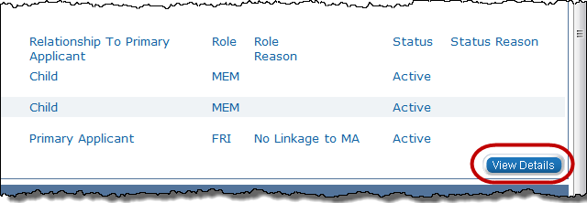
Medical Eligibility: Prior Medical
Lesson 1: Adding Prior Medical
Prior Medical is requested on the Medical Person Detail page.
Step 1: There are 7 main steps to add prior medical months to a case. On the Case Summary page click the View Details button in the Medical Program block for the consumer requesting Prior Medical.

Slide 6
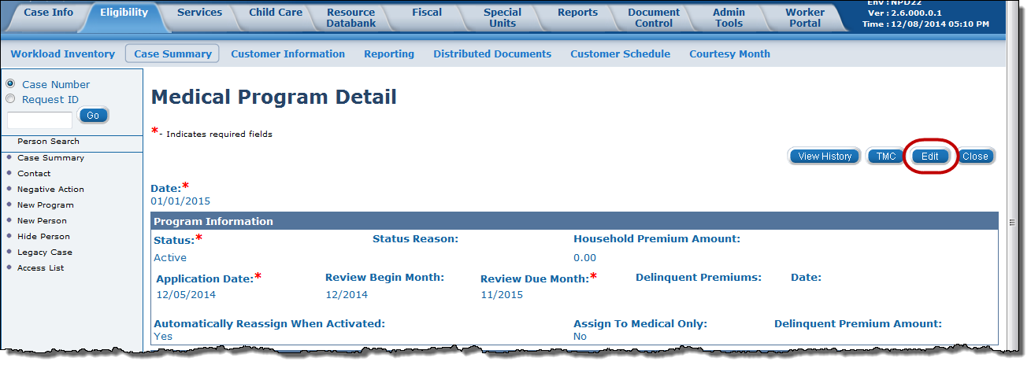
Medical Eligibility: Prior Medical
Lesson 1: Adding Prior Medical
Step 2: On the Medical Program Detail page click the Edit button.
Notes:
Now, I am going to show you how to add prior Medical.

Slide 7
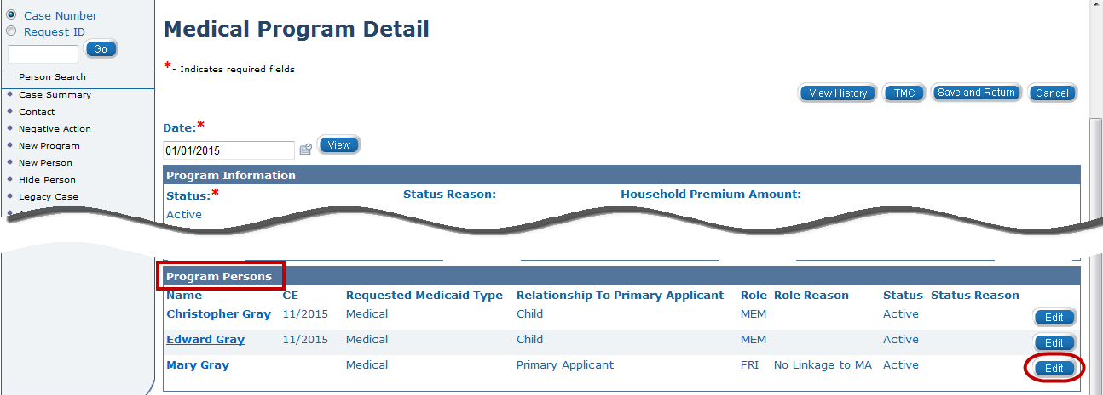
Medical Eligibility: Prior Medical
Lesson 1: Adding Prior Medical
Step 3: Click the Edit button in the Program Persons section for the consumer requesting Prior Medical.

Slide 8
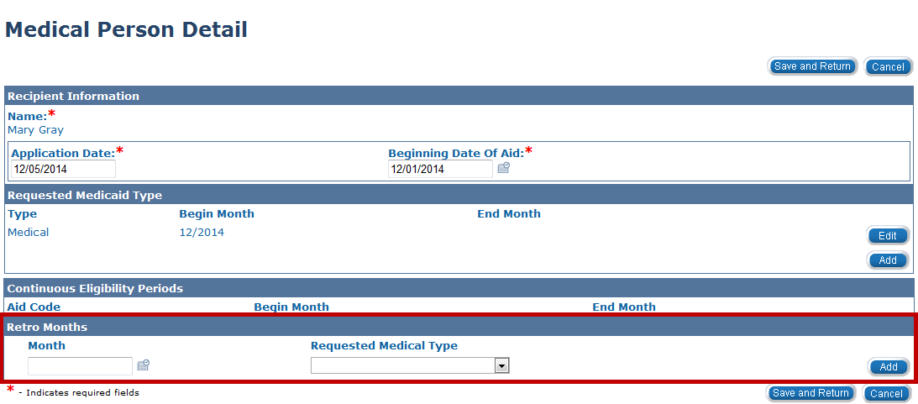
Medical Eligibility: Prior Medical
Lesson 1: Adding Prior Medical
Step 4: Medical Person Detail page appears. At the bottom of the page, in the Retro Months section you can add up to three (3) months for Prior Medical.
For each month:
  Enter the Month.
  Select the Requested Medical Type.
  Click Add.
Notes:
Don’t forget to select the “Add” button after indicating your last month.

Slide 9
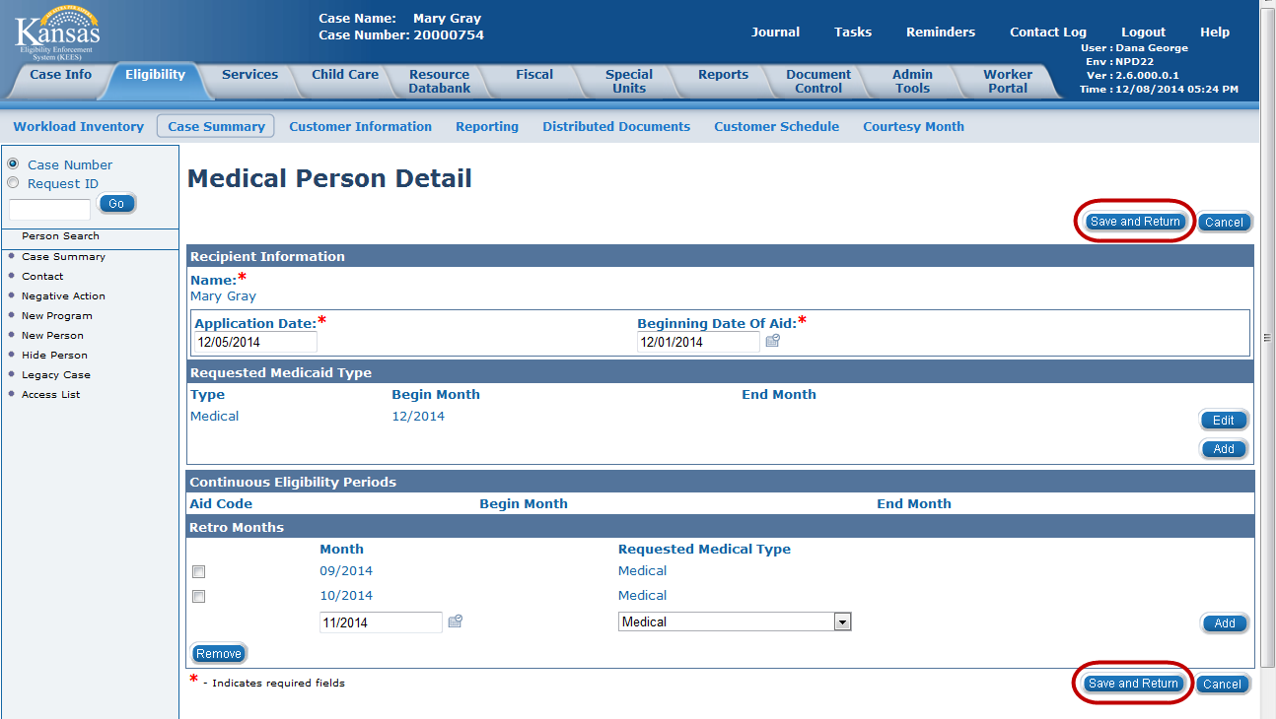
Medical Eligibility: Prior Medical
Lesson 1: Adding Prior Medical
Step 5: After all month(s) are added click the Save and Return button.

Slide 10
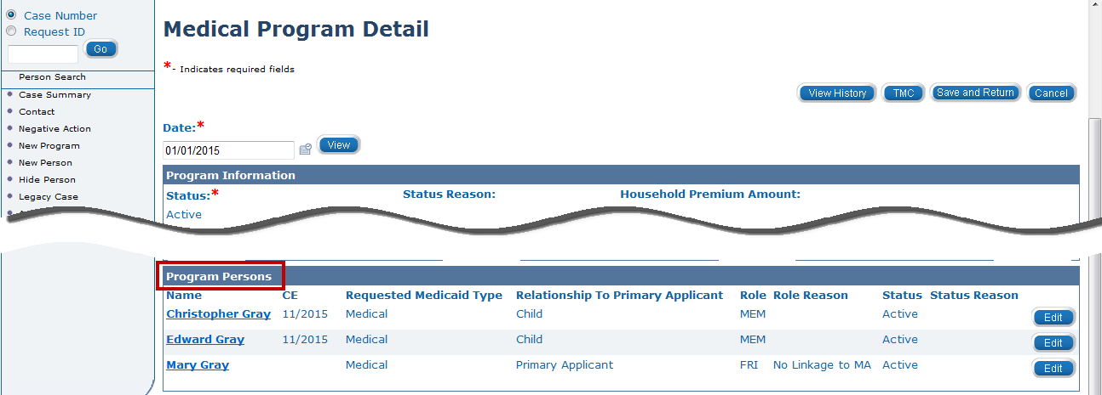
Medical Eligibility: Prior Medical
Lesson 1: Adding Prior Medical
Step 6: On the Medical Program Detail page, complete STEPS 3 through 5 for each program person requesting Prior Medical.
Step 7: When all Prior Medical has been added, click Save and Return on the Medical Program Detail page to return to the Case Summary page.

Slide 11
Medical Eligibility: Prior Medical
Lesson 1: Adding Prior Medical > Summary
In this lesson we learned :
Prior medical request can be completed at anytime.
There are 7 steps in how to add prior medical to a case.

Slide 12
Medical Eligibility: Prior Medical
Agenda
Lesson 1: Add Prior Medical Months
Lesson 2: Understand how Effective Dating impacts Prior Medical Coverage
Lesson 3: Run EDBC for Prior Medical
Notes:
Check for BOLD

Slide 13
Medical Eligibility: Prior Medical
Lesson 2: Effective Dating
It is important to capture the financial and non-financial information for these consumers for the prior medical months.
The Begin Date and End Date of these records must reflect the consumer’s situation at the time he/she is requesting prior medical coverage.
If a Begin Date is after the Prior Medical month, rules do not use that information in the benefit calculation.

Slide 14
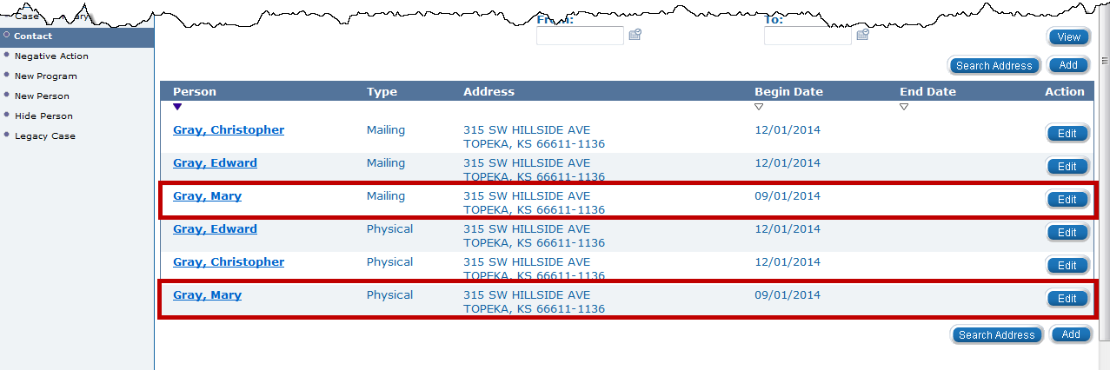
Medical Eligibility: Prior Medical
Lesson 2: Effective Dating
For example: The Begin Date for the Address, Relationships, Income, Resources, Expenses, etc., should be the first day of the month prior medical begins.
Notes:
In this example: Mary’s physical and mailing address was updated for the 3 prior medical months compared to Edward and Christopher begin dates.

Slide 15
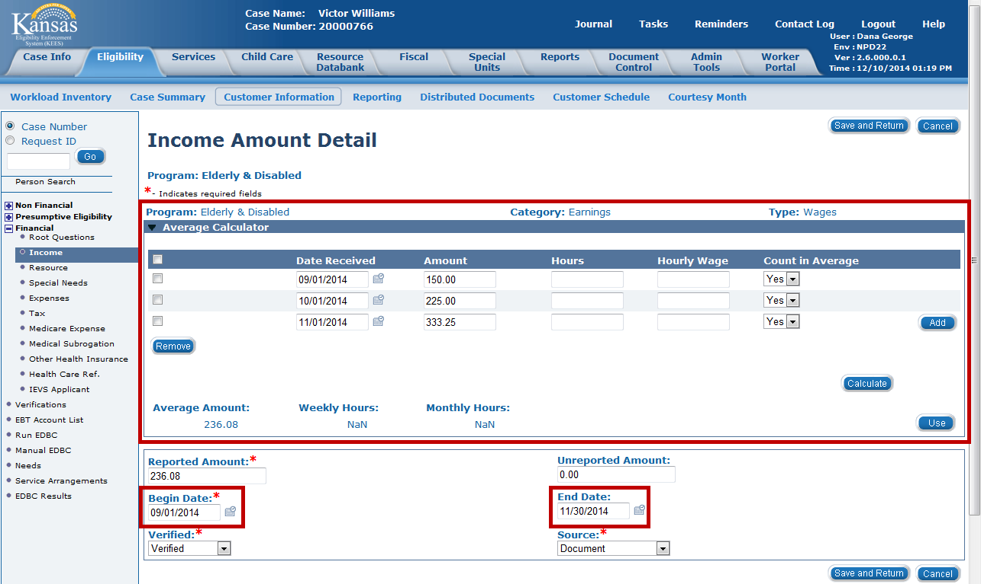
Medical Eligibility: Prior Medical
Lesson 2: Effective Dating
For Long Term Care (LTC) and Working Healthy (WH) cases, the prior medical month income must be recorded in the Average Calculator section on the Income Amount Detail page.
The Income Amount Detail is what the rules reference to capture the “actual” income received by the consumer in a prior medical month.
Notes:
The KEES User Manual will assist you in Prospective Budgeting For Prior Medical Income for Working Healthy Applications.

Slide 16
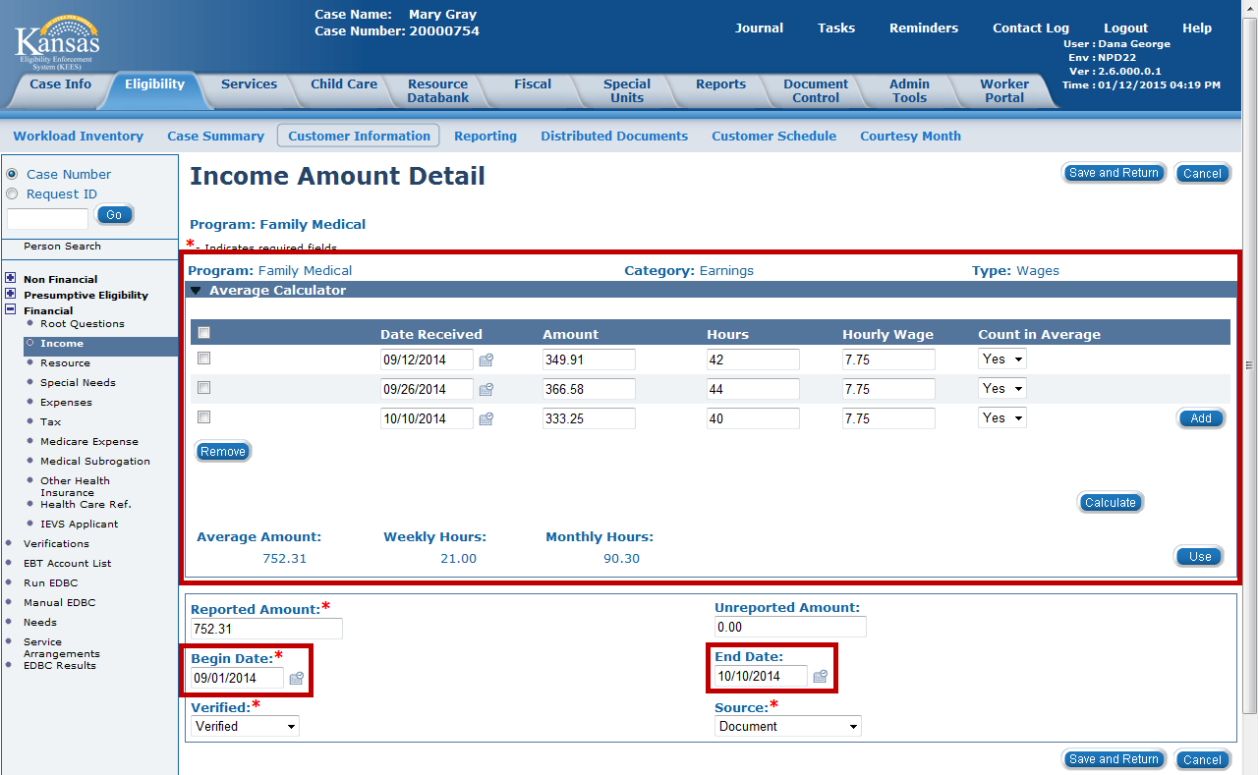
Medical Eligibility: Prior Medical
Lesson 2: Effective Dating > Summary
The Average Calculator is also used to record any actual amounts of income received in prior medical month.
Notes:
If a Begin or End date does not span the month (i.e. is the first day and/or last day of a month) the rules will use actual income from the amounts in the Average Calculator.

Slide 17
Medical Eligibility: Prior Medical
Lesson 2: Effective Dating > Summary
In this lesson we learned :
It is important to capture the financial and non-financial information for these consumers for the prior medical months.
The Begin Date and End Date of these records must reflect the consumer’s situation at the time he/she is requesting coverage.
If a Begin Date is after the Prior Medical month, rules will not use that information in the benefit calculation.
For LTC and WH cases, actual income must be recorded in the Average Calculator section for Prior Medical determination.
Notes:
Next will run EDBC for the Prior Medical

Slide 18
Medical Eligibility: Prior Medical
Agenda
Lesson 1: Add Prior Medical Months
Lesson 2: Understand how Effective Dating impacts Prior Medical Coverage
Lesson 3: Run EDBC for Prior Medical

Slide 19
Medical Eligibility: Prior Medical
Lesson 3: Run EDBC for Prior Medical
Running EDBC is the last step in authorizing Prior Medical months.
There are eight (8) steps in this process.

Slide 20
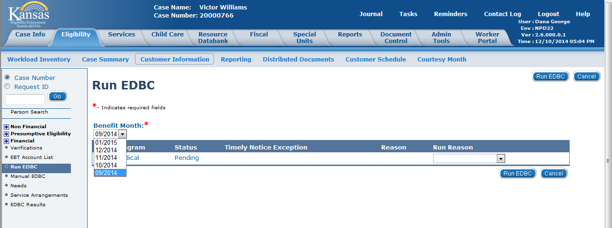
Medical Eligibility: Prior Medical
Lesson 3: Run EDBC for Prior Medical
Step 1: After the Prior Months, financial, and non-financial information has been added, navigate to the Run EDBC page.
Step 2: Select the Prior Month from the Benefit Month drop-down menu.
Step 3: Click the Run EDBC button.

Slide 21
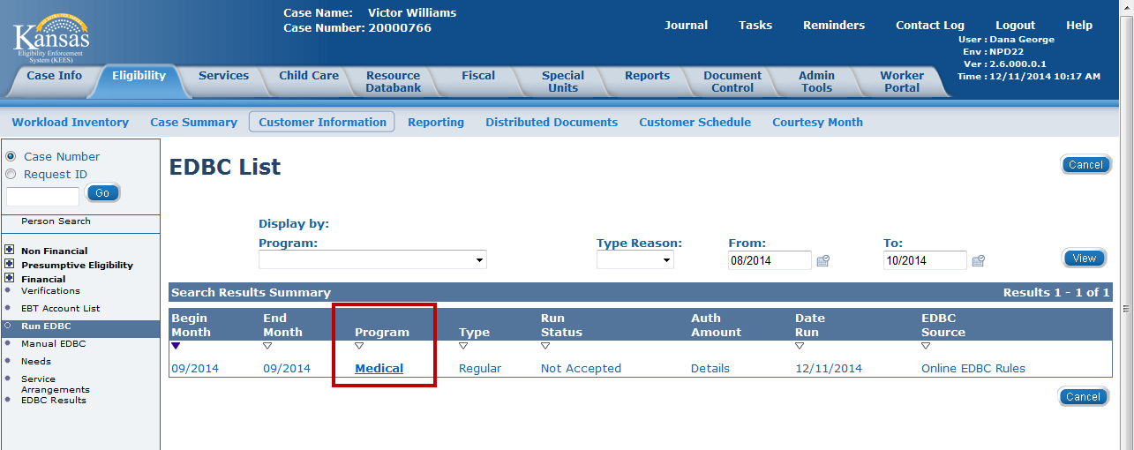
Medical Eligibility: Prior Medical
Lesson 3: Run EDBC for Prior Medical
Step 4: On the EDBC List page select the Medical hyperlink for the EDBC result in a status of “Not Accepted”.

Slide 22
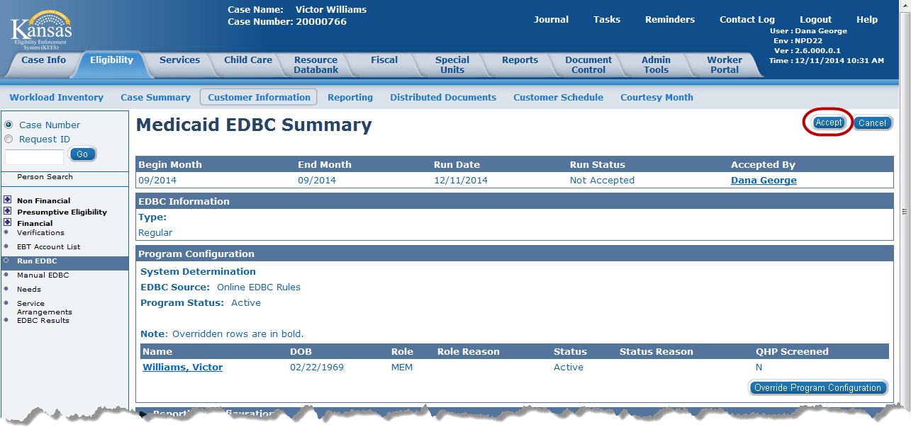
Medical Eligibility: Prior Medical
Lesson 3: Run EDBC for Prior Medical
Step 5: Review the results on the Medical EDBC Summary page.
Step 6: Click the Accept button if the results are accurate.

Slide 23
Medical Eligibility: Prior Medical
Lesson 3: Run EDBC for Prior Medical
Step 7: The EDBC List page appears with the Run Status of Accepted- Not Saved. Click the Save and Continue button.
Step 8: Review all auto-generated Notifications for accuracy.
Repeat Steps 1 to 8 for each month of requested Prior Medical.

Slide 24
Medical Eligibility: Prior Medical
Lesson 3: Run EDCB for Prior Medical > Summary
In this lesson we learned :
How to run EDBC for the prior medical months.
There are eight (8) steps in authorizing Prior Medical months that need to be repeated for each prior medical month requested.
It is important to review and verify each Prior Medical month before accepting the results.

Slide 25
Medical Eligibility: Prior Medical
Summary
In this course, you learned how to:
Enter Prior Medical months
Understand how a “Rules Engine” relates to EDBC
Run EDBC
Review and Verify EDBC
Run EDBC for Prior Medical
Notes:
Remember to update all pertinent data collection records for the prior medical months.
Don’t forget to Run EDBC for each Prior Medical months.

