Slide 1
Medical Eligibility
Registration
Notes:
Welcome participants to the training session.
Cover any housekeeping items such as:
The location of restrooms and breakrooms.
Ground rules for the training.
Instructor introductions.
Participant introductions.
Transition: Let’s talk about why we’re all here.

Slide 2
Medical Eligibility: Registration
Introduction
In this course you will learn about the File Clearance and Registration process.
After completing this course, you will be able to complete the following actions in KEES:
Perform a Person Search
File Clear Case Persons
Register Applications
Notes:
Let’s take a closer look at what we will be covering in this course.

Slide 3
Medical Eligibility: Registration
Agenda
Lesson 1: Performing a Person Search
Lesson 2: Completing File Clearance
Lesson 3: Registration
Lesson 4: e-Summary Registration (CH only)
Lesson 5: Existing Case Registration
Notes:
PPS- (Prevention & Protection Services) - any specific/special process unique to PPS will have PPS called out on the slide as well as in the notes.

Slide 4
Medical Eligibility: Registration
Lesson 1: Performing a Person Search > Introduction
The Person Search process is completed prior to File Clearance to help a user determine whether a person currently exists in KEES, and whether they already have a usable case number.
It is important to complete a thorough search as to avoid creating duplicate persons or additional case numbers during the File Clearance and Registration process.
Notes:
Let’s take a look at the Person Search page.

Slide 5
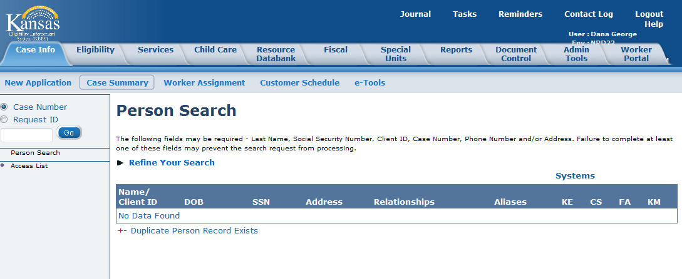
Medical Eligibility: Registration
Lesson 1: Performing a Person Search > Person Search results
No search results display if the consumer is not known to KEES. A user could click on Refine Your Search to add additional information for the search criteria such as DOB & SSN.

Slide 6
Medical Eligibility: Registration
Lesson 1: Performing a Person Search > DOB / SSN
KEES will return every person whose Date of Birth matches according to the following:
Month may be off by +1 or -1
KEES will return every person whose Social Security Number matches according to the following:
SSN may be off by +1 or -1 in any one of the sections (first 3 numbers; middle 2 numbers; last 4 numbers)
Ex: 11/07/01 would return 10/07/01 and 12/07/01
Day may be off by +1 or -1
Ex: 11/07/01 would return 11/06/01 and 11/08/01
Year may be off by +1 or -1
Ex: 11/07/01 would return 11/07/00 and 11/07/02
SSN 123-45-6789 looking at the first 3 numbers only:
Could return 023, 223, 113, 133, 122, or 124
Notes:
This search criteria will be applied by KEES automatically.

Slide 7
Medical Eligibility: Registration
Lesson 1: Performing a Person Search > Person Search
The Person Search page utilizes wild card searches.
Wild card searches can be performed on both the first name and last name of the consumer.
This means that the user can enter only partial first and last names followed by an asterisk (*) to get a larger return on their search.
Notes:
Any number of things on the screen can be searched for, with the exception of relationships, which has been disabled for Phase 2.
Let’s look at how the wild card search works.

Slide 8
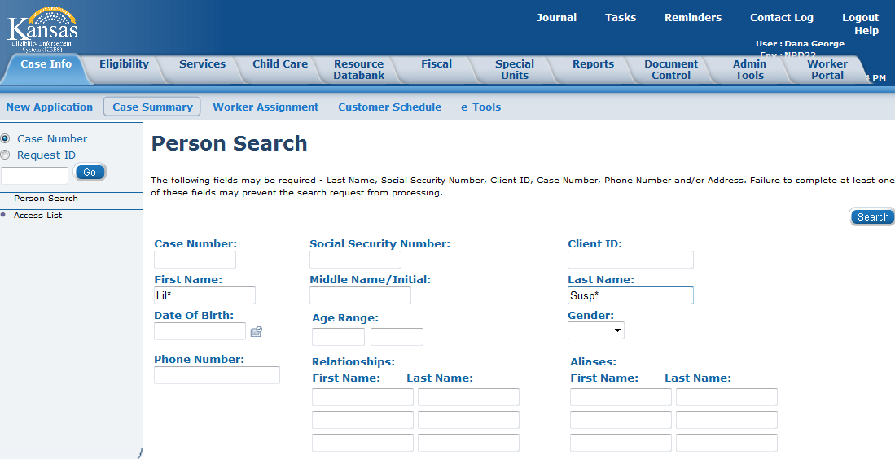
Medical Eligibility: Registration
Lesson 1: Performing a Person Search > Person Search
If the user was looking for Lilly Suspend they could enter Lil* Susp*. This would return any persons in KEES whose first three letters of their first name were ‘Lil’ and the first four letters of their last name were ‘Susp’.

Slide 9
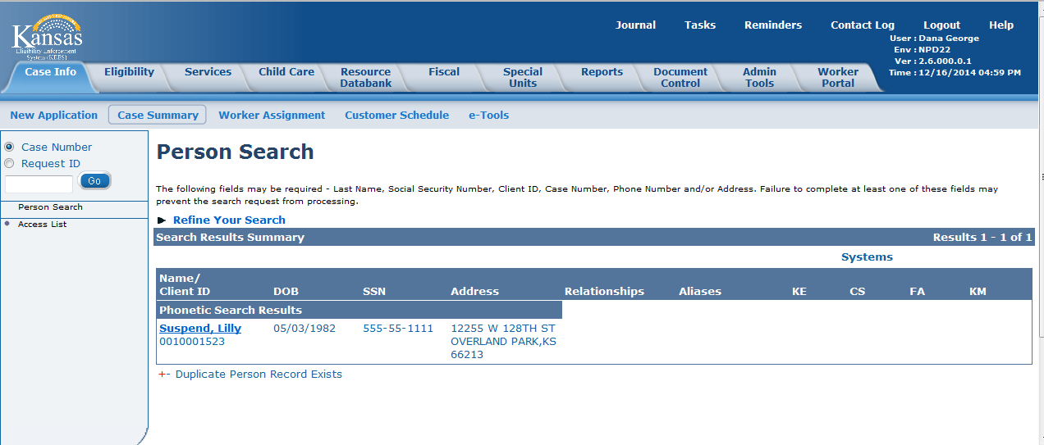
Medical Eligibility: Registration
Lesson 1: Performing a Person Search > Person Search results
KEES will perform a comprehensive search and return any potential matches for the user to review. If a user is uncertain whether one of the potential matches that was returned is the person they were looking for, additional case specific information can be used to aid in the decision. By clicking the name hyperlink a user will be directed to the Person View page.
Notes:
If too many candidates are returned, the user can click on Refine Your Search to go back to the Person Search page (maintaining previously entered info) and add additional info.

Slide 10
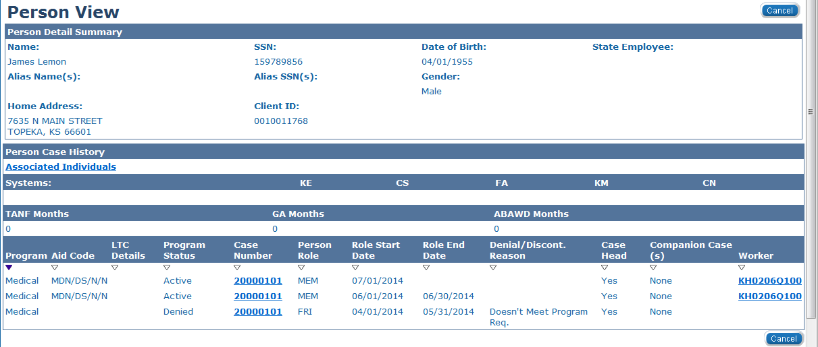
Medical Eligibility: Registration
Lesson 1: Performing a Person Search > Person View
The Person View page displays a holistic view of the individual and case related details. From here the user will be able to see all of the case numbers the person is associated to. The Person View page is very helpful when trying to determine whether a person has a usable case number.
Notes:
We need to determine if this is the James Lemon we are looking for. The Case Number is a hyperlink. Any case numbers listed here will link the user to the Case Summary page for that particular case. The Case Summary page will provide the user with an overview of the case and all of the programs and persons associated with it.
Under the section labeled “Systems” – [KE=known to KEES, CS=known to CSE, FA=known to FACTS, KM=known to KMIS] – CS, FA, and KM will have NO indicators for Phase 2.

Slide 11
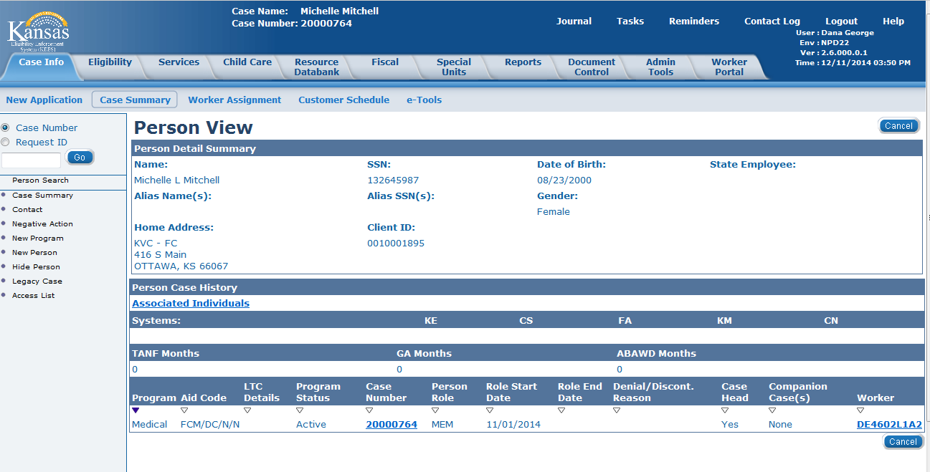
Medical Eligibility: Registration
Lesson 1: Performing a Person Search > Person View
PPS
The Person View page displays a holistic view of the individual and case related details. From here the user will be able to see all of the case numbers the person is associated to. The Person View page is very helpful when trying to determine whether a person has a usable case number
Notes:
This is a PPS Slide only ****

Slide 12
Medical Eligibility: Registration
Lesson 1: Performing a Person Search > Case Number
PPS
What is a usable case number?
Usable case is one that has a foster care medical program with a medical aid code of FCM/DC/N/N/, FCM/JC/N/N, or FCM/TC/N/N/. DC= DCF; JC=KDOC-JS; TC=Tribal cases.
Adoption Cases will have a medical aid code of ASM/C/N/N.
Notes:
This is a PPS Slide only

Slide 13
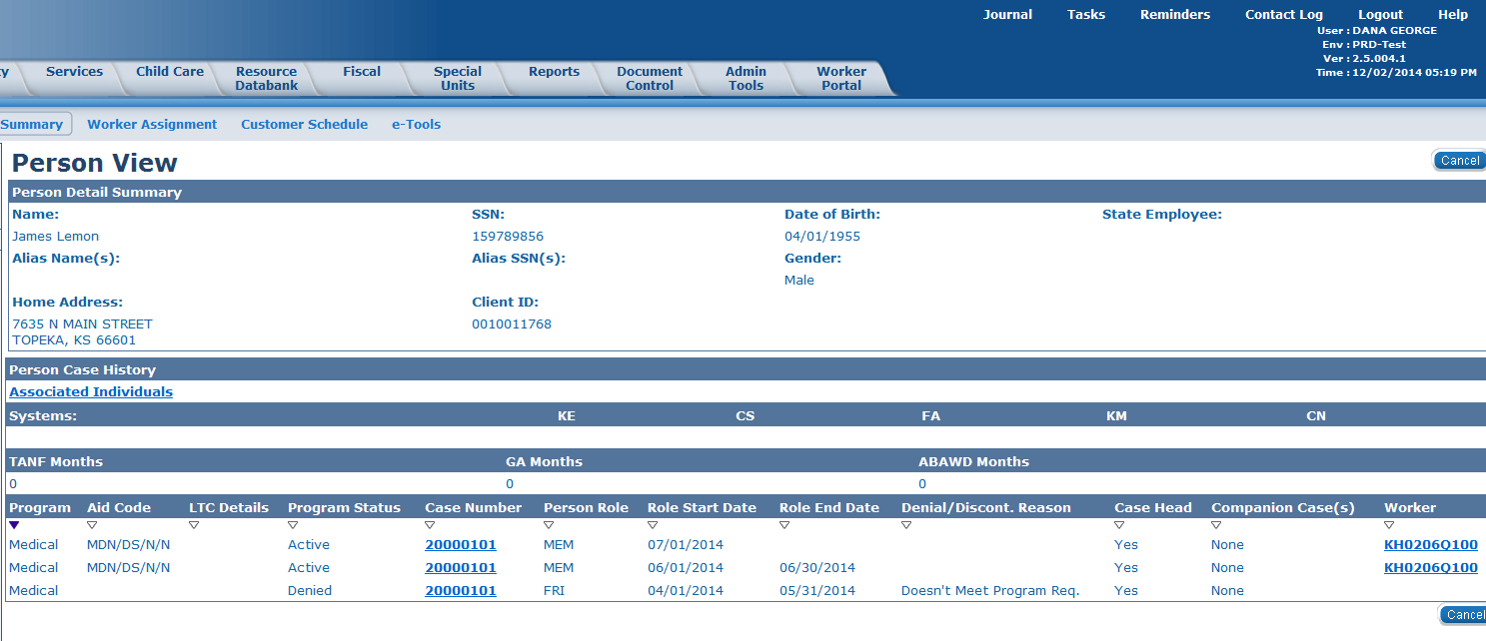
Medical Eligibility: Registration
Lesson 1: Performing a Person Search > Case Number
Hdetermine a usable case number:
Under Program look for Medical or SSPP. If Medical is listed - look under Aid Code. If first 3 letters are FCM or ASM then it should NOT be used by any program other than Foster Care or Adoption Support medical.
A user may need to look at several case numbers, as well as, the Case Head field to determine the best case number to use.
Notes:
FCM = Foster care medical; ASM = Adoption support medical
Due to conversion- it is possible that a consumer has many different case numbers listed. It is important to have a high level discussion of how to find the best case to use. Refer to the KEES user manual as well.
NOTE: A worker will need to perform a Person Search on each individual applying for coverage.

Slide 14
Medical Eligibility: Registration
Lesson 1: Performing a Person Search > Summary
In this lesson we have discussed the Person Search process using the wild card searches and how to identify a usable case number.
Now let’s take a look at the File Clearance process.

Slide 15
Medical Eligibility: Registration
Agenda
Lesson 1: Performing a Person Search
Lesson 2: Completing File Clearance
Lesson 3: Registration
Lesson 4: e-Summary Registration (CH only)
Lesson 5: Existing Case Registration

Slide 16
Medical Eligibility: Registration
Lesson 2: Completing File Clearance > Definition
What is File Clearance?
File Clearance is the process of searching for a person to determine if they are currently known to KEES and whether they are associated to any existing case numbers.
It also includes adding new persons to KEES and assigning a Client ID to them.

Slide 17
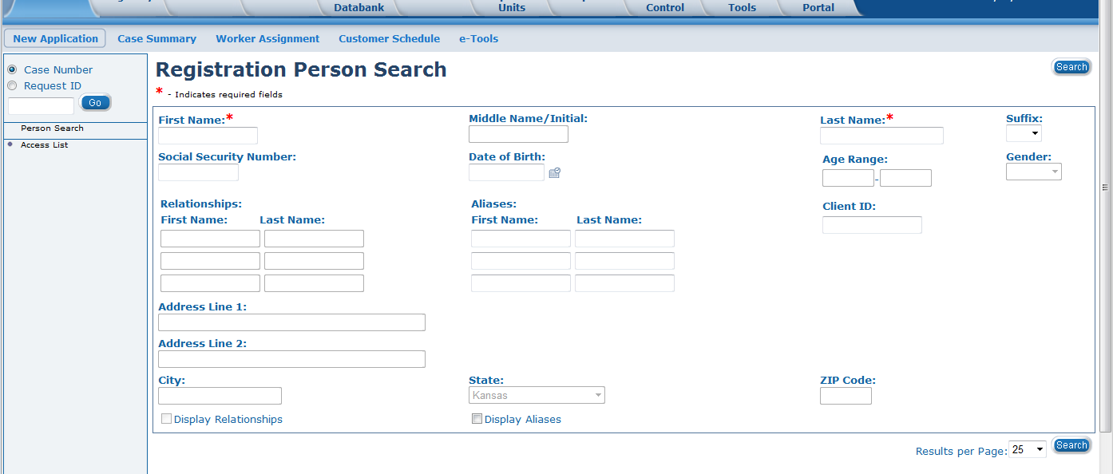
Medical Eligibility: Registration
Lesson 2: Completing File Clearance > Registration Person Search
Since a Person Search has already been completed and the person was not found, the user should enter the person’s full name, SSN, and DOB (or as much is known). Whoever is file cleared first will be the Case Head for this medical case.
Notes:
If the person was not known to KEES, the more info the user enters here, the less info that will have to be added later after the case has been created. This is not an issue for persons known to KEES as nothing entered on this page will “add” anything that was previously unknown.
*This is where the Person Search we performed comes into play. If any of the applicants are known to KEES, and have a usable case number, we would want to file clear the Case Head (or case owner) for that case number FIRST. This is done because that existing case number is chosen based off of the first person you file clear. Therefore, if Jack, Jane, and Joey submit an application and Jane and Joey had an existing case number, you would be unable to select that case number if you file cleared Jack first (because he was not known to that case number previously).
For Phase 2, several fields on this page have been disabled. Age Range, Relationships, and Address will NOT be searchable fields.

Slide 18
Medical Eligibility: Registration
Lesson 2: Completing File Clearance > Search Criteria
If available, search for an EXACT match on SSN, DOB, and First Name.
If this matches then this is considered an exact match for the person.
If available, search for an EXACT match on SSN (not considering any other search criteria) AND search for:
First Name (with assumed 2 character wild card)
Ex: If name is James, the system will search for Ja*
Last Name (with assumed 3 character wild card)
Ex: If name is Lemon, the system will search for Lem*
Notes:
This search criteria will be applied by KEES automatically – it does not require the user to add the wild card.
A wild card search performed on the name Lindsay [Li*] could return – Lindsay, Lindsey, Lindy, Linda (and so on).

Slide 19
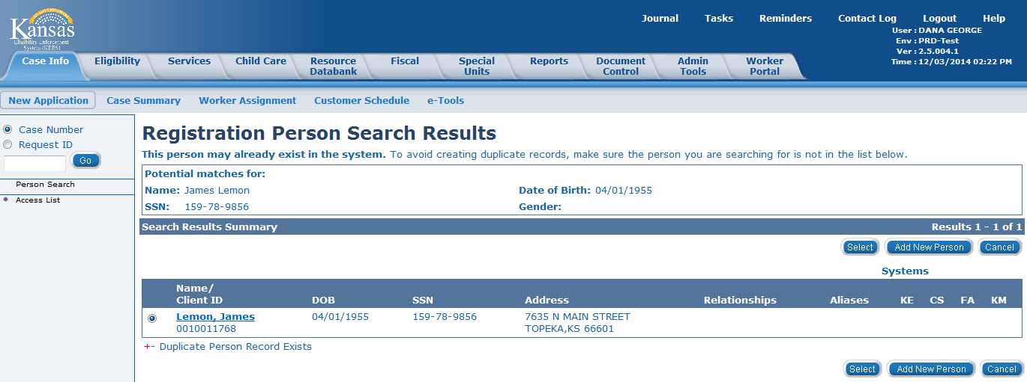
Medical Eligibility: Registration
Lesson 2: Completing File Clearance > Search Results
If the person already exists in KEES, use the radio button to identify the correct consumer and then click the Select button.
If the person is not known to KEES, the user will click Add New Person.
Notes:
Next, let’s take a look at the Registration Person Detail page.

Slide 20
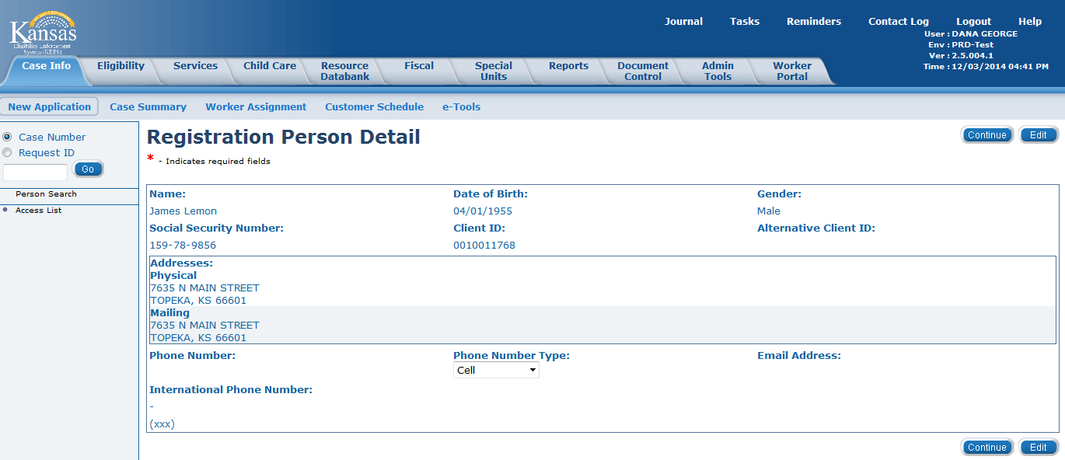
Medical Eligibility: Registration
Lesson 2: Completing File Clearance > Registration Person Detail
If the person is known to KEES, then information (address, phone number & e-mail address) known to KEES will populate on the Registration Person Detail page. If a consumer is not known to KEES, the user will enter the information on the data collection pages after registration has been completed.

Slide 21

Medical Eligibility: Registration
Lesson 2: Completing File Clearance > Registration Person Detail
The Alternative Client ID is the consumer’s client ID from KAECSES. It is only used if the consumer is not known to KEES .
Notes:
This is a DCF process ONLY) The Alternative Client ID is only necessary when the consumer is known to KAECSES but NOT known to KEES. This should only happen if a consumer applies for non-medical assistance without requesting medical coverage. That would cause the person to be added to KAECSES, but not to KEES. When a user creates a new person in KEES, they would add the person’s KAECSES Client ID (if they are known to KAECSES) to the Alternative Client ID field. Because of this, if a user is registering BOTH a medical application and a non-medical application at the same time, they MUST start with the non-medical application registration in KAECSES then move to KEES.

Slide 22
Medical Eligibility: Registration
PPS
The business process for PPS medical applications is two steps:
  The Social Worker (DCF), Community Service Officer (Kansas Department of Corrections – Juvenile Services; KDOC-JS), or Social Worker – Tribal Agency submit an application – PPS 5410A Initial IV-E Eligibility Determination, notification of placement, and supporting eligibility documents.
  The eligibility specialist completes the PPS 5410B – Initial IV-E eligibility determination to determine whether the child is funding eligible for Foster Care. Similar forms are used for Adoption Assistance. This determination is not completed in KAECSES or KEES at this time.
  ES will register the case in KAECSES first and then register in KEES.
  The KAECSES Client ID will be entered as an alternative ID on the Registration Person Detail page during the KEES registration process.
Notes:
THIS IS A PPS SLIDE ONLY ****

Slide 23
Medical Eligibility: Registration
Lesson 2: Completing File Clearance > Summary
In this lesson we learned about the file clearance process.
We have seen the differences in a person known to KEES and someone not known to KEES.
We have also discussed when to add the Alternate Client ID.
Now let’s move on to Registration.

Slide 24
Medical Eligibility: Registration
Agenda
Lesson 1: Performing a Person Search
Lesson 2: Completing File Clearance
Lesson 3: Registration
Lesson 4: e-Summary Registration (CH only)
Lesson 5: Existing Case Registration

Slide 25
Medical Eligibility: Registration
Lesson 3: Registration > Introduction
Registration is the process of adding persons from an application to the appropriate case. Case registration for KEES includes the following:
Creating a case
Adding case persons
Creating a program
Adding program persons
Assigning a worker to the program

Slide 26
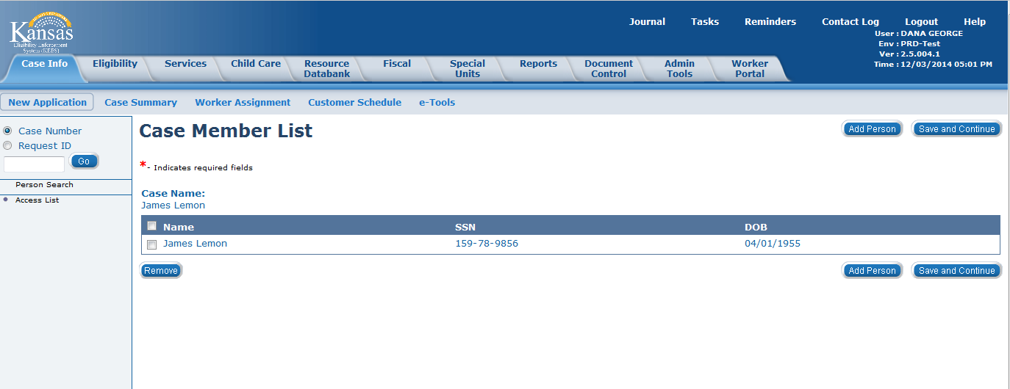
Medical Eligibility: Registration
Lesson 3: Registration > Case Member List
After a person has been searched for and chosen, the Case Member List page is displayed so that the user can create a new case. At this point, it is a ‘shell’ and the user will continue to add additional household members to the case until all have been added.
Notes:
To add additional members to the case, the user would click the Add Person button. This would then take the user through the File Clearance process for each additional member. To save the case and all the members that have been added to it, the user would click the Save and Continue button. This would take the user to the New Programs Detail page.
The Remove button will allow the user to remove a person just added to the case, however the person has already been created in KEES at this point and been assigned a Client ID.

Slide 27
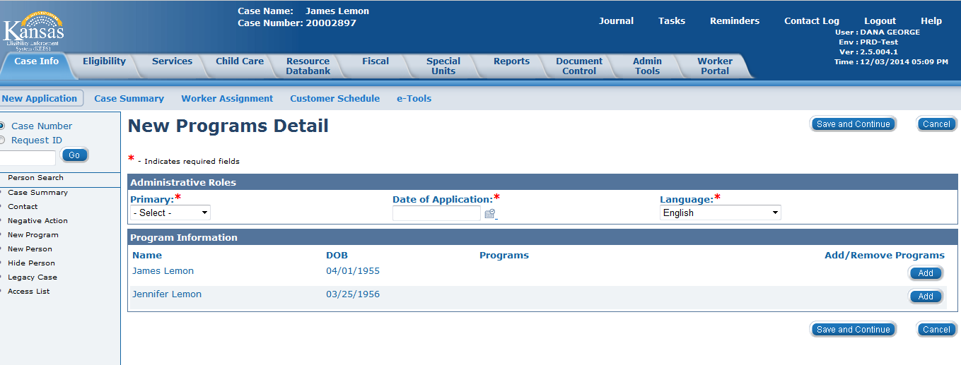
Medical Eligibility: Registration
Lesson 3: Registration > New Programs Detail
Once all members have been added, the New Programs Detail page displays prompting the user to select a person to be the Primary Applicant for the program and what program the consumer(s) is requesting. For PPS only- the child will always be chosen as the Primary Applicant.

Slide 28
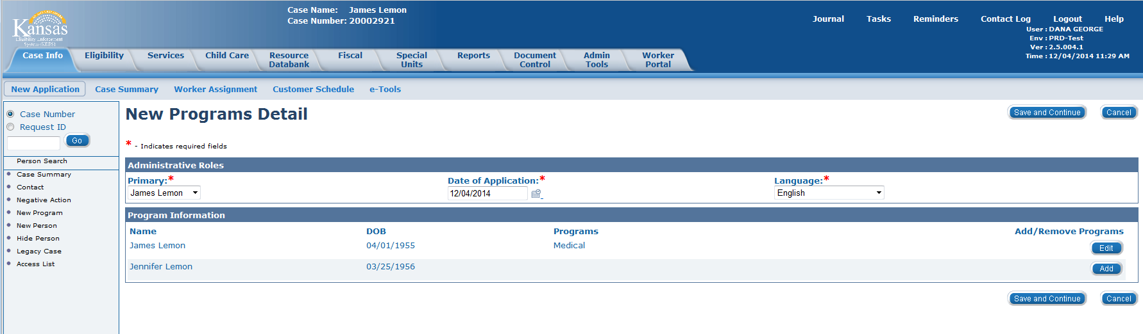
Medical Eligibility: Registration
Lesson 3: Registration > New Programs Detail
The Add Program process repeats for each applicant requesting coverage. Each person that is added to the Medical program at this step, will share the same Medical program block. Therefore, if any applicant requires their own program block, do not add it here – it will need to be added in a later step.
Notes:
It is very important that the user NOT click on the Cancel button on this page. At this point, a case has already been created and Cancel will navigate the user to the Case Summary page without adding any programs, or completing the worker assignment.

Slide 29
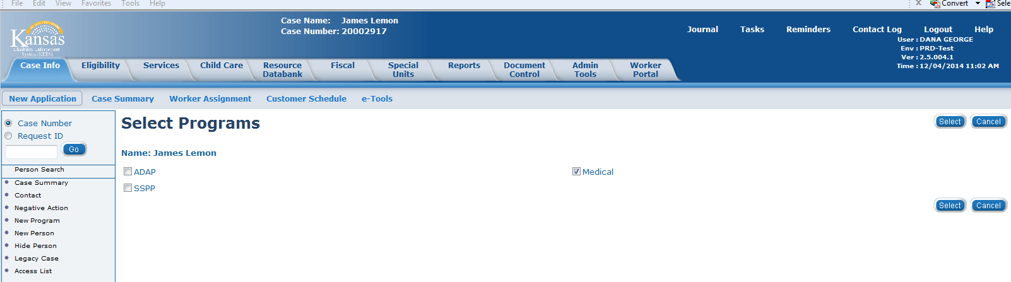
Medical Eligibility: Registration
Lesson 3: Registration > Select Programs
Here the program (usually Medical) will need to be selected for the individual. Medical encompasses all of the different program types except for ADAP and SSPP.
Once the program has been checked, the user will click the Select button.
Notes:
The select programs step is repeated for each applicant.
Once this step has been completed, the Case Number will be created.

Slide 30
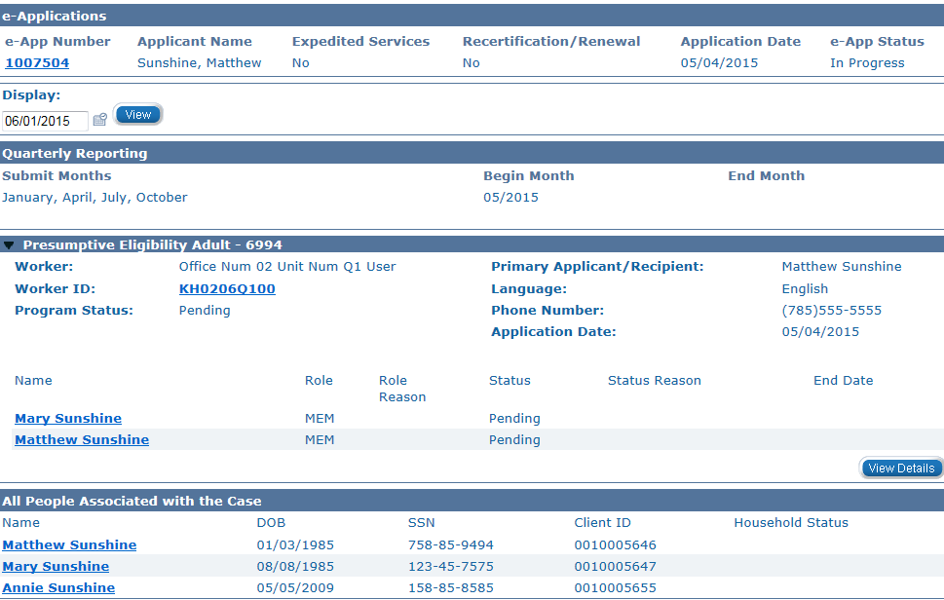
Medical Eligibility: Registration
Lesson 3: Registration > Case Summary
After adding the consumers and programs the user is taken to the Case Summary Page where the user will see all the entered information.
At the bottom of the Case Summary page you will see a block called ‘All People Associated with the Case’. This is where all of the Case Persons will be listed.

Slide 31
Medical Eligibility: Registration
Lesson 3: Registration > Case Person
A Case Person is a person who is part of the case, but may or may not be requesting aid for themselves.
A Case Person can NEVER be removed from the case. They can have a Household Status of “Permanently Out of the Home” and can even be “hidden” so as not to appear on other pages throughout the system.
Notes:
Now let’s go back to the Case Summary page to look at a program block.

Slide 32
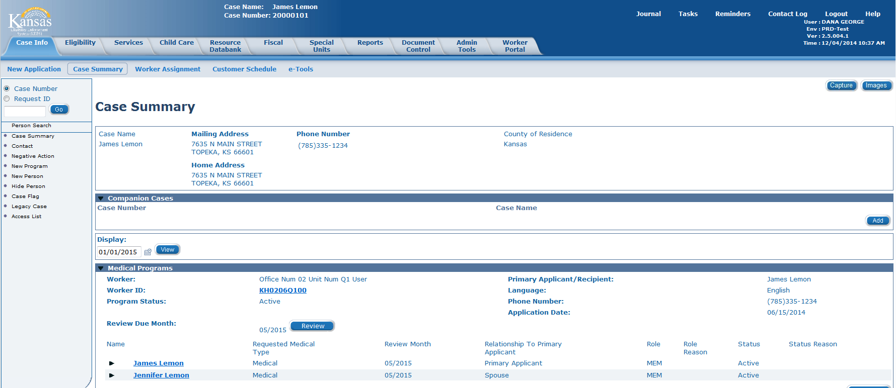
Medical Eligibility: Registration
Lesson 3: Registration > Program Blocks
This is an example of the Case Summary page showing one medical program block.

Slide 33
Medical Eligibility: Registration
Lesson 3: Manual Case Registration > Program Blocks
What is a Program Block?
A program block shows the program details for each program on the case. Some of the details that will display in the program block are:
The program persons (applicants and the case persons financially responsible for them).
The type of medical coverage being requested.
The status of the medical request.
The worker or work team assigned to the program block.

Slide 34
Medical Eligibility: Registration
Lesson 3: Registration > Program Blocks
KDHE managed medical programs and DCF managed medical programs can live together on the same case number, but are never combined on the same program block.
Once a KDHE medical program block or DCF medical program block becomes active, it remains a program block for that agency. This means that if it should become inactive at some point, it should not be used as a program block for the other agency.
PPS will have only one program block for FC/AS medical and will be on their own case number.

Slide 35
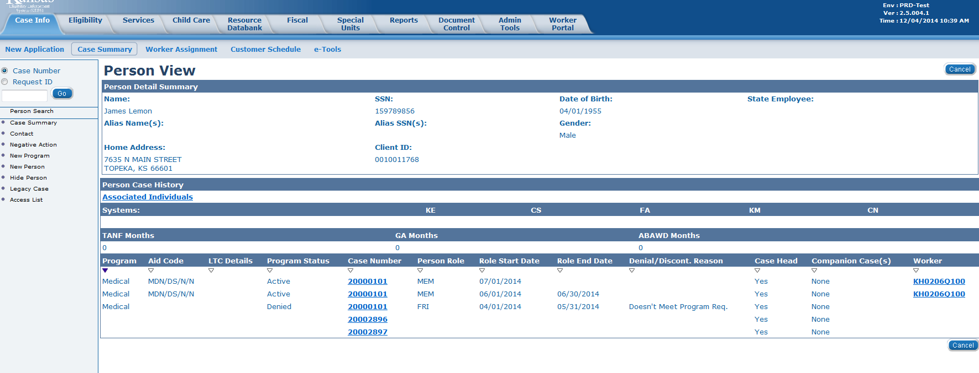
Medical Eligibility: Registration
Lesson 3: Registration > Program Blocks
How to tell which agency “owns” the program block:
On the Person View page - under Worker - the first letter will be a “D” for DCF or “K” for KDHE. This same information can be located on the program block itself.
Notes:
This same information can be located on the program block itself on the Case Summary page.

Slide 36
Medical Eligibility: Registration
Lesson 3: Registration > Program Blocks
Long Term Care (LTC) and Home and Community Based Services (HCBS) recipients each get their own Medical program block, however they can share a case number with any other medical program other than PPS.
PPS will use the same program block for PPS, LTC and HCBS. They will just update the RMT as needed.
Notes:
Long Term Care (LTC) and Home and Community Based Services (HCBS) recipients each get their own Medical program block, however they can share a case number with any other medical program other than PPS.

Slide 37
Medical Eligibility: Registration
Lesson 3: Registration > Program Blocks
Husband and Wife both requesting a Medicare Savings Program
Add both applicants at the same time to a Medical program block.
Husband requesting LTC and wife requesting a Medicare Savings Program
Each applicant will get their own Medical program block.
Only one program can be added during the initial Registration process.
The key is in understanding which program types can share a program block, and which cannot.
Notes:
In the second example two individual program blocks will be needed. One of them can be created now during the initial Registration process. The other one will be added later after the case has been established.

Slide 38
Medical Eligibility: Registration
Lesson 3: Registration > Program Blocks
Family of four all requesting Family Medical
Add all applicants at the same time to a Medical program block.
Same family of four but one child is requesting HCBS
Family Medical applicants are added to the same Medical program block at the same time. Other child will need a separate Medical program block.
Only one program can be added during the initial Registration process.
Notes:
In the second example, two individual program blocks will be needed. One of them can be created now during the initial Registration process. The other one will be added later, after the case has been established.

Slide 39
Medical Eligibility: Registration
Lesson 3: Registration > Administrative Roles
  PPS- Administrative Role
  Child will always display as the Primary Applicant/Recipient.
  Begin Date for Medical will always default to the first day of the month. If the child is eligible one day in the month they are eligible for the entire month. This date should never be changed.
  A “Placement Provider” will always be assigned from the Resource Data Bank for Foster Care Medical cases. Exception is if child is in detention or PRTF.
  A “PPS Payee will always be assigned from the RDB for Adoption Medical cases.
  Begin Date for Placement Provider or PPS Payee is the actual date of placement with that provider.
Notes:
PPS ONLY *****************
Case Summary > View Details > Medical Program Detail > Edit – this will take you to the Administrative Roles block where the user will Add/Edit the roles

Slide 40
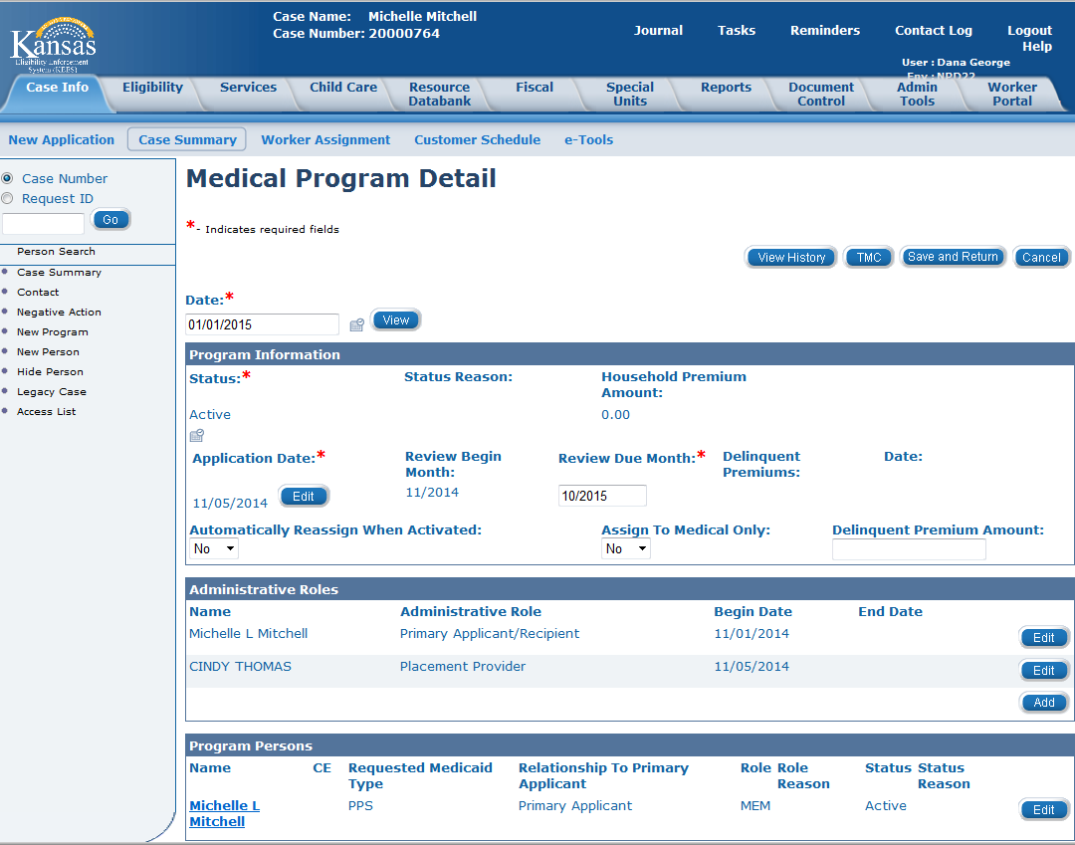
Medical Eligibility: Registration
Lesson 3: Registration > Administrative Roles
PPS
Notes:
Case Summary > View Details > Medical Program Detail > Edit – this will take you to the Administrative Roles block where the user will Add/Edit the roles

Slide 41
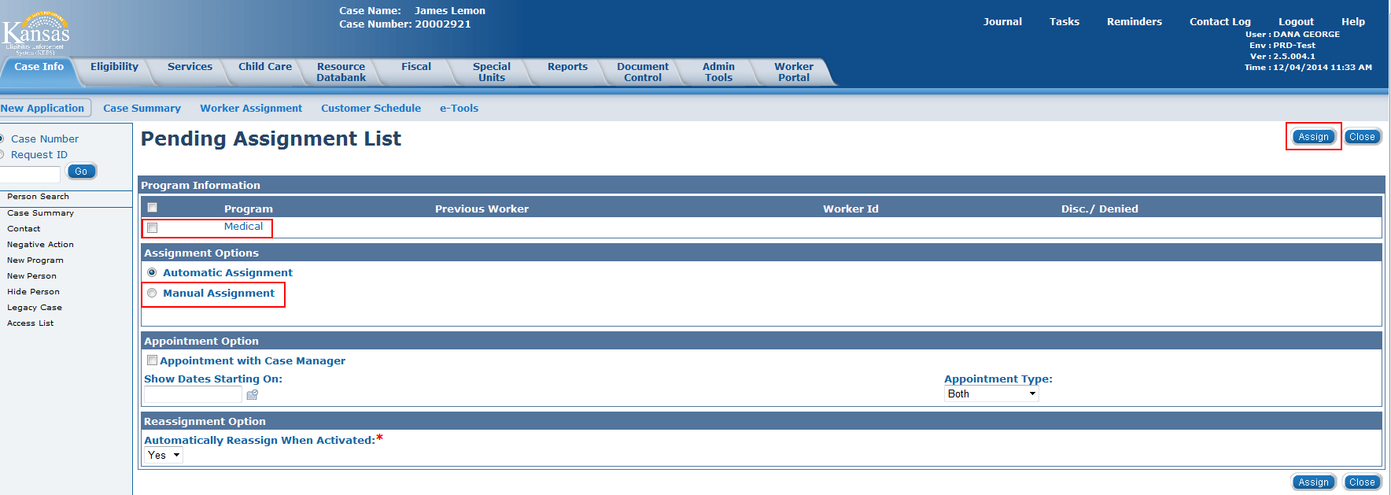
Medical Eligibility: Registration
Lesson 3: Registration > Pending Assignment List
The Pending Assignment List page is used to assign a worker or work team to the newly created Medical program. The user can choose to either assign the program manually, or allow KEES to assign it automatically using behind-the-scenes logic.
Notes:
You will want to follow your office procedure as to which process you will use. EES will always use Manual Assignment.
It is very important that the user NOT click on the Close button on this page. Close will navigate the user to the Case Summary page without completing the worker assignment process.

Slide 42
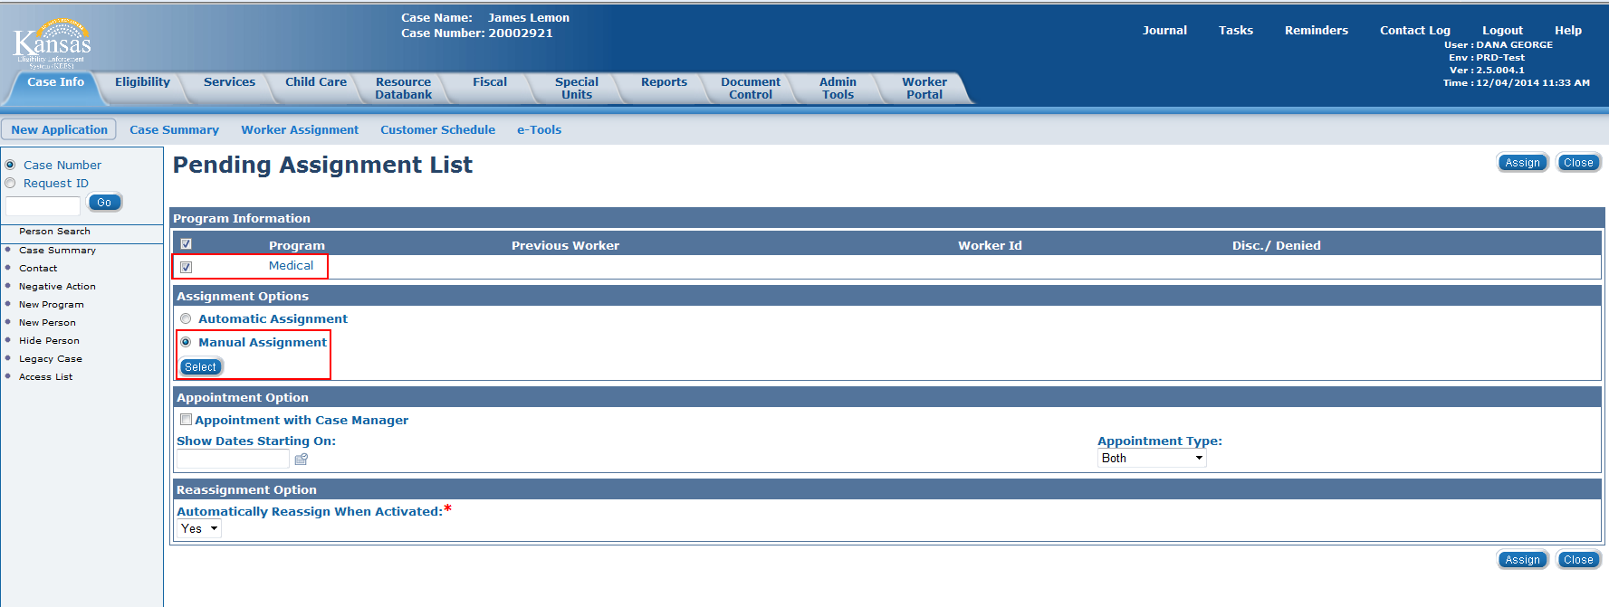
Medical Eligibility: Registration
Lesson 3: Registration > Pending Assignment List
To manually assign a program, the user will select the program they wish to assign, and then select the radio button to the left of Manual Assignment. Clicking on the Select button will take the user to the Select Worker page.

Slide 43
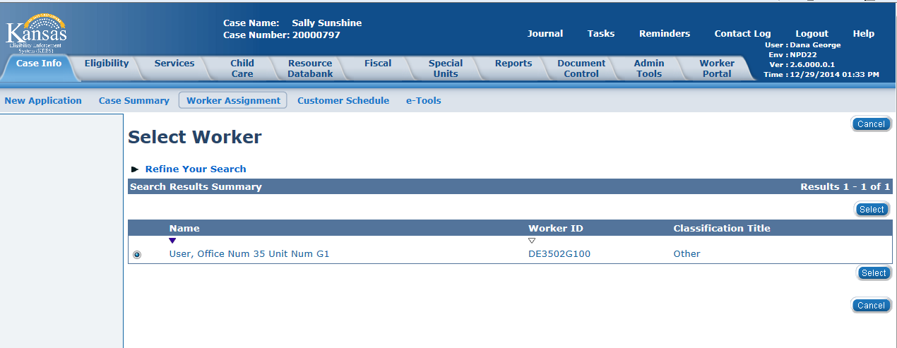
Medical Eligibility: Registration
Lesson 3: Registration > Select Worker
The user will enter the Worker ID from the Worker ID list or, for PPS cases, the user will enter their own Worker ID or their name to assign the case to themselves.
Notes:
Worker Assignment is the last step in the Registration flow and once it has been completed, the user will be taken to the Case Summary page.

Slide 44
Medical Eligibility: Registration
Lesson 3: Registration > Pending Assignment List
If automatic assignment is chosen, KEES applies behind-the-scenes logic to assign the program to the appropriate worker.
If the auto assignment logic is unable to find a worker or work team that meets all of the auto assignment criteria, the user will need to manually assign the program.
If this happens, no error message will display, the user simply stays on this page.
Notes:
When the auto worker assignment process has failed, the page does kind of blip… like it was going to navigate to another page, but then didn’t.
EES will always use manual assignment. They will either assign the case to LTC caseload or the Non-LTC caseload.

Slide 45
Medical Eligibility: Registration
Lesson 3: Registration > Pending Assignment List
PPS
PPS Staff have individual caseloads.
Cases will be manually assigned to individual workers.
Always check “no’ for automatically reassign when activated
Notes:
THIS IS A PPS SLIDE ONLY *********

Slide 46
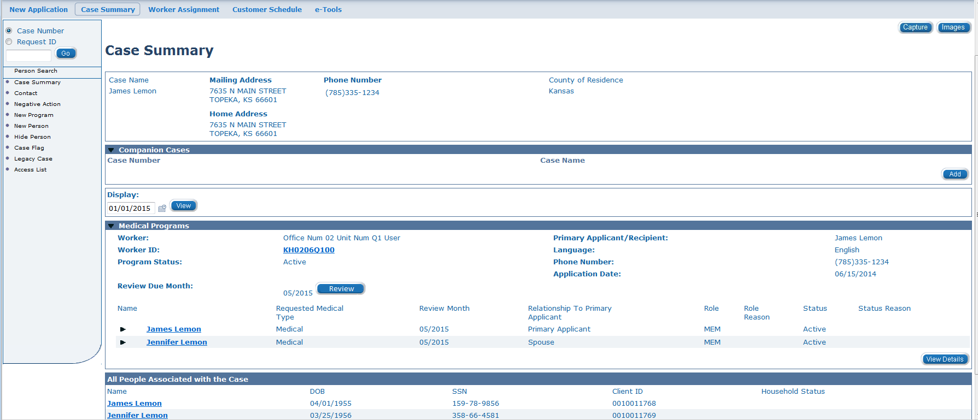
Medical Eligibility: Registration
Lesson 3: Registration > Case Summary
The Case Summary page allows the user to view all of the information that was just entered when creating the case. At this point, the case creation process is complete but there are a few final steps that need taken to finish the registration process.

Slide 47
Medical Eligibility: Registration
Lesson 3: Registration > Additional steps
Update RMT as needed
Add additional program blocks as needed
Update the primary applicant as needed
Update the contact information as needed
Update the household status (per your agency’s policy)
Verify the task priority set correctly (Clearinghouse only)
Notes:
So let’s start with RMT. What is it?

Slide 48
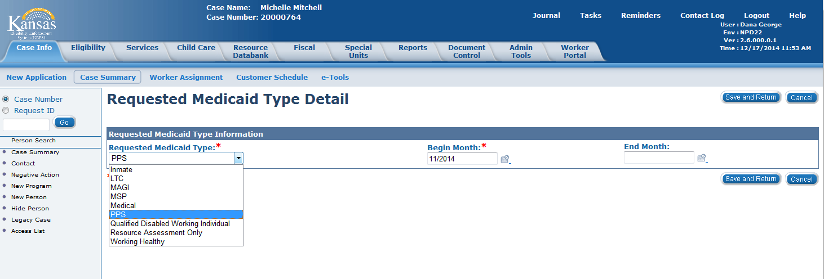
Medical Eligibility: Registration
Lesson 3: Registration > Update RMT
The Requested Medical Type (RMT) is a data element associated to a person’s application which will restrict the rules’ medical hierarchy.
This is used to apply for only a specific type of medical benefit (such as: MAGI, LTC, MSP, PPS, etc.)
It is important that the RMT be set correctly for each applicant.
Notes:
Case Summary > View Details > Medical Program Detail > Edit > Program Person > Edit > Requested Medicaid Type > Edit – this will take user to the Requested Medicaid Type Detail screen where RMT can be changed.

Slide 49
Medical Eligibility: Registration
Lesson 3: Registration > Update RMT
REQUESTED MEDICAL TYPES:
Inmate- Used when Inmate medical is requested
LTC- Used when an applicant requests LTC/HCBS only
MAGI- Used for all other Clearinghouse requests
MSP- Used when an applicant requests a Medicare Savings Program only
Medical- Used for all other DCF requests
PPS- Used for FC/AA medical requests
Qualified Disabled Working Individual- Used for QWD requests
Resource Assessment Only- Used for Resource Assessment Only requests
Working Healthy- Used for Working Healthy requests
Notes:
So here we can see that LTC and MSP are very specific Requested Med Types, whereas Medical is very broad.

Slide 50
Medical Eligibility: Registration
Lesson 3: Registration > Contact Info
Once we have updated any necessary Requested Medical Types we will look at updating contact information.
If any of the Case Persons were previously known to KEES, they may have had a change in contact information.
It is easiest to update this information from within the context of the case (rather than during the Registration flow).
Contact information (specifically address) is updated through the Contact Summary page.
Notes:
Let’s take a quick look at the Contact Summary page.

Slide 51
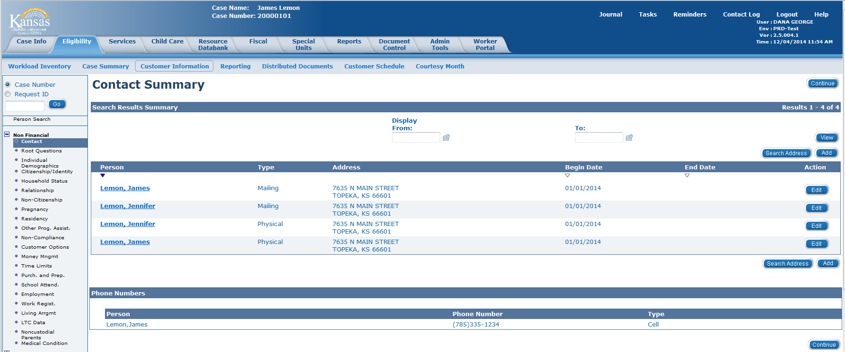
Medical Eligibility: Registration
Lesson 3: Registration > Contact Summary
The user can add a new address for any or all Case Persons from the Contact Summary page.
Notes:
Using the ADD button for the new address will automatically end-date the old address.
The reason why we update the address from here rather than in the Registration flow is that we are able to update all Case Persons at one time rather than one at a time in the Registration process.
It is also to have a begin date that will reflect the correct date for eligibility.

Slide 52
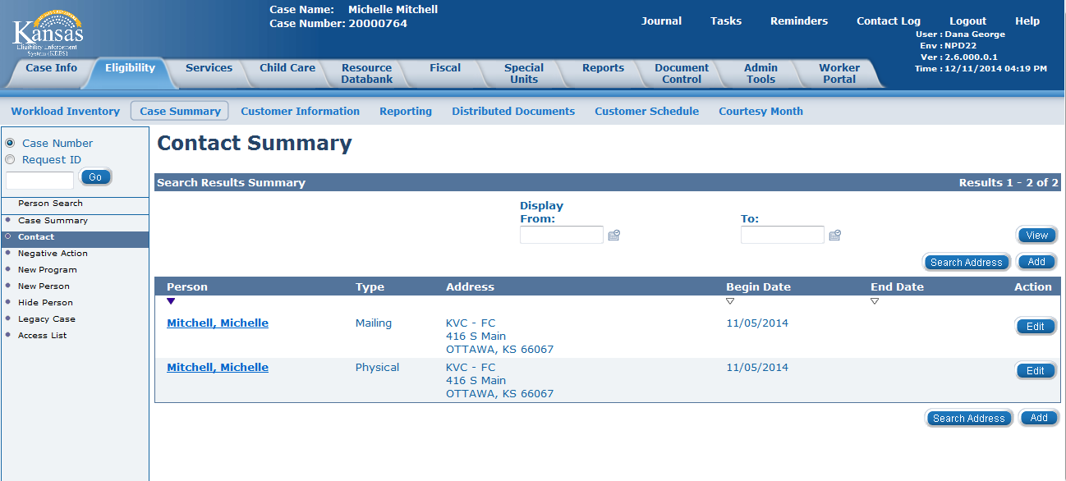
Medical Eligibility: Registration
Lesson 3: Registration > Contact Summary
PPS- Enter the Contract Manager’s office as the mailing and physical address for the child, not the actual placement address. This is to ensure confidentiality of the foster home placement.
Notes:
This is a PPS slide only
NOTES:
In the Address Line 1, enter the Contract Managers Name (KVC or St. Francis) and Attn: FC
In the Address Line 2, enter the street address
Enter the City and State for the address
In the County Field enter the County of Jurisdiction
Zip Code should be the zip for the actual address
Click Save and Return.
Select the user-entered address and enter the county for the court of jurisdiction.
Addresses:
KVC: Attn: FC 416 S. Main Suite 2 & 3; Ottawa, KS 66067.
St. Francis: Attn: FC; 501 E. Elm; Salina, KS 67401

Slide 53
Medical Eligibility: Registration
Lesson 3: Registration > Additional Programs
If two separate Medical program blocks were needed now would be the time to go back and add that other program block.

Slide 54
Medical Eligibility: Registration
Lesson 3: Registration > Additional Programs
The process to add an additional program block is very similar to the process used to create the initial one.
Add the program
Select the Primary Applicant
Add the RMT
Assign a worker
.

Slide 55
Medical Eligibility: Registration
Lesson 3: Registration > Update Task
If you are at the KanCare Clearinghouse, you will need this one last step.
Because we want to ensure that the downstream workflow maintains the appropriate priority (ex: Expedited), it is important to double check it before completing your task.
Notes:
Instructor Note: **THIS SLIDE IS FOR THE CLEARINGHOUSE ONLY**

Slide 56
Medical Eligibility: Registration
Lesson 3: Registration > Summary
In this lesson we covered:
How to create a new case in KEES
How to add a program
What a program block is
Who can share a program block
How to assign a worker
Updating Requested Medical Types
Updating Contact Information
Adding additional program blocks
Updating task status (CH only)
Notes:
Now we are going to switch gears and look at the e-Summary Registration process.

Slide 57
Medical Eligibility: Registration
Agenda
Lesson 1: Performing a Person Search
Lesson 2: Completing File Clearance
Lesson 3: Registration
Lesson 4: e-Summary Registration (CH only)
Lesson 5: Existing Case Registration

Slide 58
Medical Eligibility: Registration
Lesson 4: e-Summary Registration > Introduction
The e-Summary Registration process is very similar to the Manual Registration process, with the biggest difference being that many of the steps can be skipped by the user as KEES will perform them automatically.
Notes:
Let’s take a look at the e-Application Summary page.

Slide 59
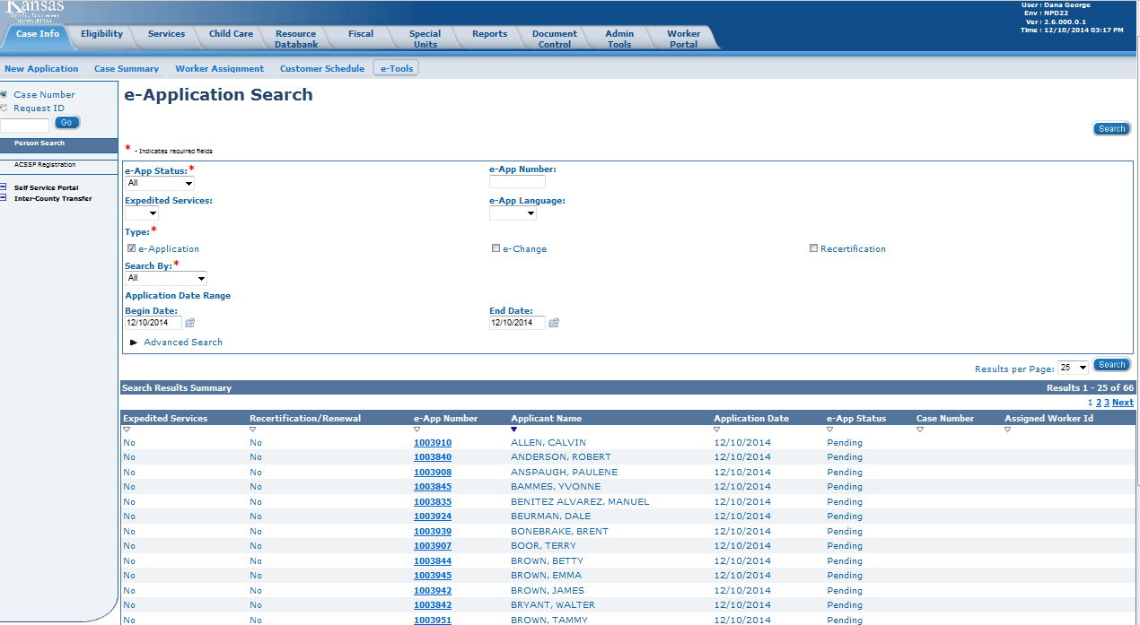
Medical Eligibility: Registration
Lesson 4: e-Summary Registration > Introduction
A user will select the e-App Status and Type. To make the search easier, the user may also want to choose a date range. Any e-Application falling within those criteria will be displayed. The user would then click the e-Application Number of the chosen case.
Notes:
Clicking the E-Application Number hyperlink will direct the user to the E-Application Summary page.

Slide 60
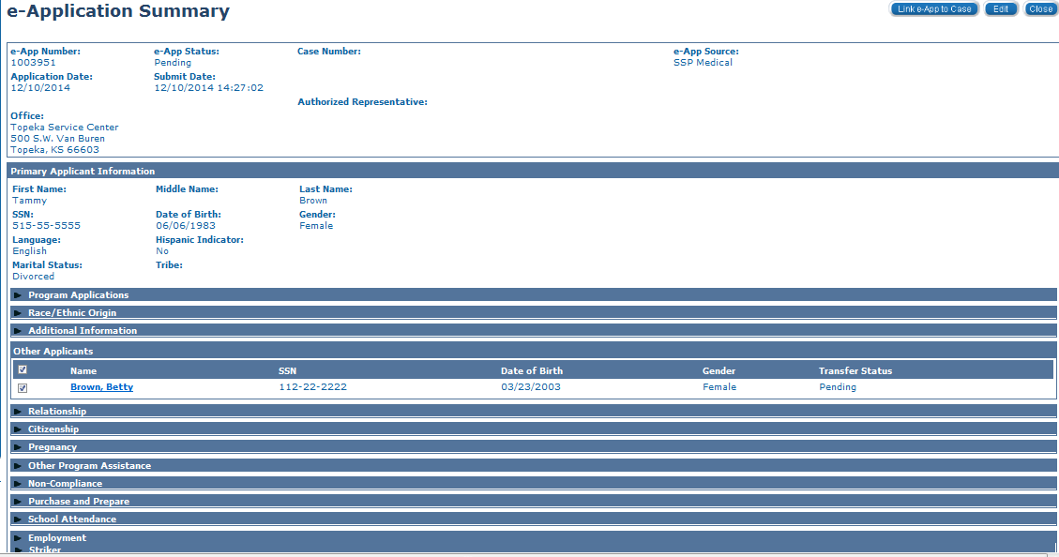
Medical Eligibility: Registration
Lesson 4: e-Summary Registration > e-Application Summary
To begin the e-Application Registration process, the user will click the Link e-App to Case button in the upper-right corner.
Notes:
The e-Application Summary page – Claiming an Intake task related to an application submitted electronically brings the user directly to the e-Application Summary page.

Slide 61
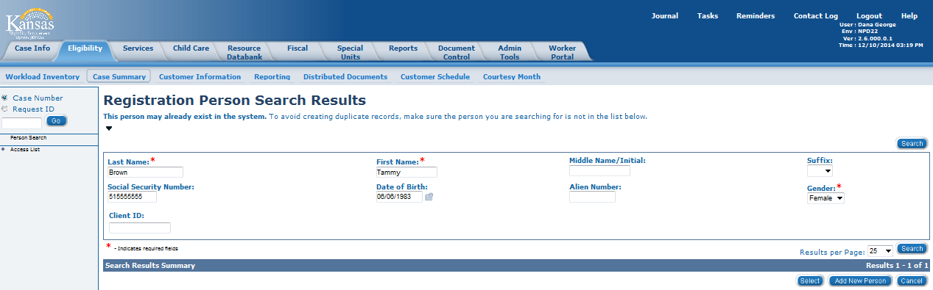
Medical Eligibility: Registration
Lesson 4: e-Summary Registration > Registration Person Search Results
The user is brought directly to the Registration Person Search Results page. The information has been pulled in from the e-App Summary automatically. Since the person was not known to KEES, the user will click the Add New Person button. Had the person been known to KEES, the user would click the radio button to the left of the person’s name and click Select.
Notes:
Had the person been known to KEES, just like in the Manual Registration process, the user would click the radio button to the left of the person’s name and click Select.

Slide 62
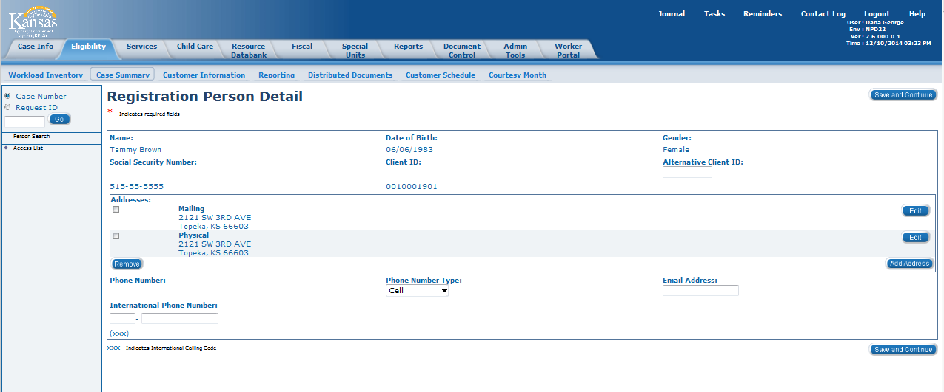
Medical Eligibility: Registration
Lesson 4: e-Summary Registration > Registration Person Detail
This brings the user to the Registration Person Detail page, and just like in the Manual Registration Process, the user would enter the person’s Alternative Client ID if they were only known to KAECSES. Then the user will click the Save and Continue button.
Notes:
Notice the address is already populated.

Slide 63
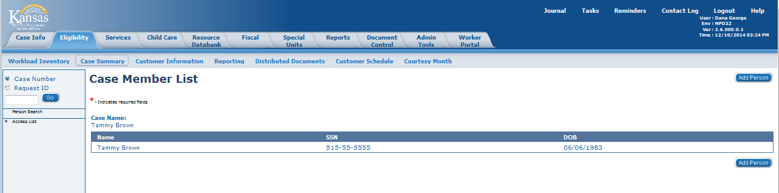
Medical Eligibility: Registration
Lesson 4: e-Summary Registration > Case Member List
KEES will continue to give the Add Person option until all Case Persons have been file cleared.

Slide 64
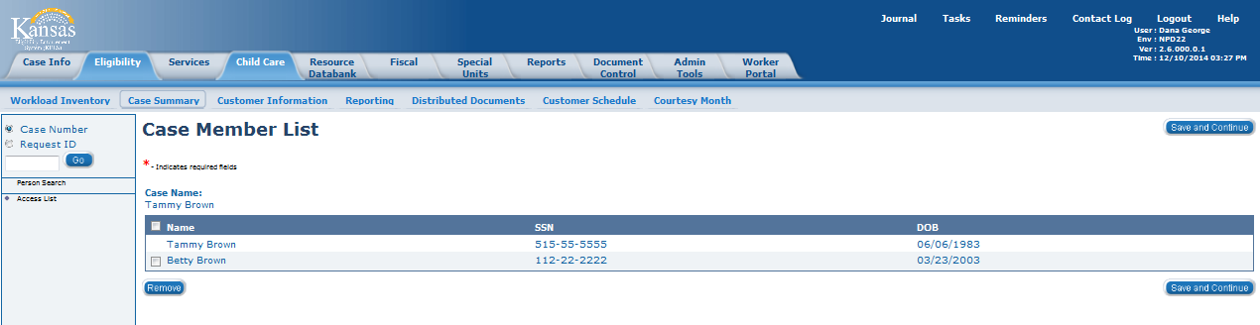
Medical Eligibility: Registration
Lesson 4: e-Summary Registration > Case Member List
Once all Case Persons have been file cleared, the Save and Continue button will display.

Slide 65
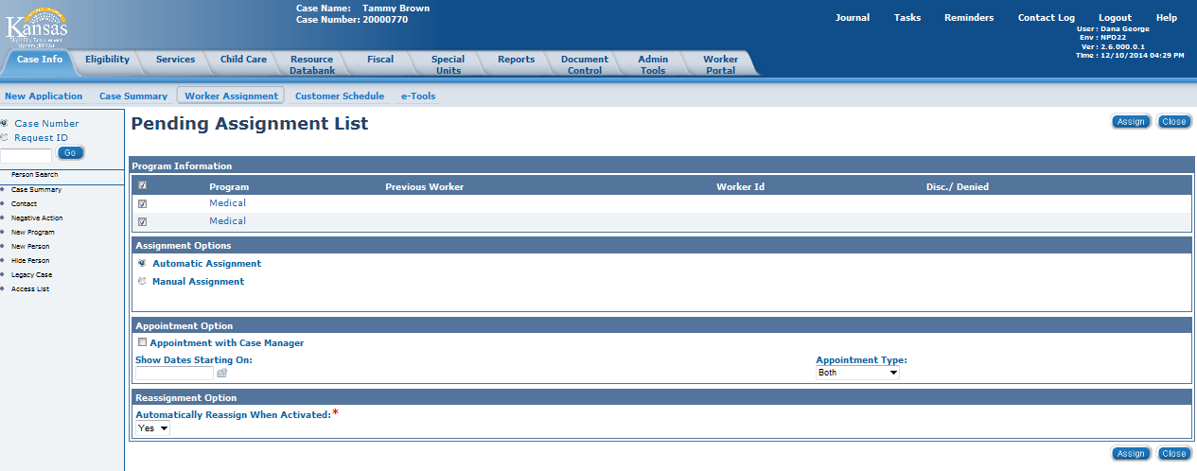
Medical Eligibility: Registration
Lesson 4: e-Summary Registration > Pending Assignment List
The Pending Assignment List page works the same as in the Manual Registration Process – the user can either choose Automatic Assignment or Manual Assignment.

Slide 66
Medical Eligibility: Registration
Lesson 4: e-Summary Registration > Worker Assignment Logic
Basic automatic worker assignment logic:
If Outstationed Worker assistance was indicated, assign to the Outstationed Worker ID.
If ALL persons on the program block requested Long Term Care (LTC), assign to DCF.
If ALL persons on the program block requested Medicare Savings Program (MSP), or are age 65 or older and not pregnant, or are a Medicare recipient and not pregnant, assign to DCF.
All other requests are assigned to the Clearinghouse.
Notes:
This is very high-level, basic worker assignment logic – there are many additional things that happen behind-the-scenes.

Slide 67
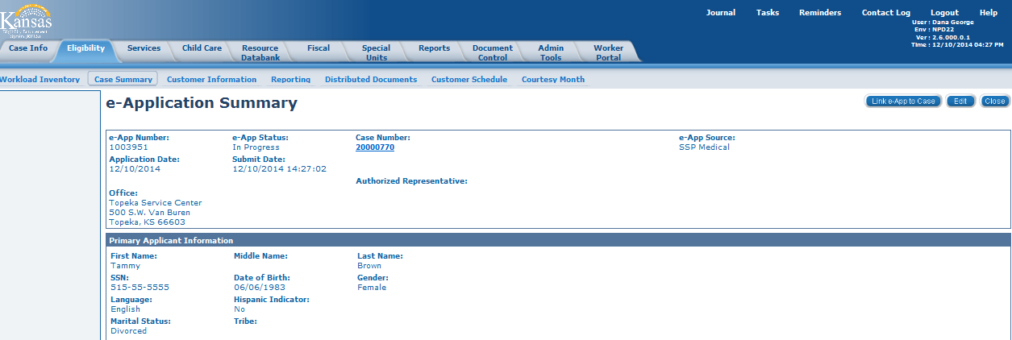
Medical Eligibility: Registration
Lesson 4: e-Summary Registration > e-Application Summary
Once worker assignment is complete, the user is returned to the e-Application Summary page. The information has now been linked to a case number. Clicking on the case number hyperlink will take the user to the Case Summary page.

Slide 68
Medical Eligibility: Registration
Lesson 4: e-Summary Registration > Additional Steps
Now that the e-Summary Registration process is complete, we need to verify that everything was set up correctly.

Slide 69
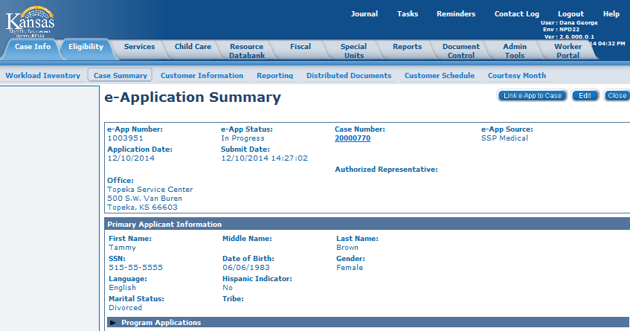
Medical Eligibility: Registration
Lesson 4: e-Summary Registration > Verify Case Persons
The Worker Portal only allows for the data entry of up to eight persons. If
more than eight persons were listed on the application, the worker will need to manually file clear them and register them to the newly created case number.
Notes:
Instructor Note: To go back to the e-Application a worker will click the E-App Number hyperlink found on the Case Summary page under the e-Applications block.

Slide 70
Medical Eligibility: Registration
Lesson 4: e-Summary Registration > Check Program Block
You may have also noticed that one of the biggest differences between the manual registration process and the e-Application Summary process is that KEES automatically selected the:
Program
Program Persons
Requested Medical Type
The worker (Clearinghouse/DCF)

Slide 71
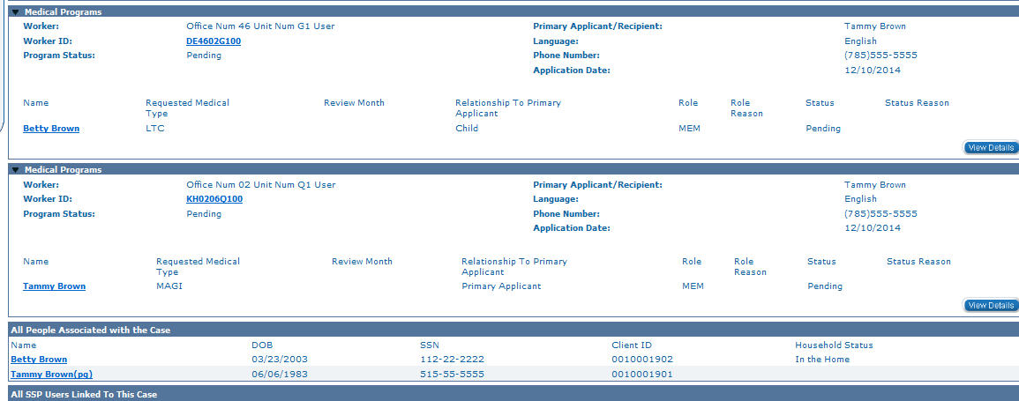
Medical Eligibility: Registration
Lesson 4: e-Summary Registration > Check Program Block
Check the Case Summary page to verify if any of the Program Persons need to be added or removed from the program block due to their RMT.
Notes:
The Requested Medical Types are set based on how the consumer answered certain questions. From the Medical SSP, the questions are as follows:
“Is this person only interested in the Medicare Savings Plan?” If YES = set RMT to MSP
“Who in the household receives or is interested in receiving HCBS Services?” For each person indicated = set RMT to LTC
“Who in the household receives or is interested in receiving LTC Services?” For each person indicated = set RMT to LTC

Slide 72
Medical Eligibility: Registration
Lesson 4: e-Summary Registration > Check Program Block
Remember
KDHE managed medical programs and DCF managed medical programs can never be combined on the same program block.
LTC/HCBS applicants must always get their own Medical Program block.

Slide 73
Medical Eligibility: Registration
Lesson 4: e-Summary Registration > Check Program Block
If there is more than one consumer on the application, the user will need to consider how many program blocks are needed.
MAGI, MAGI = 1 program block
MAGI, MEDICAL = 2 program blocks
MAGI, LTC = 2 program blocks
MAGI, MSP = 2 program blocks
MAGI, LTC, MSP = 3 program blocks
LTC, LTC = 2 program blocks
LTC, MSP = 2 program blocks
MSP, MSP = 1 program block
Notes:
All MAGI requests can share 1 program block; All MSP requests can share 1 program block; Each LTC request must have its own program block; KDHE and DCF programs must be split apart.

Slide 74
Medical Eligibility: Registration
Agenda
Lesson 1: Performing a Person Search
Lesson 2: Completing File Clearance
Lesson 3: Registration
Lesson 4: e-Summary Registration (CH only)
Lesson 5: Existing Case Registration

Slide 75
Medical Eligibility: Registration
Lesson 5: Existing Case Registration > Introduction
In this lesson we will look at what steps are needed for existing case registration.

Slide 76
Medical Eligibility: Registration
Lesson 5: Existing Case Registration > Add Case Persons
The most important thing to remember about existing case registration is that a user must find a usable case number.
Are all persons listed on the application also listed under the “All People Associated with the Case” block?
If any persons need to be added to the case, complete the Add A Case Person Process.

Slide 77
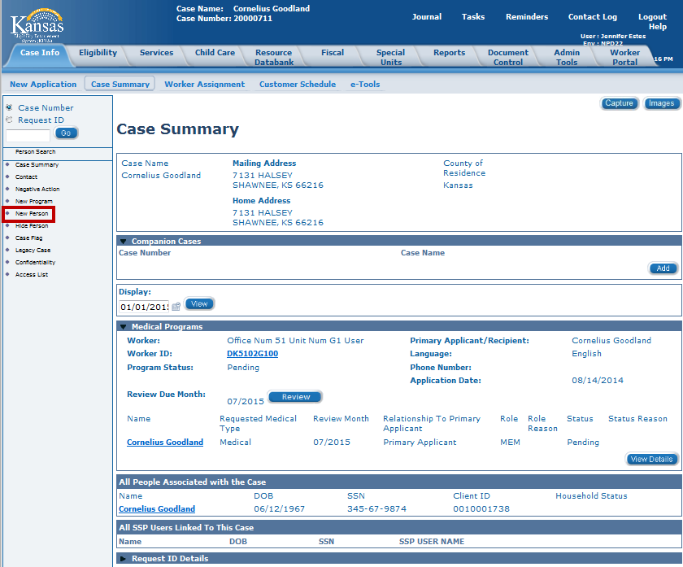
Medical Eligibility: Registration
Lesson 5: Existing Case Registration > Add Case Persons
On the Case Summary page select New Person in the Task Navigation to access the Registration Person Search page.

Slide 78
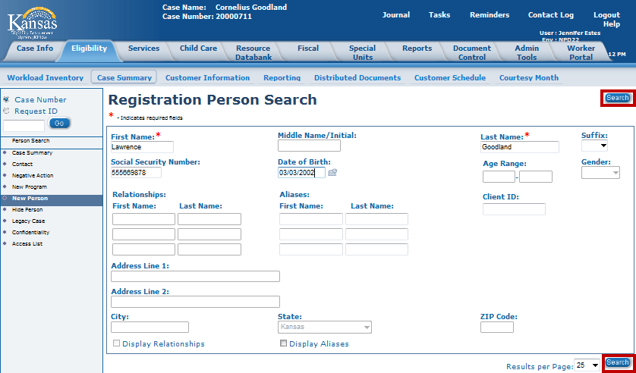
Medical Eligibility: Registration
Lesson 5: Existing Case Registration > Add Case Persons
Notes:
The Registration Person Search page displays. Enter search criteria and click Search. The minimum information required is the First Name and Last Name. However, if more information is known it can help narrow down the number of results found.
• Consumer Known to System: a candidate list will be returned. Use the radio button to identify the correct consumer from the Person Search process then click the Select button.
• Consumer Not Know to System: No search results will show, either start over, refining the search criteria, or if the consumer is new to KEES, click the Add New Person button.

Slide 79
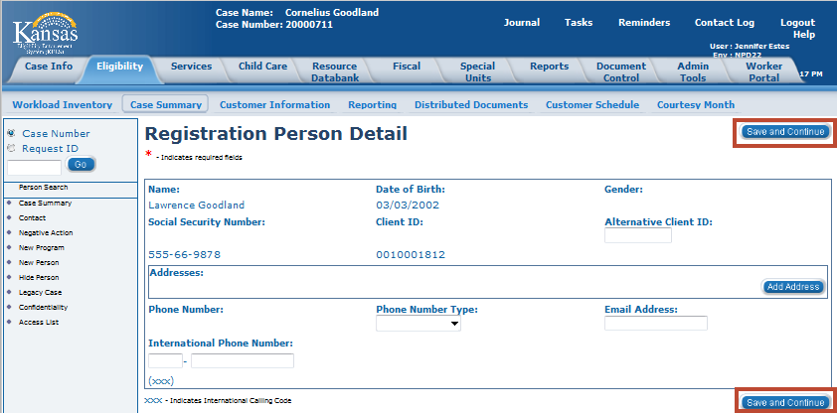
Medical Eligibility: Registration
Lesson 5: Existing Case Registration > Add Case Persons
Notes:
The Registration Person Detail page displays. Click Save and Continue. (Do not update address here.)

Slide 80
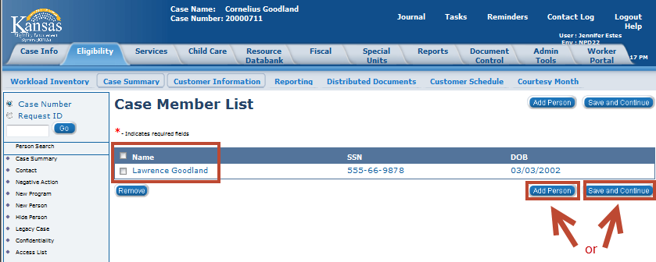
Medical Eligibility: Registration
Lesson 5: Existing Case Registration > Add Case Persons
The Case Member List page displays. To repeat the File Clearance process for another new Case Person, click Add Person. If no other Case Persons are needed, click the Save and Continue button.

Slide 81
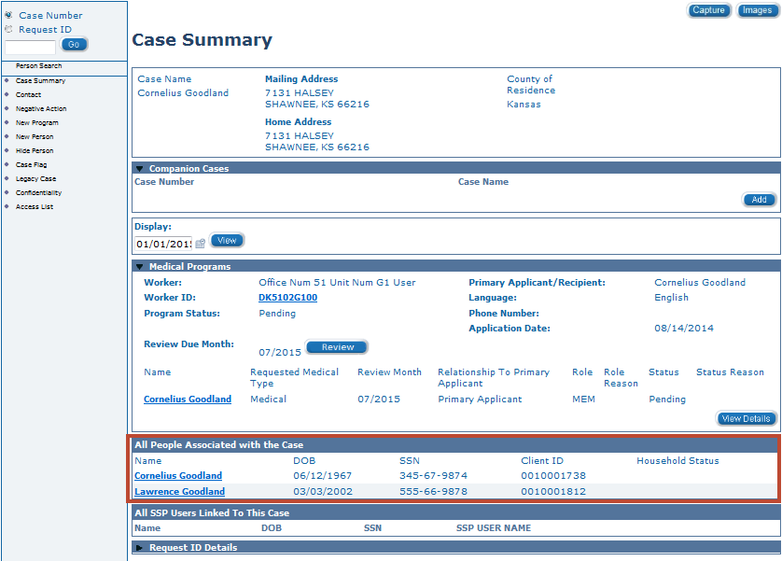
Medical Eligibility: Registration
Lesson 5: Existing Case Registration > Add Case Persons
After the Save and Continue button is selected the Case page displays with the new person added to the case.

Slide 82
Medical Eligibility: Registration
Lesson 5: Existing Case Registration > Add Program Person
Can any of the applicants be added to any of the program blocks? If yes, complete one of the following:
  Rescind Program Person
  Reapply Program Person
  Add Program Person
  If no, the user would add a new program block
Notes:
Rescind means to undo a denial or discontinuance of a person and/or program, without logging a new application. This function is also used during the Review Reconsideration period.
Reapply means to log a new application on an existing program.
PPS: Reapply: Child released of custody or home for 6 months or more.
PPS: Rescind: For PPS it is not based on the application date. It is based on the "episode of care."
Examples: PPS: Rescind
1. Child placed in detention. We use when child returns to a foster care placement. (Child still technically retained eligibility for medical but he was in an ineligible placement).
2. Child in custody returns to foster home after being home for less than 6 months.

Slide 83
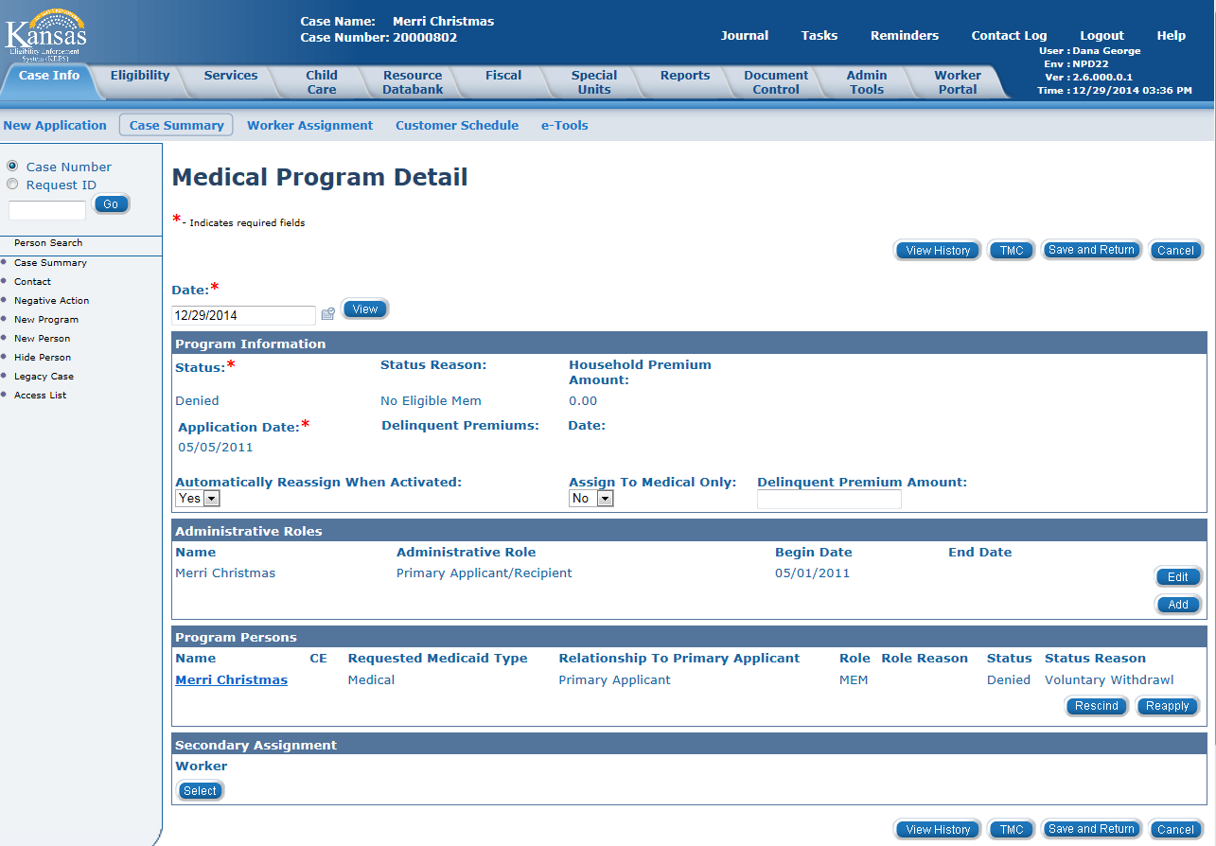
Medical Eligibility: Registration
Lesson 5: Existing Case Registration > Add Program Person
The Medical Program Detail page is where to find the reapply and rescind buttons.
Notes:
Case Summary > View Details > Medical Program Detail page > Edit - This takes you to the Medical Program Detail page in EDIT mode.

Slide 84
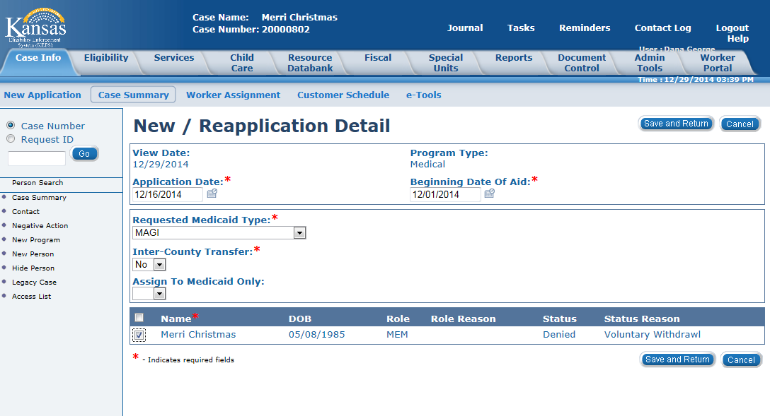
Medical Eligibility: Registration
Lesson 5: Existing Case Registration > Add Program Person
Notes:
The user will update all mandatory fields and click the Save and Return button.

Slide 85
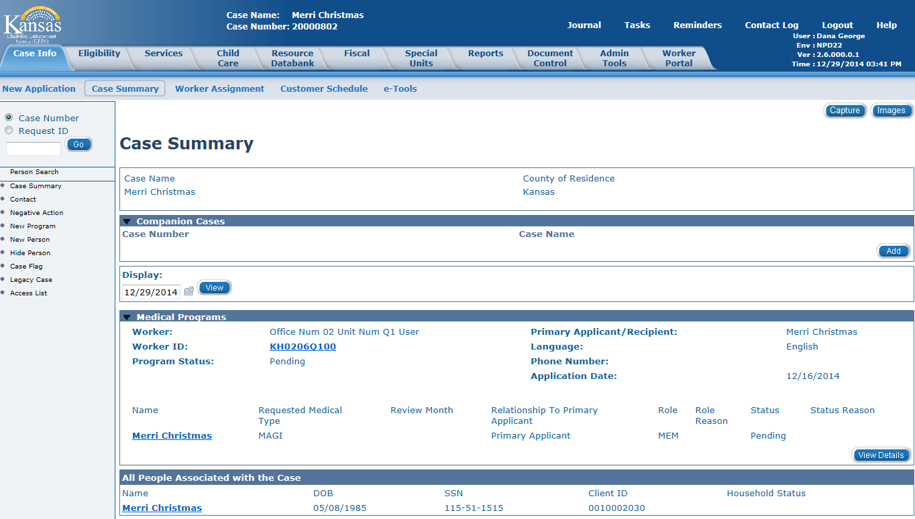
Medical Eligibility: Registration
Lesson 5: Existing Case Registration > Add Program Person
The Case Summary page displays showing the applicant is in pending status with the new application date.

Slide 86
Medical Eligibility: Registration
Lesson 5: Existing Case Registration > Reapply/Add Program
Are there any applicants left that have not been addressed? If yes, complete one of the following:
Reapply Program (if there is a usable inactive program block available)
Add New Program (if there is no usable inactive program block)

Slide 87
Medical Eligibility: Registration
Lesson 5: Existing Case Registration > Update Contact Info
If needed, a worker would then complete the steps below:
Update or add RMT
Update or add administrative role
Update the worker
Update contact information
Complete the e-linking process
Update the priority of the task

Slide 88
Medical Eligibility: Registration
Lesson 5: Existing Case Registration > Summary
This lesson has covered many different processes:
Add Case Person
Rescind/Reapply
Add Program Person
Add New Program
Update Contact Information (DCF only)
Update RMT
Add/Update Admin. Roles
Update Household Status
Reassign Work

Slide 89
Medical Eligibility: Registration
Wrap up
That concludes the training. In this course, we reviewed the steps needed to complete the following processes in KEES:
Person Search
File Clearance
Case Registration

