Slide 1
Medical Eligibility
Resource Databank for Workers
Notes:
Welcome participants to the training session.
Cover any housekeeping items such as:
The location of restrooms and breakrooms.
Ground rules for the training.
Instructor introductions.
Participant introductions.
Transition: Let’s talk about why we’re all here.

Slide 2
Medical Eligibility: Resource Databank for Workers
Introduction
The Resource Databank (RDB) is the main location to store resource information.
A resource is defined as any entity that provides a service, paid or unpaid and includes vendors, providers with agreements, community resources, employers, and schools.
Notes:
One of the key functionalities the RDB provides is to allow workers to connect a specific resource to a customer based on their location and service needs.
It also acts as the repository to maintain specific resource information.
Some examples of Providers are: Guardians, Conservators, DPOA’s & Responsible Persons

Slide 3
Medical Eligibility: Resource Databank for Workers
Introduction
After completing this course, you will be able to:
Search and locate the Resource Databank for the appropriate resource.
Determine if a resource is listed and information is accurate.
Request the addition of a resource or a change of a resource’s information or status.
Connect a resource to a consumer case in the context of working on a case.

Slide 4
Medical Eligibility: Resource Databank for Workers
Agenda
Lesson 1: Using the Resource Databank
Lesson 2: Connecting a Resource to a Case

Slide 5
Medical Eligibility: Resource Databank for Workers
Introduction
To effectively use the Resource Databank you will need to know how to:
Search for a resource
Request a new resource
Request a change to an existing resource

Slide 6
Medical Eligibility: Resource Databank for Workers
Lesson 1: Using the RDB > Searching
Searching is always the first step when requesting to add new resources or making changes to an existing resource.
This is to:
Avoid duplicates when adding a new resource
Confirm information is correct
Searching is standard functionality that is the same throughout KEES.
Notes:
* Refer participants to KEES User Manual

Slide 7
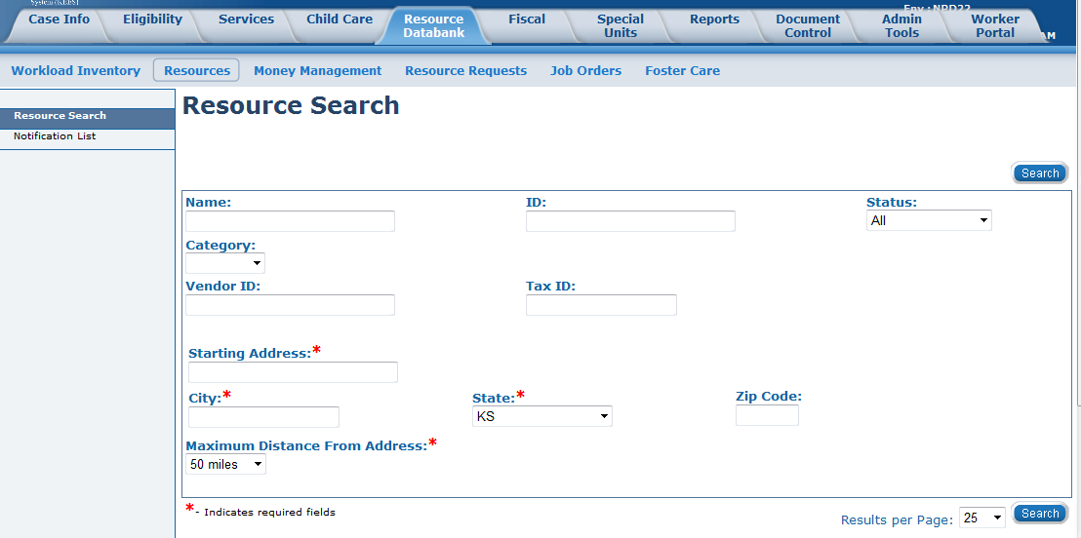
Medical Eligibility: Resource Databank for Workers
Lesson 1: Using the RDB > Searching
The standard defaults in KEES are search pages, so the first page in RDB is the Resource Search page.
On this page there are mandatory fields indicated by a red asterisk.

Slide 8
Medical Eligibility: Resource Databank for Workers
Lesson 1: Using the RDB > Searching
All the fields on the Resource Search screen have “wildcard functionality”. This means you can type three letters and an asterisk and the search results will return all resources that start or contain those letters.
To get more specific results, complete as many fields with accurate information as possible.
These fields are recommended to be completed for more accurate results:
Category: Employer, Provider, School
Status: Active, Pending, Suspended, Denied, Closed
Notes:
EES and PPS workers will search by Category-Provider

Slide 9
Medical Eligibility: Resource Databank for Workers
Lesson 1: Using the RDB > Searching
The Service Category and Service Type fields are dynamic and will display when “Provider” is chosen.
Service Category: Community Resource, EES Providers, Medical-Facilitators, Medical-Institutional Care, Medical-HCBS, PPS Adult Protective Services, PPS Family Services-Health Related, PPS Family Services-Other, PPS Non-Placement PA Required, PPS Placements, PPS Youth Independent Living, Rehab Services
Service Type: This is a dynamic field where values change dependent on Service Category

Slide 10
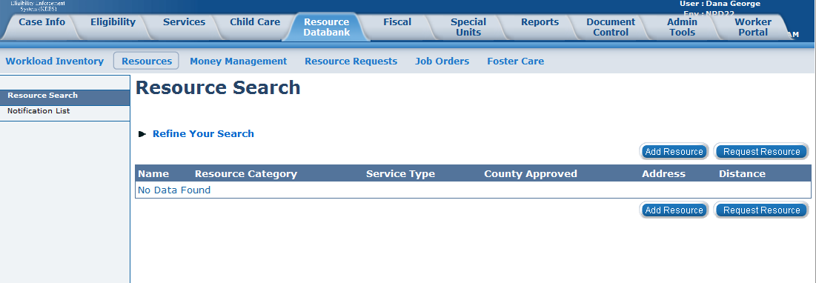
Medical Eligibility: Resource Databank for Workers
Lesson 1: Using the RDB > Searching
The results of a search will determine whether a resource needs to be added to the RDB or if the resource is inaccurate and needs edited.
Notes:
If a resource is not found then it needs to be added and the Request New Resource Process is followed. If a resource is found but needs updating or correction then the Request Changes to a Resource Process is followed.

Slide 11
Medical Eligibility: Resource Databank for Workers
Lesson 1: Using the RDB > Add or Change Resource
A manual, external process is used to request additions or changes to resources managed by the Clearinghouse such as Long Term Care and Representative/Facilitator providers.
Requests to add or update Resources will come through the form sent to KSRDBMedicalRepandFa@Policy-Studies.com.
A response from the Clearinghouse will be sent indicating that the change was made or an explanation of why it was not made.
Notes:
PPS Eligibility staff have the authority to make additions and changes to resources.
Requests to make PRTF resource changes or additions are sent to the Clearinghouse using the process above.

Slide 12
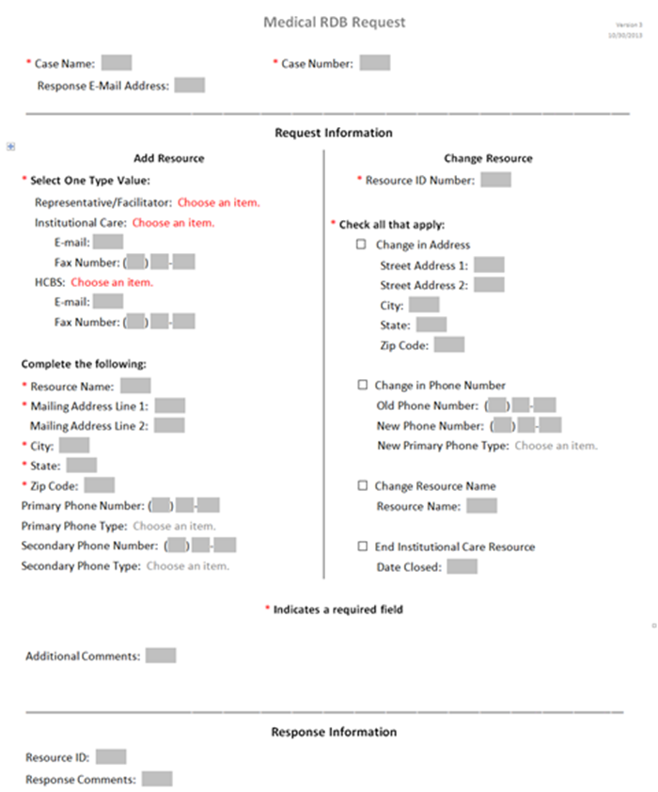
Medical Eligibility: Resource Databank for Workers
Lesson 1: Using the RDB > Medical RDB Request Form
Notes:
The Medical RDB Request form will be available through the KDHE implementation memo at Go-Live. Training on this form will be at a later date.

Slide 13
Medical Eligibility: Resource Databank for Workers
Summary
In the previous Lesson you learned how to use the RDB by:
Searching
Requesting new resources
Changing an existing resource

Slide 14
Medical Eligibility: Resource Databank for Workers
Agenda
Lesson 1: Using the Resource Data Bank
Lesson 2: Connecting a Resource to a Case

Slide 15
Medical Eligibility: Resource Databank for Workers
Introduction
Resources kept in the RDB are accessed from various pages in KEES.
Most are within the context of a case. The most common is setting Administrative Roles.

Slide 16
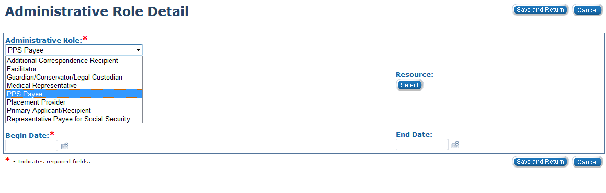
Medical Eligibility: Resource Databank for Workers
Lesson 2: Connecting a Resource to a Case > Admin Role
The Administrative Role is accessed from the Case Summary Page. PPS workers will choose either PPS Payee or Placement Provider for the Administrative Role.
Notes:
Case Summary > View Details > Edit > Add (in the Administrative Roles block)

Slide 17
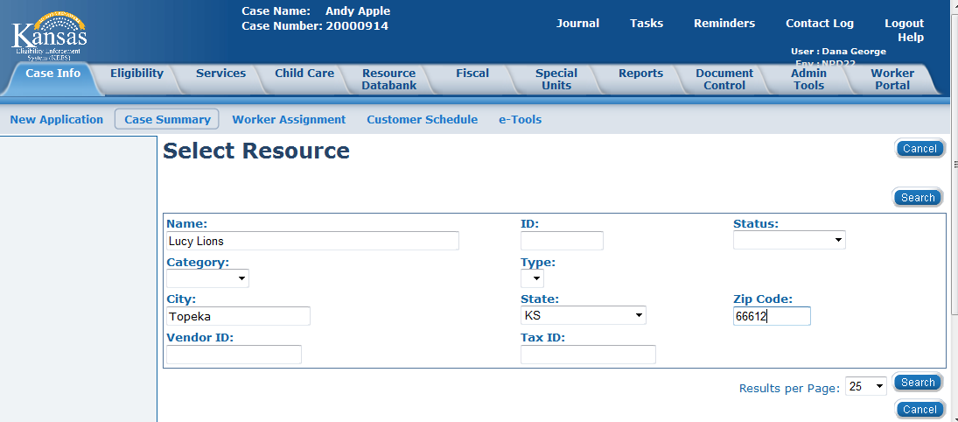
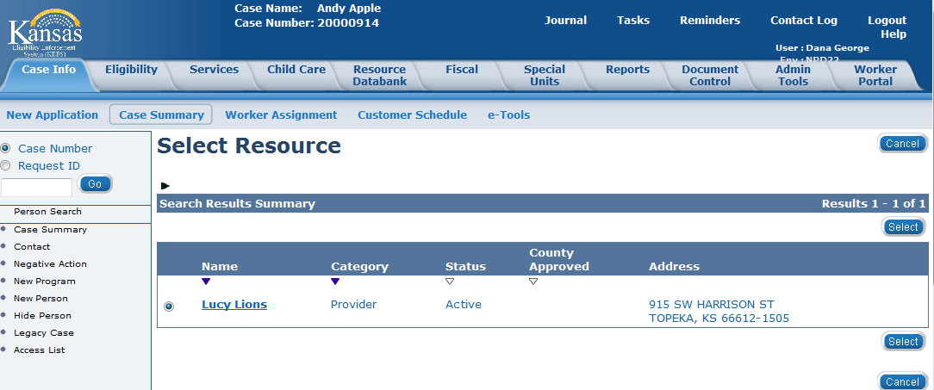
Medical Eligibility: Resource Databank for Workers
Lesson 2: Connecting a Resource to a Case > Select Resource
Enter the Name, City, State & Zip Code for the Resource you are trying to find.
The Select Resource page will display with any matching record.

Slide 18
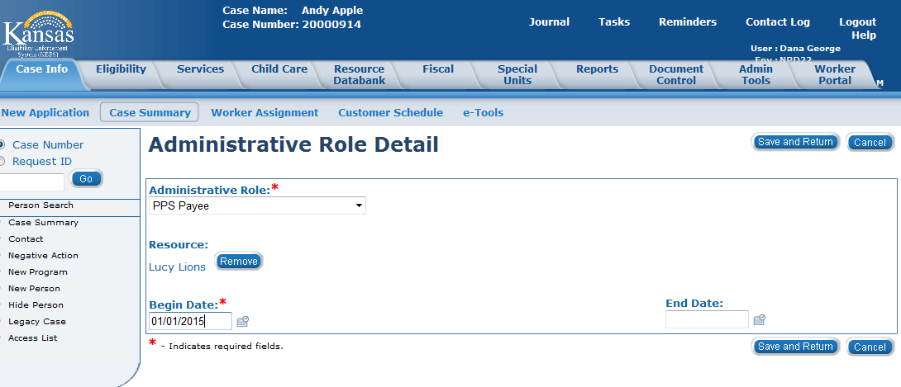
Medical Eligibility: Resource Databank for Workers
Lesson 2: Connecting a Resource to a Case > Admin Role
Once the resource is selected, it will populate on the Administrative Role Detail page. The user will add the Begin Date and click the Save and Return button to complete this page.

Slide 19
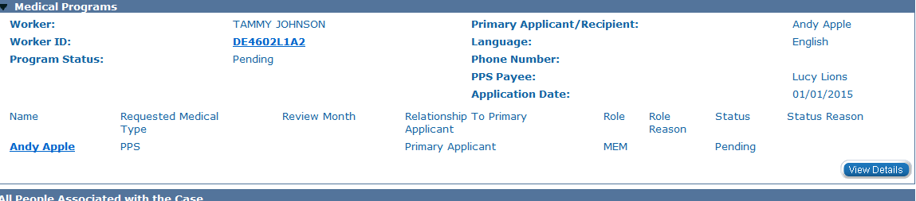
Medical Eligibility: Resource Databank for Workers
Lesson 2: Connecting a Resource to a Case > Case Summary
The Case Summary page will display the Administrative Role information in the Medical Programs block.

Slide 20
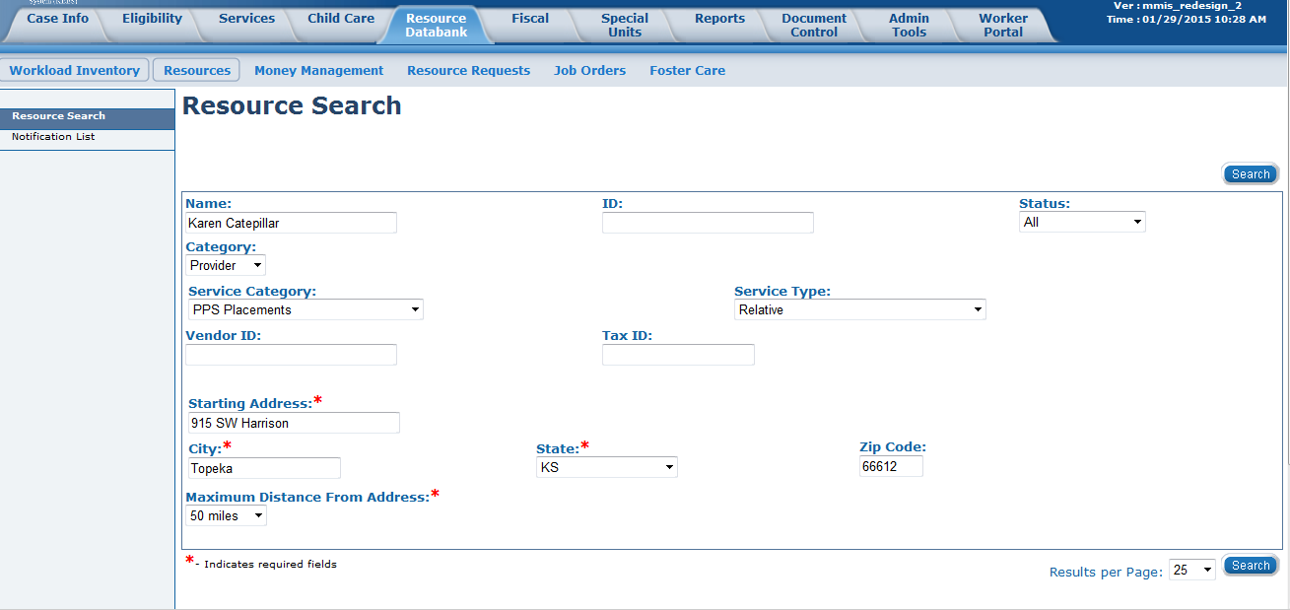
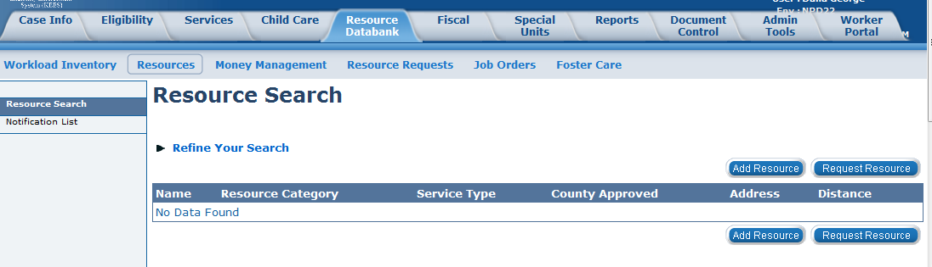
Medical Eligibility: Resource Databank for Workers
Lesson 2: Connecting a Resource to a Case > Resource Search
If a user searched on a resource and that resource was not found, the user would need to either send the request to add the resource or, if PPS, would add the resource by clicking the Add Resource button.

Slide 21
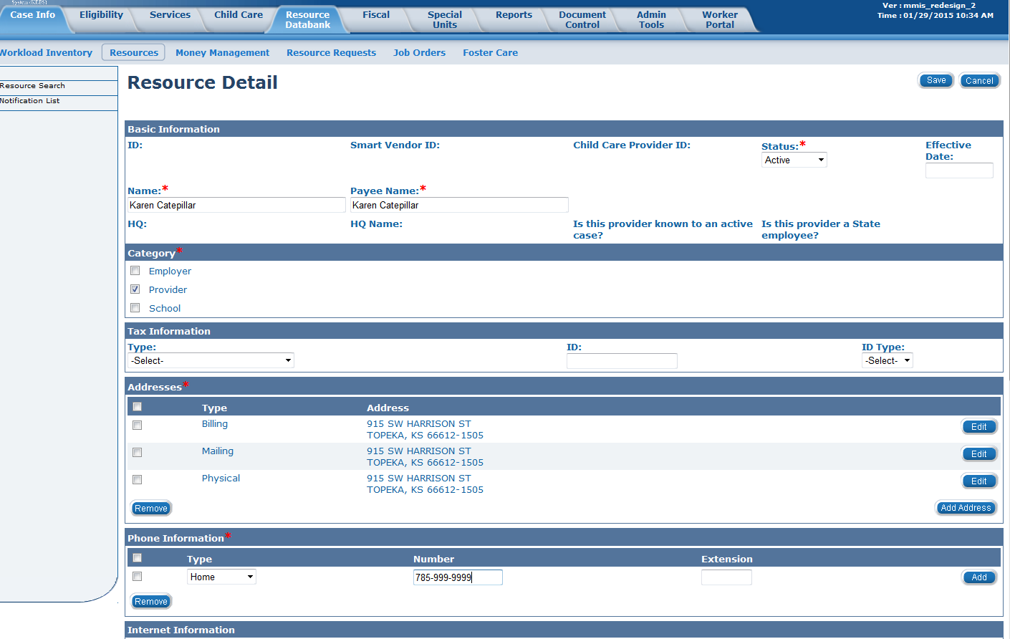
Medical Eligibility: Resource Databank for Workers
Lesson 2: Connecting a Resource to a Case > Resource Detail
PPS:
The worker will fill out all mandatory fields.

Slide 22
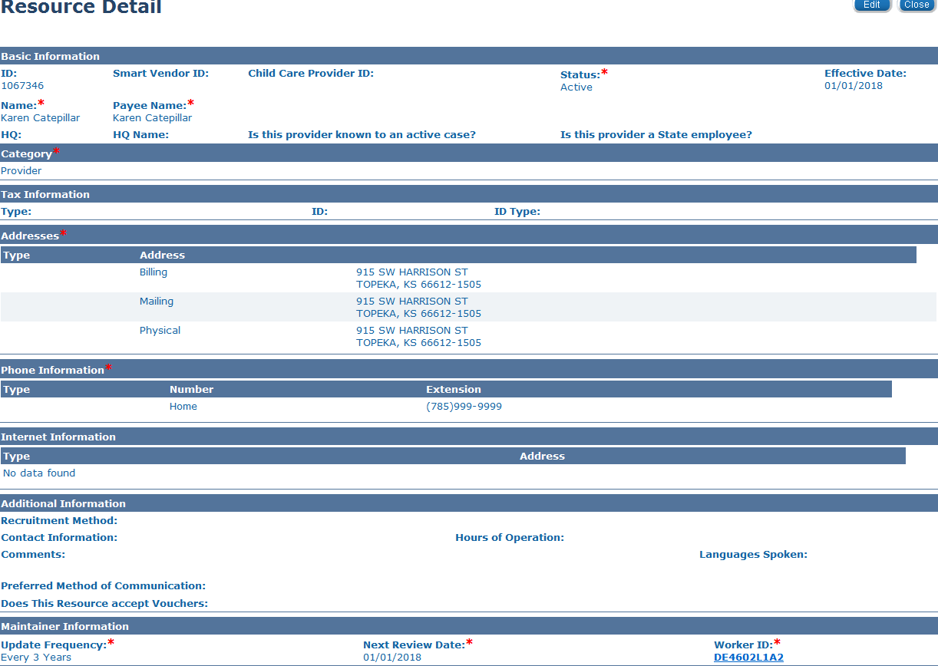
Medical Eligibility: Resource Databank for Workers
Lesson 2: Connecting a Resource to a Case > Resource Detail
PPS:
The worker will fill out all mandatory fields. The worker filling out this page will be the Worker ID entered in the last field.
Notes:
Maintainer Information Block- Even though Update Frequency and Next Review Date are mandatory fields, they are not necessary for certain situations (i.e.- Relative Provider). Please follow your offices’ guidelines on how to populate these fields.

Slide 23
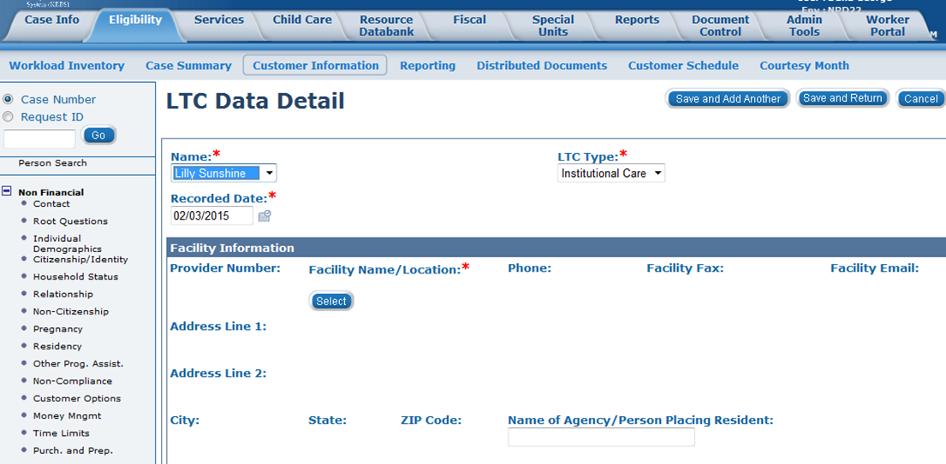
Medical Eligibility: Resource Databank for Workers
Lesson 2: Connecting a Resource to a Case > LTC Data Detail
The RDB will be accessed on the LTC Data Detail page by clicking the Select button under the Facility Name/Location heading.

Slide 24
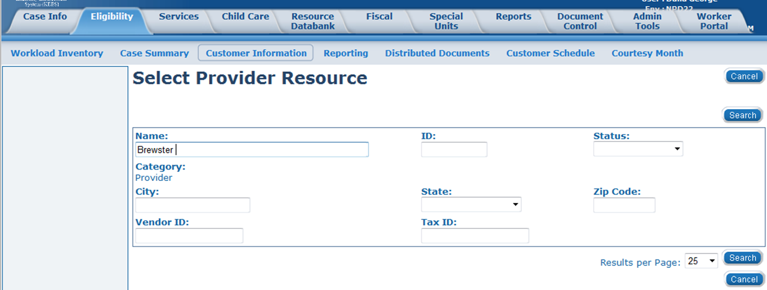
Medical Eligibility: Resource Databank for Workers
Lesson 2: Connecting a Resource to a Case > Select Provider Resource
The worker will enter the name of the facility and then click the Search button.

Slide 25
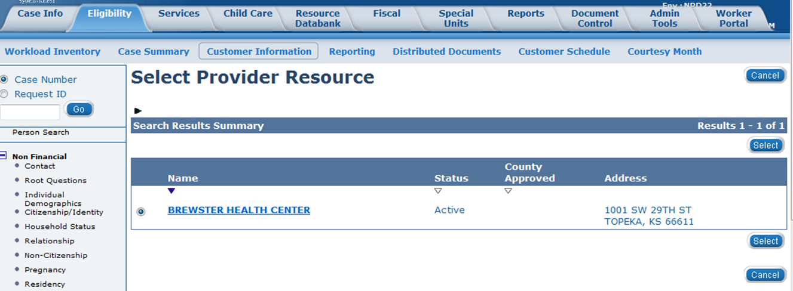
Medical Eligibility: Resource Databank for Workers
Lesson 2: Connecting a Resource to a Case > Select Provider Resource
The Select Provider Resource page will display with any matching records. The worker will click the radio button to the left of the name they would like to choose and then click the Select button. If unsure of resource, the worker will click on the Name hyperlink to be taken to the Resource Detail page.

Slide 26
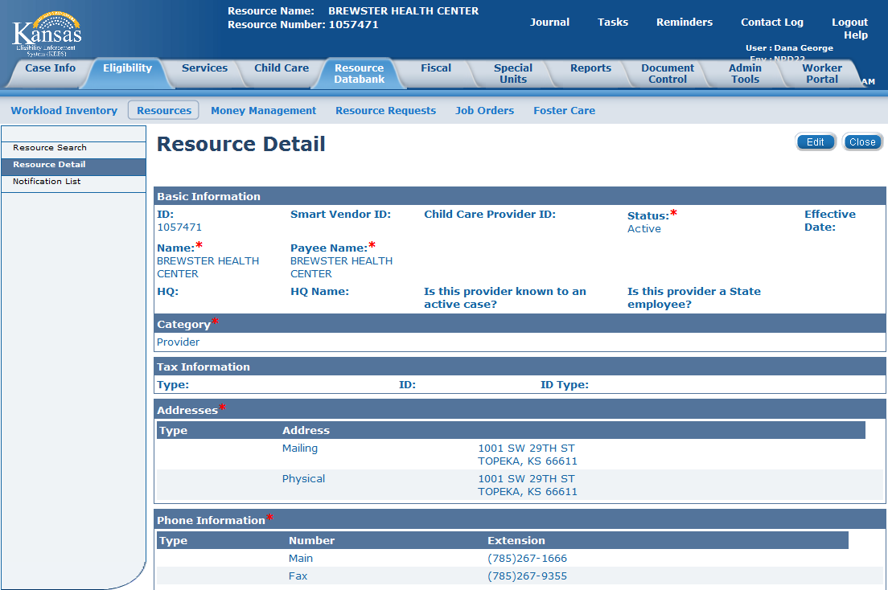
Medical Eligibility: Resource Databank for Workers
Lesson 2: Connecting a Resource to a Case > Resource Detail
The Resource Detail page displays with all of the resource’s information.
Notes:
The worker would close this page to be taken back to the Select Provider Resource page where they would then click the radio button next to the resource they were choosing.

Slide 27
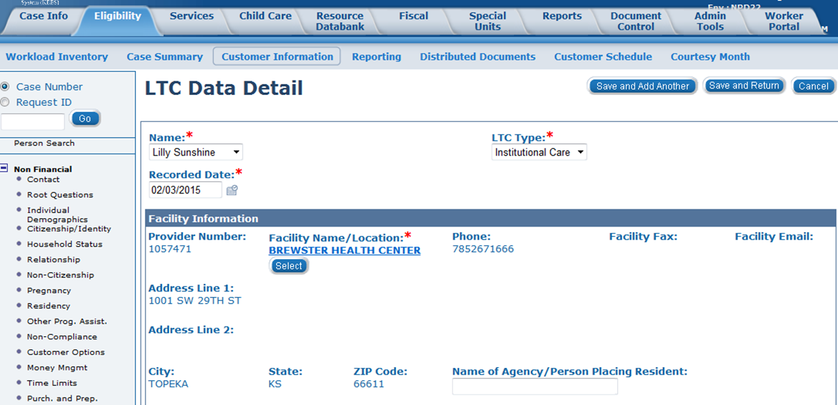
Medical Eligibility: Resource Databank for Workers
Lesson 2: Connecting a Resource to a Case > LTC Data Detail
The LTC Data Detail page will display showing all the selected resource information populated under the Facility Information block.

Slide 28
Medical Eligibility: Resource Databank for Workers
Summary
After completing this lesson you learned the following:
Resources are connected via different pages in KEES
In certain scenarios, specific actions must be taken to connect a resource

Slide 29
Medical Eligibility: Resource Databank for Workers
Wrap up
After completing this course, you are able to do the following using the Resource Databank pages
Search and locate the Resource Databank for the appropriate resource
Determine if a resource is listed and information is accurate
Request the addition of a resource or a change of a resource’s information or status
Connect a resource to a consumer case in the context of working on a case

