Slide 1
Medical Eligibility
Utility Navigation
Notes:
Welcome participants to the training session.

Slide 2
Medical Eligibility: Utility Navigation
Introduction
  Utility Navigation within the Kansas Eligibility Enforcement System (KEES) provides users the utilities or tools to:
  Manage their workload
  Track important events
  Log case related information
  These tools are accessed through the Utility Navigation bar located in the upper right corner of the KEES page.

Slide 3
Medical Eligibility: Utility Navigation
Introduction
  This is the Utility Navigation bar. The primary tools include:
  Journal, Tasks, Contact Log, Logout, and Help
  Reminders is not being used by either DCF or KDHE
  Upon completion of this course, you will have the knowledge and skills to use these tools.

Slide 4
Medical Eligibility: Utility Navigation
Agenda
Lesson 1: Journal
Lesson 2: Tasks
Lesson 3: Contact Log
Lesson 4: Logout
Lesson 5: Help
Notes:
There are five lessons in this course
Journal
Tasks
Contact Log
Logout
Help

Slide 5
Medical Eligibility: Utility Navigation
Lesson 1: Journal > Introduction
After completing this course, you will be able to:
Define Journal entries
Add, Edit, Append, Suppress, Copy, Transfer entries
Export (print) entries

Slide 6

Medical Eligibility: Utility Navigation
Lesson 1: Journal > Introduction
The Journal provides the ability to record information and actions related to a case. It provides:
  A central location to quickly determine the current or historical actions specific to a case
  System generated journal entries
  Manually created journal entries
Notes:
System generated journal entries are:
created based on certain actions
identified as either ‘Auto Logs’ or Batch Process’
User created manual journal entries are automatically identified by the user’s name and Worker ID.
Journals are always created within the context of a case.

Slide 7
Medical Eligibility: Utility Navigation
Lesson 1: Journal > Automatic Logs
Automatic journal entries are triggered by case activity and are generated in one of two ways:
Templates
A template utilizes different pieces of data from the Contact Log and generates a journal entry.
Auto Logs
A pre-scripted system message which is automatically produced when certain actions are taken.
Notes:
An example of Auto Logs could be when the Review batch is run on a case and coverage is extended for another year. An auto log will populate the Journal detailing this action

Slide 8
Medical Eligibility: Utility Navigation
Lesson 1: Journal
In order to access the Journal List:
Click the Journal hyperlink while in the context of a case
The Journal List will appear in a separate window

Slide 9
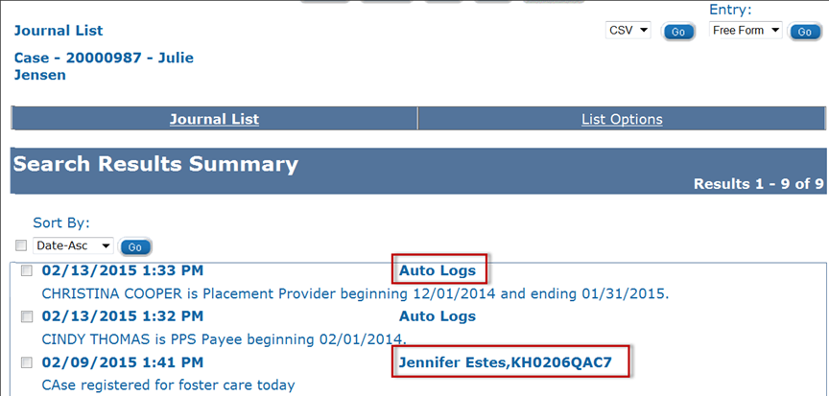
Medical Eligibility: Utility Navigation
Lesson 1: Journal >Journal List
User entered logs are identified by the Worker’s name and ID.
Notes:
The Journal List page will display the Case Name and Number at the top.
The list can be sorted using the Sort By: drop-down menu

Slide 10
Medical Eligibility: Utility Navigation
Lesson 1: Journal > Journal List
The Journal List page displays the following fields:
Journal List – Case Number and Case Name
Action buttons: Append, Edit, Copy, Transfer
Export
Add Entry
In the Search Results Summary section, information is sorted by Date. User can sort by ascending or descending dates.
The search results show:
Date of entry
Time of entry
Worker Name and ID/Auto Logs
Text entry

Slide 11
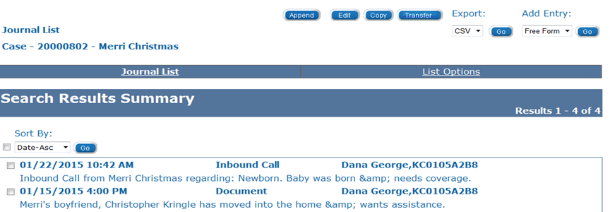
Medical Eligibility: Utility Navigation
Lesson 1: Journal > Add Entry
To add a new journal entry, click the Go button associated to the Add Entry field. A new Journal Entry page displays in a new window.
Notes:
Non-Medical Journals will be IN Printed to Image Now by selecting the KEES DCF Non-Medical Application type with the Journaling Document Type.

Slide 12
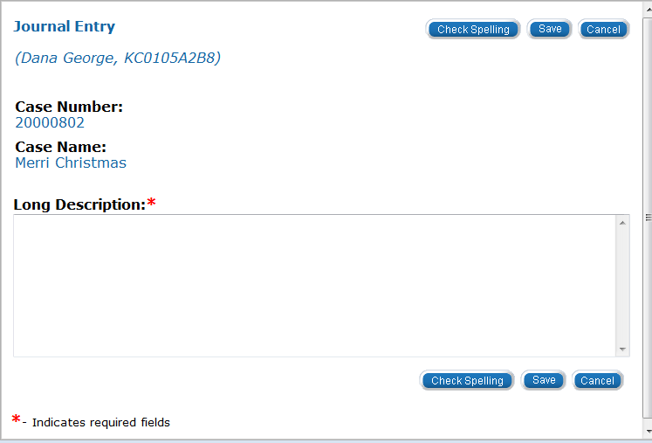
Medical Eligibility: Utility Navigation
Lesson 1: Journal > Add Entry
Enter the narrative in the Long Description box. Review the narrative
Check Spelling
Click the Save button to save the entry
Click the Cancel button to return to the Journal List page without saving the entry
Notes:
The Journal pop-up will be pre-populated with the Worker Name, Worker ID, Case
Number and Case Name.

Slide 13
Medical Eligibility: Utility Navigation
Lesson 1: Journal > Edit Entry
Editing a journal entry allows the user to create an entry that will replace the existing entry.
Please note:
Only manual journal entries can be edited.
A journal entry can only be edited by the creator.
Editing may only be done on the same business day.

Slide 14
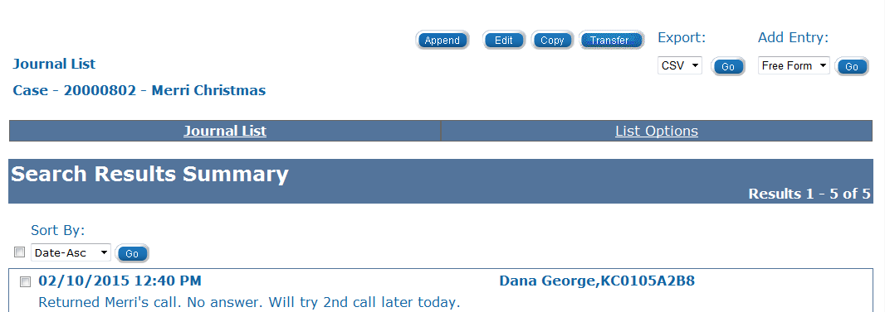
Medical Eligibility: Utility Navigation
Lesson 1: Journal > Edit Entry
To edit a journal entry:
Click the check box to the left of the entry to be edited.
Click the Edit button to open the Journal Entry page.

Slide 15
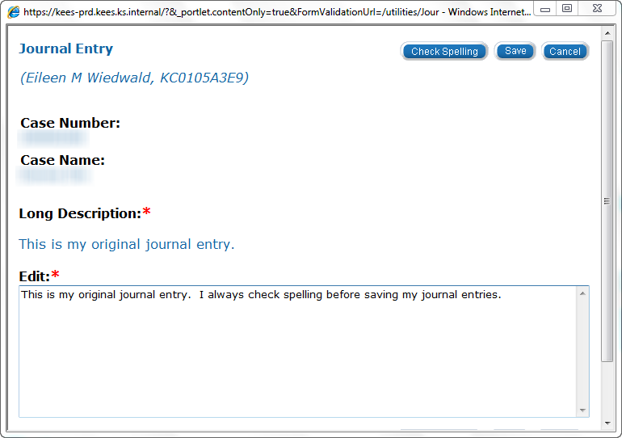
Medical Eligibility: Utility Navigation
Lesson 1: Journal > Edit Entry
Notes:
The original text from the Long Description is visible above the text entry box.
The user can make any necessary changes to the entry in the Edit box. After completing the entry click Save to return to the Journal List page.

Slide 16
Medical Eligibility: Utility Navigation
Lesson 1: Journal > Append Entry
If additions to a journal entry are needed, the user can Append the entry.
Please note:
All users can Append a Journal entry.
Only manual journal entries can be appended.
A journal entry can be appended unlimited times.
Journal entries cannot be sorted or filtered by the date the entry was appended.
It is best to avoid appending journal entries, unless the appended text relates directly to the original text.
Notes:
To append means to add additional verbiage to an existing entry. The user will be unable to alter the existing entry’s verbiage

Slide 17
Medical Eligibility: Utility Navigation
Lesson 1: Journal > Append Entry
To append a journal entry:
Click the check box to the left of the entry to be appended.
Click the Append button to open the Journal Entry page.

Slide 18
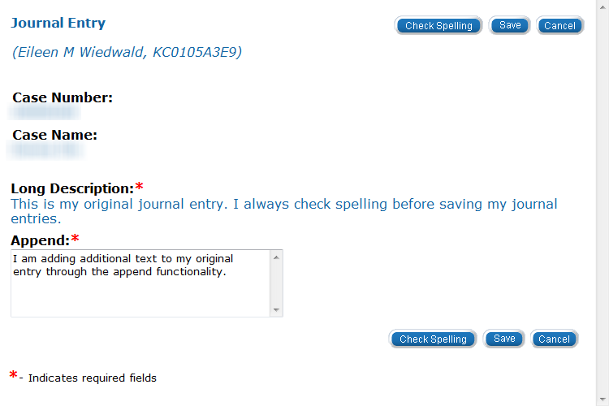
Medical Eligibility: Utility Navigation
Lesson 1: Journal > Append Entry
Notes:
The user can add any necessary information to the entry in the Append box. After completing the entry click Save to return to the Journal List page.
NOTE: Once the entry is saved, a pushpin displays to the right of the entry to notate the entry was appended.

Slide 19
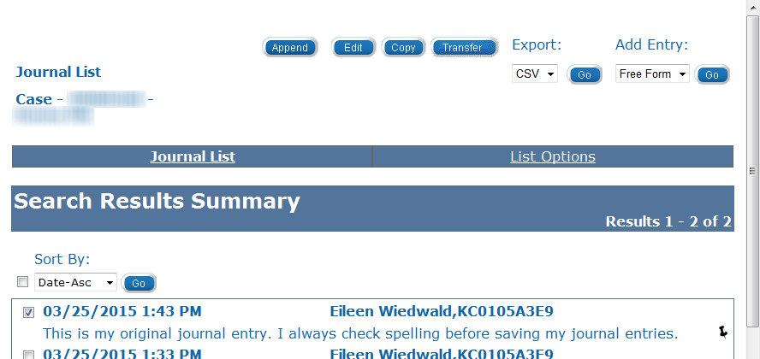
Medical Eligibility: Utility Navigation
Lesson 1: Journal > Append Entry

Slide 20
Medical Eligibility: Utility Navigation
Lesson 1: Journal > Suppress Entry
Journal entries CANNOT be deleted. Suppressing a journal entry means the entry will only be visible to designated users.
Please note:
Suppressing a journal entry is a feature that only certain users will be able to utilize.
The Suppress button will not be visible to people without the proper security profile.
Suppressed entries appear in the Journal List, but details cannot be accessed.
When an entry is suppressed, all appended text is also suppressed.
Suppressed Journal entries cannot be unsuppressed.
Journal entries may need to be suppressed when protecting confidential information such as in Foster Care cases or Adoption cases.

Slide 21
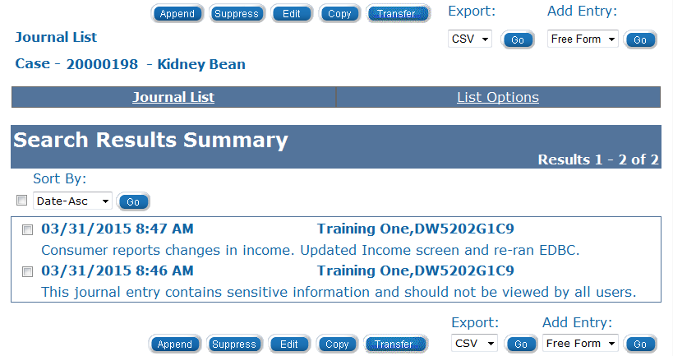
Medical Eligibility: Utility Navigation
Lesson 1: Journal > Suppress Entry
To suppress a journal entry:
Click the check box to the left of the entry to be suppressed.
Click the Suppress button to open the Journal Entry page.

Slide 22
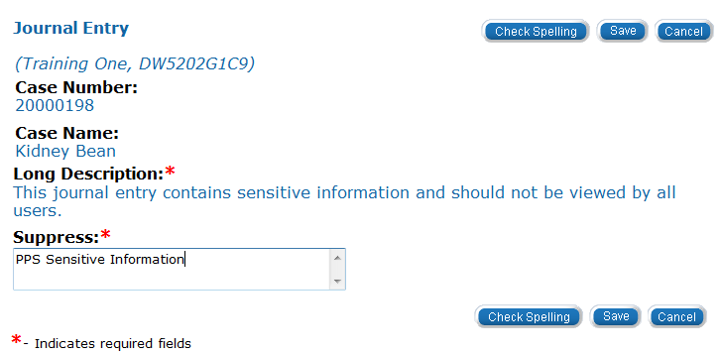
Medical Eligibility: Utility Navigation
Lesson 1: Journal > Suppress Entry
Enter the reason why the entry is being suppressed in the Suppress text box
Click Save
Notes:
Enter why the entry is being suppressed in the Suppress text box.
Review the Narrative
Click the Save button to save the entry
Click the Cancel button to cancel the entry and return to the Journal List page

Slide 23
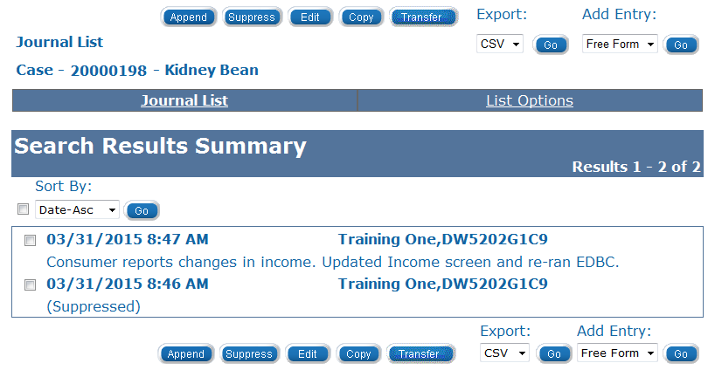
Medical Eligibility: Utility Navigation
Lesson 1: Journal > Suppress Entry
The journal entry will appear on the list page with the long description displaying as (Suppressed).
Notes:
To view a suppressed journal entry:
Select the checkbox to the left of the entry to view.
Click the Suppress button to open the Journal Entry page.
The Suppressed information displays.
Click the Save button, if adding additional information to the suppressed entry reason.
Click the Cancel button if no changes were made.

Slide 24
Medical Eligibility: Utility Navigation
Lesson 1: Journal > Copy Entry
The Journal has a Copy feature that will allow you to duplicate an entry on multiple cases.
Please note:
When you copy a Journal entry, it remains visible on the original case. The same Journal entry will appear on both cases.
Copying a journal entry is a feature that only certain users will be able to utilize.
The Copy button will not be visible to people without the proper security profile.
Ensure the case numbers are accurate when copying Journal entries.
  The system will error only if the case number is not valid.
When deciding whether or not to copy an entry, be mindful of HIPPA regulations.
Notes:
Journal entries can be copied if the information applies to more than one case and it does not violate HIPPA.

Slide 25
Medical Eligibility: Utility Navigation
Lesson 1: Journal > Copy Entry
To copy a journal entry:
Click the check box to the left of the entry to be copied.
Click the Copy button to open the Journal Entry: Copy page.
Notes:
NOTE: PPS staff may use the copy feature when processing a sibling group of children placed in foster care and the entry is needed for each case.

Slide 26
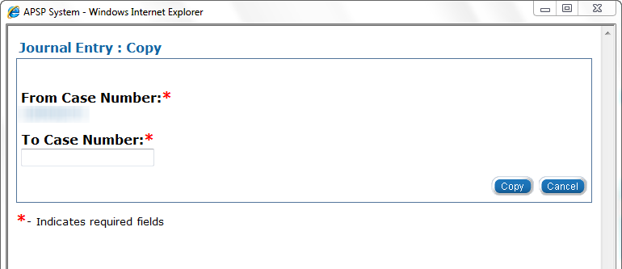
Medical Eligibility: Utility Navigation
Lesson 1: Journal > Copy Entry
To copy a journal entry:
Enter the case number
Click the Copy button
Notes:
After clicking Copy the window will close. The user can verify the entry has been duplicated on the case entered by accessing the Journal list for that case.

Slide 27
Medical Eligibility: Utility Navigation
Lesson 1: Journal > Transfer Entry
The Journal has a Transfer feature that will allow you to remove an entry from one case and move it to another case.
Please note:
When transferring a Journal entry, it no longer remains visible on the original case.
Transferring a journal entry is a feature that only certain users will be able to utilize.
The Transfer button will not be visible to people without the proper security profile.
Ensure the case numbers are accurate when copying Journal entries.
  The system will error only if the case number is not valid.
Notes:
Transferring journal entries is NOT the same as copying.
If a journal entry is mistakenly entered on the wrong case, the user could use the transfer feature to move the entry to the appropriate case.

Slide 28
Medical Eligibility: Utility Navigation
Lesson 1: Journal > Transfer Entry
To transfer a journal entry:
Click the check box to the left of the entry to be transferred.
Click the Transfer button to open the Journal Entry: Transfer page.

Slide 29
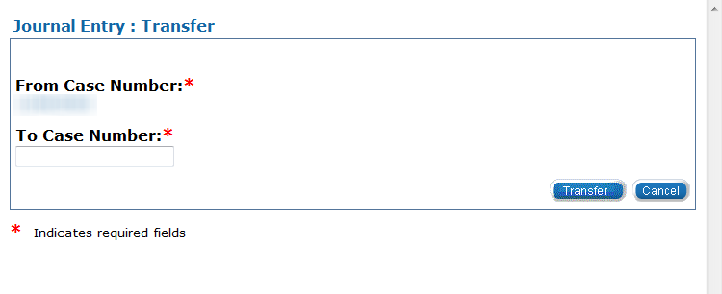
Medical Eligibility: Utility Navigation
Lesson 1: Journal > Transfer Entry
To transfer a journal entry:
Enter the case number
Click the Transfer button
Notes:
After clicking Transfer the window will close. The user can verify the entry has been removed from the journal list page after closing the window and clicking Journal to open the List page again. To verify the entry appears on the new case access the Journal list for that case.

Slide 30
Medical Eligibility: Utility Navigation
Lesson 1: Journal > Export/Print Entry
The Export/Print process is used:
  to produce a printed version of journal entries associated to a specific case
  in cases where Journal are a part of a fair hearing or fraud case.
Please note:
An entire journal or selected journal entries may be printed.
Only 50 journals can be exported at one time.
The Journal can be exported in CSV (Excel) or Text (Notepad) which allows it to be printed in the selected format.

Slide 31
Medical Eligibility: Utility Navigation
Lesson 1: Journal > Transfer Entry
To export a journal entry:
Click the check box to the left of the entry to be exported.
  The user can use the select all check box to the left of the Sort By: drop-down.
  From the Export drop-down menu select CSV (Excel) or Text (Notepad).
  Click Go.
Notes:
The File Download window will appear. Select Open, Save or Cancel.
Once you have selected open or save the user can choose the print function.

Slide 32
Medical Eligibility: Utility Navigation
Lesson 1: Journal > Summary
In this lesson we have discussed how to:
  Add Journal entries
  Edit Journal entries
  Append Journal entries
  Suppress Journal entries
  Copy Journal entries
  Transfer Journal entries
  Export (print) Journal entries
Next, we will discuss Lesson 2: Tasks

Slide 33
Medical Eligibility: Utility Navigation
Agenda
Lesson 1: Journal
Lesson 2: Tasks
Lesson 3: Contact Log
Lesson 4: Logout
Lesson 5: Help

Slide 34
Medical Eligibility: Utility Navigation
Lesson 2: Tasks > Introduction
Tasks is the second tool accessible from the Utility Navigation bar to help KEES users manage their workload.
A task captures and assigns a need for specific program action to an individual or a work queue
Tasks can be assigned manually by a user or automatically by KEES.
Tasks can be created within the context of a case or created without an associated case number

Slide 35
Medical Eligibility: Utility Navigation
Lesson 2: Tasks > Introduction
After completion of this lesson you will be able to :
  Locate Tasks
  Add a Task
    Create Future Tasks
  Claim a Task
  Release a Task
  Reassign a Task
  Complete a Task
  Void a Task

Slide 36
Medical Eligibility: Utility Navigation
Lesson 2: Tasks
Tasks can be viewed from the:
  Task Portlet: Contains a list of the tasks assigned to the user.
  Task Inventory: Allows a user to search for tasks using specific search criteria.
  Task Management: Allows a user to view all tasks related to a specific case.
Notes:
Queue- A series of tasks assigned according to the type of work completed.
DCF- Queue- Your team color (i.e.- Red/Green/Purple)

Slide 37
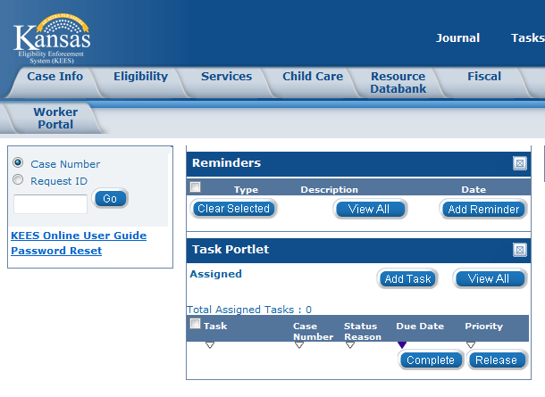
Medical Eligibility: Utility Navigation
Lesson 2: Tasks > View Task
Task Portlet
Displays on the home page and contains a list of tasks assigned to user. Up to ten tasks will display. If more than ten tasks are assigned Next and Previous hyperlinks display.

Slide 38
Medical Eligibility: Utility Navigation
Lesson 2: Tasks > View Task
To access Task Inventory:
Click View All in the Task Portlet.

Slide 39
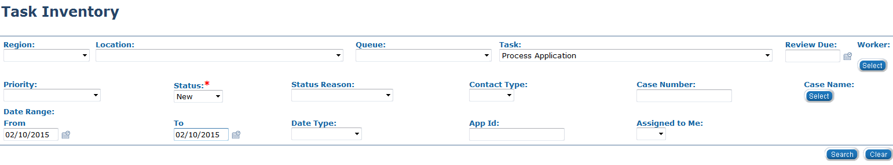
Medical Eligibility: Utility Navigation
Lesson 2: Tasks > View Task
Task Inventory
Allows the user to search for tasks using criteria entered.
Notes:
Available Filters:
Region, Location, Queue, Task, Review Due, Worker, Priority, Status, Status Reason, Contact Type, Case Number, Case Name, Date Range, Date Type, App ID and Assigned to Me

Slide 40
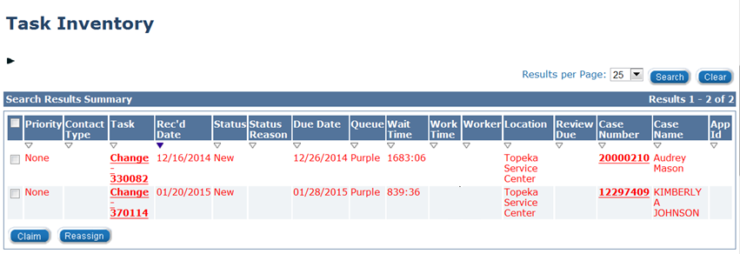
Medical Eligibility: Utility Navigation
Lesson 2: Tasks > View Task
The Task Inventory page displays a list of tasks based on the search criteria.
Click on the hyperlink under the Task Name to view the Task Details.
Notes:
It is a shared page between the agencies. As a result, some columns may not pertain to your agency and or business process.
The Search Results Summary can be sorted by the caret associated to each column header. The image above is sorted by the Rec’d Date column.

Slide 41
Medical Eligibility: Utility Navigation
Lesson 2: Tasks > View Task
  Task Management
  Displays tasks assigned to the specific case and all tasks assigned to the user.
  To access Task Management:
    Click on Tasks from the Utility Navigation bar.
Notes:
Task Management is accessed within the context of a case.

Slide 42
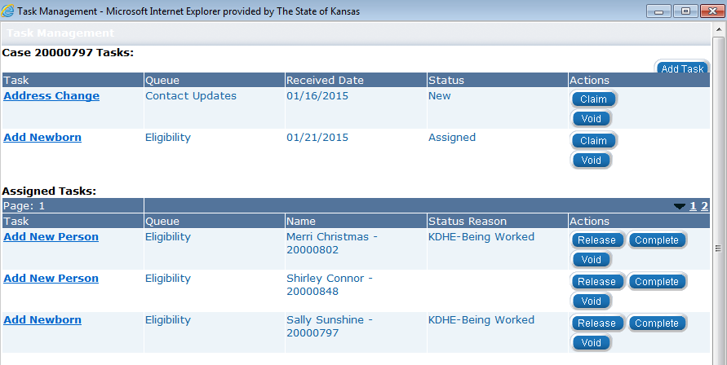
Medical Eligibility: Utility Navigation
Lesson 2: Tasks > View Task
Task Management Window: Allows user to view all tasks related to a specific case as well as all tasks assigned to them.

Slide 43
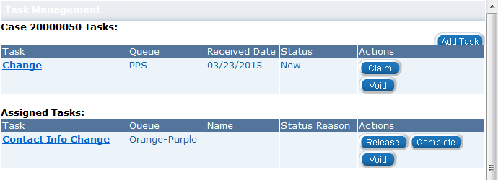
Medical Eligibility: Utility Navigation
Lesson 2: Tasks > Add Task
Clicking the Add Task button in the Task Portlet will open a pop-up window for Manual Task-No Case.
Clicking the Add Task button in the Task Management window will open a pop-up window for Manual Task-In Case.
Notes:
Manual Task-No Case will only be used in rare instances. It could be used when a task is needed, but the case has not yet been registered.
Staff will almost always add a task within the context of a case.

Slide 44
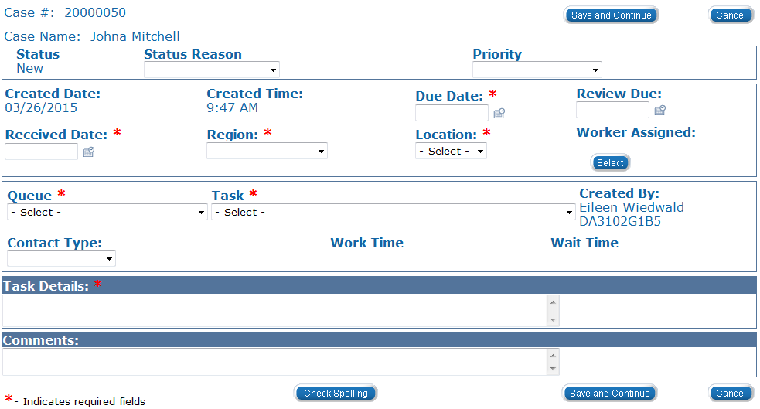
Medical Eligibility: Utility Navigation
Lesson 2: Tasks > Add Task> Task Details
On the Task Detail page the following information is required when adding a task:
Due Date, Received Date, Region, Location, Queue, Task, Task Details
Notes:
When creating a manual task, the user has the option to set a priority. The priorities include: Accelerated, Expedited, KDHE-Passive Review, None, Urgent Need.
Due Date is required using current policy. Application = 30 days; all other 10 days.
Task Detail is where you would enter the KAECSES ID# to link to a non-medical case.

Slide 45
Medical Eligibility: Utility Navigation
Lesson 2: Tasks > Add Task> Task Details
The following fields will be populated by system on the Task Detail window:
Status will always begin as ‘New’
Created Date and Time act as a Date and time stamp of when the task was completed
Created by will auto-populate with worker ID and name

Slide 46
Medical Eligibility: Utility Navigation
Lesson 2: Tasks > Add Task> Task Details
The following dynamic drop-down fields MUST be completed in order:
Region
Location
Queue
Task
Notes:
When all fields have been completed:
Check Spelling
Click Save and Continue

Slide 47
Medical Eligibility: Utility Navigation
Lesson 2: Tasks > Add Task> Future Task
Future Tasks are a type of Manual Task that are created when future action is required on a case.
Examples of some actions beyond the current come-up month:
Medicare Expenses: A future task would be set to update Medicare Expenses when Buy-In occurs.
Absence Without Leave (AWOL) youth. A future task would be set to check the youth’s status so the case could be discontinued per agency policy.
Placements in Detention: Task to review the case for discontinuance of the Medical case per agency policy.
Pregnancy: Task to review the case based on the due date of the child.
Notes:
In creating future tasks:
Received Date: Use the date the information was received .
Due Date: Use the date when you want to take action on the case.
Now that we’ve learned how to Add Tasks, we’ll walk through how to claim a task.

Slide 48
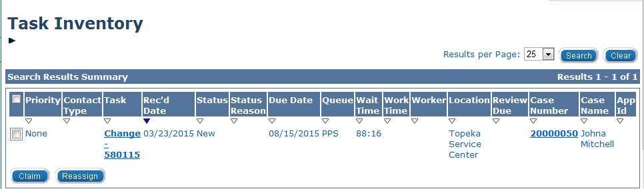
Medical Eligibility: Utility Navigation
Lesson 2: Tasks > Claim a Task
When a worker claims a task, they assign the action to themselves. There are multiple screens from which to claim a task.
From the Task Inventory page:
  Click the check box next to the task(s) you wish to claim.
  Click the Claim button.
Notes:
Next will show you how to claim a task from the Task Detail window.

Slide 49
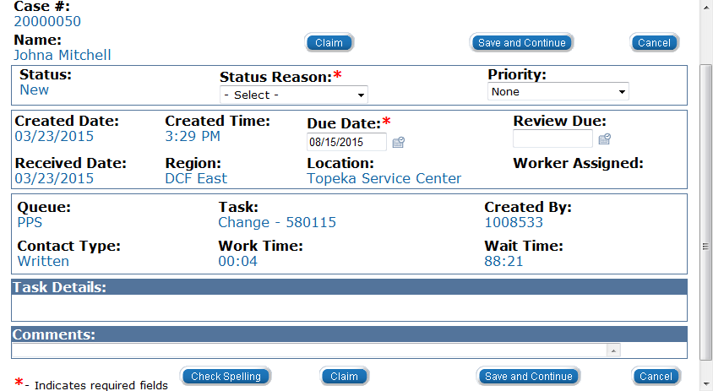
Medical Eligibility: Utility Navigation
Lesson 2: Tasks > Claim a Task
A task can be claimed on the Task Details page if the Status field displays New.
  Click the Claim button.
Notes:
Next we will show you how to claim a task within the context of a case, from the Task Management window.

Slide 50
Medical Eligibility: Utility Navigation
Lesson 2: Tasks > Claim a Task
A task can be claimed on the Task Management window.
  Click the Claim button.
Notes:
Occasionally when you claim a task from the Task Details page, and there are other tasks associated with that case those will be assigned to you as well.
You will have to release each one of them if they should not be assigned to you.
Releasing a task can be done from the Task Portlet on the home page, the Task Management page, or Task Inventory page by filtering by “assigned to me”.

Slide 51
Medical Eligibility: Utility Navigation
Lesson 2: Tasks > Release Task
Release is used to send the task back to the queue it originally came from and the status will revert to New.
Some examples of instances when you would release a task are:
If a task is assigned to you in error.
If the task assigned to you is outside of your skill set.
There are multiple screens from which to release a task.
Notes:
Queue will be either PPS or EES team colors.

Slide 52
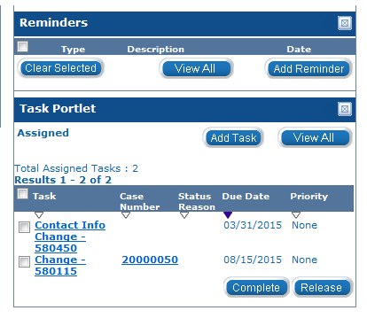
Medical Eligibility: Utility Navigation
Lesson 2: Tasks > Release Task
From the Task Portlet:
Click the check box next to the task(s) you wish to release.
Click Release.

Slide 53
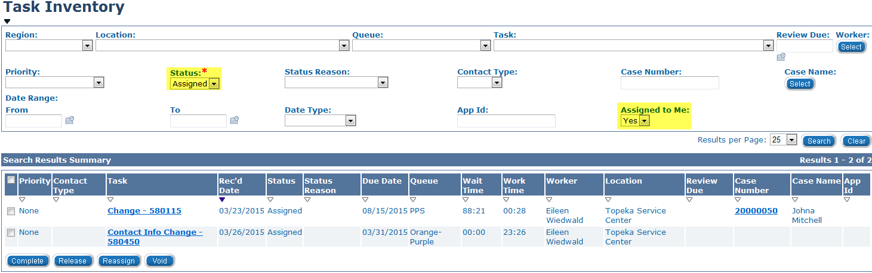
Medical Eligibility: Utility Navigation
Lesson 2: Tasks > Release Task
From the Task Inventory:
Select Assigned from the Status drop-down.
Select Yes from the Assigned to Me drop-down.
Click the check box next to the task(s) you wish to release.
Click Release.

Slide 54
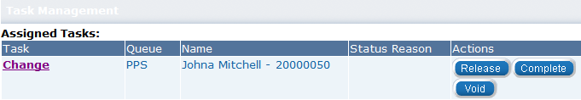
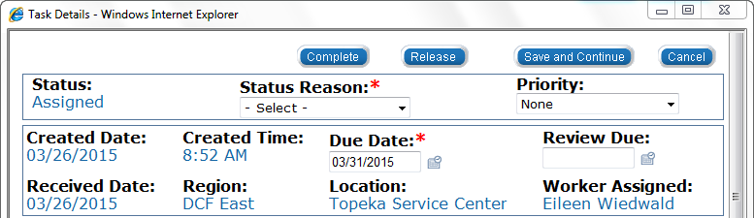
Medical Eligibility: Utility Navigation
Lesson 2: Tasks > Release Task
From the Task Management window:
Click Release.
From the Task Details window:
Click Release.

Slide 55
Medical Eligibility: Utility Navigation
Lesson 2: Tasks > Reassign Task
Reassign is a feature that allows the user to move the task within one of the four sections:
  Queue
  Worker
  Location
  Case
Possible scenarios when Reassign would be used:
  Case with conflict of interest.
  When a task is created and assigned to a wrong queue.
Notes:
When an application belongs to a worker in the same office the task can be assigned to a worker in a different office.

Slide 56
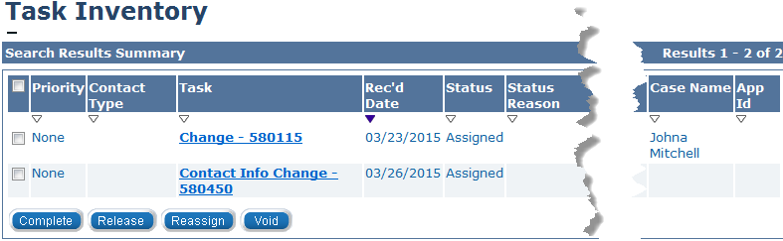
Medical Eligibility: Utility Navigation
Lesson 2: Tasks > Reassign Task
From the Task Inventory window:
Click the check box to the left of the task.
Click Reassign.
Notes:
The Reassign Tasks page will appear after clicking Reassign.

Slide 57
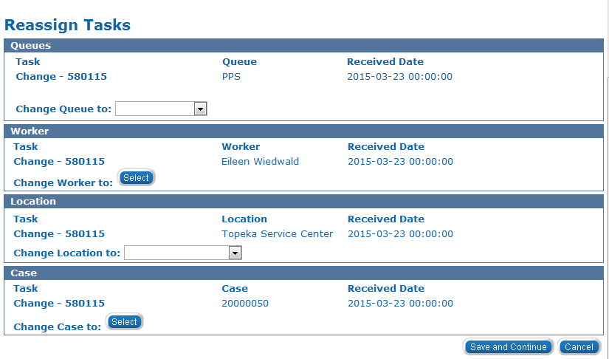
Medical Eligibility: Utility Navigation
Lesson 2: Tasks > Reassign Task
From the Task Inventory window:
Highlight the task you wish to reassign.
Update the appropriate section(s).
Click Save and Continue.
Notes:
Clicking the Save and Continue button will return you to the Task Inventory page.

Slide 58
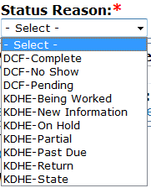
Medical Eligibility: Utility Navigation
Lesson 2: Tasks > Complete Task
After claiming and working a task, you must consider whether or not the task is finished.
Anytime action is taken related to a task, the status reason should be updated to reflect the appropriate task status.
In order to Complete a task, a status must be selected from the Status Reason drop-down.
Notes:
The definitions of the status reasons may vary between agencies and may be repurposed based on business needs.
PPS will not select Pending as a status reason
Complete button will appear if the status is ‘assigned’.

Slide 59
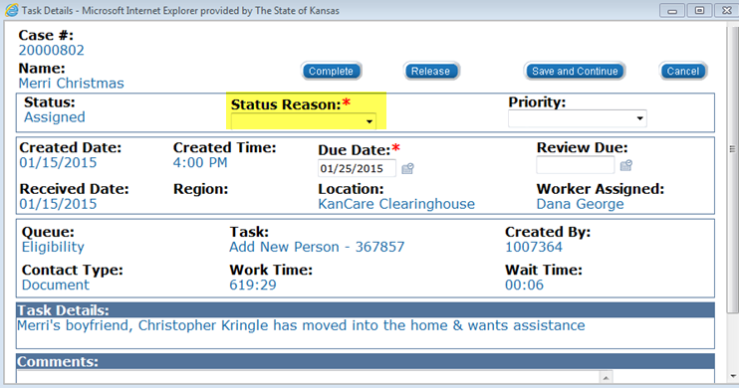
Medical Eligibility: Utility Navigation
Lesson 2: Tasks > Complete Task
From the Task Details window:
Update Status Reason
Click Complete
Notes:
When it is determined that all action necessary has been taken on a task and it is ready to completed. The user MUST complete a task from the Task Details page.

Slide 60
Medical Eligibility: Utility Navigation
Lesson 2: Tasks > Void Task
Void is a feature that will allow the user to remove a task from the system permanently.
One example of when this function could be utilized is if duplicate tasks are created in error.
DO NOT void tasks unless you are certain it should be voided.
From the Task Inventory or Task Management window:
Click the check box to the left of the task.
Click Void.
Notes:
When the task is voided the system will change the status to Rejected.

Slide 61
Medical Eligibility: Utility Navigation
Lesson 2: Tasks > Summary
This completes our lesson.
In this lesson, we discussed Tasks and how they will help users manage their work and communicate with each other.
We discussed:
  Locate Tasks
  Add a Task
  Create Future Tasks
  Claim a Task
  Release a Task
  Reassign a Task
  Complete a Task
  Void a Task

Slide 62
Medical Eligibility: Utility Navigation
Agenda
Lesson 1: Journal
Lesson 2: Tasks
Lesson 3: Contact Log
Lesson 4: Logout
Lesson 5: Help
Notes:
Next we will discuss Contact Log.

Slide 63
Medical Eligibility: Utility Navigation
Lesson 3: Contact Log > Introduction
After completing this lesson you will be able to:
Define the purpose and use of the Contact Log
Create a Contact Log entry
Use General Inquiry - No established case
Search the Contact Log

Slide 64
Medical Eligibility: Utility Navigation
Lesson 3: Contact Log > Introduction
The Contact Log is the screen that captures interactions with consumers and provides users with the ability to view historical interactions associated with a case or individual.
Many of the Contact Logs will be generated by the receptionist and lobby staff.
Contact Log entries may also be generated after contact with other providers, co-workers and agencies.
The Contact Log can create tasks based on the reason the contact was made.
Notes:
NOTE: DCF will use the Contact Log in communicating to the Clearinghouse. The BPM Tracker will continue to be used for other processes.
In order to understand how the Contact Log will assist users in their daily job, we will first familiarize ourselves with the fields of the Contact Log.

Slide 65
Medical Eligibility: Utility Navigation
Lesson 3: Contact Log
To access the Contact Log:
Click Contact Log
Notes:
Within the context of a case the Contact Log Entry window displays with the Case Number and Person pre-populated.
Outside of the context of a case the Contact Log Entry window displays with no case information.

Slide 66
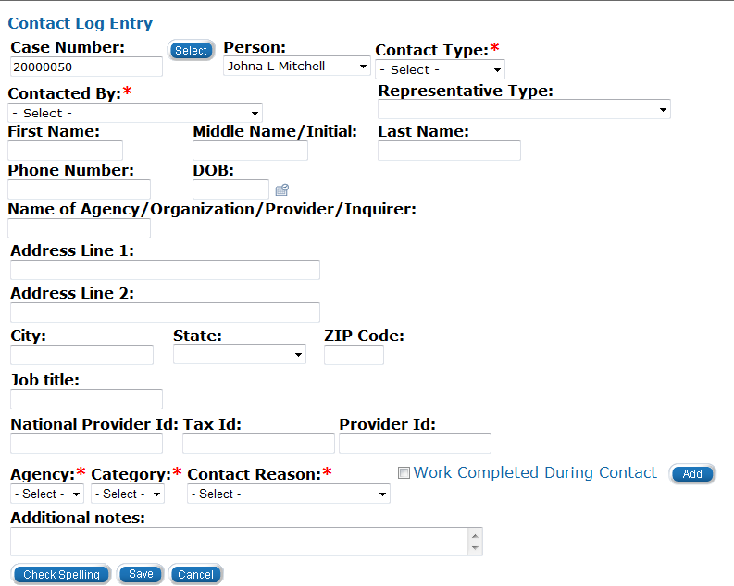
Medical Eligibility: Utility Navigation
Lesson 3: Contact Log > Create Contact Log
Enter the Case Number
Select the Person from the drop-down menu
Notes:
When creating a contact log, Contact Type, Contacted By, Agency, Category and Contact Reason are required fields. The user should enter any known information, even if not required.
If a contact log is not created within the context of a case, the Person Search page will display after entering the Case Number and clicking Select.
If there is more than one person on the case, a list of case persons will be visible under the Person drop-down.

Slide 67
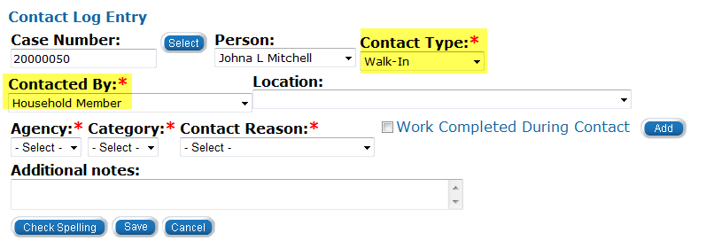
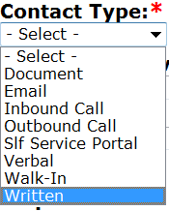
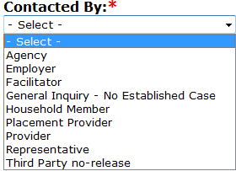
Medical Eligibility: Utility Navigation
Lesson 3: Contact Log > Create Contact Log
Select Contact Type from the drop-down menu
Select Contacted By from the drop-down menu
  The contact log fields will vary based on this selection

Slide 68
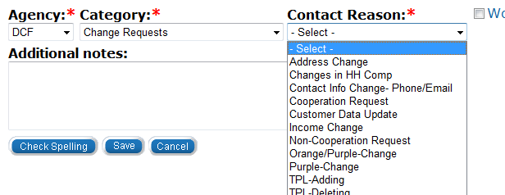
Medical Eligibility: Utility Navigation
Lesson 3: Contact Log > Create Contact Log
Select Agency, Category, Contact Reason from the drop-down menus
  The drop-down values will vary based on these selections

Slide 69
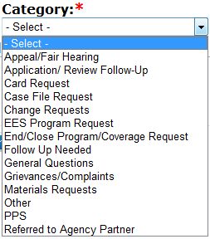
Medical Eligibility: Utility Navigation
Lesson 3: Contact Log > Create Contact Log
The Category drop-down menu will vary based upon the Agency selected.
When selecting KDHE from Agency, the drop-down will include Family Medical Coverage Request
PPS and EES Program Request are DCF specific Category values

Slide 70
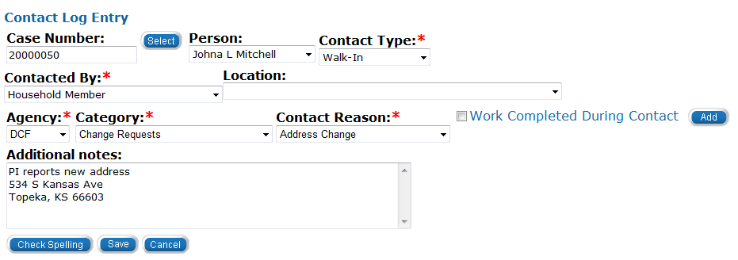
Medical Eligibility: Utility Navigation
Lesson 3: Contact Log > Create Contact Log
Enter any applicable information in the Additional notes field
Check Spelling
Click Save
Notes:
Contact Log Entries can create tasks. The Location selection DCF or KDHE assists in routing the task to the appropriate Location and Agency.
By marking “Work Completed During Contact”, a task is generated and completed for the user so no task is entered in the Queue.
By clicking Add the user can add an additional Agency, Category and Contact Reason to the log.

Slide 71
Medical Eligibility: Utility Navigation
Lesson 3: Contact Log > Imaged Documents
We have looked at the fields of the Contact Log and how a user enters a contact record. Imaging a document can create a contact log.
Imaged Documents:
  Imaged into the ImageNow system
  Indexed and associated to a case
  Automatically create a Contact Log entry
    This includes Case Number, App ID, Receive Date of the document, Scan Date, Document Type and the Image ID
    The Contact Type is set to Document

Slide 72
Medical Eligibility: Utility Navigation
Lesson 3: Contact Log > General Inquiry
Users may receive inquiries from individuals who are not known to KEES. This type of inquiry can be recorded by using the Contacted By: General Inquiry – No Established Case.
It is important to capture the full name, address, phone number and date of contact for whom the call is regarding. This will provide the capability for the logs to later be linked if a new case is created.
For all Contact Log entries that are not linked to a case, a monthly batch will run to compare the name and date of birth with new cases that have been created that month.
If the criteria match, the Contact Log will be linked to the newly created case and copied to the journal.
Notes:
Now we will look at how to search for contact entries.

Slide 73
Medical Eligibility: Utility Navigation
Lesson 3: Contact Log > Searching the Contact Log
If a Contact Log entry is not linked to a case, searching the contact log by Worker ID or Non-Case Related allows the user to link an entry to a specific case. Once linked to the case, the entry will be copied into the case journal.
The Case Number column will be blank if not associated with a case.

Slide 74
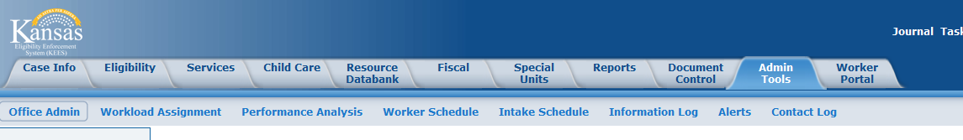
Medical Eligibility: Utility Navigation
Lesson 3: Contact Log > Searching the Contact Log
To access the Contact Log Search:
Click Admin Tools
Click Contact Log
After clicking Contact Log, the end-user is brought to the Contact Log Search page.
Notes:
The Contact Log Search page is accessed through the Admin Tools on the Global Navigation bar.
Click Contact Log in the Local Navigation bar
The Contact Log Search page will display.

Slide 75
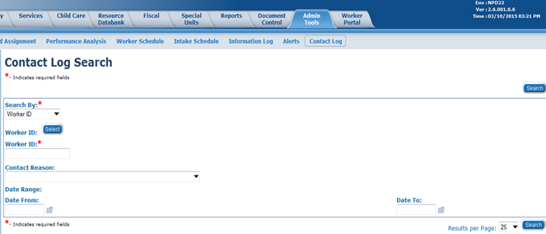
Medical Eligibility: Utility Navigation
Lesson 3: Contact Log >Searching the Contact Log
Select Search By from the drop-down field
  The user can select Worker ID, Case or Non-Case Related
The required fields vary based on Search By selection

Slide 76
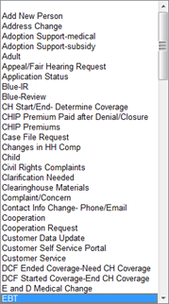
Medical Eligibility: Utility Navigation
Lesson 3: Contact Log > Searching the Contact Log
Once all the search criteria have been entered:
Click Search
Notes:
The Contact Reason and Date Range fields can be used to limit the search results.
The drop-down list displayed is an example of some of the values available in the Contact Reason drop-down.
All logs within the filtered search criteria will appear.

Slide 77
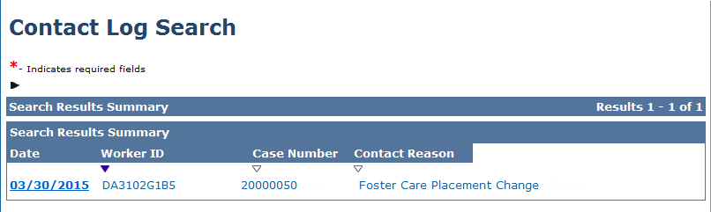
Medical Eligibility: Utility Navigation
Lesson 3: Contact Log > Searching the Contact Log
By clicking on the Date hyperlink, the details of the selected log displays on the Contact Detail page.
Notes:
A result of your search will be displayed. By clicking on the Date hyperlink, the details of the selected log will appear on the Contact Detail page.

Slide 78
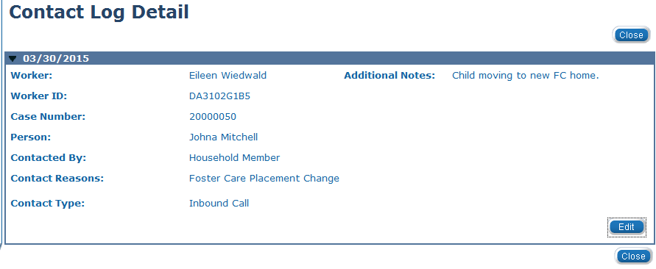
Medical Eligibility: Utility Navigation
Lesson 3: Contact Log > Searching the Contact Log
On the Contact Log Detail:
The user can click Edit to update the log
Notes:
By clicking Edit the Contact Log Entry window displays. The user can enter the case information if the log was originally created with blank fields.

Slide 79
Medical Eligibility: Utility Navigation
Lesson 3: Contact Log > Summary
In this lesson you learned:
  How to create a Contact Log
  Entries can be created from imaged documents
  Entries can be created when there is no known case
  Entries can be searched and linked to a case
  Entries can create tasks and initiate work flow
Notes:
Next let’s look at Logout and Help

Slide 80
Medical Eligibility: Utility Navigation
Agenda
Lesson 1: Journal
Lesson 2: Tasks
Lesson 3: Contact Log
Lesson 4: Logout
Lesson 5: Help

Slide 81
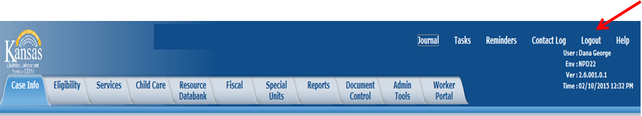
Medical Eligibility: Utility Navigation
Lesson 4: Logout > Introduction
When a user is going to be away from their desk for extended period of time, they should Logout of KEES.
If the user is in the context of a case, they MUST click the KEES logo located in the left corner.
Click Logout.

Slide 82
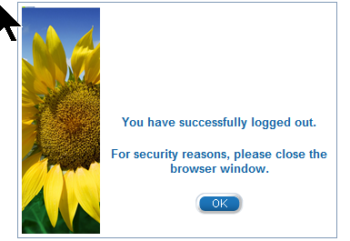
Medical Eligibility: Utility Navigation
Lesson 4: Logout
To complete the Logout process:
Click the OK button
The browser window closes

Slide 83
Medical Eligibility: Utility Navigation
Lesson 4: Logout > Summary
This completes our lesson.
Notes:
Next we will discuss the Help feature.

Slide 84
Medical Eligibility: Utility Navigation
Agenda
Lesson 1: Journal
Lesson 2: Tasks
Lesson 3: Contact Log
Lesson 4: Logout
Lesson 5: Help
Notes:
Combine lesson 4 and 5 to Other TOOLs? If so, - will need to amend agendas

Slide 85
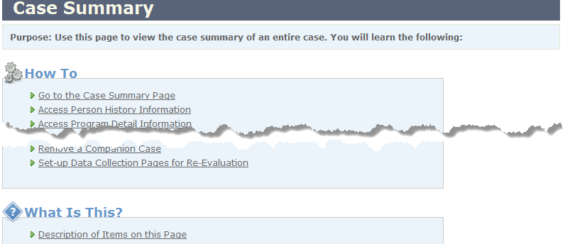
Medical Eligibility: Utility Navigation
Lesson 5: Help
Help allows the user to view instructions on how to complete the page and describes all functions that may be performed. The Help window displays information based on the current screen selection.

Slide 86
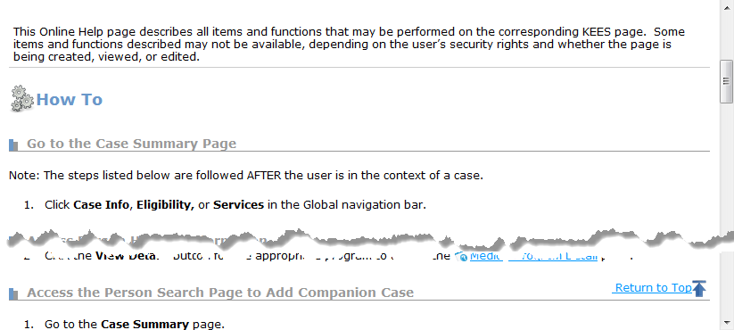
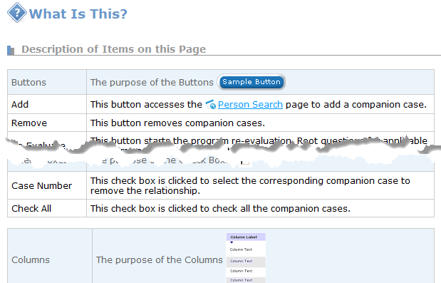
Medical Eligibility: Utility Navigation
Lesson 5: Help
Notes:
Under the How To section the hyperlinks under each item will take the user to specific step by step instructions.
Under the What is This? Heading are hyperlinks describing the items on the page

Slide 87
Medical Eligibility: Utility Navigation
Lesson 5: Help > Summary
This completes our lesson.
Notes:
Next we will discuss the Help feature.

Slide 88
Medical Eligibility: Utility Navigation
Course Summary
In this course we discussed how to use the tools on the Utility Navigation bar.
We discussed:
    Journal
    Tasks
    Contact Log
    Logout
    Help

