Slide 1
Verification Job Aid
This simple job aid is designed to show how to use the Real Time History List and Detail List pages.

Slide 2
Introduction
The Real Time Interface page was added to KEES in December 2015.
The purpose of this new screen is to show the user whether or not their Request Verifications call was sent successfully, and to view the responses for each of those calls.
This screen only displays calls made by a worker, and not those handled by No-Touch.
To see additional details on specific request items, the verification details and history pages will still need to be utilized.

Slide 3
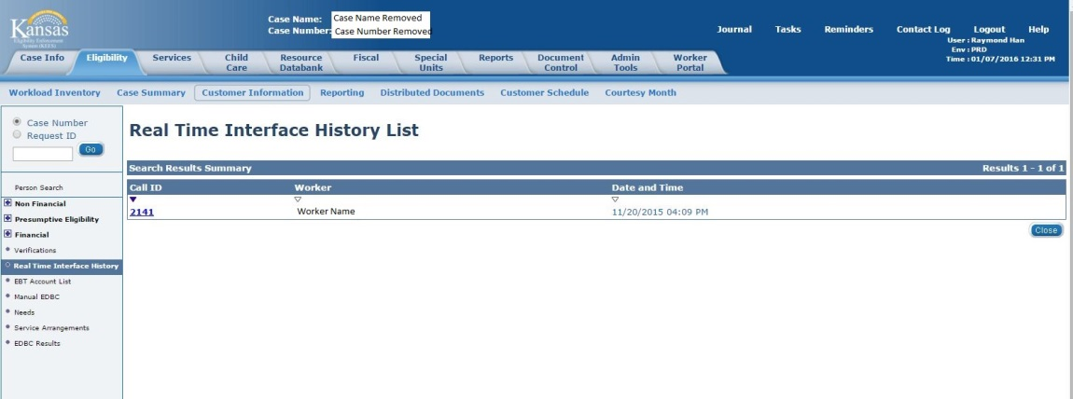
Real Time Interface History List
A record will appear in this list view each time “Request Verifications” is pushed.
This page automatically appears after pressing the button or can be navigated to via the left hand navigation.
The Worker Name as well as Date and Time can help identify the correct record that is for that specific request.
Clicking on the hyperlink under “Call ID” will navigate the worker to the specific request / response detail page.
Records are not created for “No-Touch” generated verifications

Slide 4
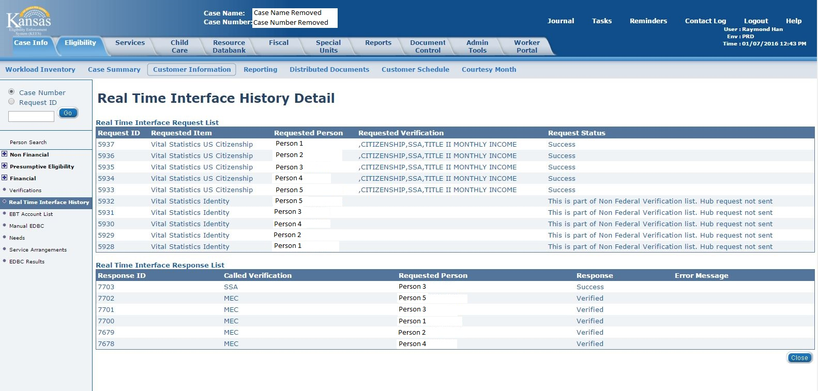
Real Time Interface Detail List
The requests that were made for that push of the “Request Verifications” button appears in the top list.
The responses that were received are in the bottom list.
There is not a one to one correlation between requests and responses – Not every request results in a response and some requests result in multiple responses.

Slide 5
Real Time Interface Detail List
The Request List will display the individuals that were requested.
The Response List will display the individuals that were returned.
Not every person requested will be returned.
Responses may not be instantaneous, it may take a couple of seconds for the response to occur

Slide 6
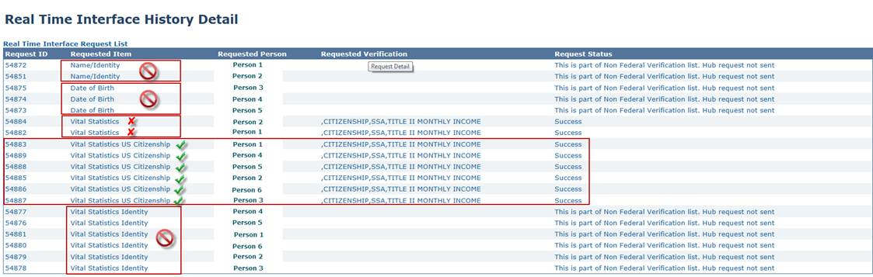
Real Time Interface Detail List
In order to verify Citizenship, Identity, SSN, or DOB, you must select the Vital Statistics or Vital Statistics US Citizenship types on the Verification List page prior to pressing the Request Verification button.
It is only necessary to select one of these options per person. Example: It is not necessary to select both Vital Statistics AND Vital Statistics US Citizenship for Person’s 1 and 2.
If an incorrect type is selected, the Hub interface will not be initiated and the following Request Status will display: This is part of Non Federal Verification list. Hub request not sent.

Slide 7
Real Time Interface Detail List
In this example, you can see that Person 3 was “Successfully” verified with SSA. Because the SSA interface can be used to verify multiple elements, you should expect to see verifications such as SSN, DOB, Identify, or Citizenship set to “Verified” on the verification list page and the information updated on the data collection pages.
When a successful response is received from the SSA, it means that some of the above items were verified, not necessarily all. The worker will need to refer back to the data collection pages to confirm which of the fields were verified.

Slide 8
Real Time Interface Detail List
Some interfaces have been disabled for Policy reasons.
  If the Called Verification says “EVVE” or “WEB-IZ” these verifications are not active and hence the Response is irrelevant. Do not worry if you see a person’s name listed in the response list on an EVVE or WEB-IZ that you did not request verification for.
Some interfaces are not essential for Worker Action.
  If the Called Verification says “MEC” this is KEES letting other systems know that the individual has applied for Medicaid.

Slide 9
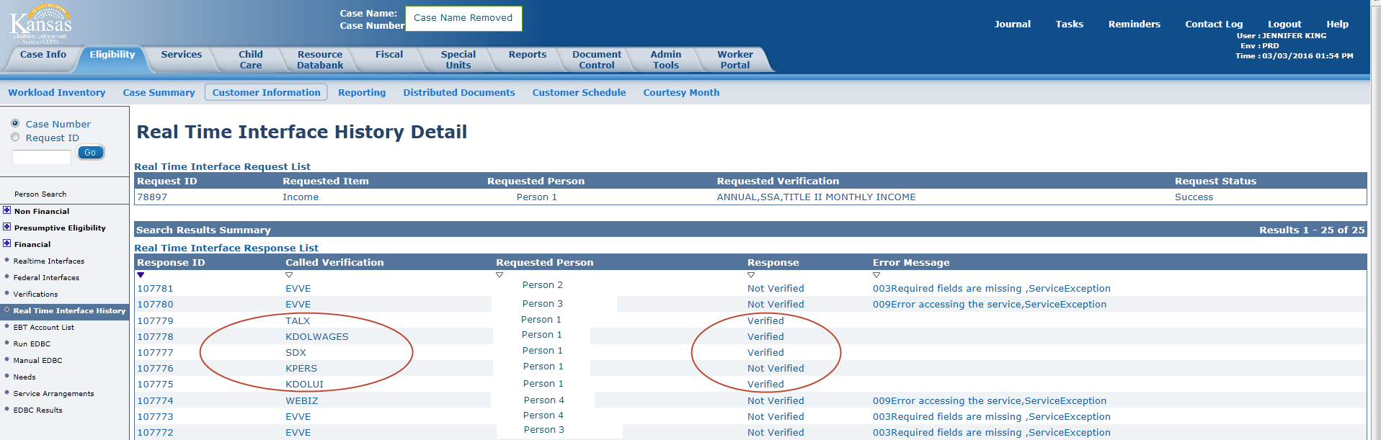
Real Time Interface Detail List
This page shows an example of the income verification being requested
  This example shows that Person 1’s verifications were requested, but additional people are shown in the response list. This should only occur for EVVE or WEBIZ, however this service has been turned off; the errors are expected.
  For income verifications, a verified response indicates income was found from that source, but does not indicate that it was reasonably compatible. The specific income record(s) will need to be reviewed on the Verification Detail page(s) to confirm income records that pass reasonable compatibility and were determined verified.
  It is necessary to select the Income type on the Verification List page for each person you wish to verify income for.

Slide 10
Real Time Interface Detail - Income
The income interfaces will return a Response of ‘Verified’ if anything is found for the SSN that is being called.
If SDX or KDOLUI return a Response of ‘Verified’, workers will need to research SDX and BARI manually.
If KPERS returns a Response of ‘Verified’, subsequent verification steps need to be followed.
KDOLWAGES will base reasonable compatibility on wages received in the current quarter, or if not available, the previous quarter to that. Ex: if the date of request is 3/03/2016, then KDOL will return 1st Qtr 2016 if available, if not, then 4th Qtr 2015. To determine if KEES found KDOLWAGES (or TALX wages) to be reasonably compatible, you will need to view the income record(s) on the Verification Detail page.

Slide 11
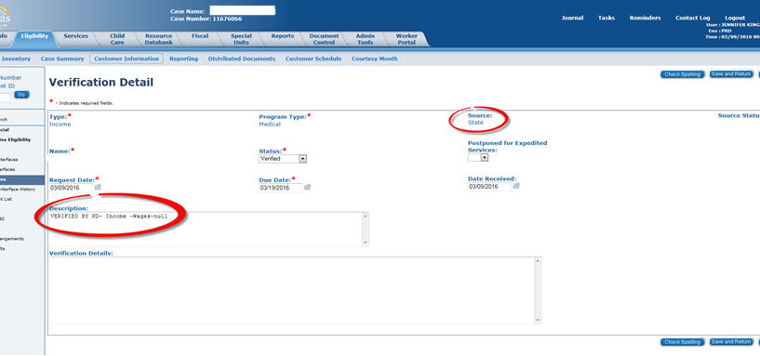
Verification Detail – Income
The Verification Detail page provides additional information regarding the specific element. User will access this page to determine if the information from the verification request through the RV Button resulted in a verified element, including a Reasonably Compatible record for earned income. This screen is accessed by navigating through the Verification List page.

Slide 12
Verification Detail – Income
When income is verified through the automated process, the results are attached to the income record and is reflected on the Income Amount Detail Page. If the worker accesses the Income Amount Detail Page and chooses the ‘Save and Continue’ button, the information on the Verification Detail page is ‘reset’, causing the results of previous RV button to disappear. If the worker selects ‘Cancel’ the Verification Detail is not impacted.
When income is verified through an interface as part of KEES functionality, it is critical that a record of that result be available to subsequent users. This includes cases transferred to the State from the Contractor, ME QC and others.
To ensure this record is retained for future reference, if the element is verified using the KEES process, workers must screen shot the Verification Detail page and retain it in the Imaged case file. This is only necessary when the results actually satisfy the verification requirements. If information is returned from the RV button, but does not satisfy the eligibility verification requirement, a screen shot is not required. Index the screen shot according to the eligibility element verified. For example, if it verifies earned income it is indexed under ‘Income’.

Slide 13
Verification types
The following outlines the verification types from the verification list page that can be selected when running verifications. The verifications performed column indicates the verification items that are performed when the type on the left is selected. The verification type is displayed in the Requested Item field in the Request List section on the Real Time Interface Detail page.
Verification Type | Verifications Performed
Name/Identity | None
SSN | None
Date of Birth | None
Date of Death | - Date of Birth Verification - Date of Death Verification - SSN Verification
INS Document | - Lawful Presence Verification
Income | - Date of Birth Verification - SSN Verification - Income Verification

Slide 14
Verification types
Verification Type | Verifications Performed
Vital Statistics | - SSN Verification - Date of Birth Verification - Citizenship Verification - Identity Verification
Vital Statistics US Citizenship | - SSN Verification - Date of Birth Verification - Citizenship Verification - Identity Verification
Vital Statistics Identity | None
Expense Amount | - Date of Birth Verification - SSN Verification - Income Verification
Living Arrangement | - Date of Birth Verification - SSN Verification - Incarceration Verification
No Income Reported | - Date of Birth Verification - SSN Verification - Income Verification

Slide 15
Request List Statuses
The following outlines the other Request Statuses that may display in the Request List.
Request Status | Definition
Success | Request was successfully sent – no implication as to verification status.
This is part of Non Federal Verification list. Hub request not sent | Requested verification (the one the user checked) does not actually call anything to be verified. This usually means the user selected Name / Identity or Vital Statistics Identity types. These are incorrect choices.
Hub request not sent due to missing fields | A request made to the HUB was not completed because a required field was missing. Refer to last few slides for a complete list of required fields. Update the missing information and resend the request.
HUB request not sent due to BPM Exception | The request to the HUB was not made because of a technical issue. An incident needs to be created with the KEES Business Support Team. Please follow your normal process for reporting incidents.

Slide 16
Response List Statuses
The following outlines the Response Messages that may display in the Response List.
Interface | Response | Message
SSA | Success | Person Verified. This means that some (or all) of the following have ben verified: SSN, DOB, Vital Statistics Identity, Vital Statistics Citizenship, Living Arrangement, and Date of Death (if applicable).
SSA | Error | Check required fields and their format -Request Fail Due to Schema Exception. This means that a required field was not available. Refer to last few slides for a complete list of required fields. **The most common issue when you see this error is a missing SSN. Update the missing information and resend the request.
SSA | Error | Trusted Data Source Unreachable This means that the HUB is unavailable. Try again at a later time.
SSA | Error | Request failed This means that the transaction failed. Please report the incident and include: case number, date and time the error occurred.

Slide 17
Response List Statuses
Interface | Response | Message
SSA | Not Verified | SSN Not Verified; SSN does not exist on the numident, is marked for deletion, or is inaccessible. Person not verified. Reason specified; confirm the SSN is entered correctly and resend the request.
SSA | Not Verified | SSN Not Verified; SSN exists; There is a match on name but not on DOB Person not verified. Reason specified; confirm the DOB is entered correctly and resend the request.
SSA | Not Verified | SSN Not Verified; SSN exists; There is a match on DOB but not on name Person not verified. Reason specified; confirm the name is entered correctly and resend the request.
SSA | Not Verified | SSN Not Verified; SSN exists; There is no match on name or DOB Person not verified. Reason specified; confirm the name and DOB are entered correctly and resend the request.
MEC | Verified | This means that KEES has successfully logged that this individual has been logged with the MEC service. No Verifications were performed by this service.

Slide 18
Response List Statuses
Interface | Response | Message
VLP | Success | When a success response is received on the VLP interface, workers will need to check the INS Document Verification Request List pages from the Verification Detail page by clicking the History button to see the details of the response.
VLP | Error | System error submitting Initial Verification This means there was a technical issue. Please report the incident and include: case number, date and time the error occurred.
VLP | Error | Invalid or missing input parameter. Refer to last few slides for a complete list of required fields. Update the missing information and resend the request.
SDX | Verified | This means that KEES has found activity on SDX for the person requested.
KDOL WAGES | Verified | This means that KEES has found earnings on the KDOL Wage file.
TALX | Verified | This means that KEES has found earnings for the person via the TALX interface.
KPERS | Verified | This means that KEES has found pension income from KPERS.
KDOLUI | Verified | This means that KEES has found unemployment activity for the person requested.
SDX | Not Verified | If there is no message listed, this means that no activity was found on SDX. Follow subsequent verification steps if income is reported.

Slide 19
Response List Statuses
Interface | Response | Message
KDOL WAGES | Not Verified | If there is no message listed, this means that there were no findings on the KDOL Wage file. Follow subsequent verification steps if income is reported.
TALX | Not Verified | If there is no message listed, this means that earnings income was not found with TALX. Follow subsequent verification steps if income is reported.
KPERS | Not Verified | If there is no message listed, this means that pension activity was not found. Follow subsequent verification steps if income is reported.
KDOLUI | Not Verified | If there is no message listed, this means that unemployment activity was not found. Follow subsequent verification steps if income is reported.
TALX | Not Verified | Error accessing the service This means there was a technical issue. Please report the incident and include: case number, date and time the error occurred.
TALX | Not Verified | Error accessing the database This means there was a technical issue. Please report the incident and include: case number, date and time the error occurred.

Slide 20
Response List Statuses
Interface | Response | Message
TALX | Not Verified | Multiple individuals may be associated with this SSN. Follow subsequent verification steps if income is reported.
KPERS | Not Verified | Error accessing the service This means there was a technical issue. Please report the incident and include: case number, date and time the error occurred.
KPERS | Not Verified | Internal Server Error This means there was a technical issue. Please report the incident and include: case number, date and time the error occurred.
EVVE |  | Users should ignore these responses. This service has been functionally turned off.
WEB-IZ |  | Users should ignore these responses. This service has been functionally turned off.

Slide 21
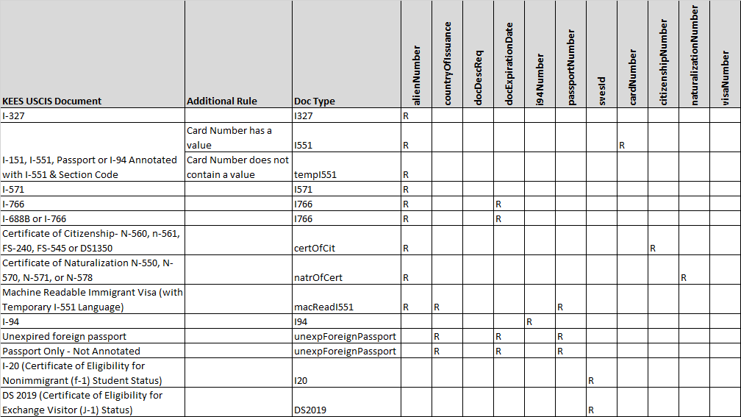
Required Fields
Verify Lawful Presence (VLP) Service
  First Name – The applicant's first name from any document in the verification process.
  Last Name – The applicant's last name from any document in the verification process.
  Date of Birth – The applicant's birth date from any document in the verification process.
  Document Type – Different document types have different required fields to perform the verification. A list of the document types and required fields can be seen below.
R = Required Field

Slide 22
Required Fields
Verify Lawful Presence (VLP) Service (continued)
  Passport Number – Although this field is not required, when it is populated, VLP requires the Country of Issuance also
Social Security Administration (SSA) Service
  SSN is required and must meet the below conditions
    Cannot be all 0's
    Cannot start with 000
    Cannot start with 666
    Cannot start with 9 (i.e. 900-999*)
    Cannot contain XXX-00-XXXX (0's in middle piece)
    Cannot contain XXX-XX-0000 (0's in the end piece)
  Date of Birth
  Last Name – The last name is constrained to a minimum of 1 and maximum of 50 characters.
Kansas Department of Labor (KDOLWAGES) Service
  Verified SSN
Kansas Department of Labor (KDOLUI) Service
  Verified SSN
  DOB

Slide 23
Required Fields
State Data Exchange (SDX) Service
  Verified SSN
  DOB
The Work Number (TALX) Service
  Verified SSN
Kansas Public Employees Retirement System (KPERS) Service
  Verified SSN

