Slide 1
PPS Webinar
October 8th, 2013

Slide 2
PPS Webinar
Introduction
This webinar will discuss:
Policy Updates
New Training topics
Updates to Processes learned in Training
Updates to Questions raised in Training

Slide 3
PPS Webinar
PPS > Policy Updates
Review Requirements –
Foster Care and Adoption Support Medical
Not Required
Based on FC and AS recipient status

Slide 4
PPS Webinar
PPS > Policy Updates
Foster Care Aged Out Medical –
Youth in Foster Care on 18th birthday
Medicaid up to age 26
Includes youth in ineligible living arrangements (e.g. Detention Facility)
Will be managed by the KanCare Clearinghouse
Must apply for coverage

Slide 5
PPS Webinar
PPS > Policy Updates
Contact for Medical questions –
The field will continue to direct medical questions to DCF / PPS Central Office.
Direct medical questions to PPS:
Debi Leal: Debi.Leal@dcf.ks.gov
Patricia Long: Patricia.Long@dcf.ks.gov

Slide 6
PPS Webinar
PPS > Policy Updates
Permanent Custodianship
Eliminating category
Cover children under KanCare poverty level programs
Managed by KanCare Clearinghouse

Slide 7
PPS Webinar
PPS > Policy Updates
Permanent Custodianship and FC Aged Out Transition Process
Will be converted into KEES
PPS Staff will create case files after go live
Perm Custodian: PII and agreement
FC Aged Out: PII, last application and relevant notes

Slide 8
PPS Webinar
PPS > Policy Updates
Medical Assistance Programs – New Division of Work
Clearinghouse: Family Medical Programs (MAGI)
DCF – EES: Elderly and Disabled Programs (non-MAGI)
DCF – PPS: Child Welfare Medical
KDHE Out stationed: Variety

Slide 9
PPS Webinar
Division of Work > Work Responsibilities
Work Responsibilities
File Clearance/Case Registration for all medical applications coming through the Self-Service Portal will be the responsibility of the Clearinghouse.
All MAGI-related determinations will be made by the Clearinghouse. Applications for both MAGI and non-MAGI medical programs will be accepted at DCF offices. DCF will complete a screening to determine if a MAGI determination is necessary. Requests that require a MAGI determination will be routed to the Clearinghouse. File Clearance/Case Registration for potential MAGI cases received through this process will be the responsibility of the Clearinghouse.
Requests received at DCF offices that do not screen for potential MAGI will be kept and processed by DCF.
The Clearinghouse will complete the MAGI determination on all cases. Cases with an elderly or disabled person requesting coverage who fail MAGI will be sent to DCF for final processing.

Slide 10
PPS Webinar
Division of Work > Work Responsibilities
Work Responsibilities
Case maintenance of MAGI cases will be the responsibility of the Clearinghouse. DCF will be responsible for case maintenance of elderly and disabled programs.
Child welfare programs (adoption and foster care) will be the responsibility of PPS staff in DCF. Aged Out Foster Care will be the responsibility of the Clearinghouse. Permanent Guardianship Subsidy medical is being eliminated. PGS members and applicants will be the responsibility of the Clearinghouse.
DCF will process MediKan programs. Although nearly all MediKan requests will be initially processed by the Clearinghouse for a MAGI screen, DCF will continue to determine initial eligibility and provide ongoing case maintenance of these programs.
Presumptive Eligibility for Children and Pregnant Women will be managed by the Clearinghouse
.

Slide 11
PPS Webinar
Division of Work > Work Responsibilities
Work Responsibilities
Refugee Medical will be processed according to current workload assignment rules. Refugee Medical for adults without minor children will be done by DCF, as will elderly and disabled programs. Other medical for refugees will be processed by the Clearinghouse.
MIPPA applications will be registered by the Clearinghouse. DCF will manage all tasks falling out of the EDBC run, denials and approvals. DCF will handle ongoing case maintenance, unless the MSP program is for a CH-managed case.
Family Medical SOBRA will be done by the Clearinghouse. E and D related SOBRA will be done by DCF.
Applications coming through the FFM will be registered, processed and maintained by the Clearinghouse
SSI Medical will be done by both the Clearinghouse and DCF.

Slide 12
PPS Webinar
Single Case
Single Case Number - Medical Cases
Although individual medical programs may be managed by different workers, a single case number is used for the family.
Program Blocks separate workload division
  Allows easier sharing of information
  Easier use of self-service tools for families
Exceptions: PPS (FC, AS), AIDS Drug Assistance Program (ADAP), Presumptive Eligibility (PE)
Existing Cases: Converted ‘As Is’. Will need to split and merge after KEES Go-Live

Slide 13
PPS Webinar
One Case > Two Cases
Single Case Number - Medical Cases
Based on Legal Responsible Relationship
Examples of One Case
Working Healthy Dad and CHIP Child
Caretaker Mother and HCBS Child
Medically Needy Wife and Nursing Home Husband
Examples of Two Cases:
Adult SI Child (Case 1) and MS Father (Case 2)
Mom with Child (Case 1) and Grandma (Case 2)
Two Adult Sisters

Slide 14
PPS Webinar
Review Extension
Early Review Closure Notices
December Rollover
Mass Change
Medical Downtime
Additional KAECSES Issues

Slide 15
PPS Webinar
KAECSES Plan
KAECSES Plan
December Rollover will run early in October
Impacts ALL cases and programs.
Job is tentatively set to run October 18th.
Allows time for KEES conversion activities.

Slide 16
PPS Webinar
Medical Downtime
Medical Downtime
Impacts KAECSES and the PSI Platform
Should have Inquiry access for Medical
Process for emergency cases will be shared
Expected to last 4-9 days
KAECSES will have ability to process non-medical programs.

Slide 17
PPS Webinar
PPS > Policy Updates
That completes and overview of Policy Updates.
Next, we will discuss topics not previously reviewed in training.

Slide 18
PPS Webinar
PPS > Contact Log
Contact Log Entry – Contacted by Agency
Used to notify KanCare CH that benefits have started at DCF.
MAKE SURE that you are in the context of the existing KanCare CH case
Contacted By: Agency
Agency: KDHE
Category: Change Requests
Contact Reason: DCF Started Coverage – End CH Coverage

Slide 19
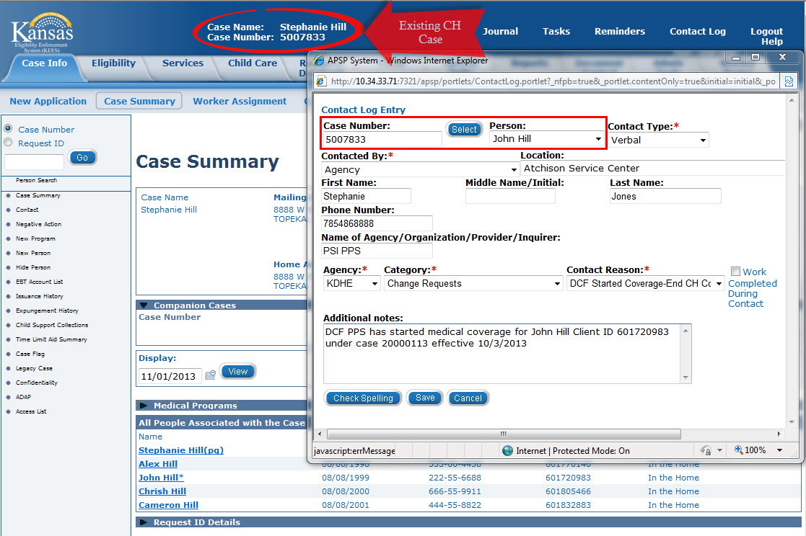
PPS Webinar
Contact Log > Existing CH Case information

Slide 20
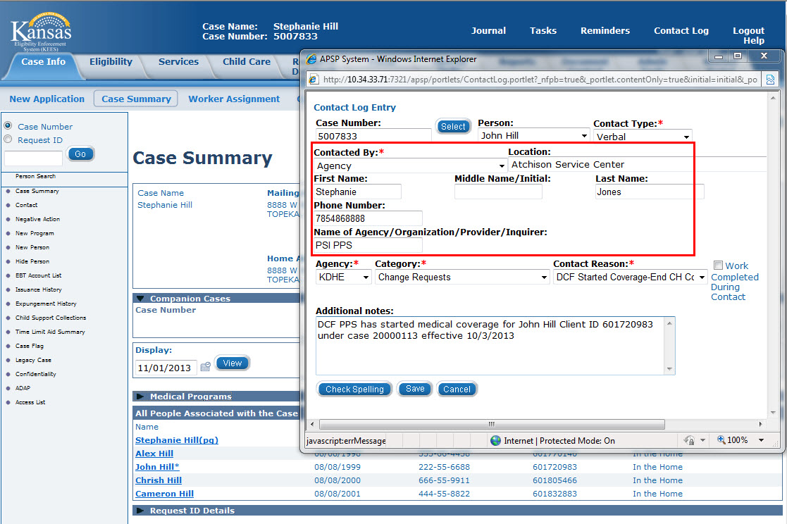
PPS Webinar
Contact Log > PPS Staff Information

Slide 21
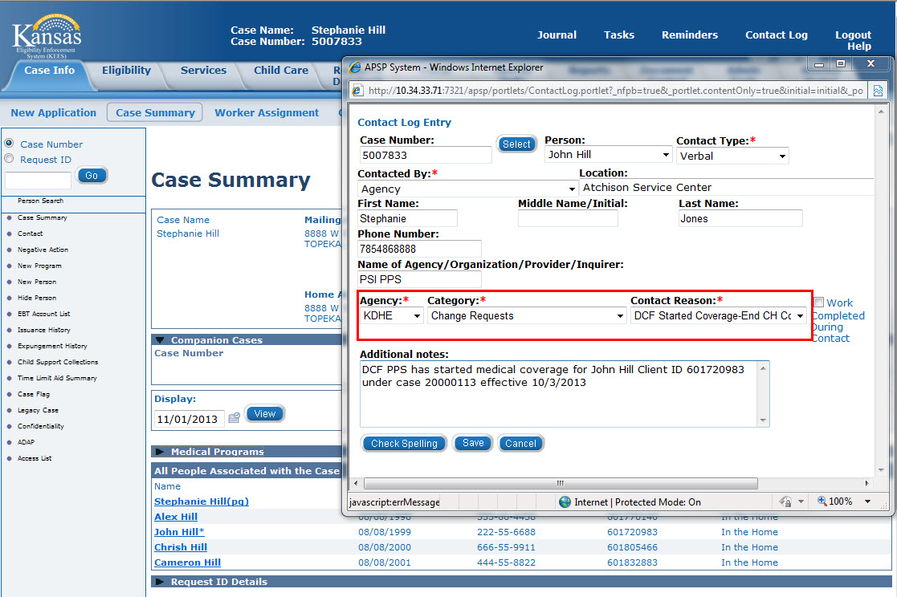
PPS Webinar
Contact Log > KanCare CH information

Slide 22
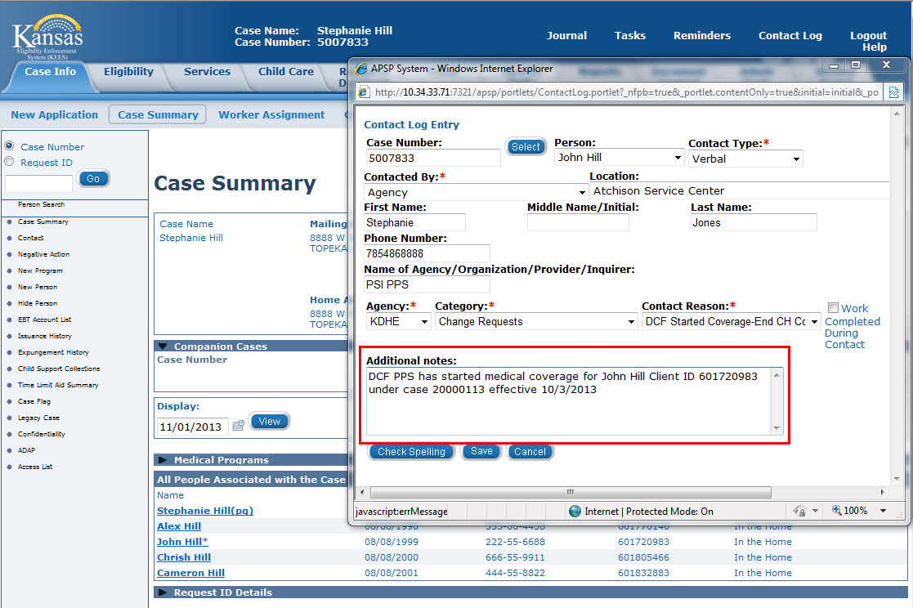
PPS Webinar
Contact Log > New PPS Case information

Slide 23
PPS Webinar
Contact Log > Summary
DCF Started Coverage – End CH Coverage
It is important to verify that you are in the context of the existing KanCare CH medical case and remember that selecting:
  Agency = KDHE
  Category = Change Requests
  Contact Reason = DCF Started Coverage – End CH Coverage
Will drive the task to the appropriate KanCare Task queue for this type of notification.

Slide 24
PPS Webinar
PPS > Contact Log > Task to Clearinghouse
That completes using the Contact Log to send a Task to KanCare CH.
Next, we will discuss using Tasks to assist with closing AWOL cases.

Slide 25
PPS Webinar
AWOL Processes > Tasks
When a child in Foster Care is AWOL and cannot be located:
Medical Coverage will end the last day of the month following the day absence is discovered.
For example:
  Notified of Absence 10/3/2013
  Coverage requires discontinuance in the come up month of 12/2013, effective 11/30/13

Slide 26
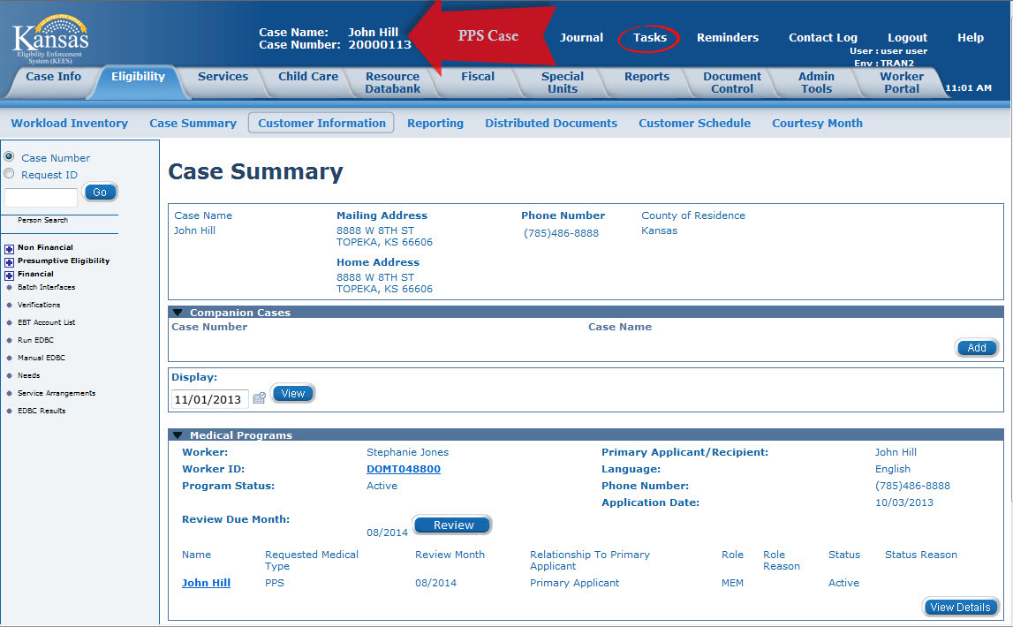
PPS Webinar
Manual Task – In Case

Slide 27
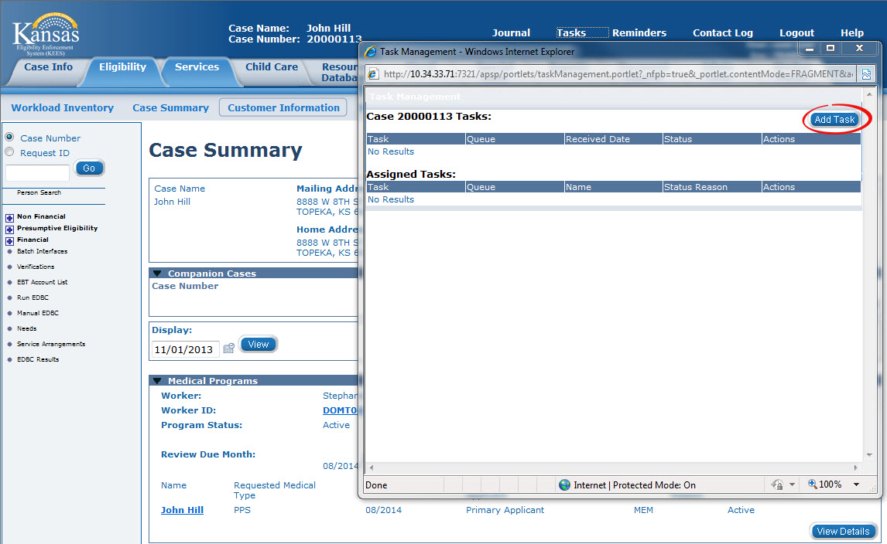
PPS Webinar
Manual Task – In Case

Slide 28
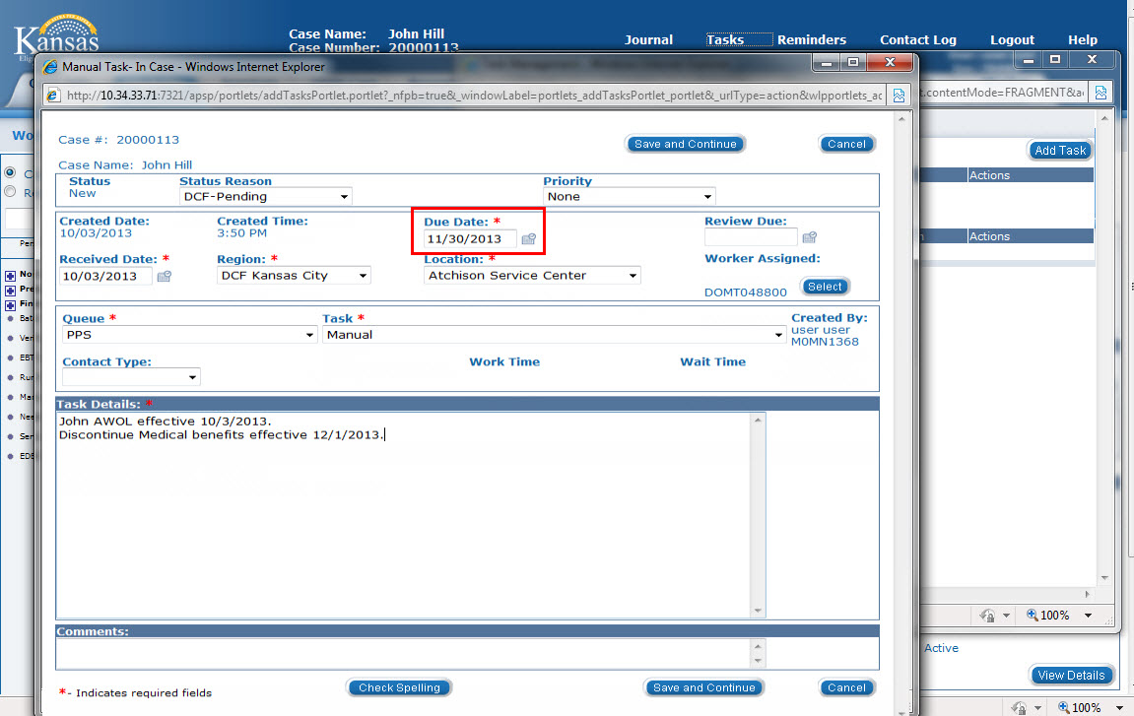
PPS Webinar
Manual Task – In Case > Due Date

Slide 29
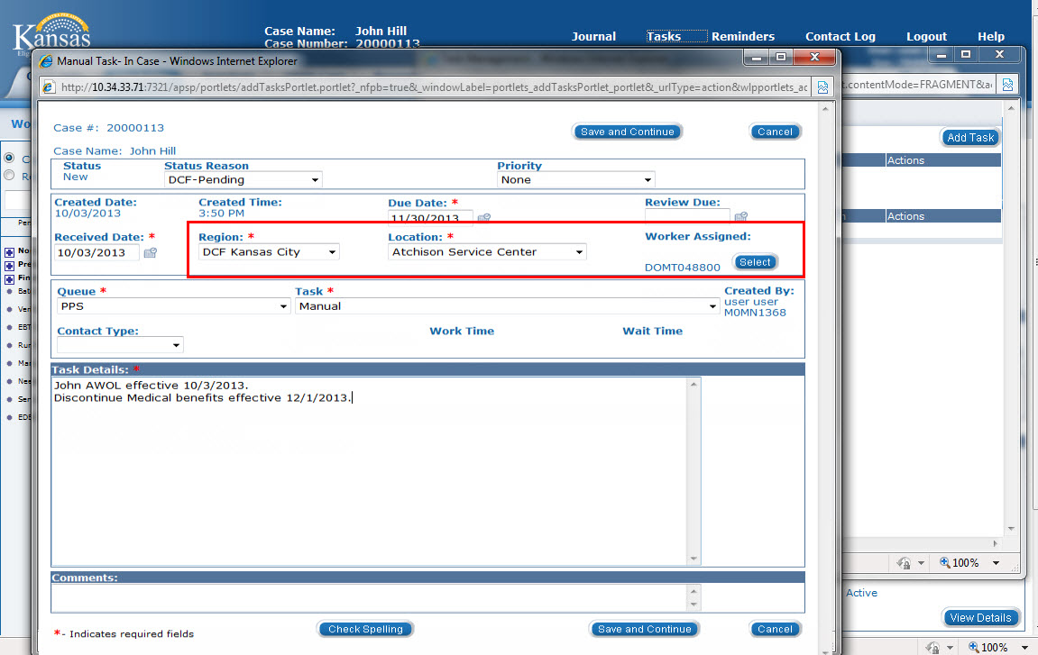
PPS Webinar
Manual Task – In Case > Your Information

Slide 30
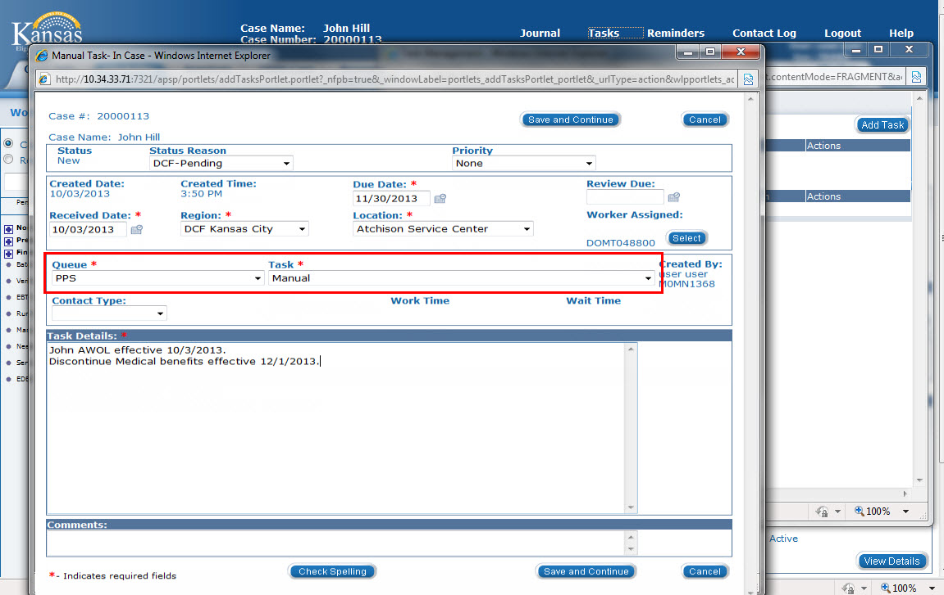
PPS Webinar
Manual Task – In Case > PPS Queue

Slide 31
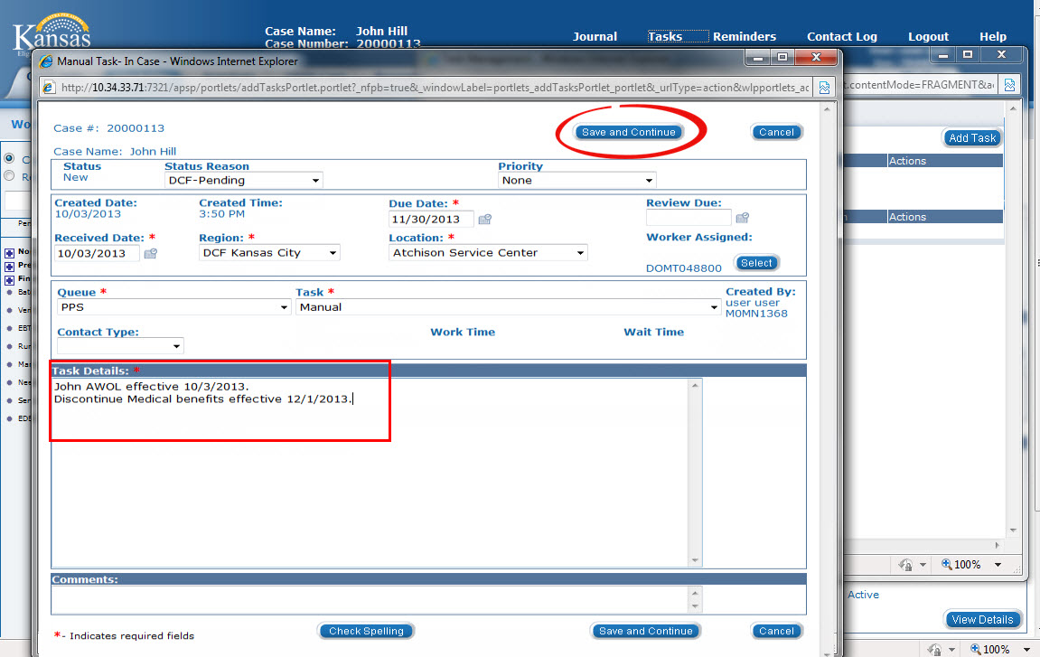
PPS Webinar
Manual Task – In Case > Task Details

Slide 32
PPS Webinar
Manual Task – In Case
Manual Task – In Case
Task in PPS queue
Task assigned to specific worker – you
Remains in Task Inventory until marked complete
Will appear overdue starting the day after Due Date

Slide 33
PPS Webinar
Task Inventory
Task Inventory
KEES home page – Task Portlet
Task Management Tasks from Utility navigation shows:
Tasks associated with Case (if in the context of a case)
Tasks Assigned to the logged in user

Slide 34
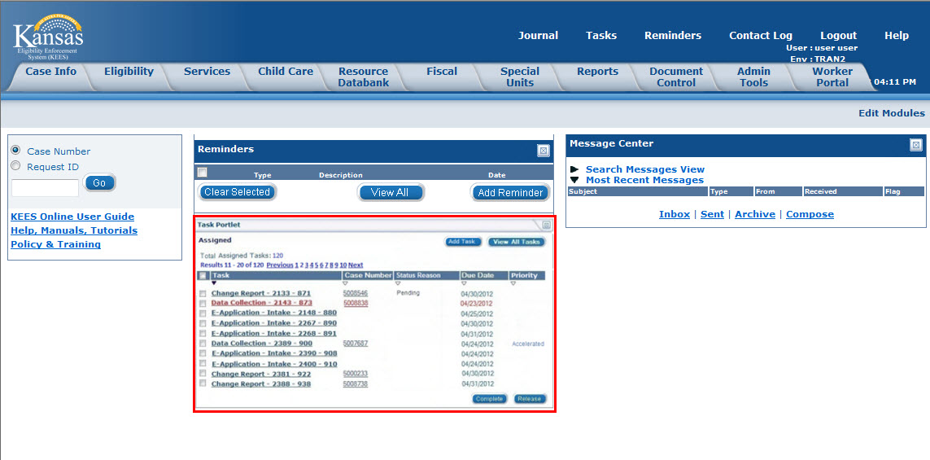
PPS Webinar
Task Portlet > Assigned to Me

Slide 35
PPS Webinar
Task Detail
The Task Portlet will display all tasks assigned to you, the logged in KEES user. Clicking on a Task name hyperlink will open the details of that task.
While you are in the context of a case, clicking Tasks in Utility navigation will show you all Tasks associated with that case as well as all tasks assigned to you.

Slide 36
PPS Webinar
PPS Case > Tasks

Slide 37
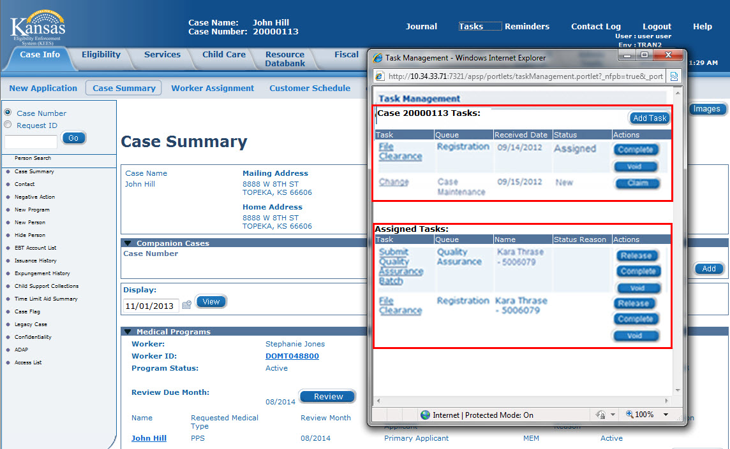
PPS Webinar
Tasks from Utility > Tasks for Case and Assigned Tasks

Slide 38
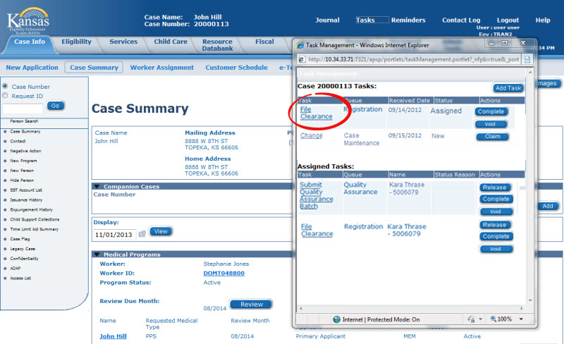
PPS Webinar
Tasks > Task name hyperlink

Slide 39
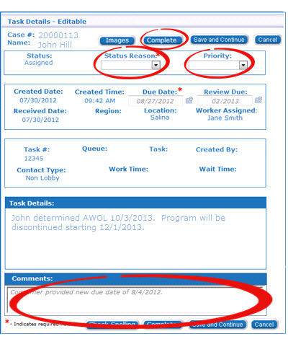
PPS Webinar
Task Details > Complete the Task
Update Status Reason to Complete
Enter Comments as they may be appropriate
Click the Complete button

Slide 40
PPS Webinar
PPS > Task to Close AWOL Case
That completes using Tasks to assist with Closing AWOL cases.
Next, we will discuss Adding Resources to the Resource Databank.

Slide 41
PPS Webinar
Entering Resources in Resource Databank
In training you learned how to search for and provide Administrative rights to Resources. Now we will discuss how to enter those Resources into the Resource Databank when they are not already there.

Slide 42
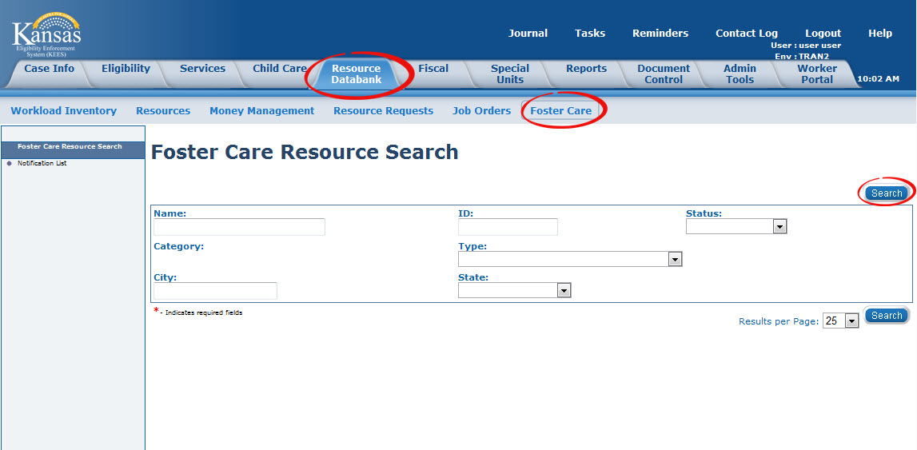
PPS Webinar
Resource Databank > Search

Slide 43
PPS Webinar
Resource Databank > Adding a Foster Care Resource
Foster Care Resource Detail
Category will be Foster Care
Complete Required fields
Set yourself as Maintainer (just like selecting yourself as the worker for a case)

Slide 44
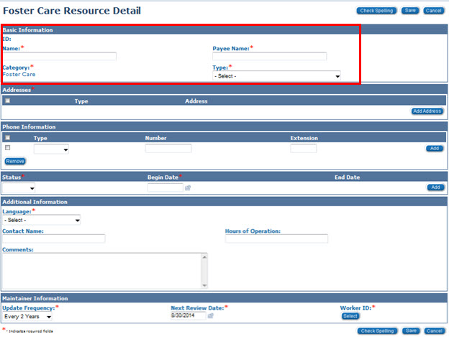
PPS Webinar
Resource Databank > Add Resource Detail

Slide 45
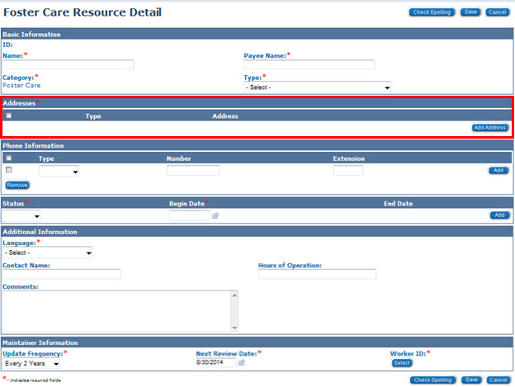
PPS Webinar
Resource Databank > Add Resource Detail

Slide 46
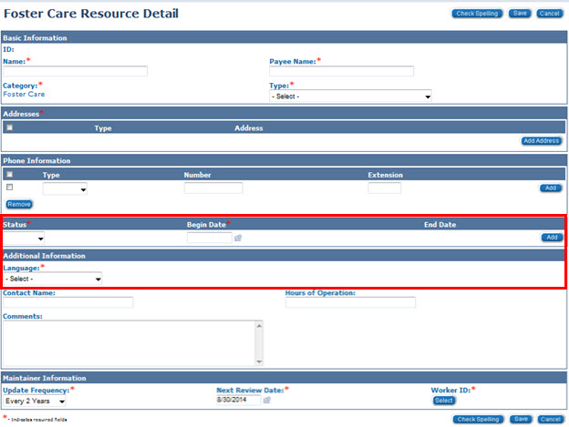
PPS Webinar
Resource Databank > Add Resource Detail

Slide 47
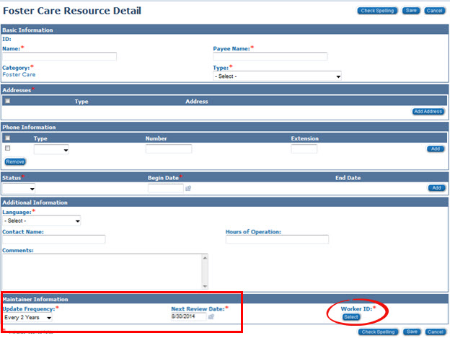
PPS Webinar
Resource Databank > Add Resource Detail

Slide 48
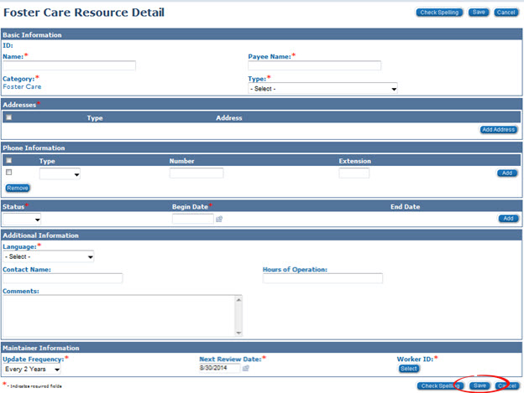
PPS Webinar
Resource Databank > Add Resource Detail

Slide 49
PPS Webinar
PPS > Add to Resource Databank
That completes Adding Resources to the Resource Databank.
Next, we will discuss Discontinuing a Program.

Slide 50
PPS Webinar
PPS > Discontinuing a Program
In training you learned that you could discontinue a program two ways:
Data Collection
Negative Action Detail

Slide 51
PPS Webinar
PPS > Discontinuing a Program
Recommended Best Practice:
First: Update or end date the appropriate fields on a data collection page.
Second: Complete the Negative Action Detail Page.
  Whereabouts Unknown
  Written Withdrawal Acknowledgement / Notice from DCF / KDOC / Tribe
Third: Run EDBC

Slide 52
PPS Webinar
PPS > Discontinuing a Program
That completes Discontinuing a Program.
Next, we will discuss Rescinding and Reapplying.

Slide 53
PPS Webinar
PPS > Rescind and Reapply
Further clarification regarding rescind and reapply.
Rescind – should be used to undo a denial or discontinuance of a program, without logging a new application.
The Beginning Date of Aid and Application Date are automatically populated based on the last valid application.

Slide 54
PPS Webinar
PPS > Rescind and Reapply
Use Rescind in these circumstances:
Child in custody and returns from AWOL
Child in custody, placed with parents but returns to a foster home within 6 months of return home
Child returns to a foster home placement from detention.

Slide 55
PPS Webinar
PPS > Rescind and Reapply
Reapply is used to log a new application on an existing PPS Medical program.
Use in these circumstances:
Child, previously released from DCF/KDOC/Tribal custody, re-enters foster care/adoption
Child reenters foster care after being home for more than 6 months.
Job Aid: Existing Case Number Registration Process DCF

Slide 56
PPS Webinar
PPS > Rescind and Reapply
That completes Rescinding and Reapplying.
Next, we will discuss a Program Block for transition from Foster Care to Long Term Care.

Slide 57
PPS Webinar
Transition from Foster Care to Long Term Care
Foster Care to Long Term Care
During the initial training we learned that PPS would need to open a separate Medical program block for foster/adoptive children requiring Long Term Care Services.
After further review it was decided that a separate Medical program block is not required when a PPS child needs Long Term Care Services (HCBS or Institutional Care – Psychiatric Residential Treatment Facility (PRTF).
LTC will need to be added to the Medical Person Detail page to cover the period the child is receiving LTC services.
Add the RMT to show the month in which the child enters a PRTF or starts receiving services.

Slide 58
PPS Webinar
Transition from Foster Care to Long Term Care
The RMT must remain LTC through the end of the month in which the services ended.
The Long Term Data Detail page will reflect the specific start and end dates of services. (Refer to JOB AID: Living Arrangement Changes for further information on start and end dates)
Example: Foster Child moves from a foster home placement to a PRTF facility on October 3, 2013. He remains in a PRTF until December 15, 2013. The RMT will need to reflect LTC for October, November and December. EDBC will need to be run for October to reflect the change. When notified that the child has been returned to a foster home on December 15th, the worker will need to set a Manual Task to change the RMT to “PPS “ effective January 2014.

Slide 59
PPS Webinar
PPS > Foster Care to Long Term Care
That completes the discussion regarding a Program Block for transition from Foster Care to Long Term Care.
Next, we will discuss responses to some of the questions raised during training.

Slide 60
PPS Webinar
Update / Highlight Questions Raised in Training
In training you asked ‘Parking Lot Questions’
They have been summarized and sent as an attachment with the invitation to this webinar.
We will review some key points on that document.

Slide 61
PPS Webinar
Wrap up
In this webinar, we reviewed:
Policy updates
New topics not covered in training
Updates to processes learned in training
Questions raised in training

Slide 62

PPS Webinar
Questions

Slide 63
PPS Webinar
Webinar Recording and Questions
A recording of this webinar is available at http://www.kancare.ks.gov/kees/ in the next 24-hours.
Send additional questions to training@kees.ks.gov. Please note the webinar title in your email.

