Slide 1
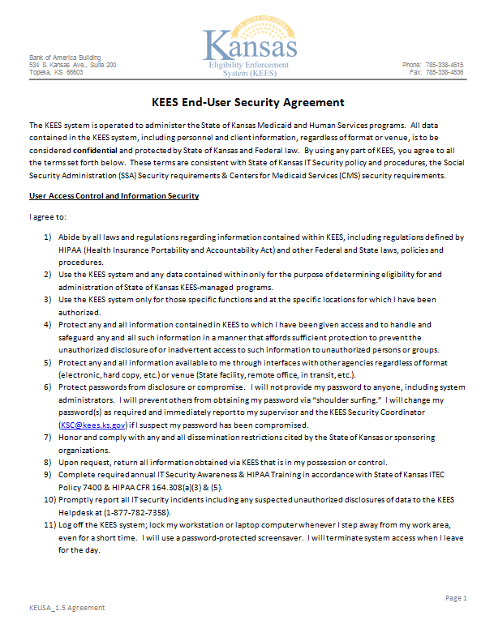

Slide 2
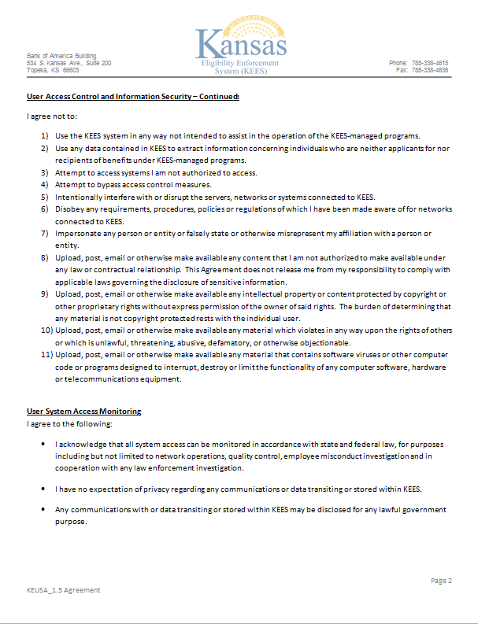

Slide 3
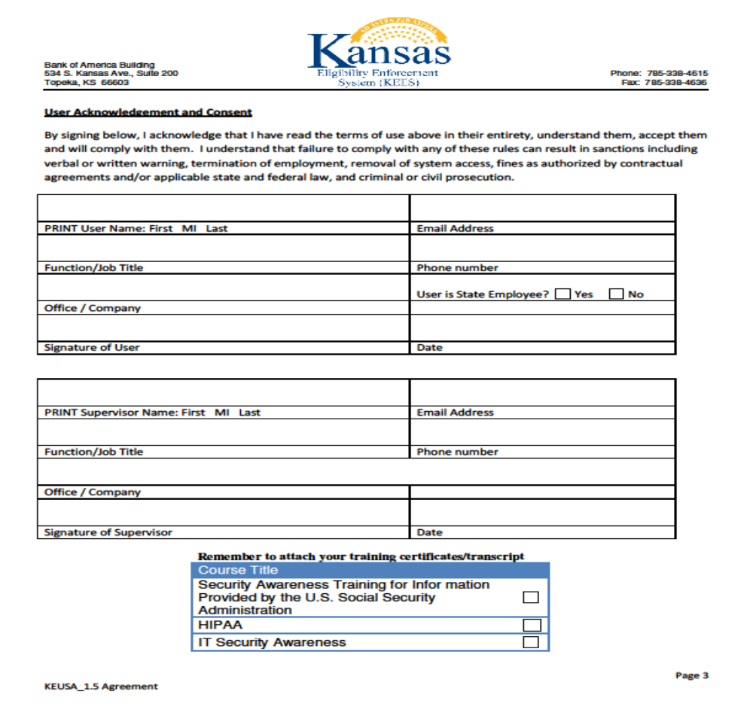
John A Doe
John.Doe@dcf.ks.gov
Any Worker
785-555-5555
Any DCF Office
X
John A Doe 9/30/15
A. Supervisor A.Supervisor@dcf.ks.gov
Any Supervisor 785-555-5555
Any DCF Office
A Supervisor 9/30/15

